Slide 1
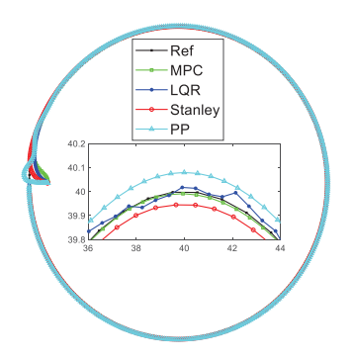
Simulation Performance Evaluation of Pure Pursuit, Stanley, LQR, MPC Controller for Autonomous Vehicles
Jia Liu, Zhiheng Yang, Zhejun Huang, Wenfei Li, Shaobo Dang, and Huiyun Li
Shenzhen Institutes of Advanced Technology, Chinese Academy of Sciences, China
Build geometry path tracking methods based on Ackerman steering model
Build optimal path tracking methods based on Ackerman steering model
Carry on simulation experiments on different paths
results of tracking circle path

