Slide 1
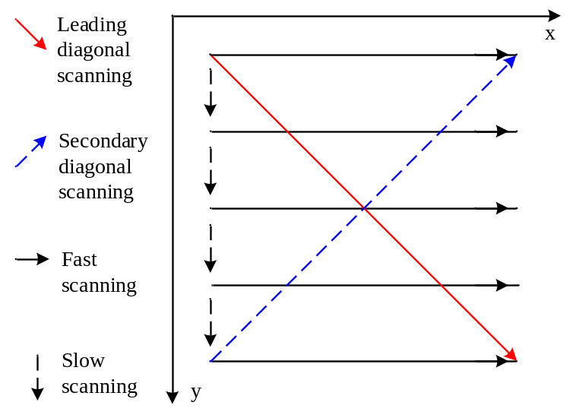
Correction of AFM image distortion caused by thermal drift
Yinan Wu
Institute of Robotics and Automatic Information System,
Tianjin Key Laboratory of Intelligent Robotics,
College of Artificial Intelligence, Nankai University, Tianjin 300350, China
Thermal drift causes image distortion of an atomic force microscopy (AFM).
A novel offline drift correction algorithm based on cross diagonals scanning is proposed to reconstruct high-quality AFM images.
The performance of the proposed method is verified by convincing experimental and application results.
The trajectory of the cross diagonals scanning method.

