Slide 1
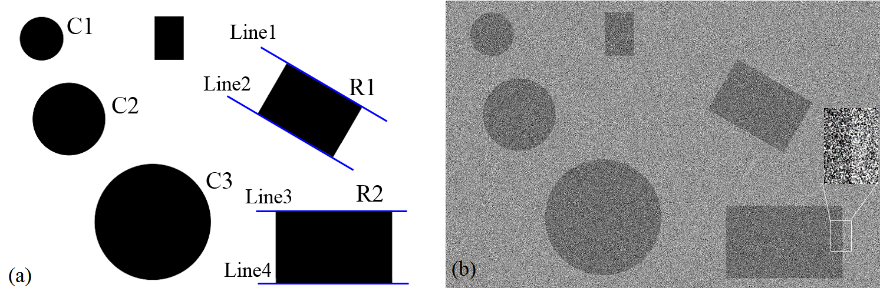
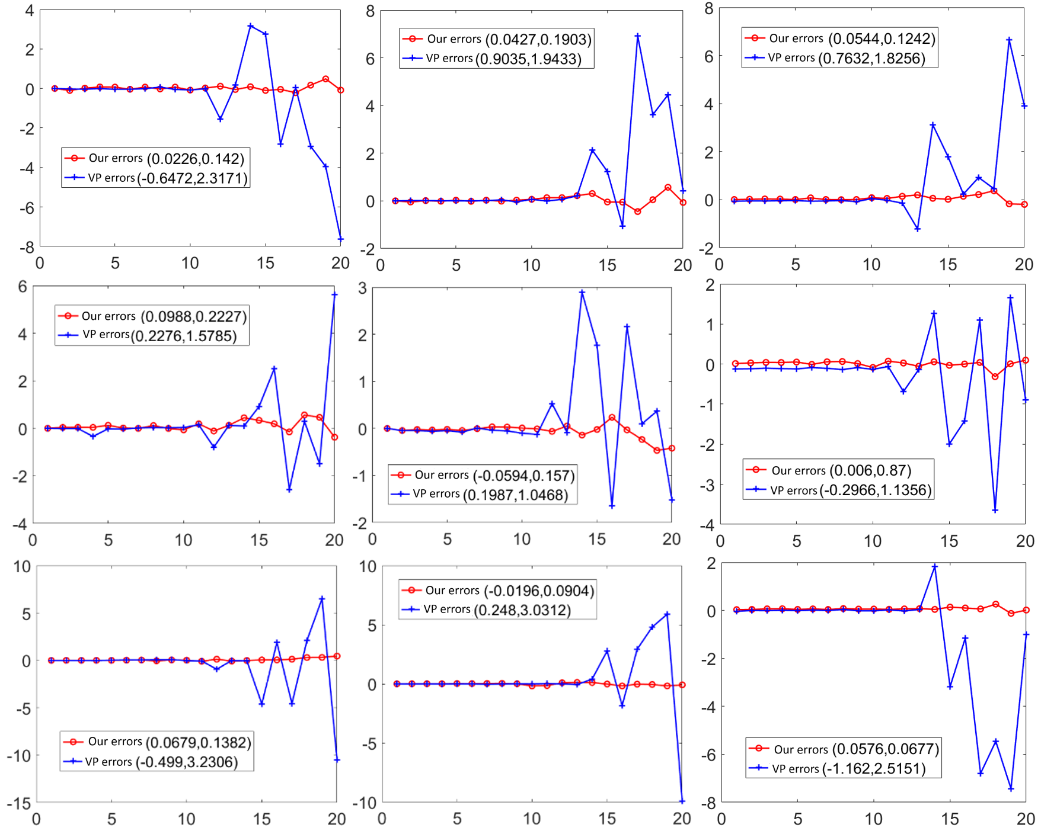
Stable Line and Circle Detection Method in Noise Image for Machine Vision
Xiaojun Wu and Xinhuan Wang
School of Mechanical Engineering and Automation,
Harbin Institute of Technology, Shenzhen
A region of interest (ROI) of line or circle is detected using a template matching method of the stable feature.
A 2D feature detection problem can be converted to 1D. Then, the local noise scale and filtering variance are computed from pixels along the sample line.
The edge point is detected from the first order derivative and the outliers are rejected.
The line or circle is fitted by using a linear least square method.
Comparisons of the center and radius measurement error of cirecle C1, C2, and C3.

