Slide 1
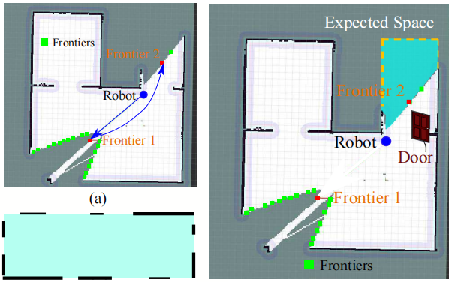
A Prior Information Heuristic based Robot
Exploration Method in Indoor Environment
Jie Liu, Yong Lv, Yuan Yuan, Wenzheng Chi, Guodong Chen and Lining Sun
Robotics and Microsystems Center, School of Mechanical and Electric Engineering, Soochow University, Suzhou, China
A new exploration strategy is proposed on the basis of the prior information heuristic.
A lightweight network model is proposed for the recognition of the heuristic objects.
Experimental studies demonstrate the effectiveness of the proposed method.
The influence of prior information heuristic on the selection of frontiers.

