Slide 1
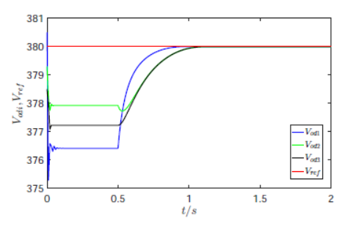
Fixed-time leader-follower consensus based
secondary voltage control for microgrid under
directed communication graph
Junkang Ni,
School of Automation,Northwestern Polytechnical University
Hui Cao,
School of Electrical Engineering,Xi’an Jiaotong University
Xinghua Liu, Lei Yang,
School of Electrical Engineering, Xi’an University of Technology
Liansong Xiong
School of Automation, Nanjing Institute of Technology
A fixed-time leader-follower consensus based secondary voltage controller is proposed.
The proposed consensus scheme achieves fixed-time consensus tracking for multi-agent systems under digraph.
The proposed consensus scheme achieves secondary voltage restoration within a fixed time.
The voltage responses of the DGs under control

