Slide 1
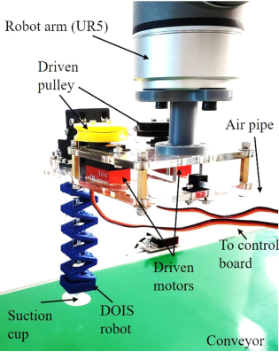
Dexterous Origami-inspired Soft (DOIS) Robot for Objects Reorientation and Overturn
Zhi Chen, ShiPan Siu, Sinyee Tin, Yukhei Liu, Hanwen Cao, Yuan Gao, Jianshu Zhou, and Yunhui Liu.
Mechanical Automation Engineering, The Chinese University of Hong Kong, Hong Kong
A novel dexterous origami-inspired soft (DOIS) robot is proposed with bi-lateral bending and linear extension/contraction in a compact structure.
Design, modeling, control of DOIS robot are
introduced for versatile customization.
Two challenging tasks, egg reorientation and envelop flipping, are performed by DOIS robot, which shows the promising practical application potential of DOIS robot.
DIOS ROBOT

