Slide 1
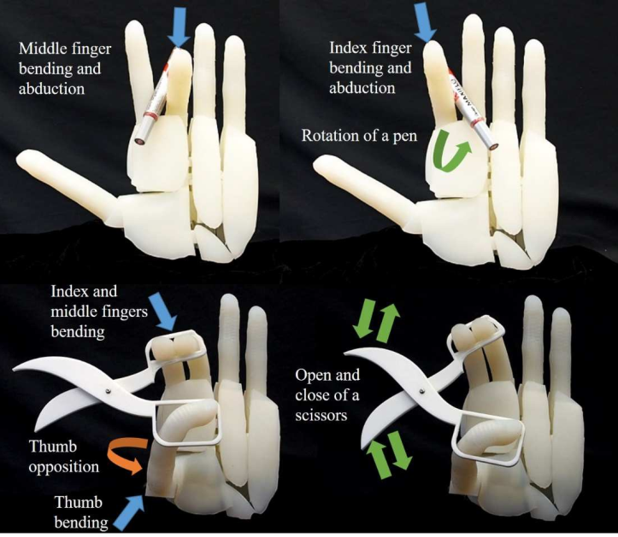
A 22-DOFs Bio-inspired Soft Hand Achieving 6 Kinds of In-hand Manipulation
Jianshu Zhou, Hanwen Cao, Junda Huang, Yunhui Liu
MAE, The Chinese University of Hong Kong, Hong Kong
Yunquan, Li, Yang Yang.
Mechanical Engineering, The University of Hong Kong. Hong Kong
An anthropomorphic 22-DOFs soft hand, S-
22, is presented with comparable dexterity of human hand.
The excellent dexterity of S-22 is enabled
by the novel V-joint, which is easily applied to build multi-DOF soft robots by arranging them in a desired order.
the successful processing of 6 kinds of
in-hand manipulation was presented to demonstrate hand capability.
S-22 anthropomorphic soft hand

