Slide 1
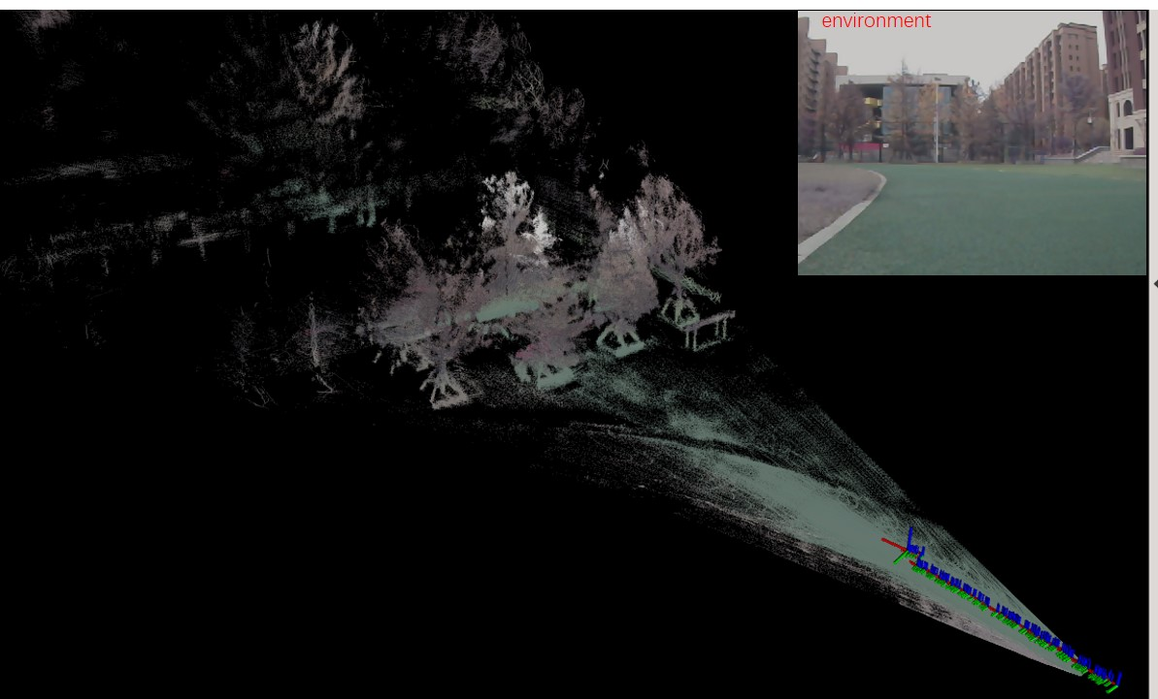
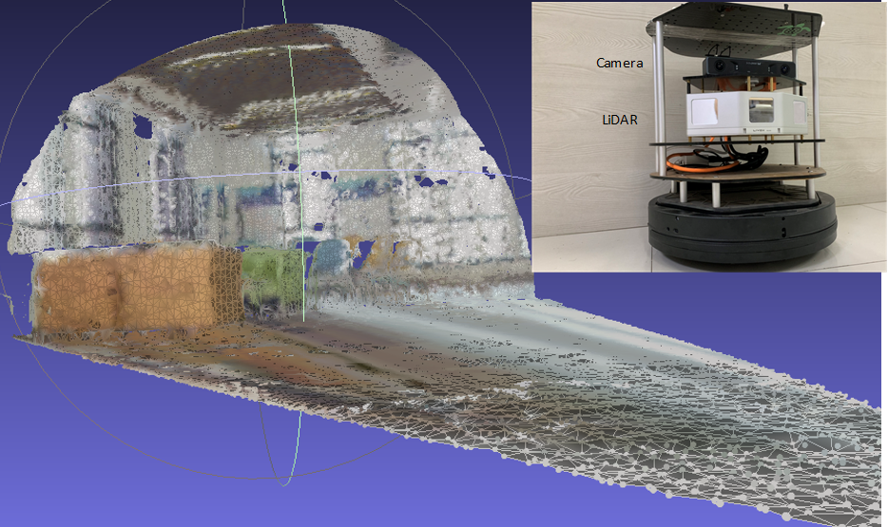
Colorful Reconstruction from Solid-State-LiDAR and Monocular Version
Jinyang Zhang, Pengfei Qu, Shenliang Li
Kuizhi Mei and Zhansheng Duan
Faculty of Electronics and Information Engineering of Xi'an Jiaotong University, Xi’an, Shaanxi, China
The fusion is both of LiDAR’s higher precision depth and version’s colorful texture.
New solid-state-LiDAR has denser pointcloud than convention Velodyne LiDAR, the former contains more details.
The cheaper LiDAR improved robot perception ability with a wide range of applications.

