Slide 1
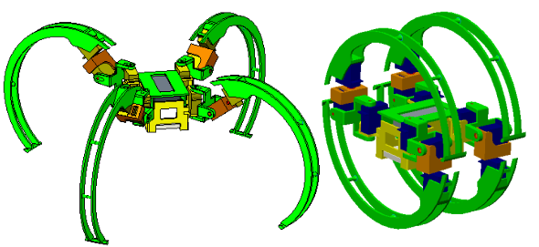
Simulation Study of a Spider-like Robot Based on Leg Reorganization
ShuQi Wang and JiZhuang Fan and Kuan Zhang
and GangFeng Liu and Jie Zhao
State Key Laboratory of Robotics and System,
Harbin Institute of Technology, China
Wei Zhang
College of Mechanical and Power Engineering,
Harbin University of Science and Technology , China
A four-legged bionic robot with wheel-foot integrated is designed.
The principle of wheel-foot conversion was analyzed.
The bionic motion simulation of the robot virtual prototype is realized.
The foot movement and wheel movement of the robot.

