Slide 1
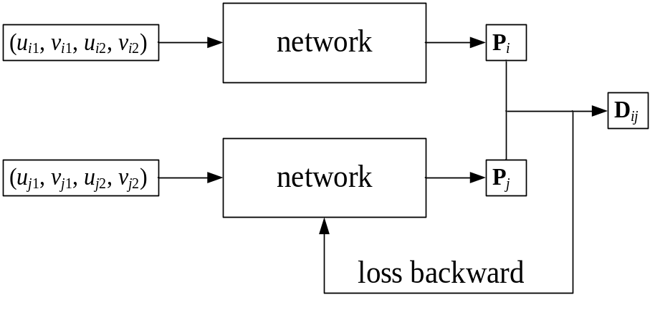
Calibration and Measurement of Large Distortion Binocular Cameras Based on Fully Connected Neural Network
Tianwei Wu
Zhongke Shijie Technology Co., Ltd, China
Xilong Liu,Mengjuan Chen,Xuejian Ma,Wenxiang Qin,Tingyu Yan and Jiawei Lu
Chinese Academy of Sciences Institute of Automation, China
Large distortion model
Data drive calibration
Metric learning
High flexibility and stability
Training method based on metric learning

