Slide 1
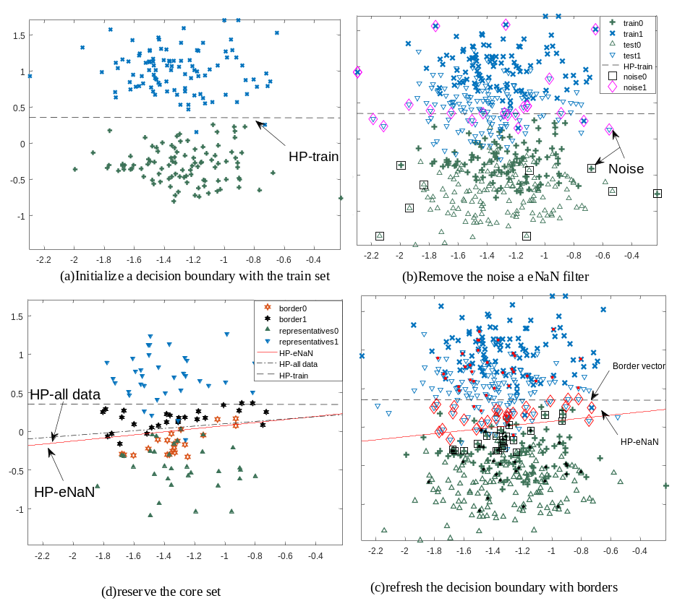
A Fast-Incremental SVM Algorithm for Online Motor Imagery-Based Brain-Computer Interface
Qin Jiang, School of Computer Science and Technology, Chongqing University of Posts and Telecommunications, Chongqing,China
Yi Zhang, Xiao-Yi He, and Ke Ren, Advanced Manufacturing and Automatization Engineering Laboratory, Chongqing University of Posts and Telecommunications, Chongqing, China
An incremental SVM learning method based on natural neighbor clustering
A nonparametric filter to reveal the underlying structure of the train set and the test set.
Less training time and storage consumption

