Slide 1
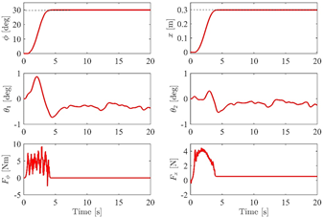
Saturated PD with sliding mode control method for 4-DOF tower crane systems
Menghua Zhang, Member, IEEE, Fuqiang Sun, Jin Zhang, Changhui Ma, and Zaixing Zhu
It is robust against uncertain system parameters and external disturbances.
The trajectory tracking controller can achieve finite-time convergence.
The designed controller needs no
payload-swing feedback.

