Slide 1
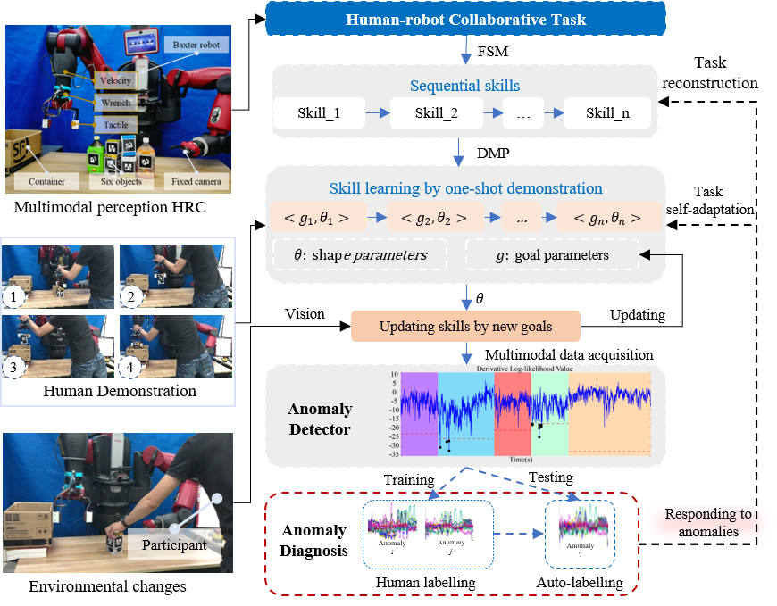
Robot Multimodal Anomaly Diagnosis
by Learning Time-lagged Complex Dynamics
Lin Yang², Wu Yan¹, Zhihao Xu¹, and Hongmin Wu^{*,1}
¹Institute of Intelligent Manufacturing, Guangdong Academy of Sciences, China
²Guangdong Provincial Key Laboratory of Electronic Information Products Reliability Technology, China
A novel method of multimodal anomaly diagnosis by learning the time-lagged dynamics of anomalies detected during an Human-robot collaborative task.
A time-lagged variational auto-encoder model (tlVAE) is first proposed to compress complex multivariate dynamics into simpler manifolds.
The manifolds are used to fitting a dynamic time warping-based K-nearest neighbors model for anomaly diagnosis in a multi-classes classification scheme.
Anomaly diagnosis in human-robot collaborative task

