Slide 1
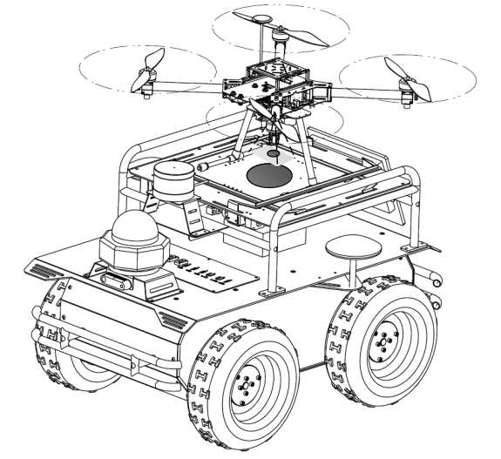
Robust Image-based Landing Control of a Quadrotor on an Unknown Moving Platform Using Circle Features
Jie lin, Yaonan Wang*, Zhiqiang Maio, Hang Zhong et al.
College of Electrical and Information Engineering, Hunan University, China
Image kinematics using circle features have simple form and decoupling properties for the landing system.
The proposed controller does not incorporate depth of the target feature needed by IBVS-like approaches.
The controller does not depend on the explicit knowledge of the landing platform.
The prescribed transient and steady-state behavior of close-loop signals are guaranteed.
Overview of a quadrotor
landed on a moving platform

