Slide 1
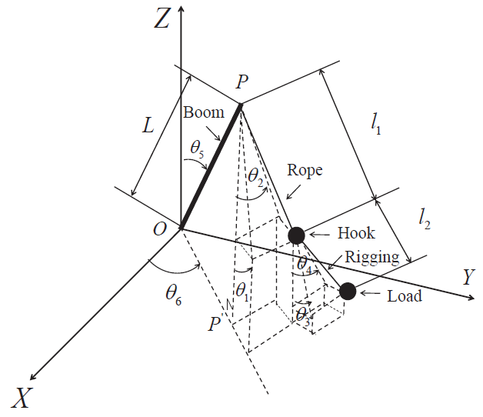
Sliding Mode Control Approach for Double-pendulum Rotary Cranes
Zheng Tian, Huimin Ouyang and Huan Xi
College of Electrical Engineering and Control Science, Nanjing Tech University, China
A variable damping algorithm is proposed to solve the load/hook suppression problems.
Disturbance observer is used to decouple it into two independent linear systems.
A sliding mode controller with a nonlinear sliding surface is designed.
Simulation results demonstrate the effectiveness of the proposed method.
Double-pendulum crane
model

