Slide 1
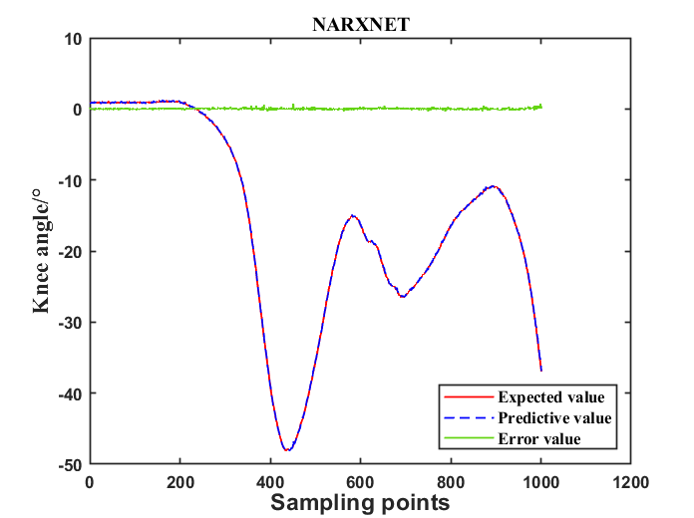
Angle Estimation for Lower Limb Joint Movement Based on VMD-NARX Algorithm
Xin Shi, Jieyi Zhang, Pengjie Qin, and Rongyi Liu
College of Automation, Chongqing University, China
A variational mode decomposition (vmd) algorithm based on neural network is proposed
The lower limb angle prediction model based on NARX neural network is established
The RMSE of NARX prediction model based on variational mode decomposition is lower than 2
Knee prediction angles in horizontal walking(HW)

