Slide 1
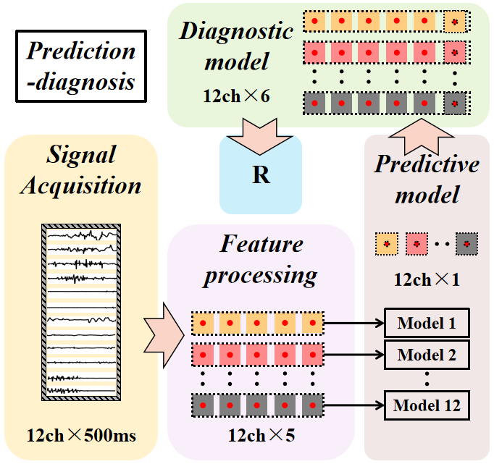
A Novel Method for Predicting Action Switching in Continuous Motion based on sEMG Signals
Xin Shi, Jiaqing Zhu and Pengjie Qin
School of Automation, Chongqing University, China
Haoyang Cui
Provincial Key Lab of Robotics and Intelligent System, Shenzhen Institudes of Advanced Technology,Chinese Academy of Sciences, China
This paper proposes a predictive classification method based on multi-channel sEMG signals.
Selects the most suitable model from several traditional prediction models through experiments.
Through online simulation testing the data of 8 objects, the average switching delay is 145.5ms.
Multi-channel
prediction scheme

