Slide 1
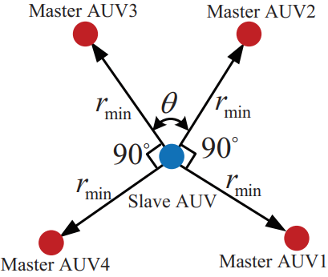
Optimality analysis for formation of Multi-AUV cooperative positioning based on genetic algorithm
Junqi Qu, Gongwu Sun, Jun Zhang, Xinguang Li, and Ying Mao
China Ship Scientific Research Center
the measurement equation of correlation between measurement information and measurement error is established.
the performance evaluation function of multi-AUV formation configuration is established based on the information matrix
the analysis method of optimal formation configuration is proposed based on the genetic algorithm.

