Slide 1
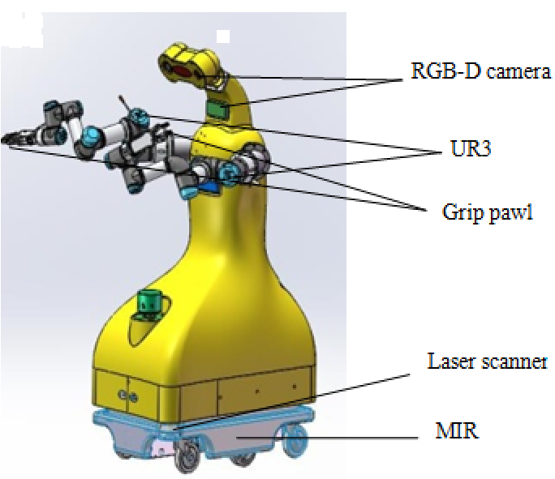
Development and initial experiments of an intelligent Dual-Arm mobile robot - Baymax-I
Wei Liu, Haitao Wang, Rui Wang, Dayong Wen, Tao Lu, and Shuo Wang
State Key Laboratory of Management and Control for Complex Systems, Institute of Automation, Chinese Academy of Sciences
The mechanism design of Baymax-I is based on modular concepts, which is mainly composed of main body, dual-arms and a mobile chassis
Software systems is designed based on hierarchical structure
Three experiments including SLAM, pressing the elevator and opening the fridge are performed

