Slide 1
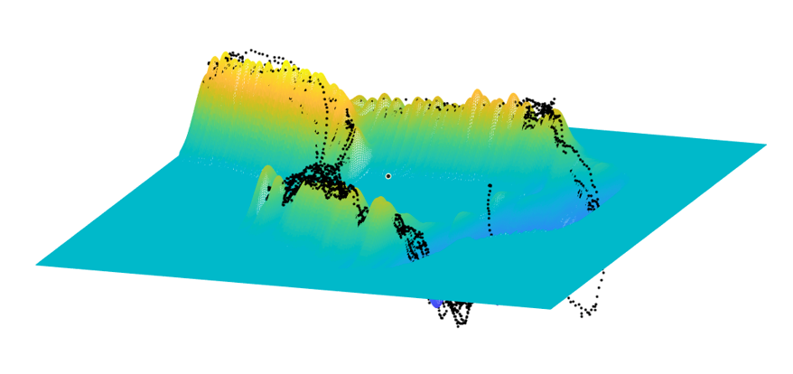
Force Tracking Control for Elector-Hydraulic Actuators Based On RBF Neural Networks
Xinhui Tian,Honglei An,Zhitong Zhang,Xu Chang,Hongxu Ma and Qing Wei
Robot Research Center, College of Intelligence Science and Technology, National University of Defense Technology, China
The static relationship between velocity-force-input has been demonstrated in hydraulic actuators.
The least square method and RBF neural network are used to identify this relationship.
The performances of force-tracking and disturbance-rejection have been improved.
Neural network visualization

