Slide 1
Single cell training
343 cell (7*7*7 periodic system)
Tolerance: 1 e -6
Initial tissue: s0 = 5, 4.8 (monodisperse)
Task: increase stress by 2.5% of original

Slide 2
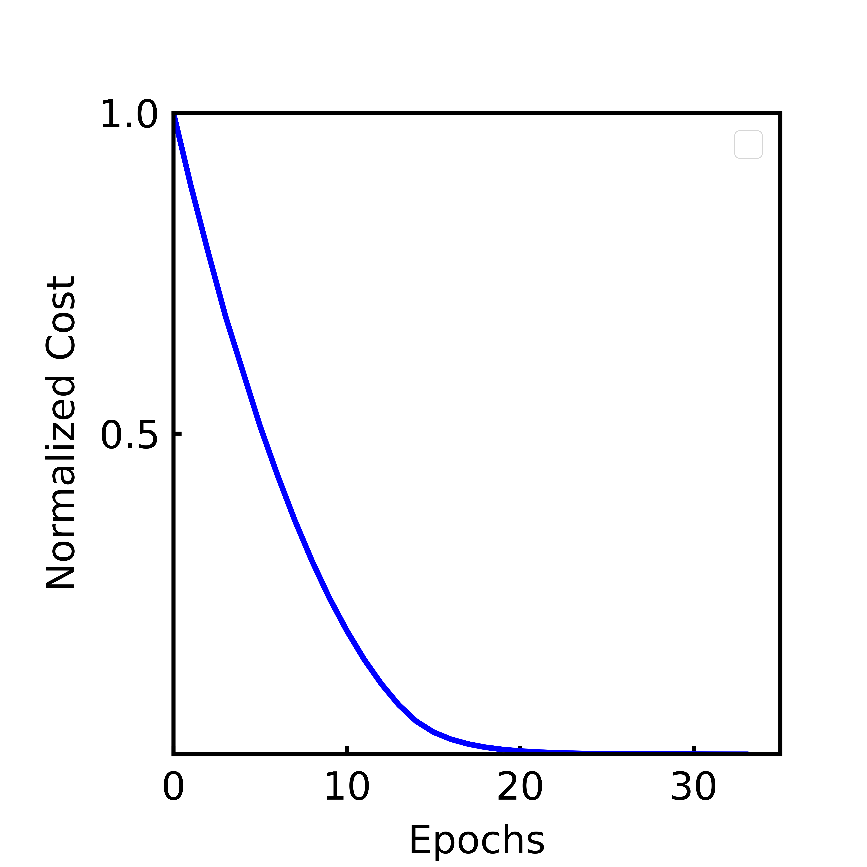
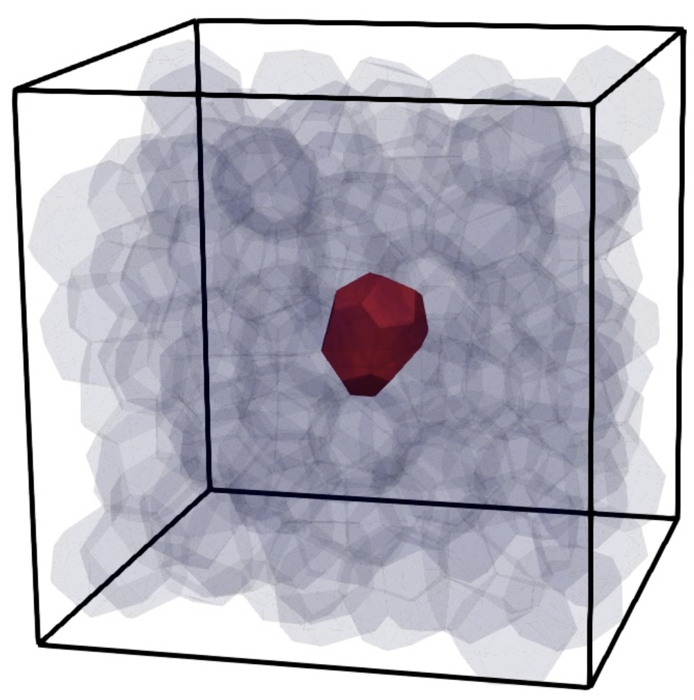
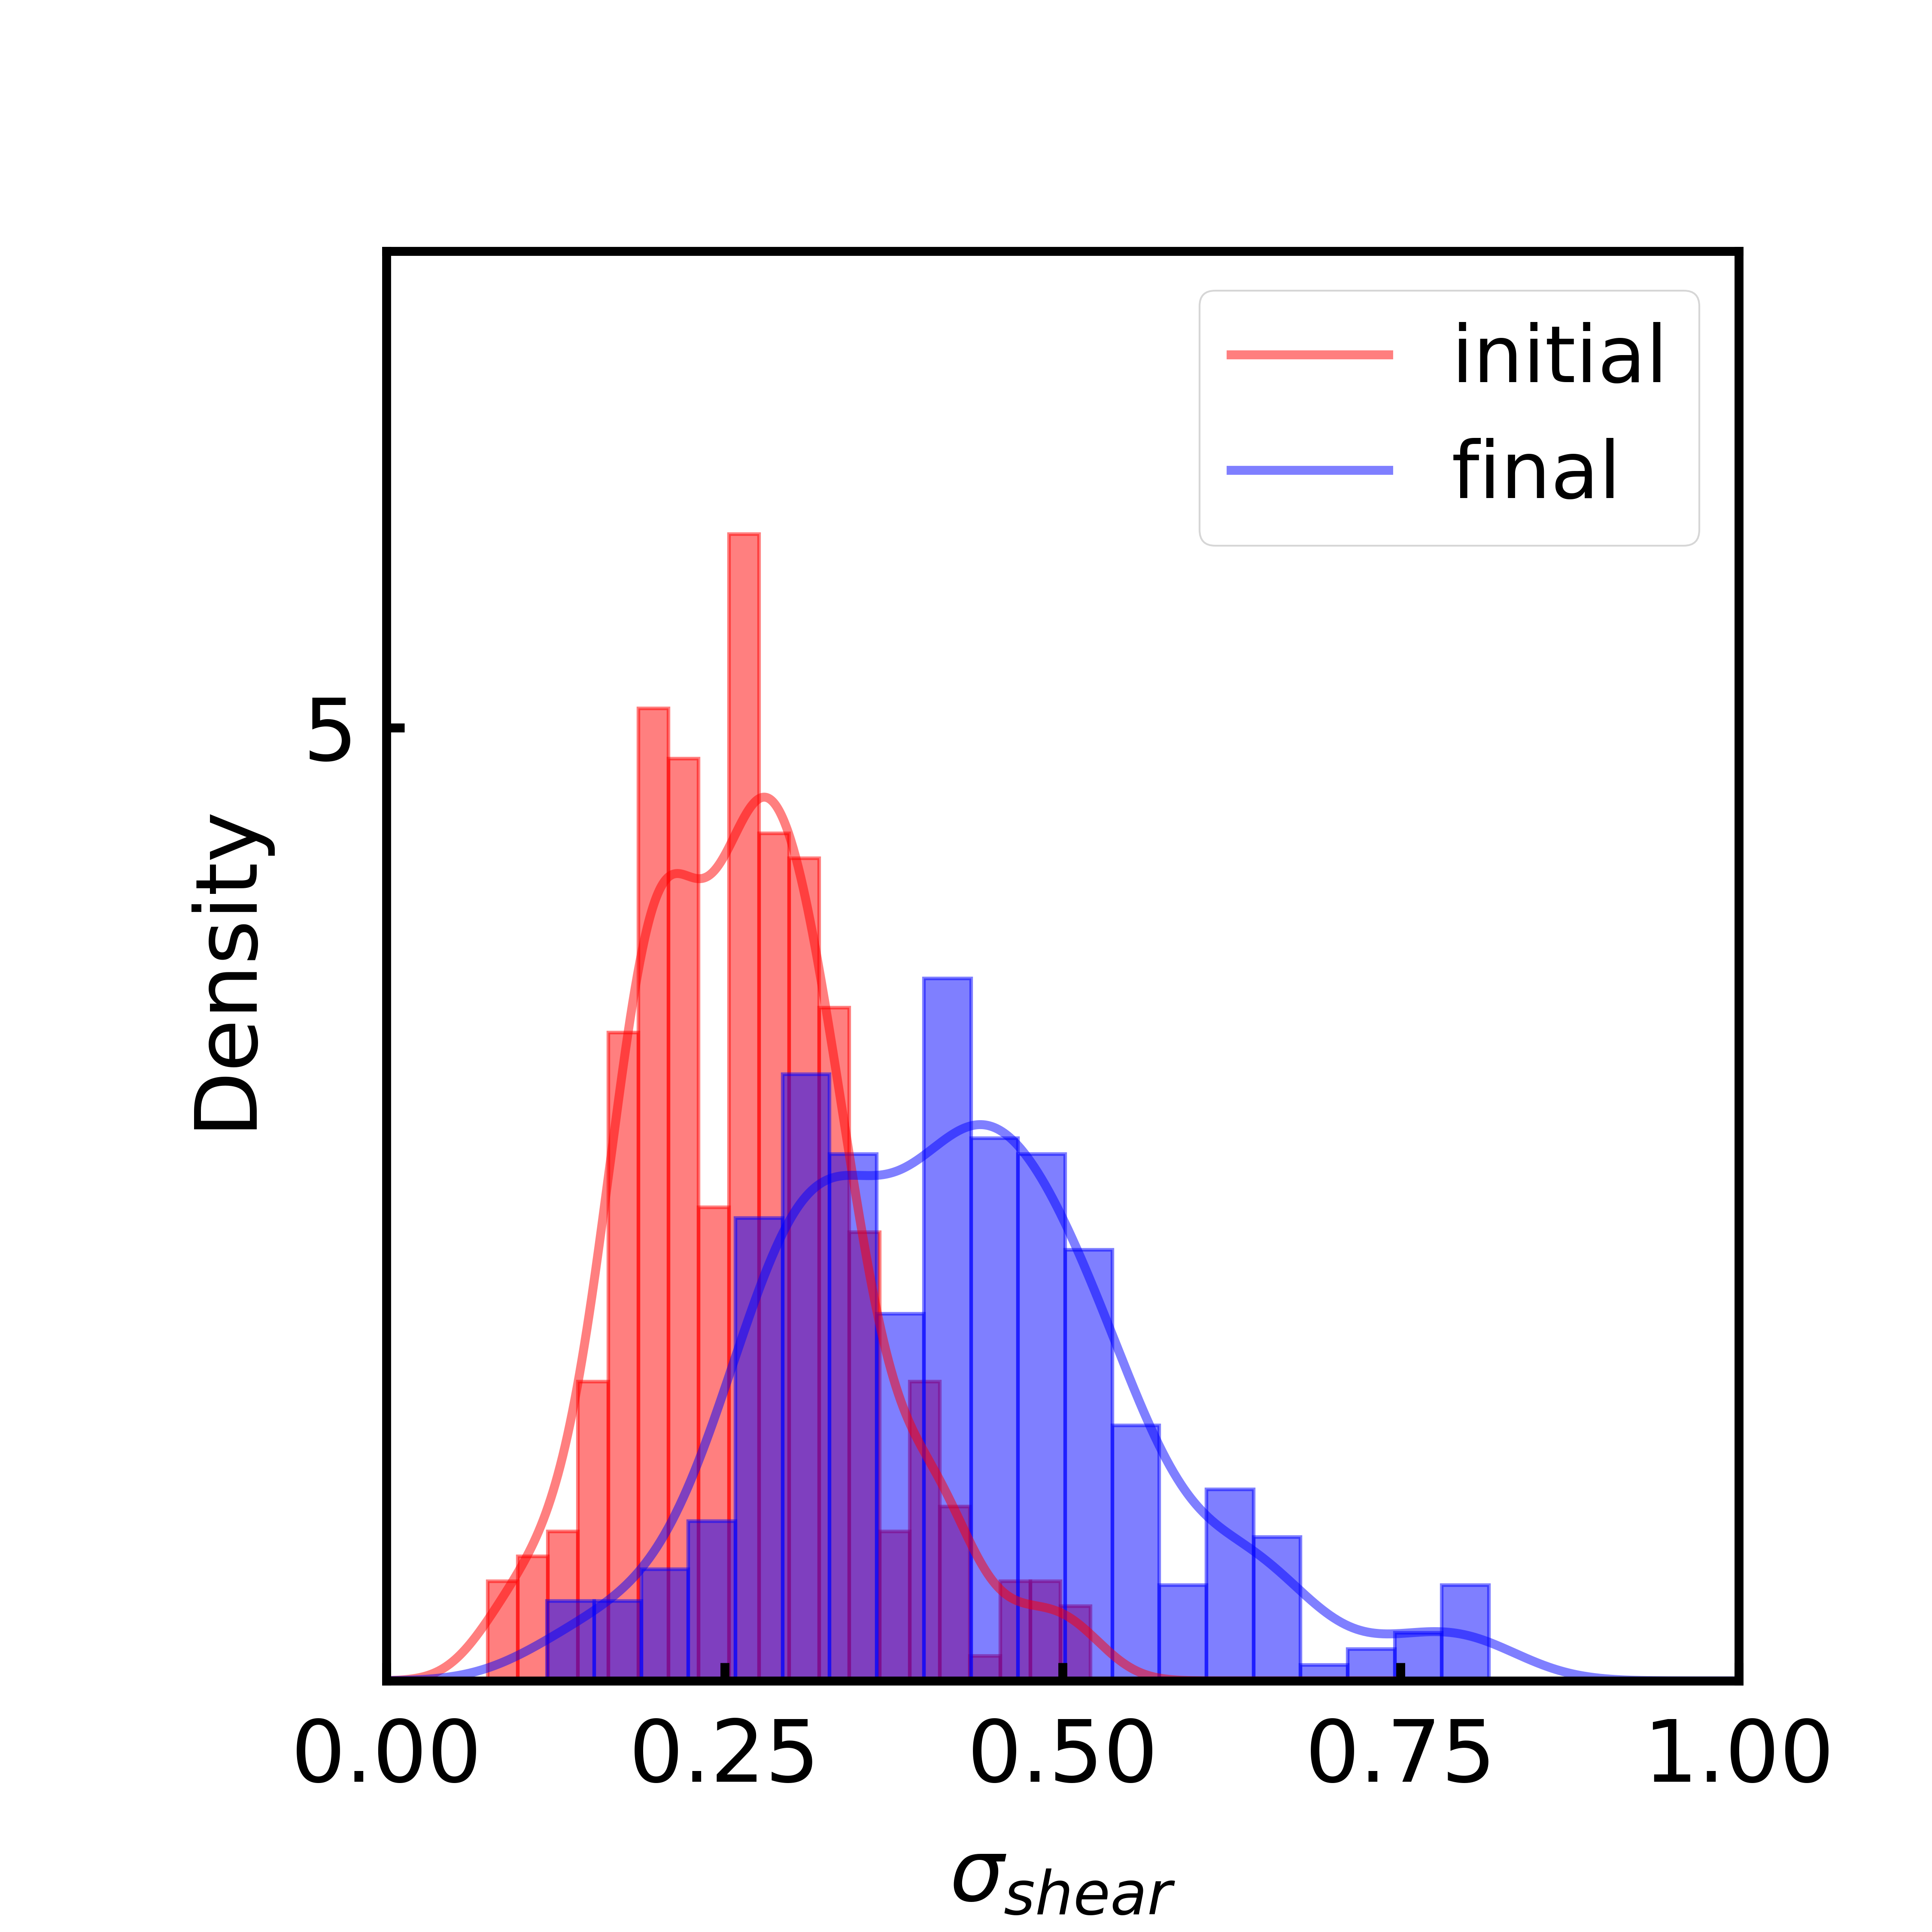
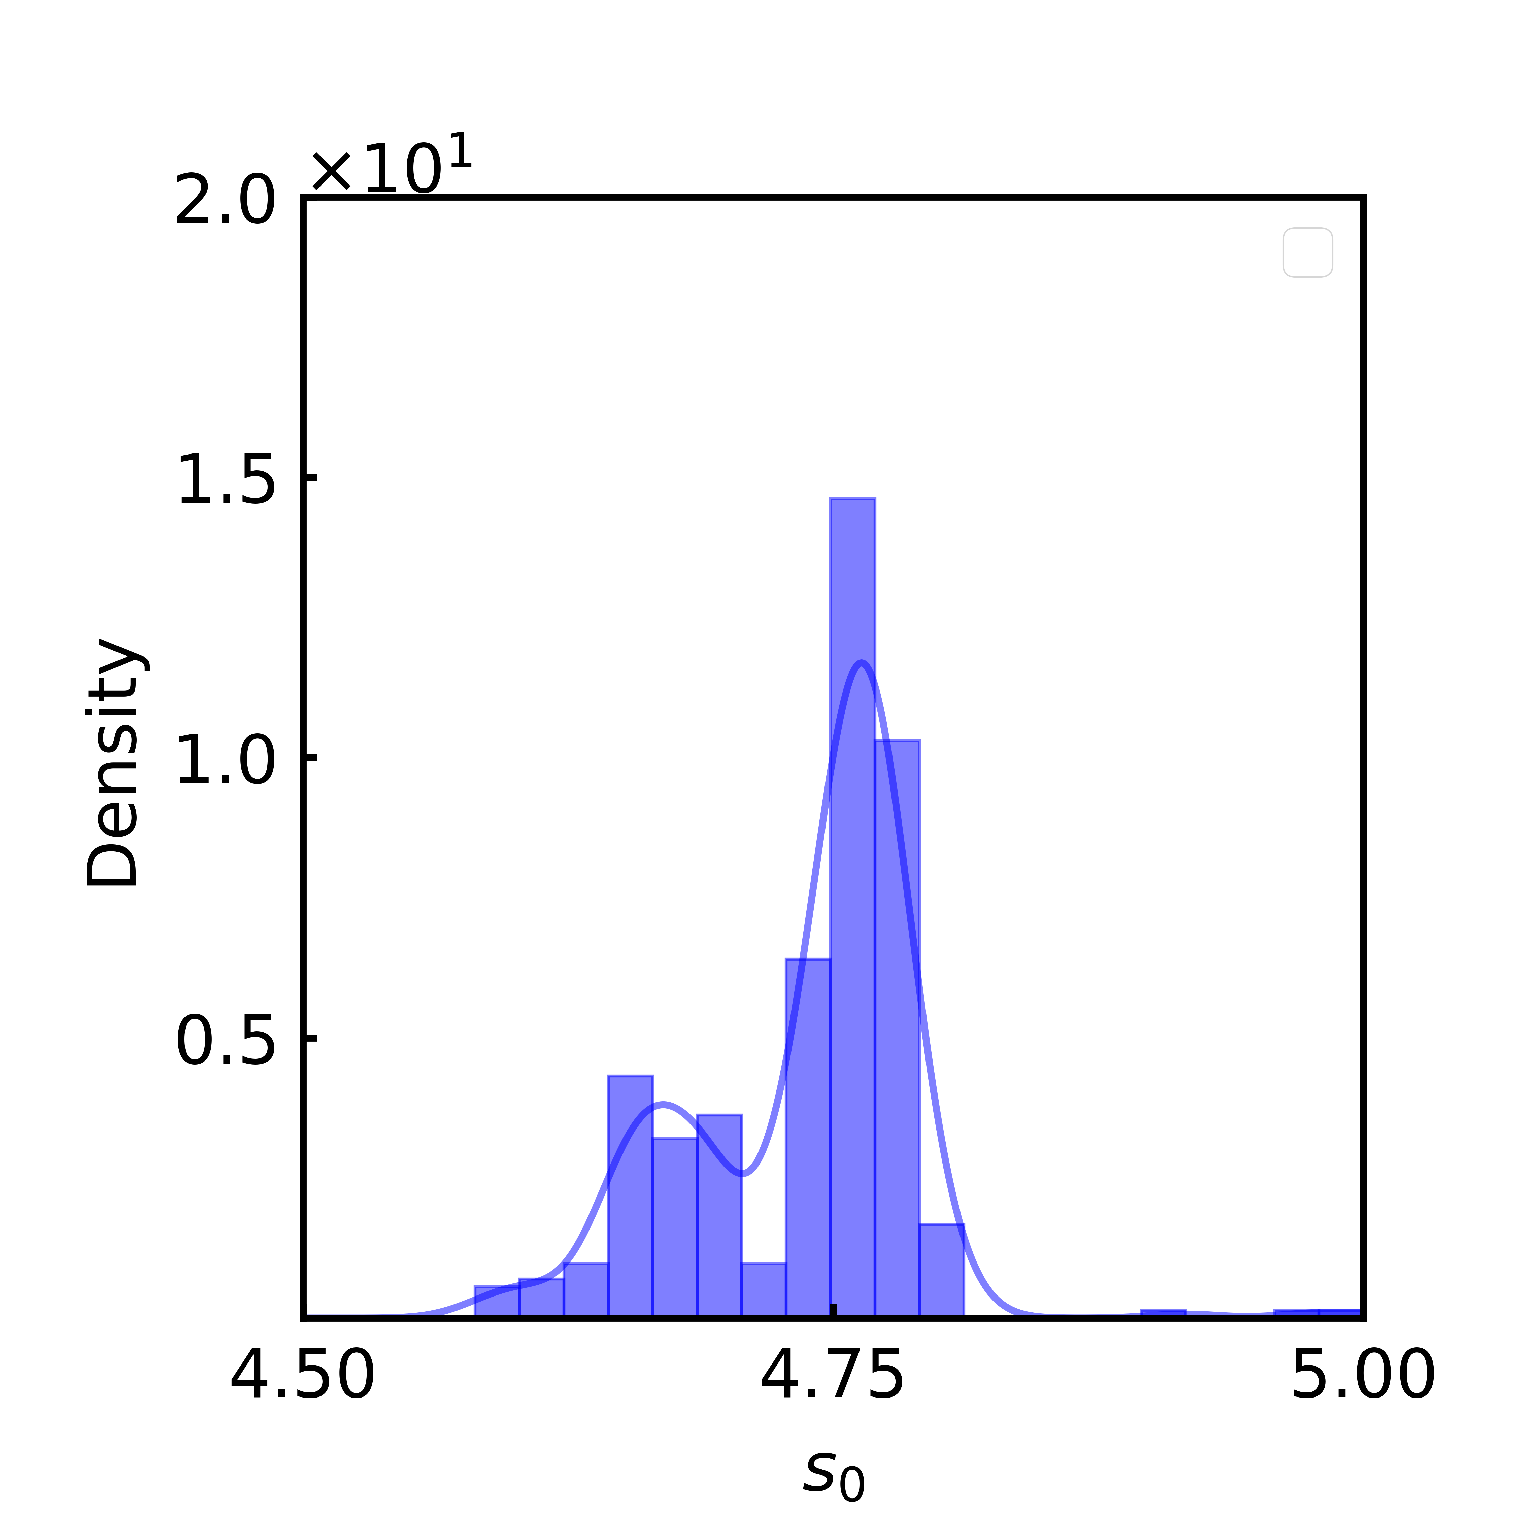
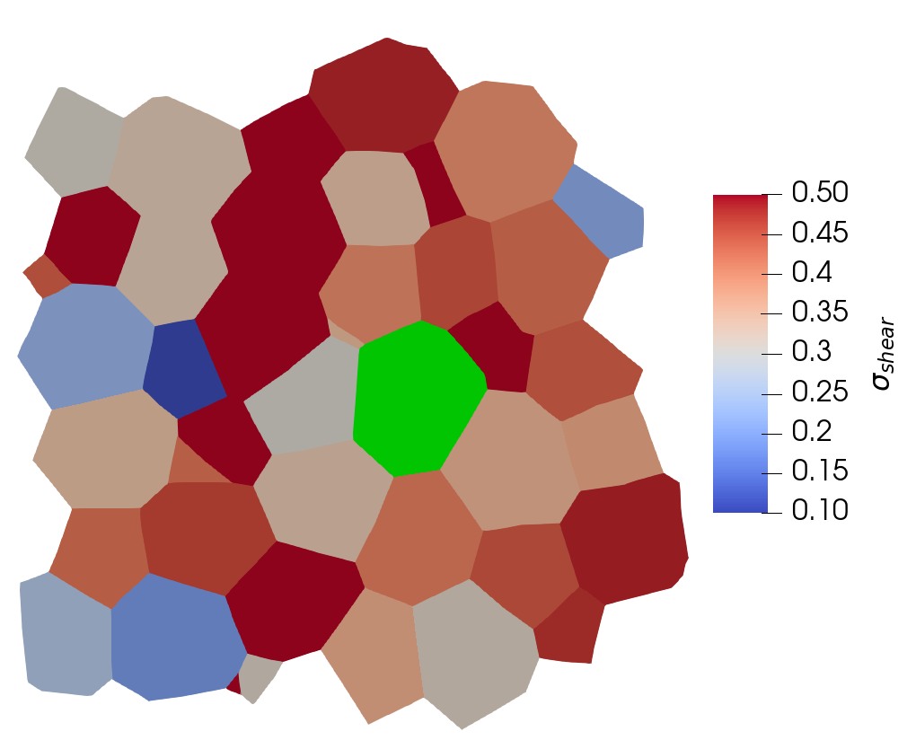
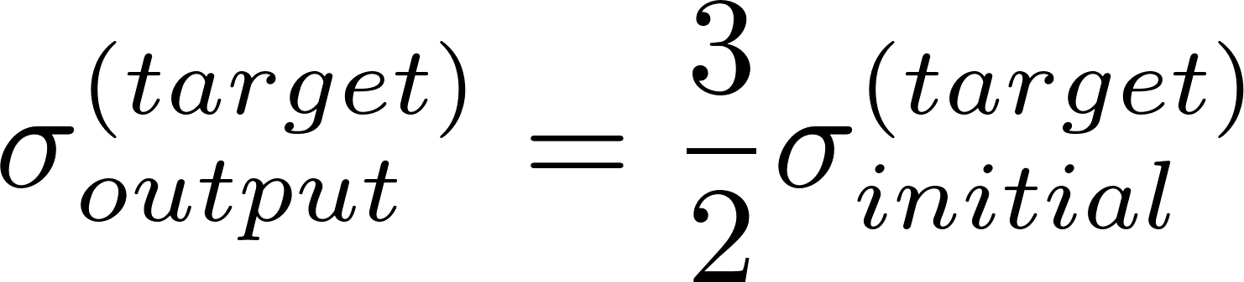
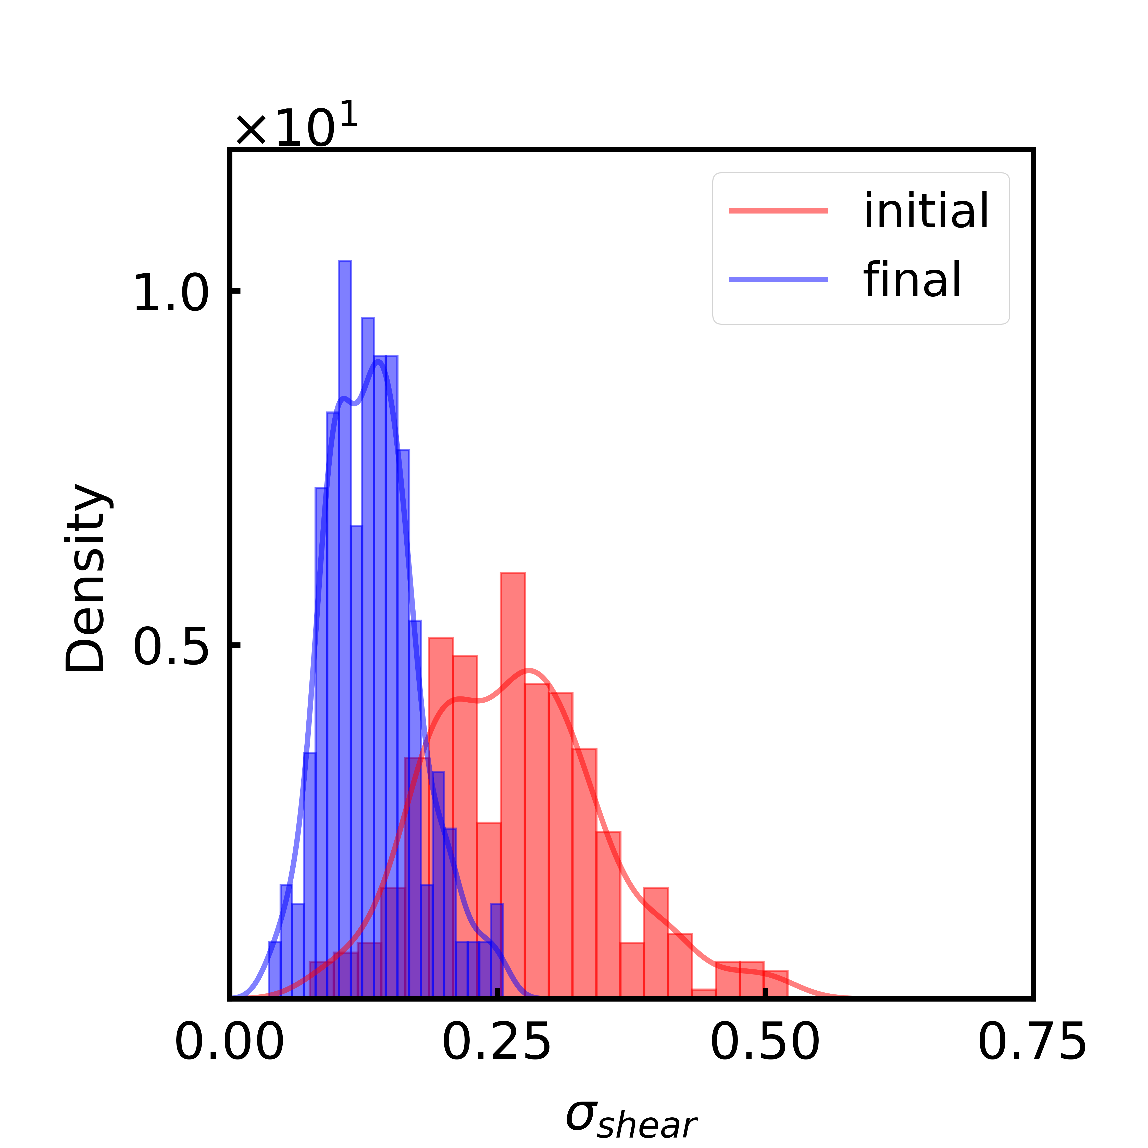
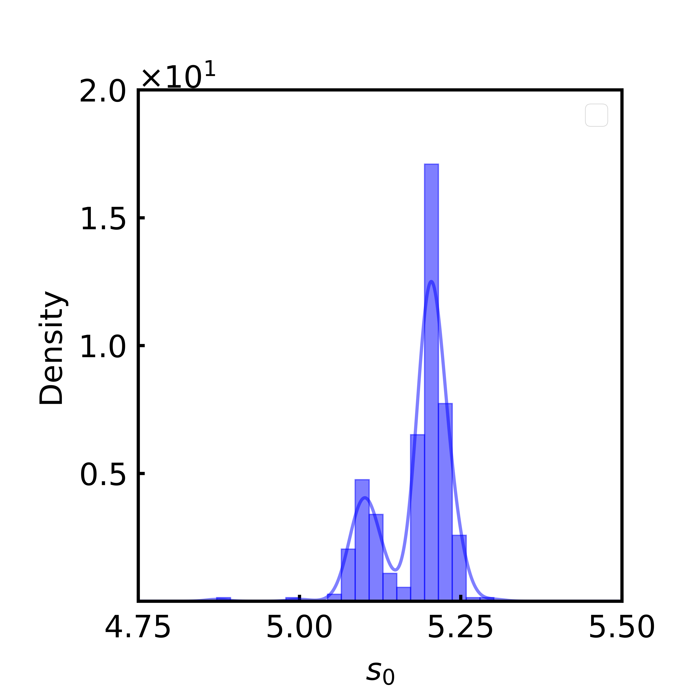
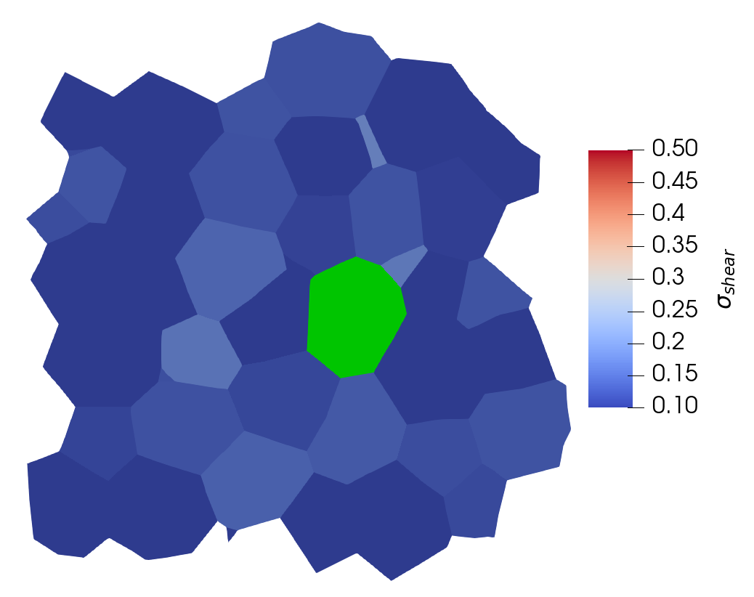
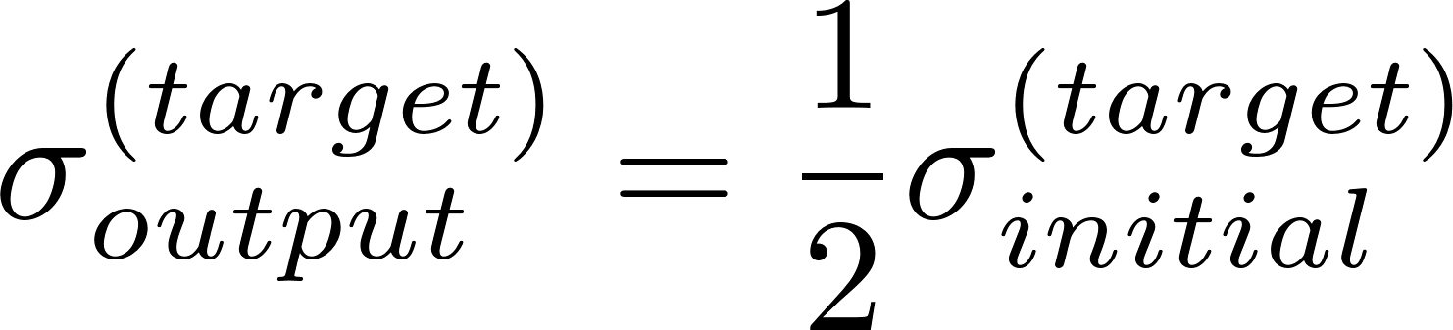
Single Cell:
The algorithm can be applied to train large changes in maximum shear stress on a single cell.

Slide 3
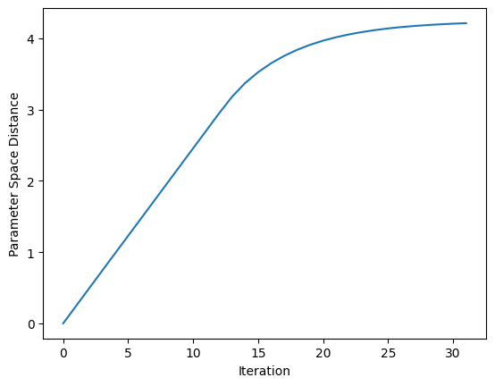
Single Cell:
The algorithm can be applied to train large changes in maximum shear stress on a single cell.

Slide 4
Two cell training
343 cell (7*7*7 periodic system)
Tolerance: 1 e -6
Initial tissue: s0 = 5 (monodisperse)
Task: increase stress by 2.5% of original

Slide 5
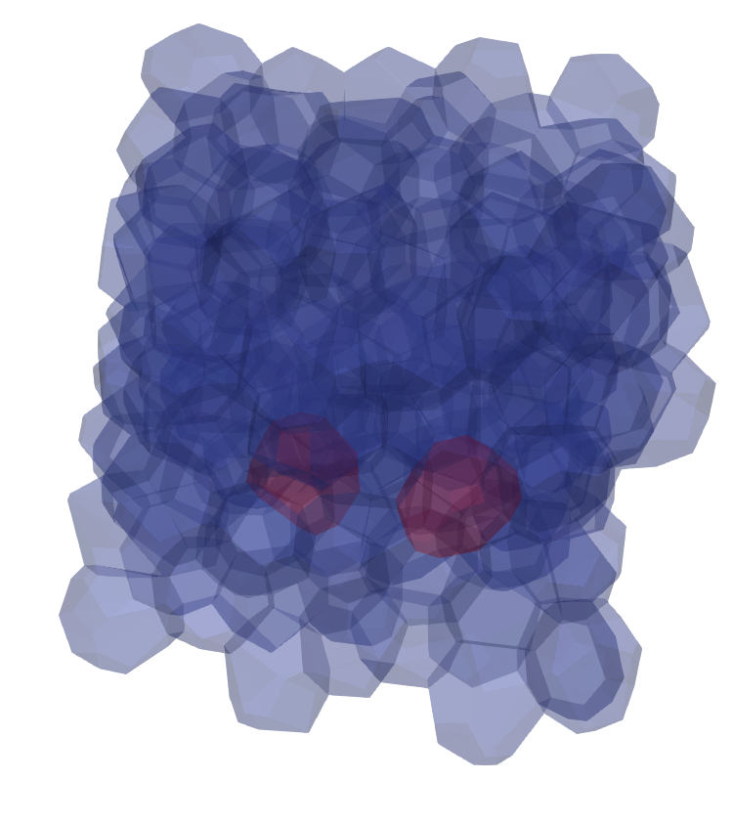
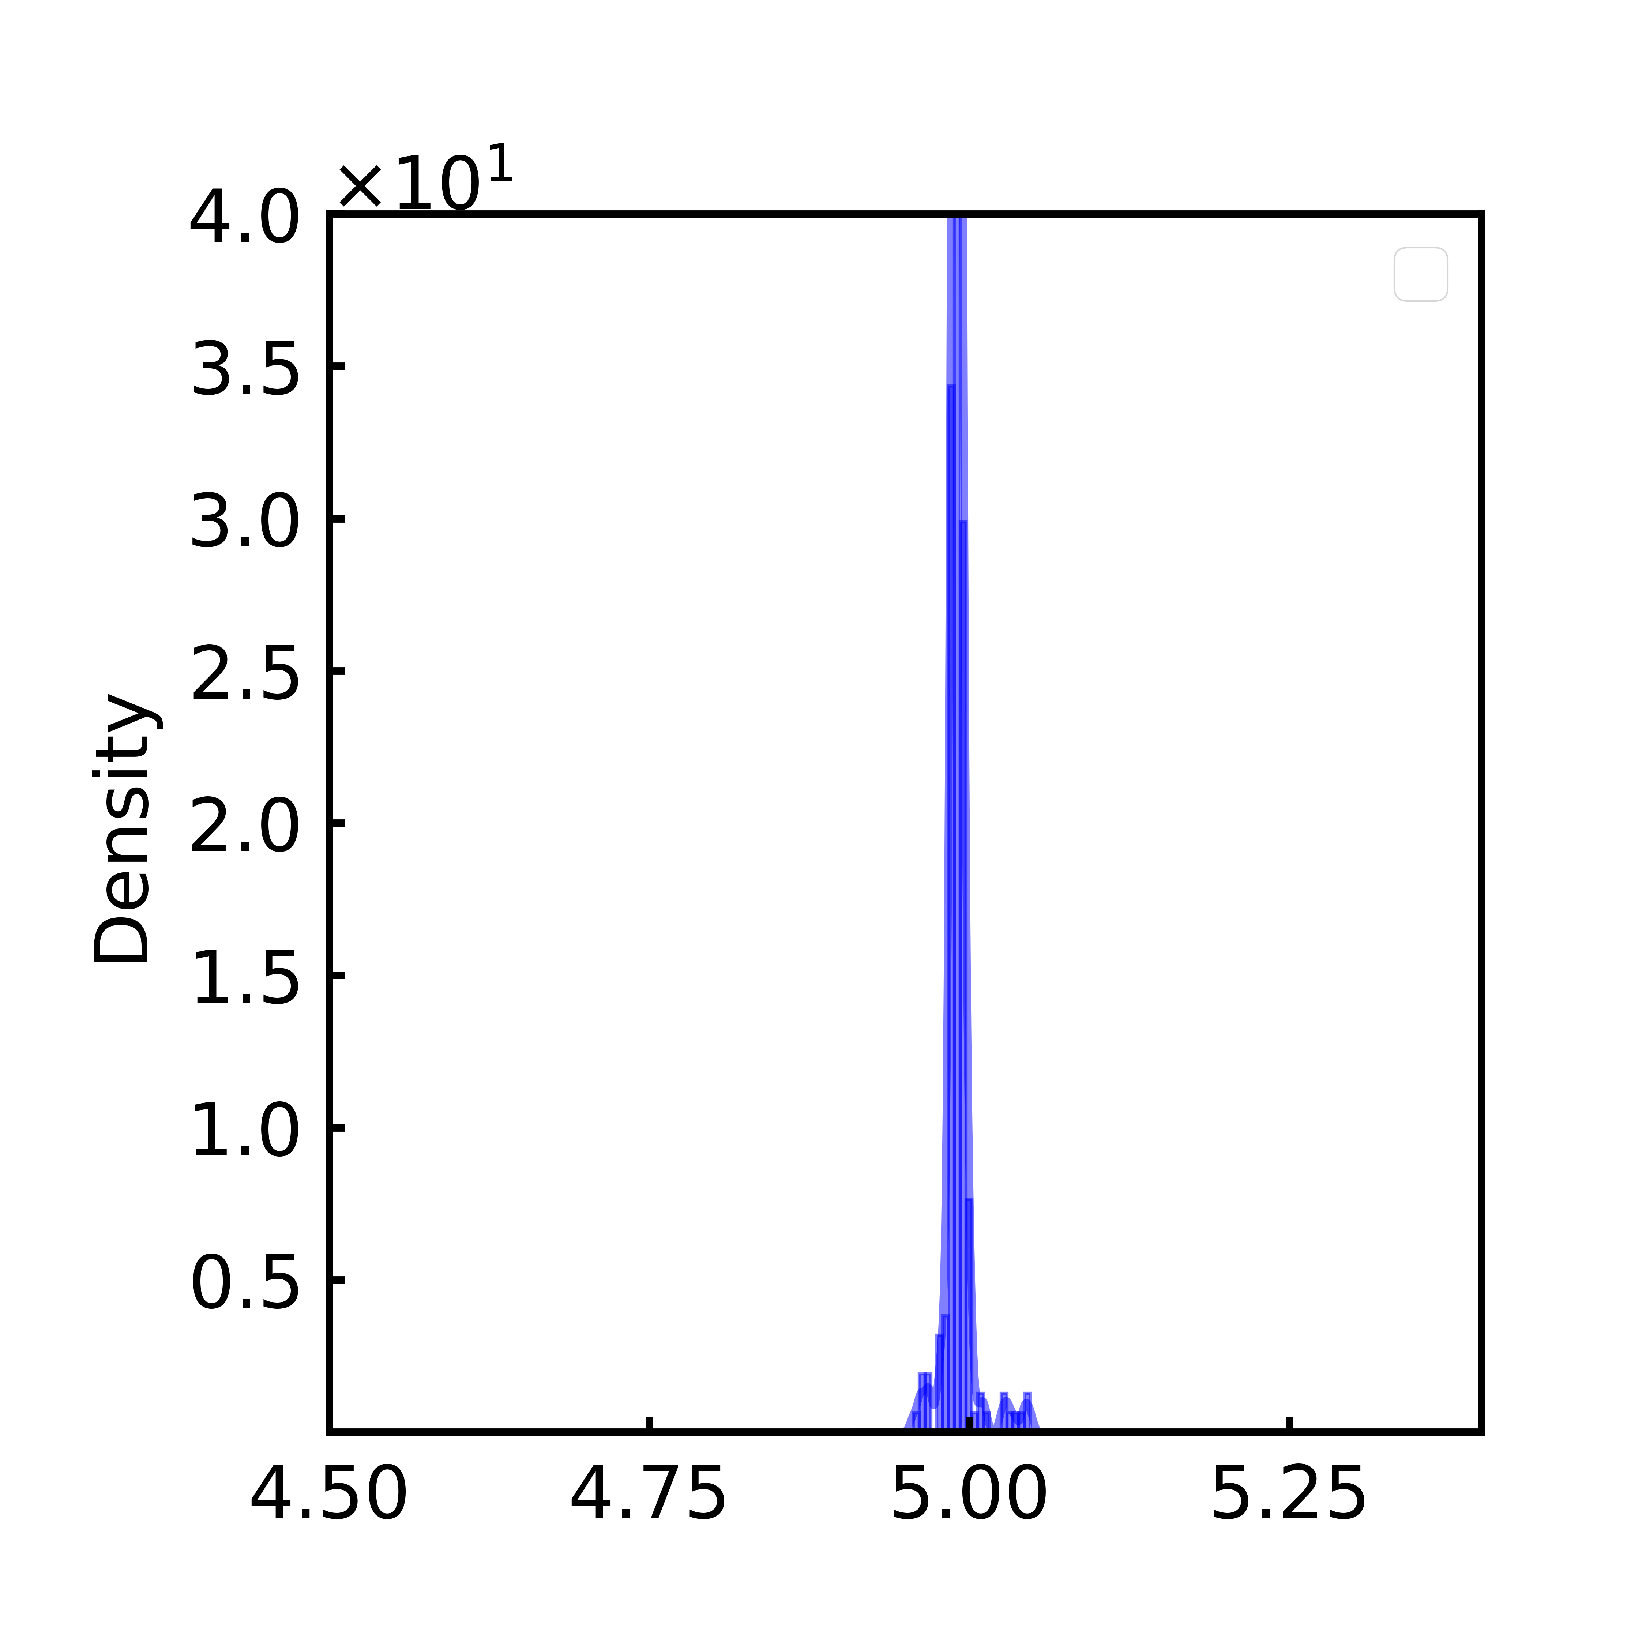
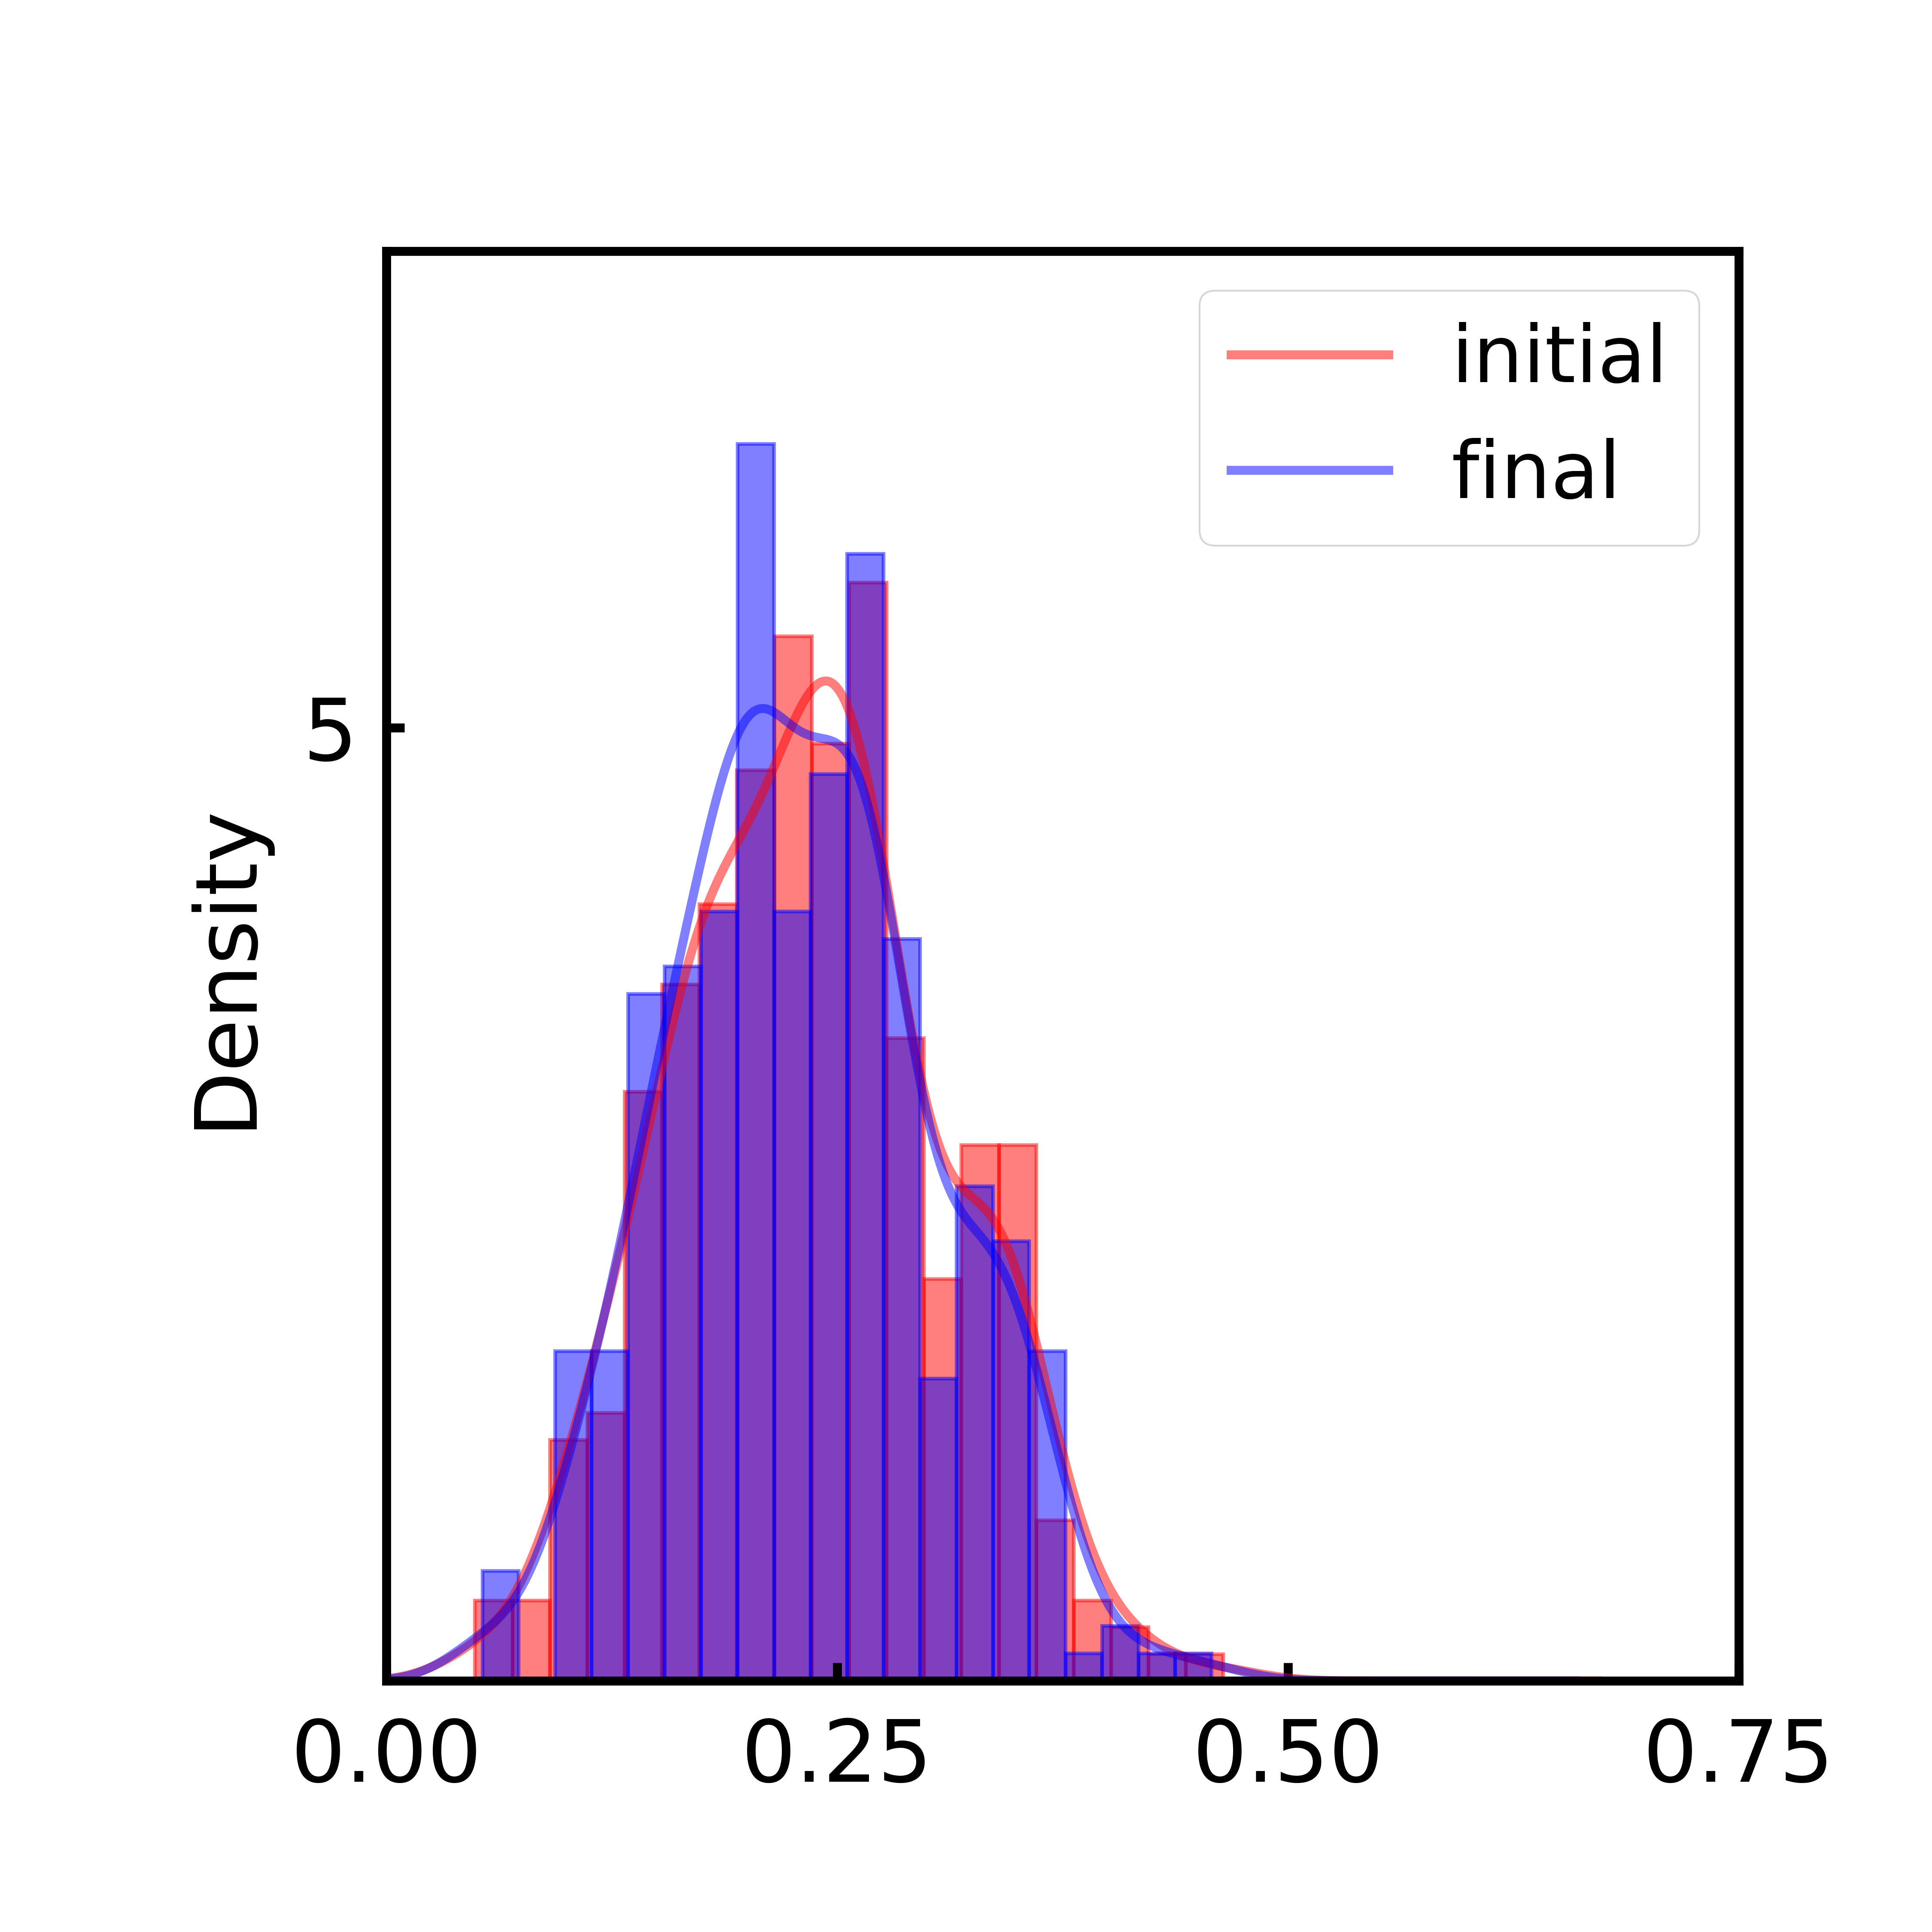
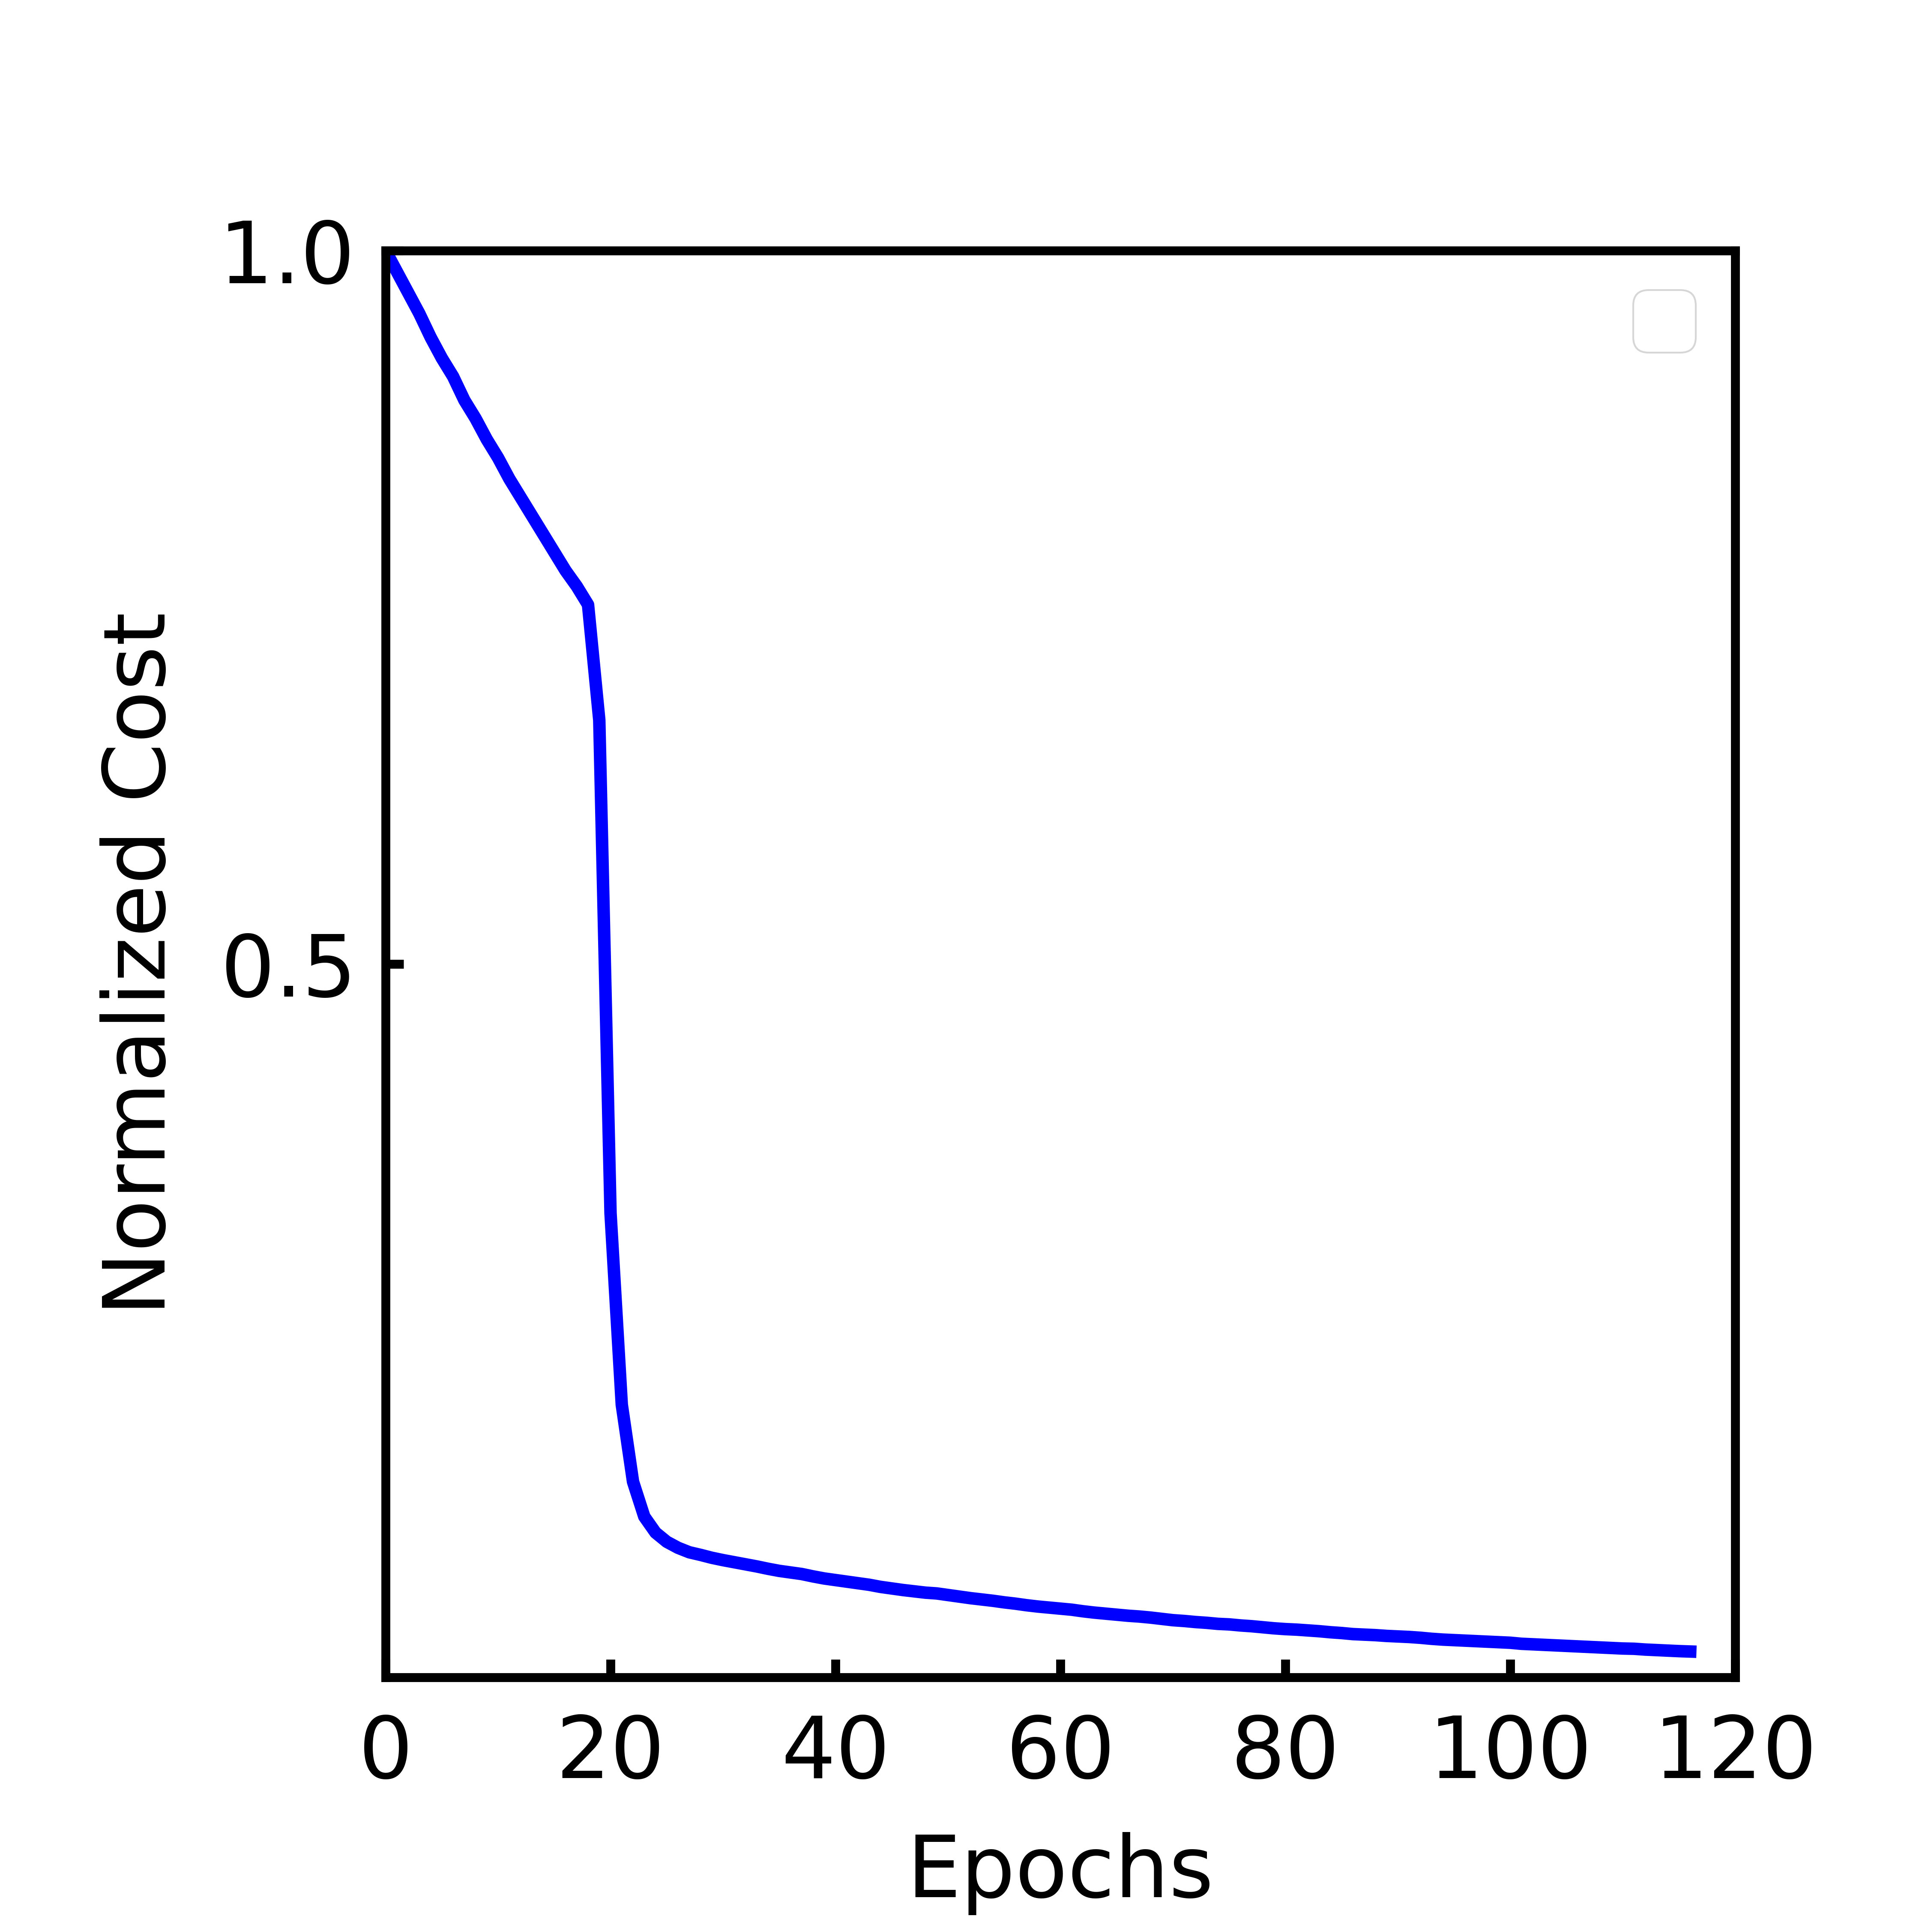
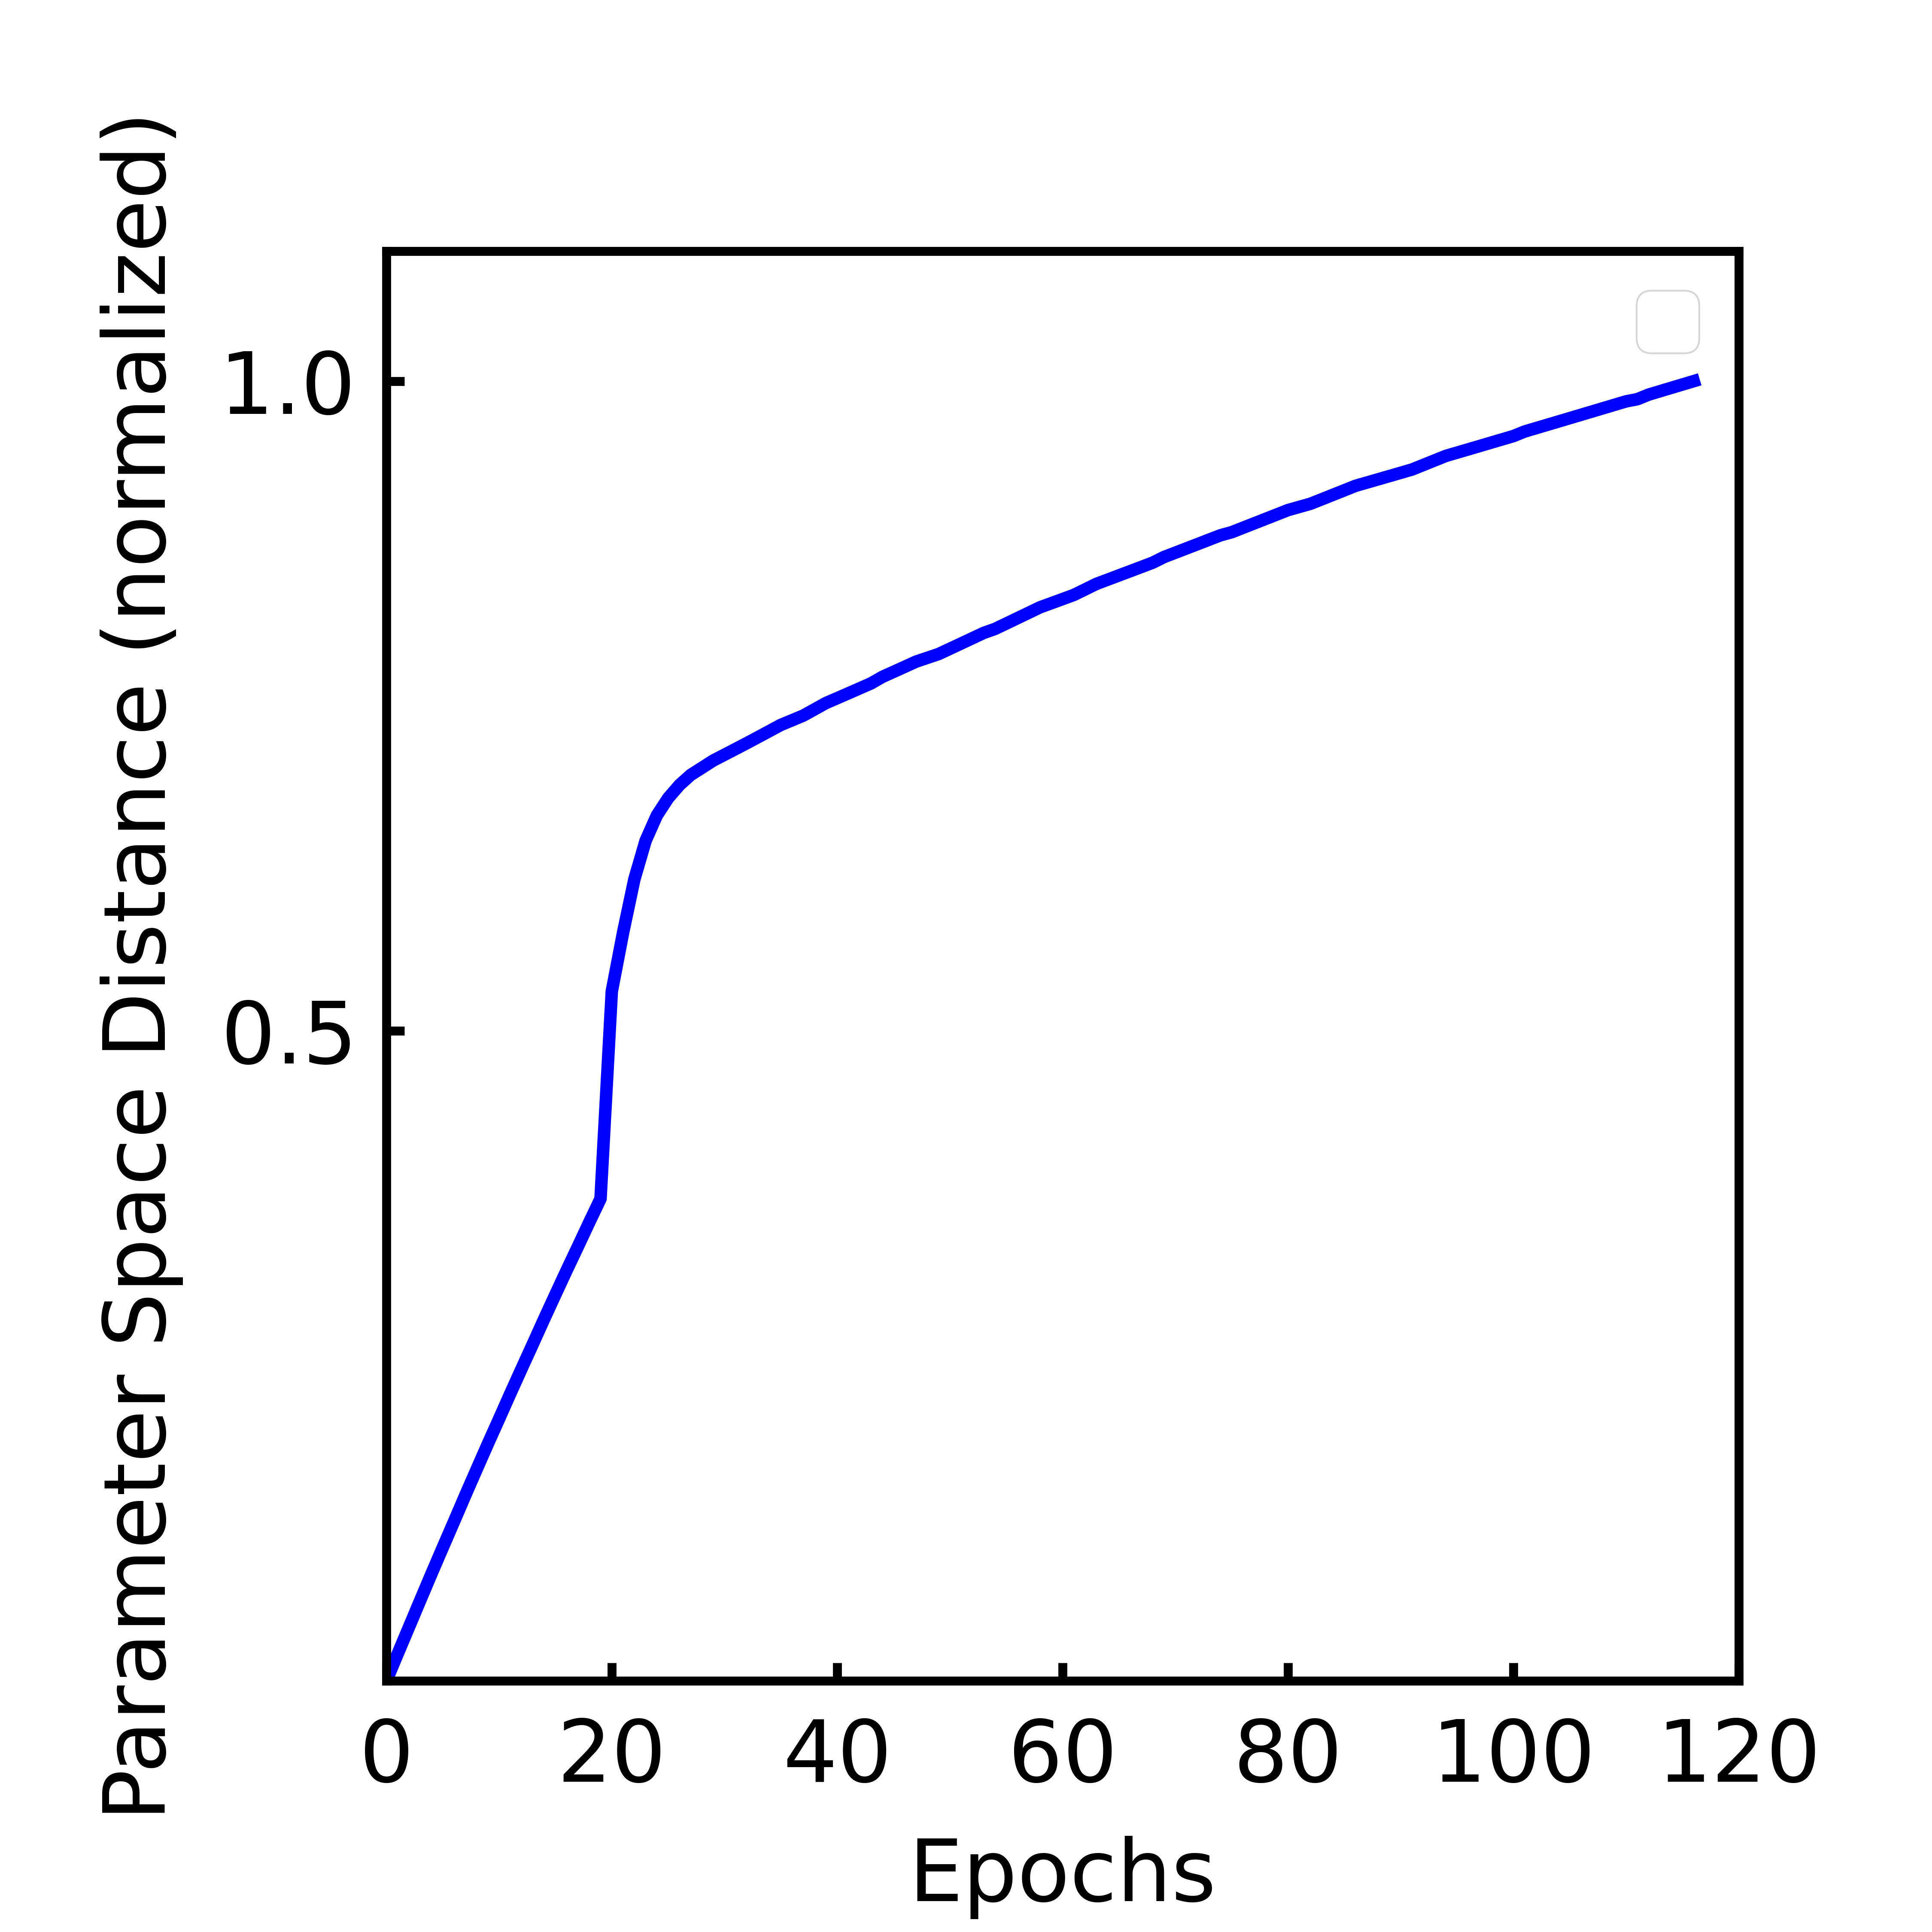
stress
s0
Typical Failure Mode:
Cost plateaus to some high value. This indicates a failure of the clamping procedure. (The desired pattern is inconsistent

Slide 6
Patterns A/B, Single cell each
343 cell (7*7*7 periodic system)
Tolerance: 1 e - 5
Task:
in each pattern, increase stress by 2.5% from original.
Reduce distance between each pattern

Slide 7
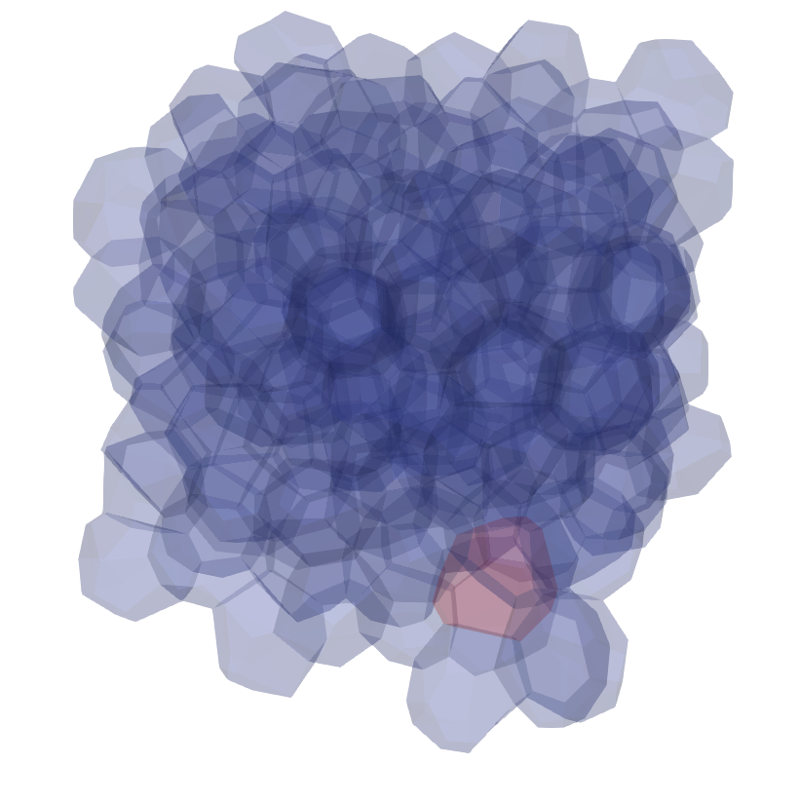
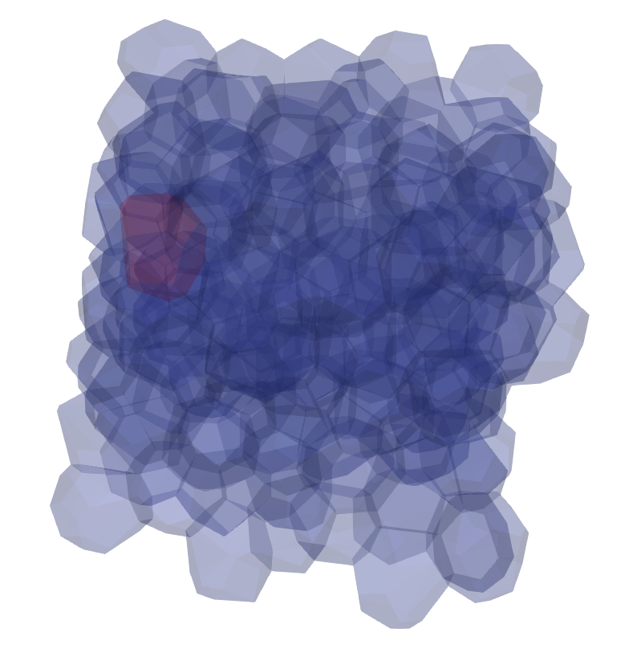
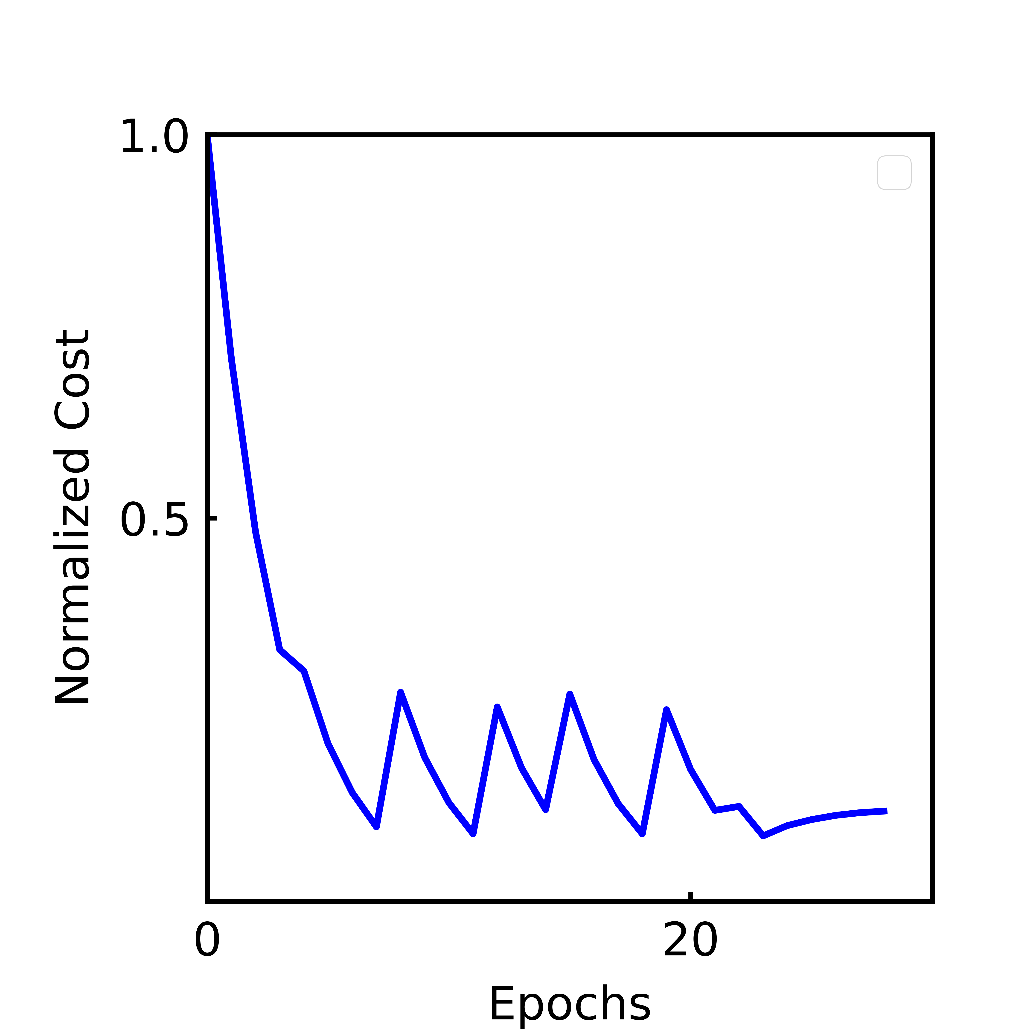
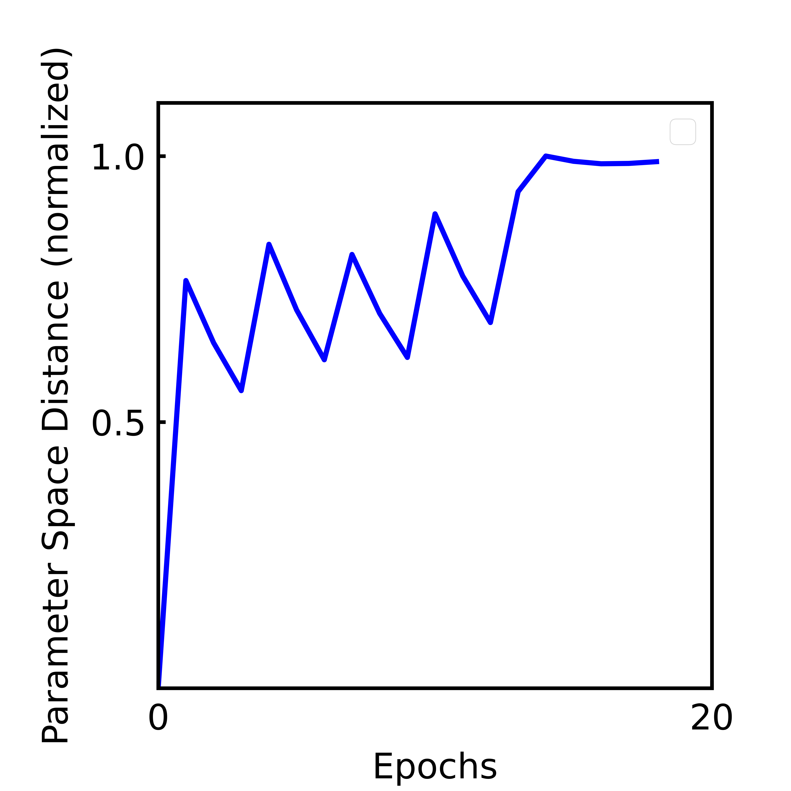
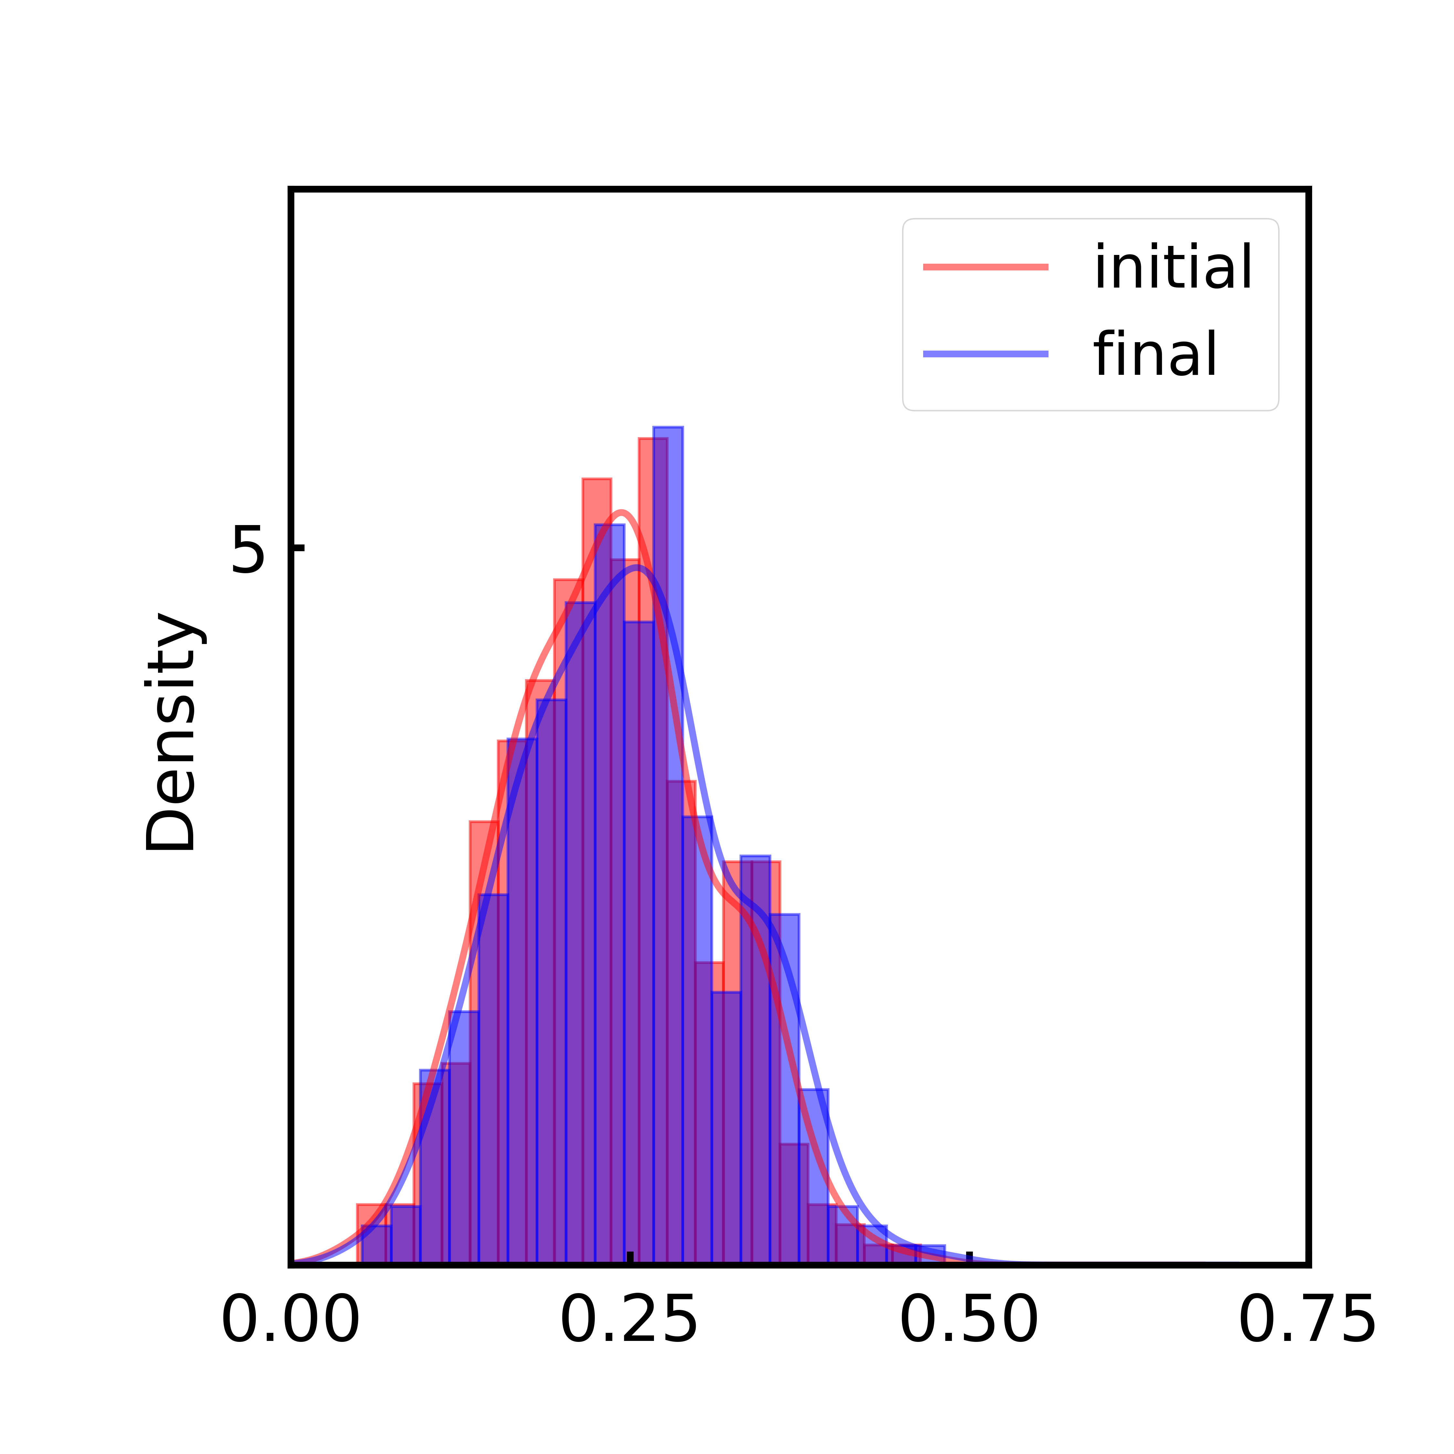
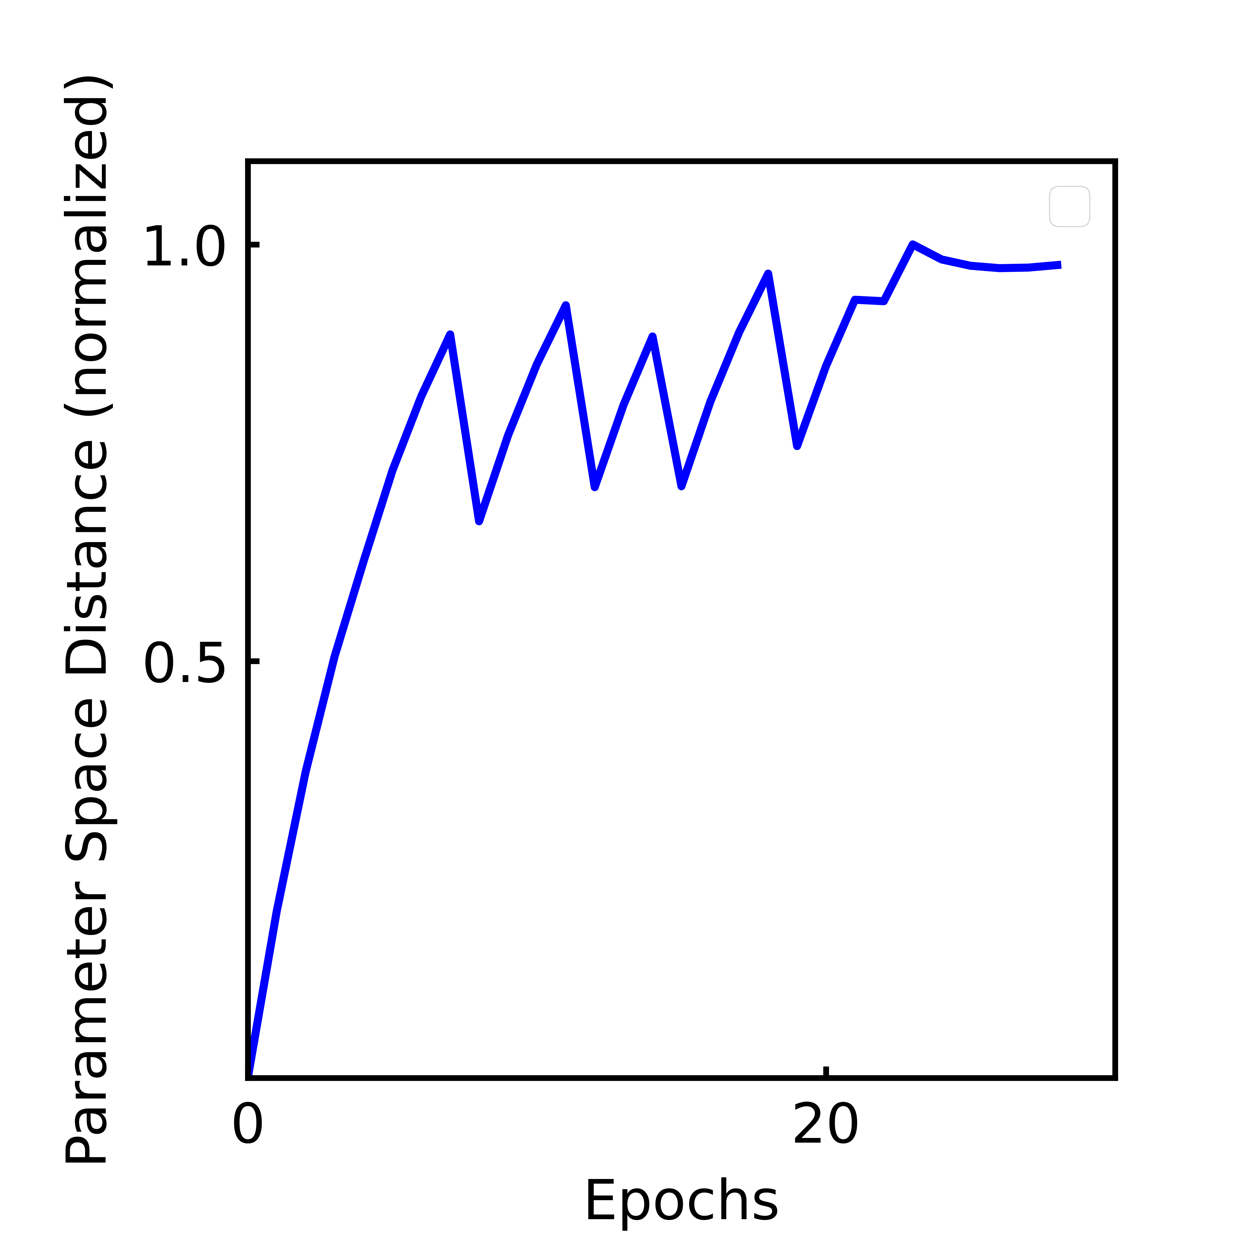
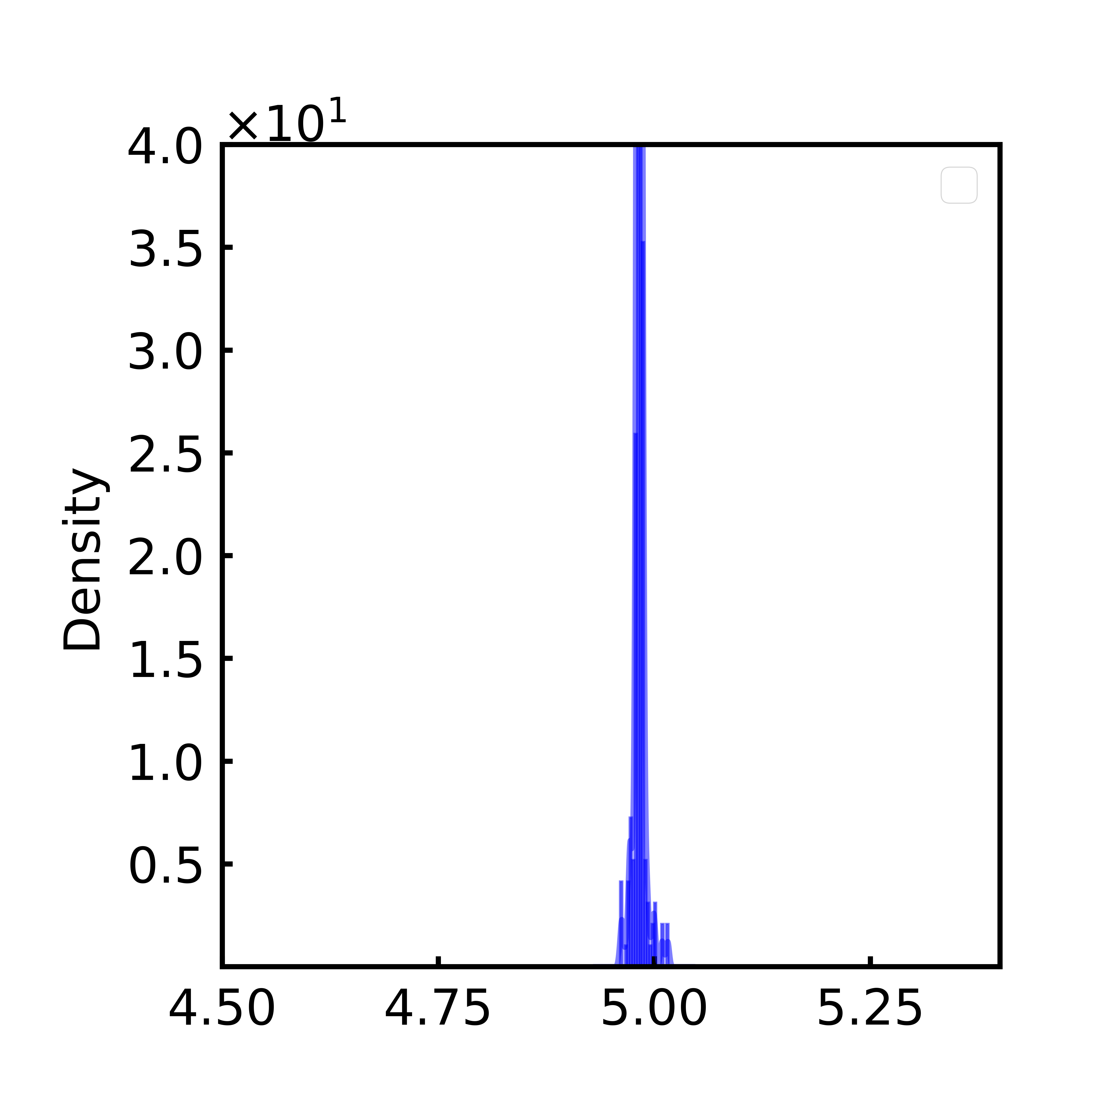

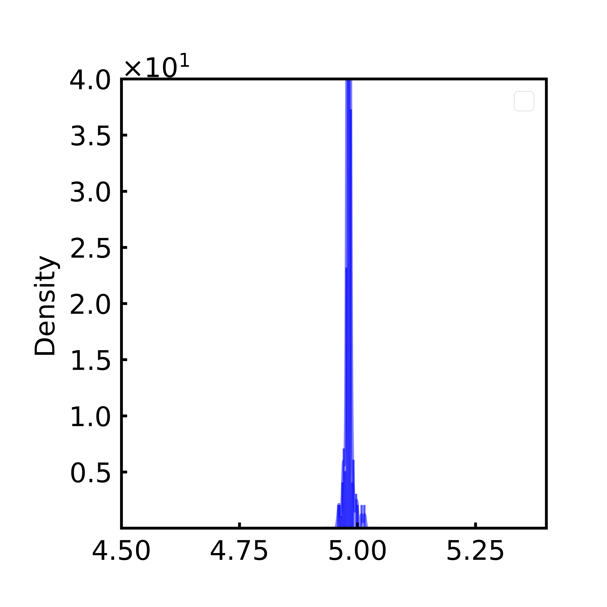
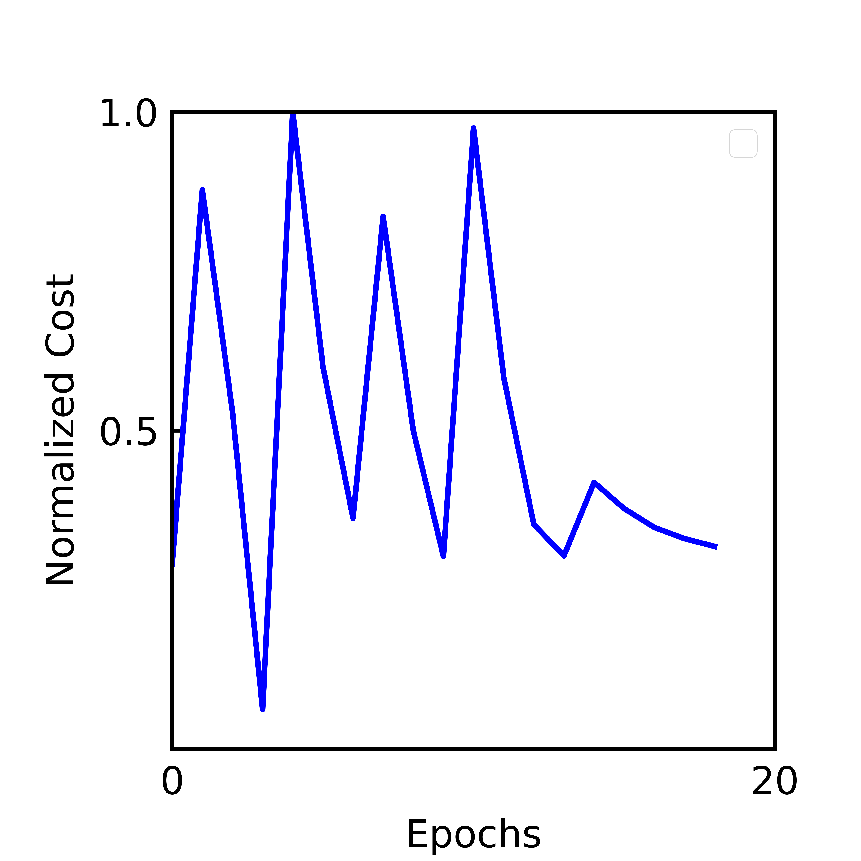

Slide 8
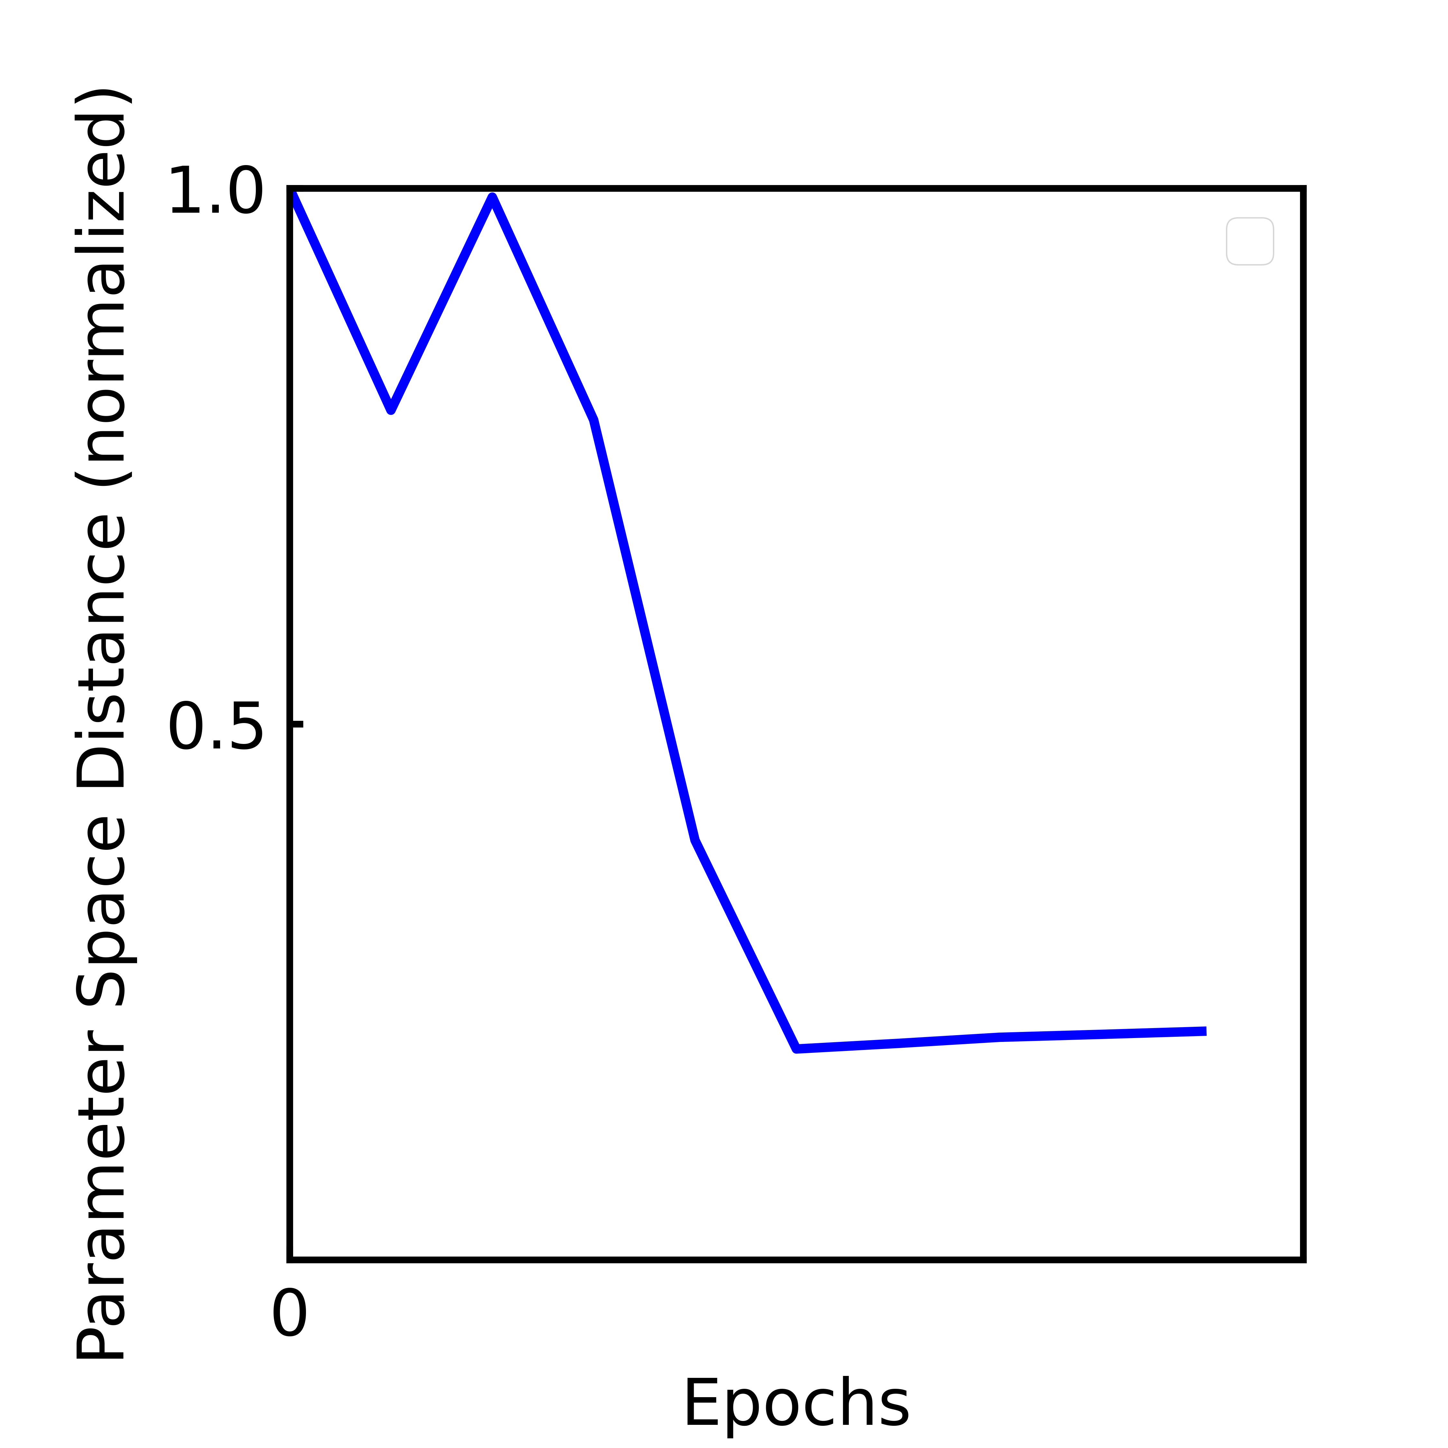
Typical Failure Modes:
If the single cell patterns are very different from initial, some s0 parameters get fluid (>5.3); this causes the training to fail (system no longer minimizes)
If single cells are trained to high precision before switching, the same can happen.

Slide 9
