Slide 1
hosteldirt
digging for dirt on Hostelworld
Natalia Zhang
Notes:
Good morning
Project Introduction

Slide 2
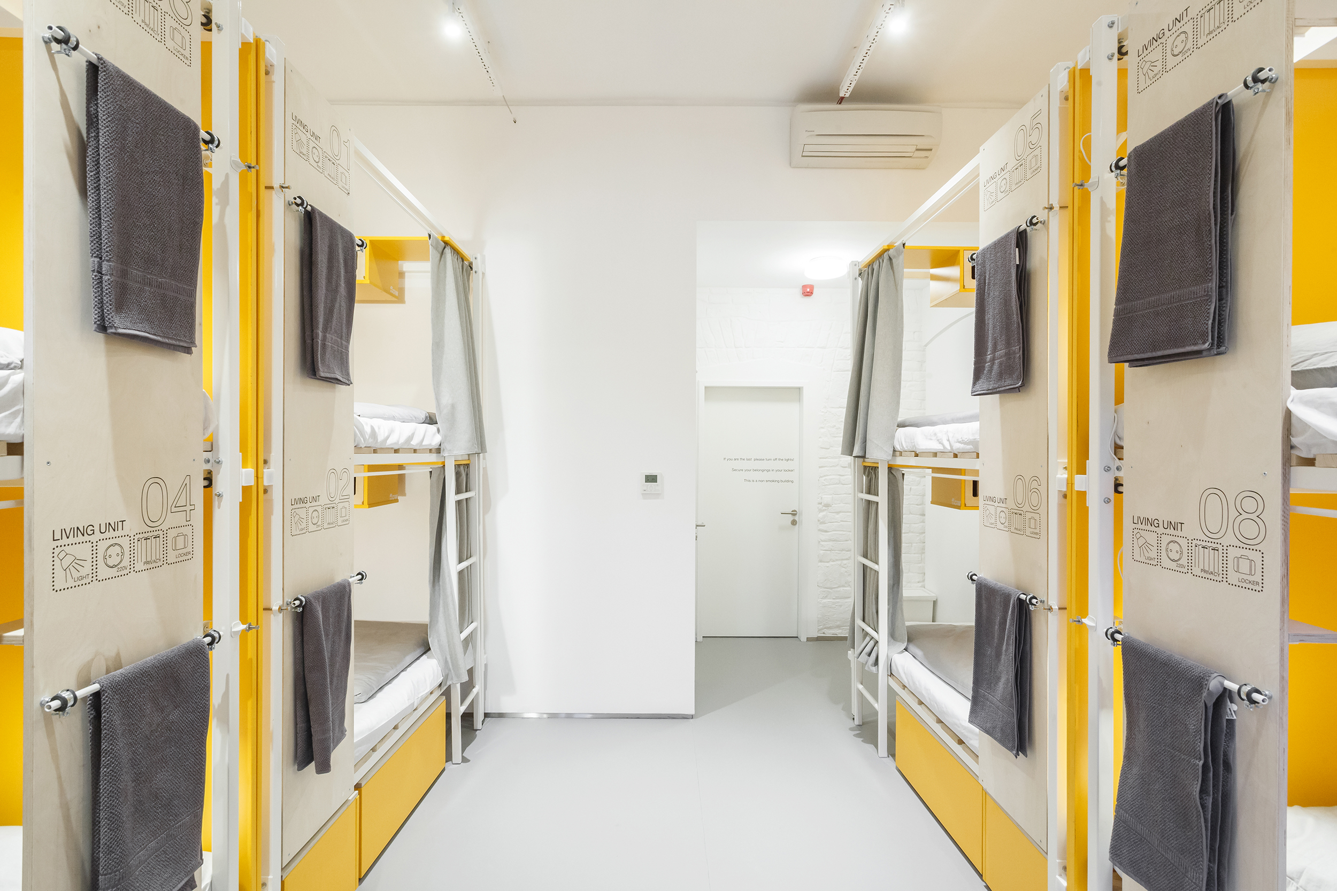
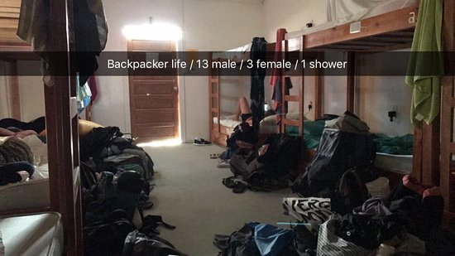
Courtesy of TripAdvisor
Notes:
We’ve all had to travel at some point

Slide 3

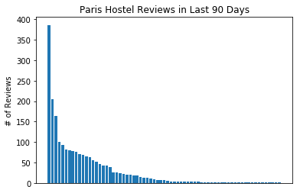
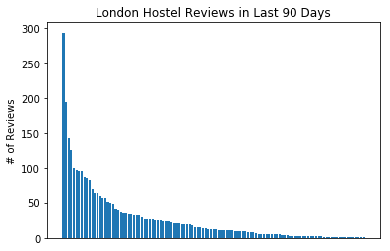
Hostelworld
36,000 properties in 170 countries
Over 10 million verified guest reviews

Slide 4
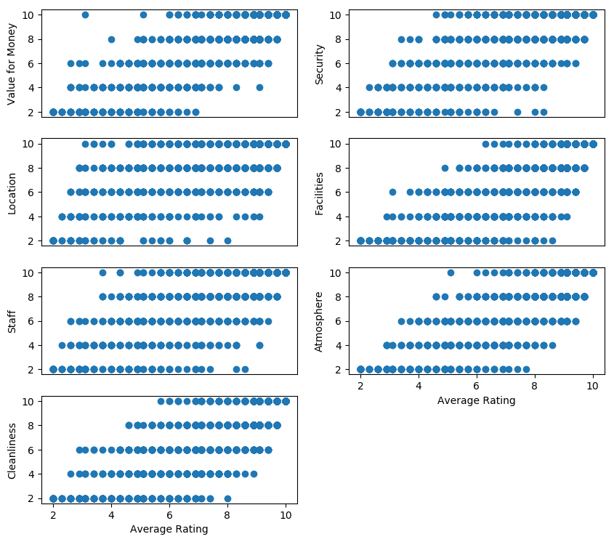
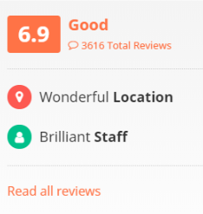

Slide 5
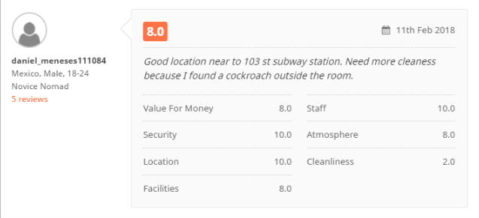
Do we care about all dimensions equally?

Slide 6

Selects hostels with 5+ reviews
Sorts hostels & selects top 5 based on requested ranking criteria
Performs sentiment analysis with VADER on hostel reviews
displays most positive comment & most negative comment for target hostels

