Slide 1




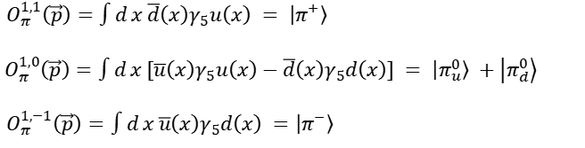
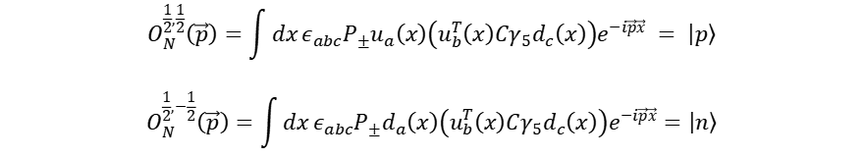
Operator structure
$$O_{N}^{\frac{1}{2},\frac{1}{2}}\left(\vec{p}\right)=\int{dx}ε_{abc}P_{±}u_{a}\left(x\right)\left(u_{b}^{T}\left(x\right)Cγ_{5}d_{c}\left(x\right)\right)e^{−i\vec{p}\vec{x}} = \left|p\right\rangle$$
$$O_{N}^{\frac{1}{2},−\frac{1}{2}}\left(\vec{p}\right)=\int{dx}ε_{abc}P_{±}d_{a}\left(x\right)\left(u_{b}^{T}\left(x\right)Cγ_{5}d_{c}\left(x\right)\right)e^{−i\vec{p}\vec{x}}=\left|n\right\rangle$$
$O_{π}^{1,1}\left(\vec{p}\right)=\int{d}x \overline{d}\left(x\right)γ_{5}u\left(x\right) = \left|π^{+}\right\rangle$
$O_{π}^{1,0}\left(\vec{p}\right)=\int{d}x [\overline{u}\left(x\right)γ_{5}u\left(x\right)−\overline{d}\left(x\right)γ_{5}d\left(x\right)] = \left|π_{u}^{0}\right\rangle +\left|π_{d}^{0}\right\rangle$
$O_{π}^{1,−1}\left(\vec{p}\right)=\int{d}x \overline{u}\left(x\right)γ_{5}d\left(x\right) =\left|π^{−}\right\rangle$
$$ππ→ee:\sum_{n}{\left\langle Ω\left|J_{μ}\right|π_{n}\right\rangle }∗\left\langle π_{n}|J_{ν}|ππ\right\rangle$$
$\left\langle p\left|J_{μ}J_{ν}\right|nπ^{−}\right\rangle =\sum_{n}{\left\langle p\left|J_{μ}|n⟩ ∗ ⟨n|J_{ν}\right|nπ^{−}\right\rangle }$
$ℒ=2\sqrt{2}G_{F}V_{ud}\left(\overline{u}\left(γ_{μ}−γ_{μ}γ_{5}\right)d\right)\left(\overline{e}\left(γ_{μ}−{γ_{μ}γ}_{5}\right)ν_{e}\right)$ $→$ $J_{μ}=\overline{u}\left(γ_{μ}−γ_{5}γ_{μ}\right)d$
Why just insert $\left|π\right\rangle$ ?
W-E theorem
$$⟨I, I_{z} | T_{I_{0z}}^{\left(I_{0}\right)}| I′, I_{z}^{′} ⟩= ⟨I′ I_{z}^{′}, I_{0} I_{0z}| I I_{z}⟩⟨I | T^{\left(I_{0}\right)}| I′ ⟩$$
$⟨I′ I_{z}^{′}, I_{0} I_{0z}| I I_{z}⟩$ is CG coefficient
Just consider the total isospin?
Momentum modes
$$\frac{{\vec{p}}_{n}}{2π/L}=\left(0,0,0\right),\left(0,0,1\right),\left(0,1,1\right),\left(1,1,1\right)$$

Slide 2
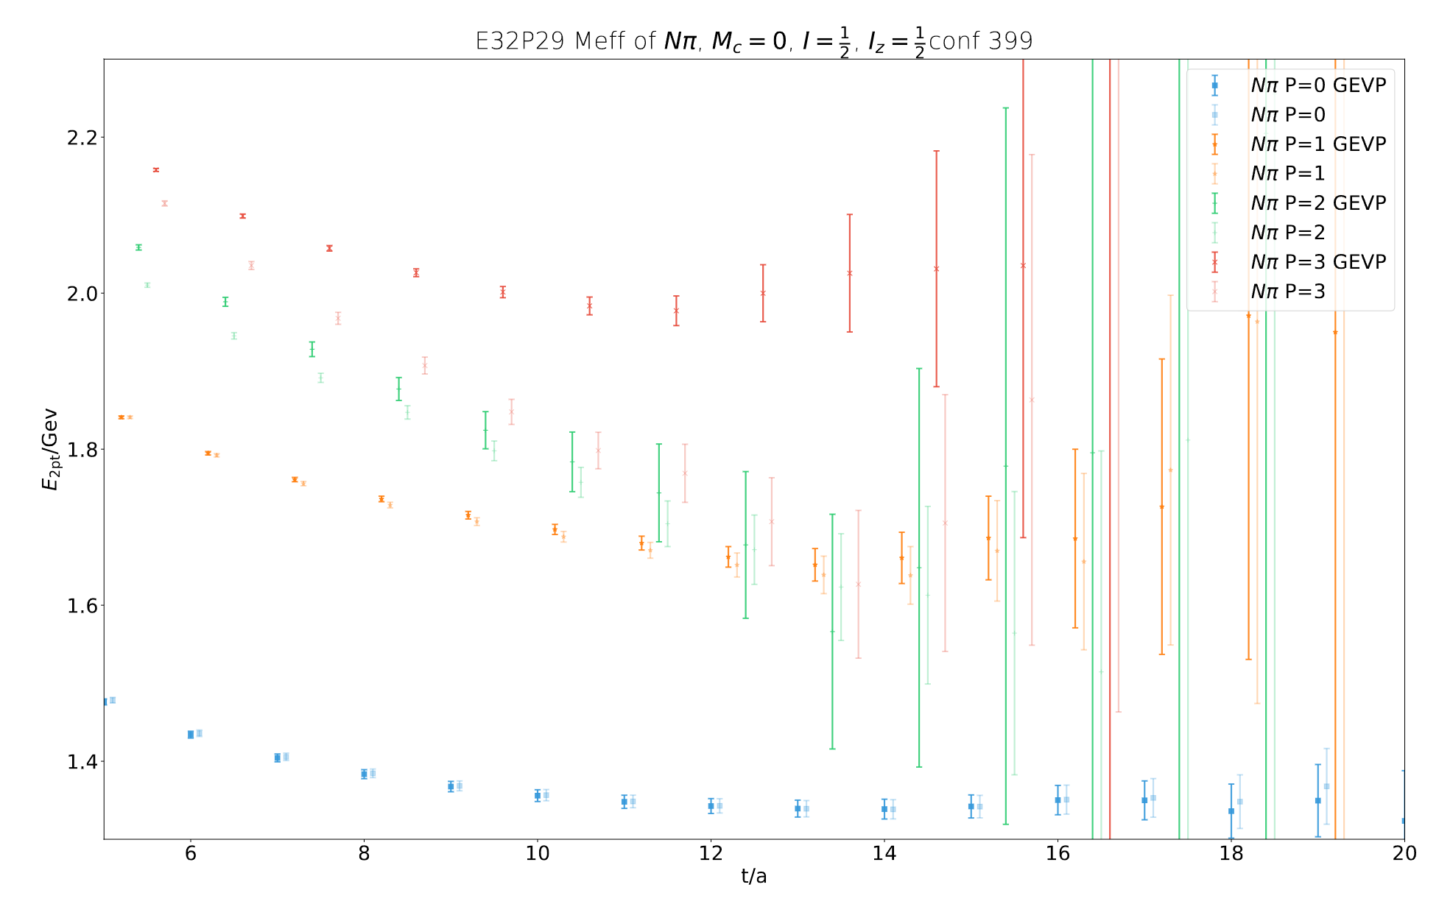
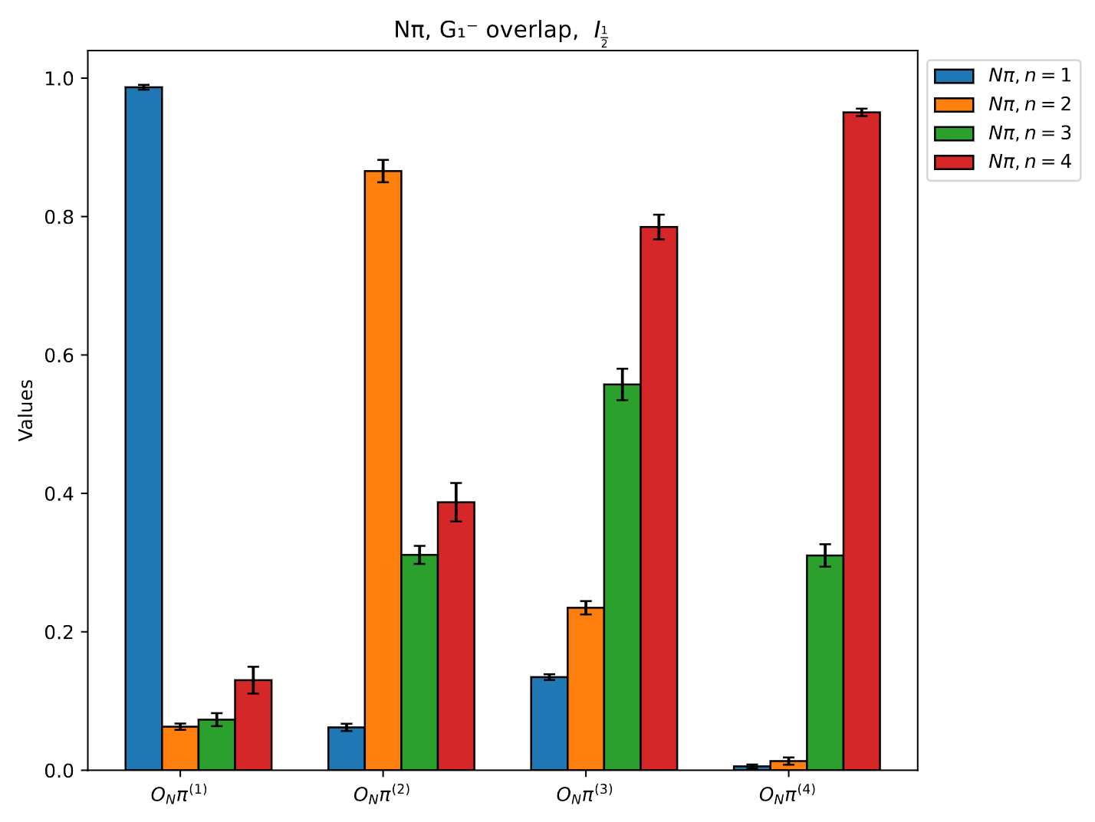


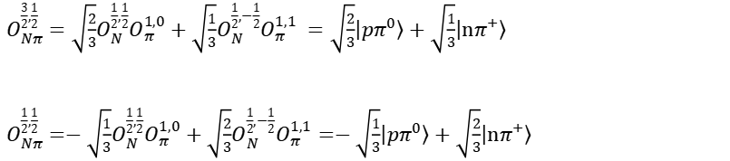
GEVP is designed to obtain a pure ground state?
$Nπ$ operator
$O_{Nπ}^{\frac{3}{2},\frac{1}{2} }=\sqrt{\frac{2}{3}}O_{N}^{\frac{1}{2},\frac{1}{2}}O_{π}^{1,0}+\sqrt{\frac{1}{3}}O_{N}^{\frac{1}{2},−\frac{1}{2}}O_{π}^{1,1} =\sqrt{\frac{2}{3}}\left|pπ^{0}\right\rangle +\sqrt{\frac{1}{3}}\left|nπ^{+}\right\rangle$
$O_{Nπ}^{\frac{1}{2},\frac{1}{2} }=−\sqrt{\frac{1}{3}}O_{N}^{\frac{1}{2},\frac{1}{2}}O_{π}^{1,0}+\sqrt{\frac{2}{3}}O_{N}^{\frac{1}{2},−\frac{1}{2}}O_{π}^{1,1}=−\sqrt{\frac{1}{3}}\left|pπ^{0}\right\rangle +\sqrt{\frac{2}{3}}\left|nπ^{+}\right\rangle$
$$C^{:,\frac{1}{2}}= ⟨n,π^{+}|n,π^{+}⟩+ ⟨n,π^{+}|p,π_{d}^{0}⟩+ ⟨p,π_{u}^{0}|p,π_{u}^{0}⟩+ ⟨p,π_{d}^{0}|p,π_{d}^{0}⟩+ {⟨n,π^{+}|p,π_{d}^{0}⟩}^{†}$$
$$ℳ_{Nπ}^{mn}=\left\langle O_{Nπ}^{(m)} | O_{Nπ}^{(n)}\right\rangle$$
GEVP

Slide 3
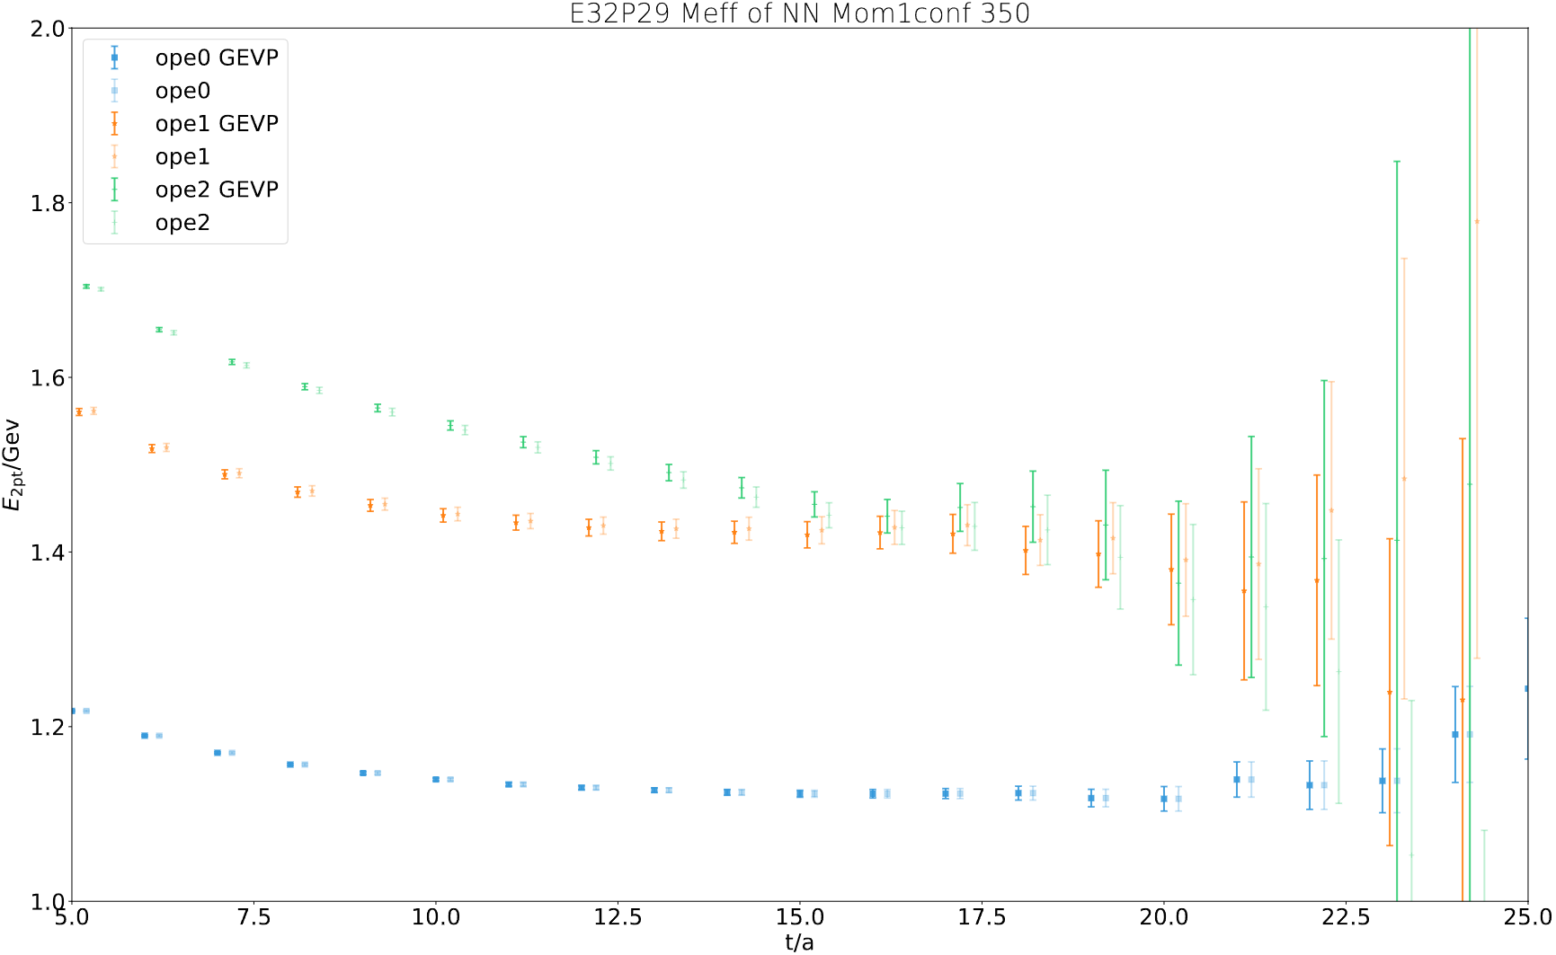
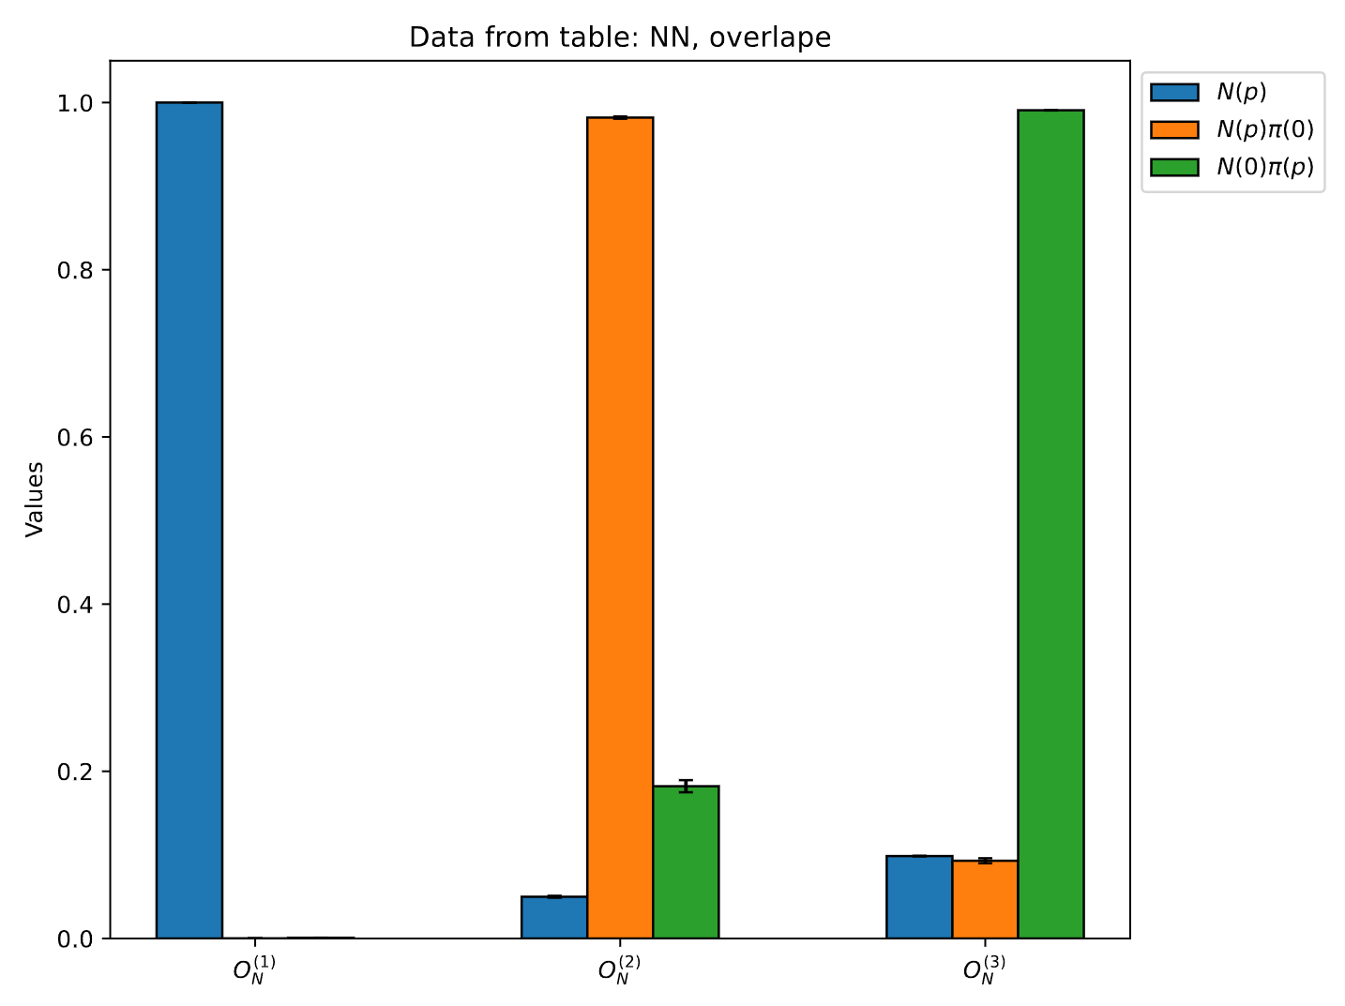



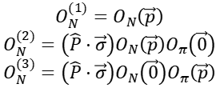

$N$ operator
$$O_{N}^{(1)}=O_{N}\left(\vec{p}\right)$$
$$O_{N}^{(2)}=\left(\hat{P}⋅\vec{σ}\right)O_{N}\left(\vec{p}\right)O_{π}\left(\vec{0}\right)$$
$$O_{N}^{(3)}=\left(\hat{P}⋅\vec{σ}\right)O_{N}\left(\vec{0}\right)O_{π}\left(\vec{p}\right)$$
Why need $\vec{p}⋅σ$ ?
$$P_{±}=\left(1+γ_{4}\right)/2$$
$$ℳ_{N}^{mn}\left(\vec{p}\right)=\left\langle O_{N}^{\left(m\right)}\left(\vec{p}\right) | O_{N}^{\left(n\right)}\left(\vec{p}\right)\right\rangle$$
GEVP

