Slide 1
Dslash奇偶预处理
GPU代码思路
2023.08.06
王建成

Slide 2
优化原始GPU代码
带宽受限
U传入9个complex→U传入6个Complex，前两行外积再共轭得到第三行

Slide 3
单平面 xy平面
0 |  | 0 |  | 0 |  | 0
 | 0 |  | 0 |  | 0 |  | 0
0 |  | 0 |  | 0 |  | 0
 | 0 |  | 0 |  | 0 |  | 0
0 |  | 0 |  | 0 |  | 0
 | 0 |  | 0 |  | 0 |  | 0
0 |  | 0 |  | 0 |  | 0
 | 0 |  | 0 |  | 0 |  | 0

Slide 4
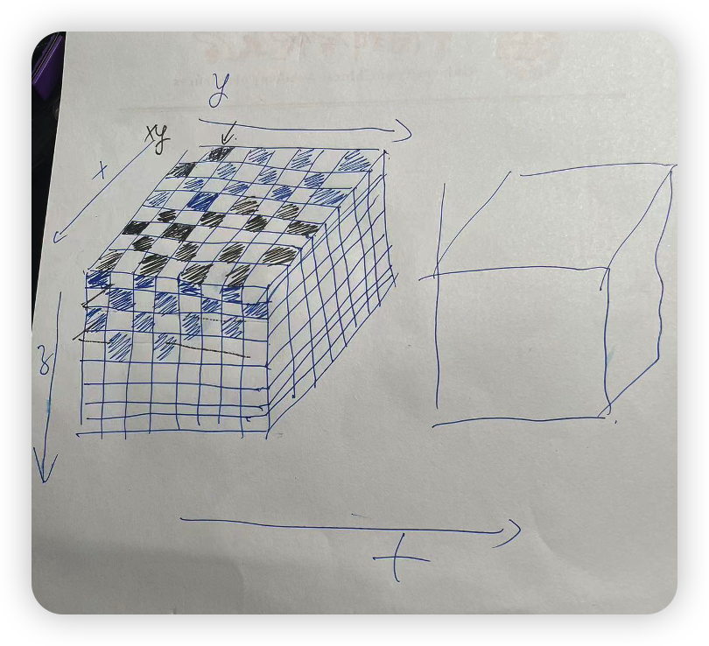
示意图

Slide 5
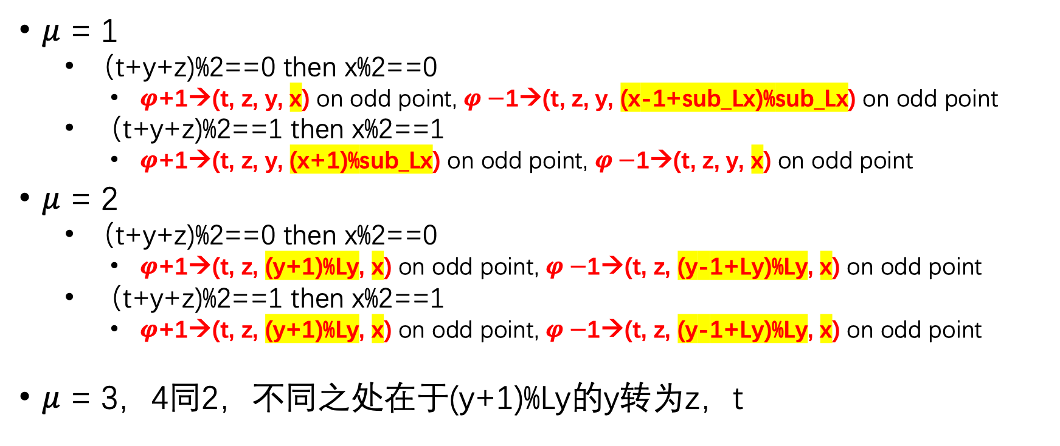
偶数点(t+z+y+x)%2 == 0，取邻近奇数点 even_odd = 0
$μ$ = 1
（t+y+z)%2==0 then x%2==0
$φ$+1→(t, z, y, x) on odd point, $φ−$1→(t, z, y, (x-1+sub_Lx)%sub_Lx) on odd point
（t+y+z)%2==1 then x%2==1
$φ$+1→(t, z, y, (x+1)%sub_Lx) on odd point, $φ−$1→(t, z, y, x) on odd point
$μ$ = 2
（t+y+z)%2==0 then x%2==0
$φ$+1→(t, z, (y+1)%Ly, x) on odd point, $φ−$1→(t, z, (y-1+Ly)%Ly, x) on odd point
（t+y+z)%2==1 then x%2==1
$φ$+1→(t, z, (y+1)%Ly, x) on odd point, $φ−$1→(t, z, (y-1+Ly)%Ly, x) on odd point
$μ$ = 3，4同2，不同之处在于(y+1)%Ly的y转为z，t

Slide 6
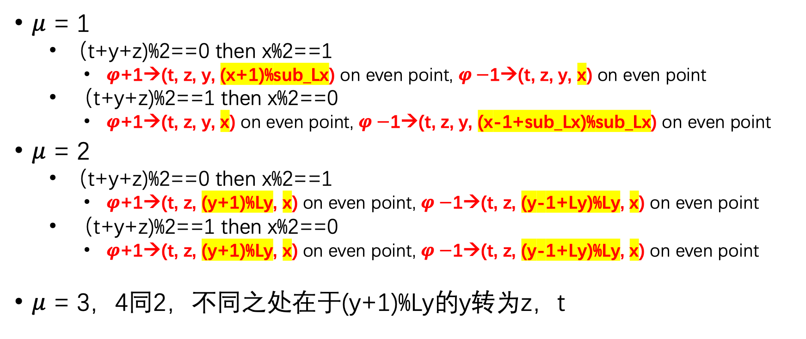
奇数点(t+z+y+x)%2 == 1，取邻近偶数点 even_odd = 1
$μ$ = 1
（t+y+z)%2==0 then x%2==1
$φ$+1→(t, z, y, (x+1)%sub_Lx) on even point, $φ−$1→(t, z, y, x) on even point
（t+y+z)%2==1 then x%2==0
$φ$+1→(t, z, y, x) on even point, $φ−$1→(t, z, y, (x-1+sub_Lx)%sub_Lx) on even point
$μ$ = 2
（t+y+z)%2==0 then x%2==1
$φ$+1→(t, z, (y+1)%Ly, x) on even point, $φ−$1→(t, z, (y-1+Ly)%Ly, x) on even point
（t+y+z)%2==1 then x%2==0
$φ$+1→(t, z, (y+1)%Ly, x) on even point, $φ−$1→(t, z, (y-1+Ly)%Ly, x) on even point
$μ$ = 3，4同2，不同之处在于(y+1)%Ly的y转为z，t

Slide 7


合并$μ$ = 1
其中even_odd代表目标点的奇偶性，even_odd=0代表计算even点的结果，=1代表odd点结果，eo = (t+y+z) % 2
$φ$+1
 | eo = 0 | eo=1
Even_odd=0 | x | (x+1)%sub_Lx
Even_odd=1 | (x+1)%sub_Lx | x
(1 & ~(even_odd ^ eo)) * x + (even_odd ^ eo) * ((x+1)%sub_Lx)

Slide 8

合并$μ$ = 1
其中even_odd代表目标点的奇偶性，even_odd=0代表计算even点的结果，=1代表odd点结果，eo = (t+y+z) % 2
$φ−$1
 | eo = 0 | eo=1
Even_odd=0 | (x-1+sub_Lx)%sub_Lx | x
Even_odd=1 | x | (x-1+sub_Lx)%sub_Lx
(1 & ~(even_odd ^ eo)) * ((x-1+sub_Lx) % sub_Lx) + (even_odd ^ eo) * x

Slide 9
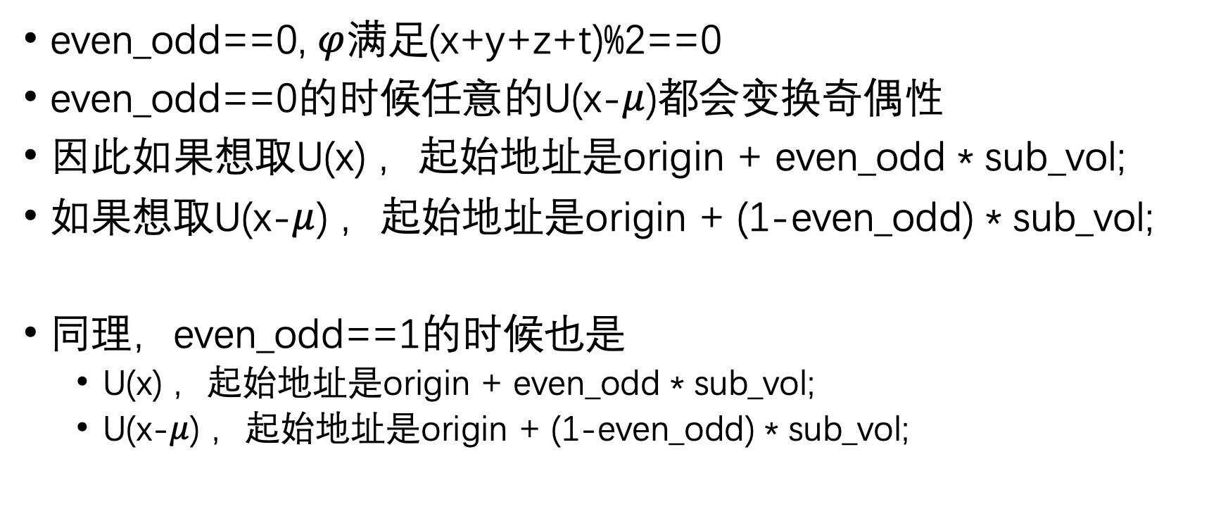
gauge
even_odd==0, $φ$满足(x+y+z+t)%2==0
even_odd==0的时候任意的U(x-$μ$)都会变换奇偶性
因此如果想取U(x) ，起始地址是origin + even_odd * sub_vol;
如果想取U(x-$μ$) ，起始地址是origin + (1-even_odd) * sub_vol;
同理，even_odd==1的时候也是
U(x) ，起始地址是origin + even_odd * sub_vol;
U(x-$μ$) ，起始地址是origin + (1-even_odd) * sub_vol;

Slide 10

特点
不管是奇数点还是偶数点，
在$μ$=1的时候前进后退方向要做文章
其他情况与不做奇偶预处理的情况相同，他在自己的坐标用第n个奇/偶点的向量，就在其他行用第n个偶/奇点的向量

Slide 11
(Nd Lt Lz Ly Lx Nc Nc)
(Nd 2 Lt Lz Ly Lx//2 Nc Nc)---U

