Slide 3
Z
Y
X

Slide 4
Z
Y
Z
Y
X
X

Slide 5
Z
Z
Y
Y
Z
Y
X
X
O
X

Slide 6
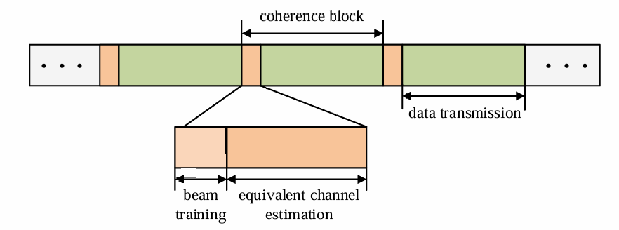
Time
BS Beam Training
BS-RIS Channel Estimation
RIS Beam Training
RIS-UE Channel Estimation
Date Transmission
RIS Codebook Design

Slide 7
Far Field
Rayleigh distance
Near Field
Scatterer
Scatterer
RIS
RIS
UE
UE

Slide 8
Wide beam scanning
Narrow beam scanning
UE
UE
Bad
Good
RIS
RIS
Good
Bad
Scatterer
Miss !!!
Scatterer

Slide 9
Single RIS codebook
Multi-ris codebook
UE or Principal scatterer
UE or Principal scatterer
Beam training
UE or Principal scatterer
UE or Principal scatterer

Slide 11






narrow beam
broadcast
move
multi-user
obstruct
obstruct
broad beam
broadcast
obstruct
move
obstruct
move

Slide 12
Y
Z
X
O

Slide 13
Z
Z
Y
Z
Y
X
X
Y
Z
Y
X
X

Slide 14
Wide beam codebook
Narrow beam codebook
…
…
BS predefined codebook
…
…

