Slide 1
Dialog System Technology Challenges
Work brief of Nature Language Processing
brucehan
2020-05-10

Slide 2

Outline
Dialogue
QA
Session
Non-structure
structure
chat
task
IR
…
IE
DB
…
KG
pipeline
e2e
QA Pairs
Reading
Comprehension

Slide 3
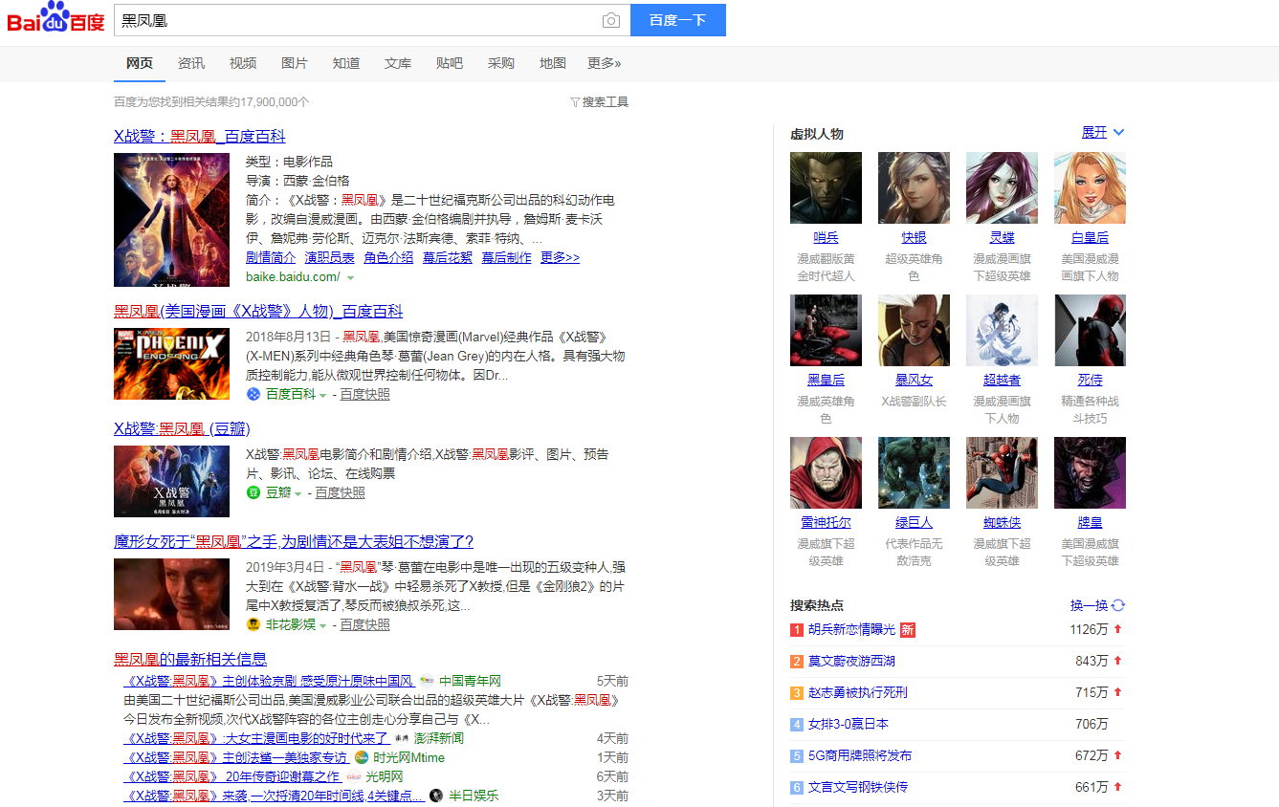
IR -- baidu

Slide 4
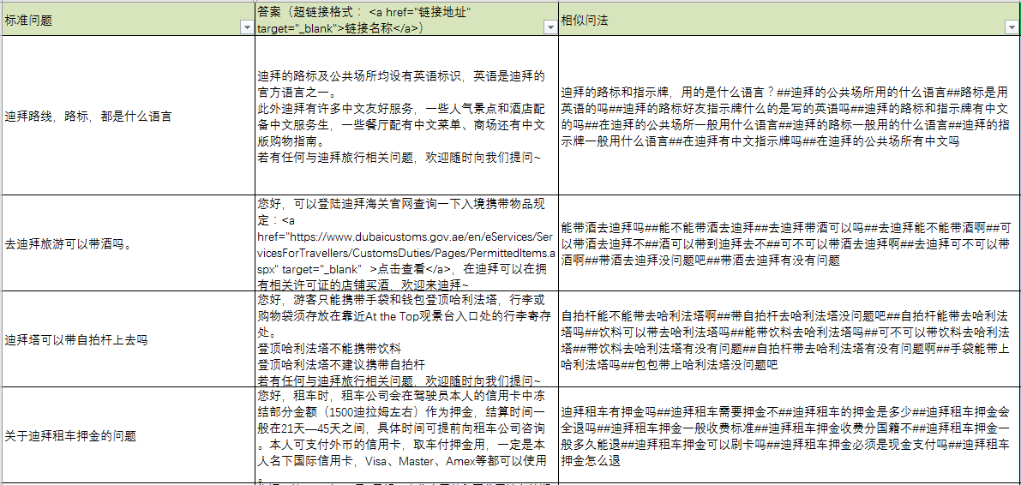
QA pairs
query
value
key

Slide 5
01
FAQ Framework
analysis
Retrieval
分词
数字规整
NER
字面召回
检索引擎
向量召回
交互矩阵
孪生网络
人工干预
业务词典
拒识规则
query
纠错
改写
指代消解
意图
向量化
…
context
Rank
Match
linear
semantic
lexical
KB
answer
DSSM
Tf-idf
BM25
xgboost
ESIM
编辑距离
cosine
rule

Slide 6
DSTC Brief
Dialog State Tracking Challenge
Dialog System Technology Challenge
 | DSTC1~5 | DSTC6 | DSTC7 | DSTC8
DST | Dialog State Tracking |  | Video Scene-Aware Dialog Track | Audio Visual Scene-Aware Dialog Track
End-to-end Task-oriented |  | End-to-End Goal-Oriented Dialog Track |  | Multi-Domain Task-Completion Dialog Challenge
Text Generation |  | End-to-End Conversation Modeling | End-to-End Conversation Modeling: Moving beyond Chitchat (WeChat)
Text Match (FAQ/ Selection) |  |  | NOESIS: Noetic End-to-End Response Selection Challenge | NOESIS II: Predicting Responses, Identifying Success, and Managing Complexity in Task-Oriented Dialogue
other |  | dialogue breakdown detection track |  | Scalable Schema-Guided Dialogue State Tracking

Slide 7

Task oriented
Spoken Language Understanding
(SLU)
Dialogue State
Tracking
(DST)
Dialogue Policy
Learning
(DPL)
Natural Language
Generation
(NLG)

Slide 8
ThankU
Thank U

