Slide 1
Chapter 10
And, Finally...
The Stack

Slide 2
Stack: An Abstract Data Type
An important abstraction that you will encounter
in many applications.
We will describe three uses:
Interrupt-Driven I/O
  The rest of the story…
Evaluating arithmetic expressions
  Store intermediate results on stack instead of in registers
Data type conversion
  2’s comp binary to ASCII strings

Slide 3
Stacks
A LIFO (last-in first-out) storage structure.
  The first thing you put in is the last thing you take out.
  The last thing you put in is the first thing you take out.
This means of access is what defines a stack,
not the specific implementation.
Two main operations:
PUSH: add an item to the stack
POP: remove an item from the stack

Slide 4
A Physical Stack
Coin rest in the arm of an automobile
First quarter out is the last quarter in.
1995
1996
1998
1998
1982
1982
1995
1995
Initial State
After
One Push
After Three
More Pushes
After
One Pop

Slide 5
A Hardware Implementation
Data items move between registers
Empty:
Yes
Empty:
No
Empty:
No
Empty:
No
/ / / / / /
TOP
#18
TOP
#12
TOP
#31
TOP
/ / / / / /
/ / / / / /
#5
#18
/ / / / / /
/ / / / / /
#31
/ / / / / /
/ / / / / /
/ / / / / /
#18
/ / / / / /
/ / / / / /
/ / / / / /
/ / / / / /
/ / / / / /
Initial State
After
One Push
After Three
More Pushes
After
Two Pops

Slide 6
A Software Implementation
Data items don't move in memory,
just our idea about there the TOP of the stack is.
/ / / / / /
/ / / / / /
#12
TOP
#12
/ / / / / /
/ / / / / /
#5
#5
/ / / / / /
/ / / / / /
#31
#31
TOP
/ / / / / /
#18
TOP
#18
#18
/ / / / / /
TOP
/ / / / / /
/ / / / / /
/ / / / / /
x4000
R6
x3FFF
R6
x3FFC
R6
x3FFE
R6
Initial State
After
One Push
After Three
More Pushes
After
Two Pops
By convention, R6 holds the Top of Stack (TOS) pointer.

Slide 7
Basic Push and Pop Code
For our implementation, stack grows downward
(when item added, TOS moves closer to 0)
Push
ADD R6, R6, #-1 ; decrement stack ptr
STR R0, R6, #0 ; store data (R0)
Pop
LDR R0, R6, #0 ; load data from TOS
ADD R6, R6, #1 ; decrement stack ptr

Slide 8
Pop with Underflow Detection
If we try to pop too many items off the stack,
an underflow condition occurs.
  Check for underflow by checking TOS before removing data.
  Return status code in R5 (0 for success, 1 for underflow)
POP LD R1, EMPTY ; EMPTY = -x4000
ADD R2, R6, R1 ; Compare stack pointer
BRz FAIL ; with x3FFF
LDR R0, R6, #0
ADD R6, R6, #1
AND R5, R5, #0 ; SUCCESS: R5 = 0
RET
FAIL AND R5, R5, #0 ; FAIL: R5 = 1
ADD R5, R5, #1
RET
EMPTY .FILL xC000

Slide 9
Push with Overflow Detection
If we try to push too many items onto the stack,
an overflow condition occurs.
  Check for underflow by checking TOS before adding data.
  Return status code in R5 (0 for success, 1 for overflow)
PUSH LD R1, MAX ; MAX = -x3FFB
ADD R2, R6, R1 ; Compare stack pointer
BRz FAIL ; with x3FFF
ADD R6, R6, #-1
STR R0, R6, #0
AND R5, R5, #0 ; SUCCESS: R5 = 0
RET
FAIL AND R5, R5, #0 ; FAIL: R5 = 1
ADD R5, R5, #1
RET
MAX .FILL xC005

Slide 10
Interrupt-Driven I/O (Part 2)
Interrupts were introduced in Chapter 8.
  External device signals need to be serviced.
  Processor saves state and starts service routine.
  When finished, processor restores state and resumes program.
Chapter 8 didn’t explain how (2) and (3) occur,
because it involves a stack.
Now, we’re ready…
Interrupt is an unscripted subroutine call,
triggered by an external event.

Slide 11
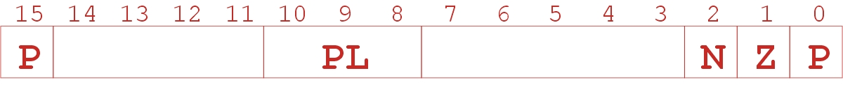
Processor State
What state is needed to completely capture the
state of a running process?
Processor Status Register
  Privilege [15], Priority Level [10:8], Condition Codes [2:0]
Program Counter
  Pointer to next instruction to be executed.
Registers
  All temporary state of the process that’s not stored in memory.

Slide 12
Where to Save Processor State?
Can’t use registers.
  Programmer doesn’t know when interrupt might occur,
  so she can’t prepare by saving critical registers.
  When resuming, need to restore state exactly as it was.
Memory allocated by service routine?
  Must save state before invoking routine,
  so we wouldn’t know where.
  Also, interrupts may be nested –
  that is, an interrupt service routine might also get interrupted!
Use a stack!
  Location of stack “hard-wired”.
  Push state to save, pop to restore.

Slide 13
Supervisor Stack
A special region of memory used as the stack
for interrupt service routines.
  Initial Supervisor Stack Pointer (SSP) stored in Saved.SSP.
  Another register for storing User Stack Pointer (USP):
  Saved.USP.
Want to use R6 as stack pointer.
  So that our PUSH/POP routines still work.
When switching from User mode to Supervisor mode
(as result of interrupt), save R6 to Saved.USP.

Slide 14
Invoking the Service Routine – The Details
If Priv = 1 (user),
Saved.USP = R6, then R6 = Saved.SSP.
Push PSR and PC to Supervisor Stack.
Set PSR[15] = 0 (supervisor mode).
Set PSR[10:8] = priority of interrupt being serviced.
Set PSR[2:0] = 0.
Set MAR = x01vv, where vv = 8-bit interrupt vector
provided by interrupting device (e.g., keyboard = x80).
Load memory location (M[x01vv]) into MDR.
Set PC = MDR; now first instruction of ISR will be fetched.
Note: This all happens between
the STORE RESULT of the last user instruction and
the FETCH of the first ISR instruction.

Slide 15
Returning from Interrupt
Special instruction – RTI – that restores state.
Pop PC from supervisor stack. (PC = M[R6]; R6 = R6 + 1)
Pop PSR from supervisor stack. (PSR = M[R6]; R6 = R6 + 1)
If PSR[15] = 1, R6 = Saved.USP.
(If going back to user mode, need to restore User Stack Pointer.)
RTI is a privileged instruction.
  Can only be executed in Supervisor Mode.
  If executed in User Mode, causes an exception.
  (More about that later.)

Slide 16
Example (1)
Program A
Saved.SSP
/ / / / / /
/ / / / / /
x3006
ADD
/ / / / / /
/ / / / / /
/ / / / / /
PC
x3006
Executing ADD at location x3006 when Device B interrupts.

Slide 17
Example (2)
Program A
ISR for
Device B
x6200
/ / / / / /
/ / / / / /
x3006
ADD
R6
x3007
PSR for A
x6210
RTI
/ / / / / /
PC
x6200
Saved.USP = R6. R6 = Saved.SSP.
Push PSR and PC onto stack, then transfer to
Device B service routine (at x6200).

Slide 18
Example (3)
Program A
ISR for
Device B
x6200
/ / / / / /
/ / / / / /
x6202
AND
x3006
ADD
R6
x3007
PSR for A
x6210
RTI
/ / / / / /
PC
x6203
Executing AND at x6202 when Device C interrupts.

Slide 19
Example (4)
Program A
ISR for
Device B
x6200
R6
x6203
PSR for B
x6202
AND
x3006
ADD
x3007
ISR for
Device C
PSR for A
x6210
RTI
x6300
/ / / / / /
PC
x6300
x6315
RTI
Push PSR and PC onto stack, then transfer to
Device C service routine (at x6300).

Slide 20
Example (5)
Program A
ISR for
Device B
x6200
x6203
PSR for B
x6202
AND
x3006
ADD
R6
x3007
ISR for
Device C
PSR for A
x6210
RTI
x6300
/ / / / / /
PC
x6203
x6315
RTI
Execute RTI at x6315; pop PC and PSR from stack.

Slide 21
Example (6)
Program A
ISR for
Device B
Saved.SSP
x6200
x6203
PSR for B
x6202
AND
x3006
ADD
x3007
ISR for
Device C
PSR for A
x6210
RTI
x6300
/ / / / / /
PC
x3007
x6315
RTI
Execute RTI at x6210; pop PSR and PC from stack.
Restore R6. Continue Program A as if nothing happened.

Slide 22
Exception: Internal Interrupt
When something unexpected happens
inside the processor, it may cause an exception.
Examples:
  Privileged operation (e.g., RTI in user mode)
  Executing an illegal opcode
  Divide by zero
  Accessing an illegal address (e.g., protected system memory)
Handled just like an interrupt
  Vector is determined internally by type of exception
  Priority is the same as running program

Slide 23
Arithmetic Using a Stack
Instead of registers, some ISA's use a stack for
source and destination operations: a zero-address machine.
  Example:
  ADD instruction pops two numbers from the stack,
  adds them, and pushes the result to the stack.
Evaluating (A+B)·(C+D) using a stack:
(1) push A
(2) push B
(3) ADD
(4) push C
(5) push D
(6) ADD
(7) MULTIPLY
(8) pop result
Why use a stack?
  Limited registers.
  Convenient calling convention for subroutines.
  Algorithm naturally expressed using FIFO data structure.

Slide 24
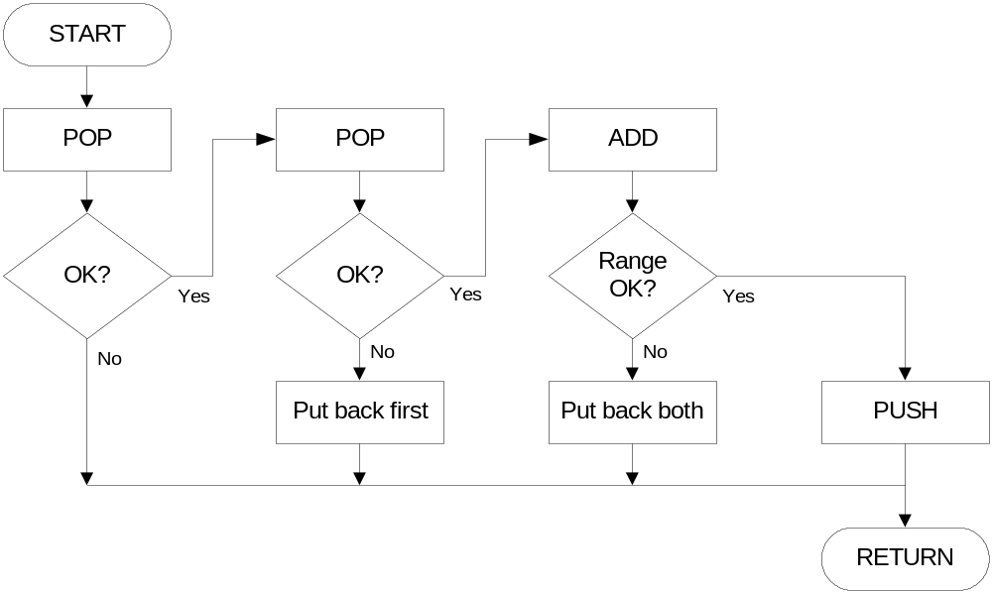
Example: OpAdd
POP two values, ADD, then PUSH result.

Slide 25
Example: OpAdd
OpAdd JSR POP ; Get first operand.
ADD R5,R5,#0 ; Check for POP success.
BRp Exit ; If error, bail.
ADD R1,R0,#0 ; Make room for second.
JSR POP ; Get second operand.
ADD R5,R5,#0 ; Check for POP success.
BRp Restore1 ; If err, restore & bail.
ADD R0,R0,R1 ; Compute sum.
JSR RangeCheck ; Check size.
BRp Restore2 ; If err, restore & bail.
JSR PUSH ; Push sum onto stack.
RET
Restore2 ADD R6,R6,#-1 ; Decr stack ptr (undo POP)
Restore1 ADD R6,R6,#-1 ; Decr stack ptr
Exit RET

Slide 26
Data Type Conversion
Keyboard input routines read ASCII characters,
not binary values.
Similarly, output routines write ASCII.
Consider this program:
TRAP x23 ; input from keybd
ADD R1, R0, #0 ; move to R1
TRAP x23 ; input from keybd
ADD R0, R1, R0 ; add two inputs
TRAP x21 ; display result
TRAP x25 ; HALT
User inputs 2 and 3 -- what happens?
Result displayed: e
Why? ASCII '2' (x32) + ASCII '3' (x33) = ASCII 'e' (x65)

Slide 27
ASCII to Binary
Useful to deal with mult-digit decimal numbers
Assume we've read three ASCII digits (e.g., "259")
into a memory buffer.
How do we convert this to a number
we can use?
  Convert first character to digit (subtract x30)
  and multiply by 100.
  Convert second character to digit and
  multiply by 10.
  Convert third character to digit.
  Add the three digits together.
x32
'2'
x35
'5'
x39
'9'

Slide 28
Multiplication via a Lookup Table
How can we multiply a number by 100?
  One approach:
  Add number to itself 100 times.
  Another approach:
  Add 100 to itself <number> times. (Better if number < 100.)
Since we have a small range of numbers (0-9),
use number as an index into a lookup table.
Entry 0: 0 x 100 = 0
Entry 1: 1 x 100 = 100
Entry 2: 2 x 100 = 200
Entry 3: 3 x 100 = 300
etc.

Slide 29
Code for Lookup Table
; multiply R0 by 100, using lookup table
;
LEA R1, Lookup100 ; R1 = table base
ADD R1, R1, R0 ; add index (R0)
LDR R0, R1, #0 ; load from M[R1]
...
Lookup100 .FILL 0 ; entry 0
.FILL 100 ; entry 1
.FILL 200 ; entry 2
.FILL 300 ; entry 3
.FILL 400 ; entry 4
.FILL 500 ; entry 5
.FILL 600 ; entry 6
.FILL 700 ; entry 7
.FILL 800 ; entry 8
.FILL 900 ; entry 9

Slide 30
Complete Conversion Routine (1 of 3)
; Three-digit buffer at ASCIIBUF.
; R1 tells how many digits to convert.
; Put resulting decimal number in R0.
ASCIItoBinary AND R0, R0, #0 ; clear result
ADD R1, R1, #0 ; test # digits
BRz DoneAtoB ; done if no digits
;
LD R3, NegZero ; R3 = -x30
LEA R2, ASCIIBUF
ADD R2, R2, R1
ADD R2, R2, #-1 ; points to ones digit
;
LDR R4, R2, #0 ; load digit
ADD R4, R4, R3 ; convert to number
ADD R0, R0, R4 ; add ones contrib

Slide 31
Conversion Routine (2 of 3)
ADD R1, R1, #-1 ; one less digit
BRz DoneAtoB ; done if zero
ADD R2, R2, #-1 ; points to tens digit
;
LDR R4, R2, #0 ; load digit
ADD R4, R4, R3 ; convert to number
LEA R5, Lookup10 ; multiply by 10
ADD R5, R5, R4
LDR R4, R5, #0
ADD R0, R0, R4 ; adds tens contrib
;
ADD R1, R1, #-1 ; one less digit
BRz DoneAtoB ; done if zero
ADD R2, R2, #-1 ; points to hundreds
; digit

Slide 32
Conversion Routine (3 of 3)
LDR R4, R2, #0 ; load digit
ADD R4, R4, R3 ; convert to number
LEA R5, Lookup100 ; multiply by 100
ADD R5, R5, R4
LDR R4, R5, #0
ADD R0, R0, R4 ; adds 100's contrib
;
DoneAtoB RET
NegZero .FILL xFFD0 ; -x30
ASCIIBUF .BLKW 4
Lookup10 .FILL 0
.FILL 10
.FILL 20
...
Lookup100 .FILL 0
.FILL 100
...

Slide 33
Binary to ASCII Conversion
Converting a 2's complement binary value to
a three-digit decimal number
  Resulting characters can be output using OUT
Instead of multiplying, we need to divide by 100
to get hundreds digit.
  Why wouldn't we use a lookup table for this problem?
  Subtract 100 repeatedly from number to divide.
First, check whether number is negative.
  Write sign character (+ or -) to buffer and make positive.

Slide 34
Binary to ASCII Conversion Code (part 1 of 3)
; R0 is between -999 and +999.
; Put sign character in ASCIIBUF, followed by three
; ASCII digit characters.
BinaryToASCII LEA R1, ASCIIBUF ; pt to result string
ADD R0, R0, #0 ; test sign of value
BRn NegSign
LD R2, ASCIIplus ; store '+'
STR R2, R1, #0
BRnzp Begin100
NegSign LD R2, ASCIIneg ; store '-'
STR R2, R1, #0
NOT R0, R0 ; convert value to pos
ADD R0, R0, #1

Slide 35
Conversion (2 of 3)
Begin100 LD R2, ASCIIoffset
LD R3, Neg100
Loop100 ADD R0, R0, R3
BRn End100
ADD R2, R2, #1 ; add one to digit
BRnzp Loop100
End100 STR R2, R1, #1 ; store ASCII 100's digit
LD R3, Pos100
ADD R0, R0, R3 ; restore last subtract
;
LD R2, ASCIIoffset
LD R3, Neg10
Loop100 ADD R0, R0, R3
BRn End10
ADD R2, R2, #1 ; add one to digit
BRnzp Loop10

Slide 36
Conversion Code (3 of 3)
End10 STR R2, R1, #2 ; store ASCII 10's digit
ADD R0, R0, #10 ; restore last subtract
;
LD R2, ASCIIoffset
ADD R2, R2, R0 ; convert one's digit
STR R2, R1, #3 ; store one's digit
RET
;
ASCIIplus .FILL x2B ; plus sign
ASCIIneg .FILL x2D ; neg sign
ASCIIoffset .FILL x30 ; zero
Neg100 .FILL xFF9C ; -100
Pos100 .FILL #100
Neg10 .FILL xFFF6 ; -10

