Slide 1
AVL Trees, Splay Trees,
and Amortized Analysis

Slide 2
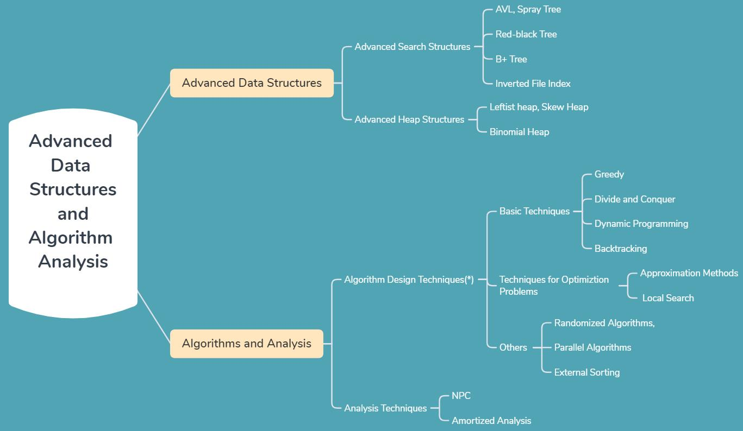

Slide 3



AVL Trees, Splay Trees, and Amortized Analysis
AVL Trees
Target : Speed up searching (with insertion and deletion)
Tool : Binary search trees
root
small
large
Problem : Although T_{p} = O( height ), but the height can be as bad as O( N ).

Slide 4
AVL Trees, Splay Trees, and Amortized Analysis
〖Example〗 2 binary search trees obtained for the months of the year
Jan
Average search time = 3.5
Feb
Mar
Apr
June
May
Average search time of the skew tree = 6.5
Aug
July
Sept
Dec
Oct
Entered from Jan to Dec
Nov
July
Average search time = 3.1
Feb
May
Aug
Jan
Mar
Oct
Apr
Dec
June
Nov
Sept
A balanced tree

Slide 5


AVL Trees, Splay Trees, and Amortized Analysis
Adelson-Velskii-Landis (AVL) Trees (1962)
【Definition】An empty binary tree is height balanced. If T is a nonempty binary tree with T_{L} and T_{R} as its left and right subtrees, then T is height balanced iff
(1) T_{L} and T_{R} are height balanced, and
(2) | h_{L} − h_{R} | ≤ 1 where h_{L} and h_{R} are the heights of T_{L} and T_{R} , respectively.
The height of an empty tree
is defined to be –1.
【Definition】The balance factor BF( node ) = h_{L} − h_{R} . In an AVL tree, BF( node ) = −1, 0, or 1.
4
5
7
3
5
2
8
2
8
2
6
1
4
7
1
4
1
7
3
3
5

Slide 6
AVL Trees, Splay Trees, and Amortized Analysis
〖Example〗 Input the months
Mar
May
Nov
0
−1
−2
Mar
0
−1
−2
−1
0
0
Single rotation
May
−1
May
0
0
0
0
0
Mar
Nov
Nov
 The trouble maker Nov is in the right subtree’s right subtree of the trouble finder Mar. Hence it is called an RR rotation.
A is not necessarily
the root of the tree
In general:
−2
0
−1
RR
B
A
A
−1
RR
0
0
Insertion
A
B
A_{L}
B
B_{R}
A_{L}
Rotation
B_{L}
B_{R}
A_{L}
B_{L}
B_{L}
B_{R}

Slide 7

AVL Trees, Splay Trees, and Amortized Analysis
Aug
Apr
2
0
−1
−2
−1
1
LL
−1
−2
0
−1
1
May
May
2
Rotation
0
1
0
0
−1
0
1
0
0
0
Mar
Nov
Aug
Nov
1
0
0
0
Aug
Apr
Mar
0
Apr
Discussion 1: What can we do now?
In general:
1
2
A
LL
A
0
LL
B
0
1
B
Insertion
B
0
A_{R}
A_{R}
Rotation
A
B_{L}
B_{L}
B_{R}
B_{L}
B_{R}
B_{R}
A_{R}

Slide 8
AVL Trees, Splay Trees, and Amortized Analysis
Jan
2
Double Rotation
−1
−2
0
−1
1
0
−1
−2
−1
May
0
−1
Mar
−1
0
1
0
0
0
0
0
−1
0
Aug
Nov
1
−1
1
Aug
May
0
0
Apr
Mar
0
0
0
Apr
Jan
Nov
0
LR
Jan
Rotation
In general:
1
LR
2
LR
A
A
0
0
Insertion
−1
Rotation
C
B
A_{R}
B
0
±1
A_{R}
0 or 1
−1 or 0
C
C
B
A
B_{L}
B_{L}
C_{L}
C_{R}
C_{L}
C_{R}
B_{L}
C_{L}
C_{R}
A_{R}
OR
OR

Slide 9
Dec
July
Feb
AVL Trees, Splay Trees, and Amortized Analysis
−1
−2
0
−1
1
2
Mar
0
−1
−2
−1
RL
1
1
Mar
0
0
−1
−1
−2
Aug
May
Rotation
0
−1
−1
0
0
−1
−2
0
0
Dec
May
1
0
Apr
Jan
0
1
0
1
−1
Nov
0
0
0
Aug
Jan
Nov
−1
0
Dec
July
0
0
0
Apr
Feb
July
0
Feb
In general:
1
RL
−2
RL
A
A
0
0
Insertion
1
Rotation
C
A_{L}
B
B
0
A_{L}
±1
0 or 1
−1 or 0
C
C
A
B
B_{R}
B_{R}
C_{L}
C_{R}
C_{L}
C_{R}
A_{L}
C_{L}
C_{R}
B_{R}
OR
OR

Slide 10
AVL Trees, Splay Trees, and Amortized Analysis
June
Oct
Sept
0
−1
0
−1
−2
−1
1
2
0
−1
Jan
Mar
−1
Jan
−1
1
0
−1
−2
0
0
−1
−1
0
0
−1
−2
−1
−1
−1
1
0
−1
−2
0
Dec
Mar
Dec
Dec
May
Mar
0
1
0
1
−1
0
1
0
−1
−2
−1
−1
1
0
−1
0
Aug
Jan
0
Aug
Feb
July
−1
May
Aug
Feb
July
Nov
0
0
Nov
0
0
−1
−1
Feb
0
0
0
July
−1
Apr
0
0
0
Apr
June
Nov
Apr
June
May
Oct
0
0
June
0
Note: Several bf’s
might be changed even if
we don’t need to reconstruct
the tree.
Oct
Sept
Another option is to keep a height field for each node.
Read the declaration and functions in [1] Figures 4.42 – 4.48

Slide 11




AVL Trees, Splay Trees, and Amortized Analysis
Let n_{h} be the minimum number of nodes in a height balanced tree of height h. Then the tree must look like
A
A
h−2
One last question:
Obviously we have T_{p} = O( h )
where h is the height of the tree.
But h = ?
h−1
h−1
h−2
OR
⇒ n_{h} = n_{h−1} + n_{h−2} + 1
Fibonacci numbers:
F₀ = 0, F₁ = 1, F_{i} = F_{i−1} + F_{i−2} for i > 1
⇒ n_{h} = F_{h+2} − 1, for h ≥ 0
Fibonacci number theory gives that

Slide 12
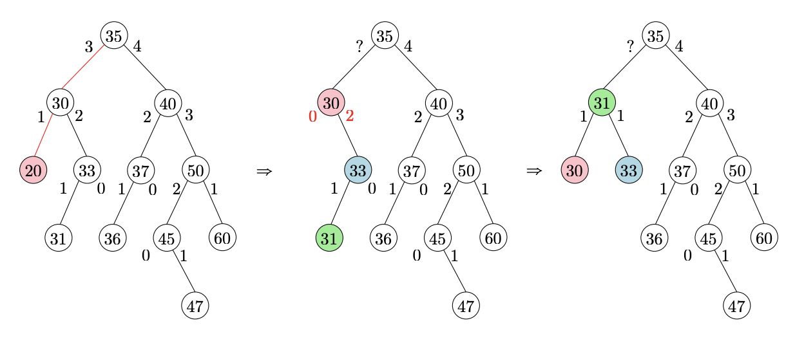
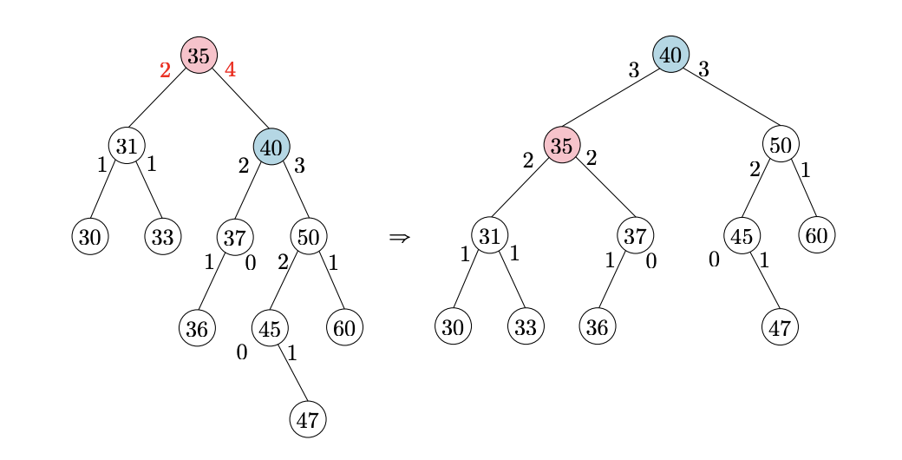
AVL-delete
BST Deletion
Rebalancing
Might more than 1 rotation

Slide 13


AVL Trees, Splay Trees, and Amortized Analysis
Splay Trees
Target : Any M consecutive tree operations starting from an empty tree take at most O(M log N) time.
But if one node takes O(N) time
to access, we can keep accessing it
for M times, can’t we?
Does it mean that every
operation takes O(log N) time?
Sure we can – that only means
that whenever a node is accessed,
it must be moved.
So a single operation might
still take O(N) time?
Then what’s the point?
The bound is weaker.
But the effect is the same:
There are no bad input sequences.
No. It means that the
amortized time is O(log N).
Idea : After a node is accessed, it is pushed to the root by a series of AVL tree rotations.

Slide 14
AVL Trees, Splay Trees, and Amortized Analysis
k₅
k₁
k₅
k₅
k₅
k₄
F
k₂
k₄
k₅
k₄
F
F
F
k₃
k₁
E
A
B
k₃
k₄
F
E
k₁
E
k₂
k₂
D
k₄
k₁
k₃
D
E
k₂
k₃
A
k₁
A
B
k₃
E
k₂
C
C
D
A
B
C
D
B
C
C
D
A
B
Does NOT work!

Slide 15
An even worse case:
AVL Trees, Splay Trees, and Amortized Analysis
Insert: 1, 2, 3, … N
3
N
Find: 1
1
1
2
2
N
1
2
3
1
3
2
3
1
2
Find: 2
2
…… Find: N
N
1
N
3
2
T (N) =
O ( N² )
3
1

Slide 16
AVL Trees, Splay Trees, and Amortized Analysis
Try again -- For any nonroot node X , denote its parent by P and grandparent by G :
Case 1: P is the root
Rotate X and P
Case 2: P is not the root
Zig-zag
G
X
Double rotation
P
D
P
G
A
X
A
B
C
D
B
C
Zig-zig
G
X
P
D
A
P
X
C
2 Single rotations
B
G
A
B
C
D

Slide 17
AVL Trees, Splay Trees, and Amortized Analysis
Splaying not only moves the accessed node to the root, but also roughly halves the depth of most nodes on the path.
k₅
k₅
k₄
k₄
F
F
k₃
k₁
k₁
E
E
k₂
k₂
k₂
D
k₃
k₄
A
k₁
A
B
C
A
B
k₃
D
k₅
B
C
C
D
E
F

Slide 18
AVL Trees, Splay Trees, and Amortized Analysis
Insert: 1, 2, 3, 4, 5, 6, 7
Find: 1
7
7
7
1
6
6
6
6
5
5
1
4
7
4
4
4
2
5
3
1
2
5
3
2
2
3
1
3
Read the 32-node example given in Figures 4.52 – 4.60

Slide 19
AVL Trees, Splay Trees, and Amortized Analysis
Deletions:
X will be at the root.
☞ Step 1: Find X ;
There will be two subtrees T_{L} and T_{R} .
☞ Step 2: Remove X ;
The largest element will be the root of T_{L} , and has no right child.
☞ Step 3: FindMax ( T_{L} ) ;
☞ Step 4: Make T_{R} the right child of the root of T_{L} .
Are splay trees really better
than AVL trees?

Slide 20
AVL Trees, Splay Trees, and Amortized Analysis
Amortized Analysis
Target : Any M consecutive operations take at most O(M log N) time.
-- Amortized time bound
worst-case bound amortized bound average-case bound
☞ Aggregate analysis
☞ Accounting method
☞ Potential method

Slide 21
AVL Trees, Splay Trees, and Amortized Analysis
☞ Aggregate analysis
Idea : Show that for all n, a sequence of n operations takes worst-case time T(n) in total. In the worst case, the average cost, or amortized cost, per operation is therefore T(n)/n.
We can pop each object
from the stack at most once for each
time we have pushed it
onto the stack
Total = O( n² ) ?
〖Example〗 Stack with MultiPop( int k, Stack S )
Algorithm {
while ( !IsEmpty(S) && k>0 ) {
Pop(S);
k - -;
} /* end while-loop */
}
Consider a sequence of n Push, Pop, and MultiPop operations on an initially
empty stack.
sizeof(S) ≤ n
T = min ( sizeof(S), k )
T_{amortized}= O( n )/n = O(1)

Slide 22




AVL Trees, Splay Trees, and Amortized Analysis
☞ Accounting method
Idea : When an operation’s amortized cost
exceeds its actual cost , we assign the
difference to specific objects in the data
structure as credit. Credit can help pay
for later operations whose amortized
cost is less than their actual cost.
Savings
Account
Note: For all sequences of n operations, we must have
T_{amortized} =
n

Slide 23



AVL Trees, Splay Trees, and Amortized Analysis
〖Example〗 Stack with MultiPop( int k, Stack S )
for Push: ; Pop: ; and MultiPop:
1
1
min ( sizeof(S), k )
for Push: ; Pop: ; and MultiPop:
2
0
0
Starting from an empty stack —— Credits for
The amortized
costs of the operations
may differ from
each other
Push: ; Pop: ; and MultiPop:
+1
–1
–1 for each +1
sizeof(S) ≥ 0 Credits ≥ 0
T_{amortized}= O( n )/n = O(1)

Slide 24



AVL Trees, Splay Trees, and Amortized Analysis
☞ Potential method
Idea : Take a closer look at the credit --
Potential function
≥ 0
In general, a good potential function should always assume its minimum at the start of the sequence.

Slide 25





AVL Trees, Splay Trees, and Amortized Analysis
〖Example〗 Stack with MultiPop( int k, Stack S )
D_{i} =
Φ( D_{i} ) =
the stack that results after the i-th operation
the number of objects in the stack D_{i}
Push:
Pop:
MultiPop:
T_{amortized}= O( n )/n = O(1)

Slide 26

AVL Trees, Splay Trees, and Amortized Analysis
〖Example〗 Splay Trees: T_{amortized} = O( log N )
D_{i} =
Φ( D_{i} ) =
the root of the resulting tree
must increase by at most O( log N ) over n steps, AND will also cancel out the number of rotations (zig:1; zig-zag:2; zig-zig:2).
where S(i) is the number of descendants of i (i included).
Rank of the subtree
≈ Height of the tree
Why not simply use the heights
of the trees?

Slide 27





AVL Trees, Splay Trees, and Amortized Analysis
Zig
X
P
Single rotation
X
C
A
P
A
B
B
C
Zig-zag
G
X
Double rotation
P
D
P
G
A
X
A
B
C
D
B
C
Lemma 11.4 on [1] p.448
Zig-zig
G
X
P
D
A
P
X
C
2 Single rotations
B
G
A
B
C
D
【Theorem】 The amortized time to splay a tree with root T at node X is at most 3( R( T ) – R ( X ) ) + 1 = O(log N).

Slide 28
Reference:
Data Structure and Algorithm Analysis in C (2nd Edition)：Ch.4，p.106-128； Ch.11，p.447-451；M.A.Weiss著、陈越改编，人民邮件出版社，2005
Introduction to Algorithms, 3rd Edition: Ch.17，p. 451-478； Thomas H. Cormen, Charles E. Leiserson, Ronald L. Rivest and Clifford Stein. The MIT Press. 2009

