Slide 1
S
u S₀
p
f_{u}
S₀
f
1 − p
d S₀
f_{d}
t = 0
T

Slide 2
S
u² S₀
u S₀
p
f_{uu}
f_{u}
p
1 − p
S₀
u d S₀
f
1 − p
p
f_{ud}
d S₀
1 − p
f_{d}
d² S₀
f_{dd}
t = 0
T / 2
T

Slide 3


















Index of
end node
Stock price
at maturity
Probability of this node
0
$$u^{n}{ S}_{0}$$
$$p^{n}$$
$$S$$
1
$$u^{n−1} d{ S}_{0}$$
$$n{ p}^{n−1} \left(1−p\right)$$
$${ S}_{0}$$
. . .
. . .
k
$$u^{n−k} d^{k}{ S}_{0}$$
$$\left(\begin{aligned}n \\ k\end{aligned}\right){ p}^{n−k} {\left(1−p\right)}^{k}$$
. . .
n
$$d^{n}{ S}_{0}$$
$${\left(1−p\right)}^{n}$$
Step number (tree level)
$$0$$
$$1$$
$$2$$
. . .
$$n$$
$$t=0$$
$$\frac{T}{n}$$
$$\frac{2 T}{n}$$
$$T$$

Slide 4

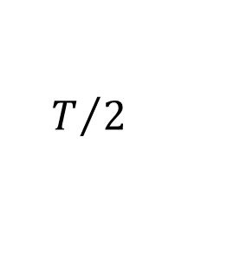




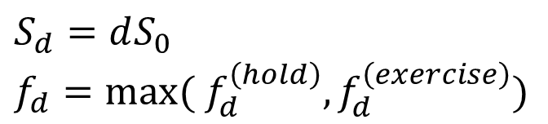






$$S$$
$$S_{ud}=udS_{0}$$
$$f_{ud}=max⁡(0,{K−S}_{ud})$$
$$p$$
$$S_{d}=dS_{0}$$
$$f_{d}=max⁡({ f}_{d}^{\left(hold\right)},f_{d}^{\left(exercise\right)})$$
$$1−p$$
$$S_{dd}=d^{2}S_{0}$$
$$f_{d}^{(hold)}=e^{−{r T}/2} [ pf_{ud}+\left(1−p\right)f_{dd} ]$$
$$f_{dd}=max⁡(0,{K−S}_{dd})$$
$$f_{d}^{(exercise)}=max⁡(0,{K−S}_{d})$$
$$t=0$$
$$T/2$$
$$T$$

