Slide 1
What is Static Testing
Static Testing is a type of software testing in which software application is tested without code execution. （不执行代码）
Static testing is a testing technique that does not involve executing or running the program or software product.（不包括执行或者运行代码）
Instead it involves, checking the software at each phase of Software Development Life Cycle (SDLC) with the requirements or standards mentioned in the Software Requirements Specifications (SRS) of the software product.

Slide 2
What is Static Testing
The main objective of static testing is to improve the quality of software applications by finding errors in early stages of software development process.（在早期开发阶段找到问题）
Manual or automated reviews of code, requirement documents and document design are done in order to find the errors.（人工或自动审查）

Slide 3
Types of Static Testing
Static Testing
Inspection
Walkthrough
Review

Slide 4
Inspection
Inspection:
Inspection process is performed in the earlier stages of the SDLC and is applied to a specific part of product like SRS, code, product design. etc. （在早期进行，只设计某一特定部分）
It involves manually examining the various components of the product at the earlier stages. （对各组成部分进行人工检查）
An important part of the inspection process is the use of a checklist to examine the program for common errors.

Slide 5
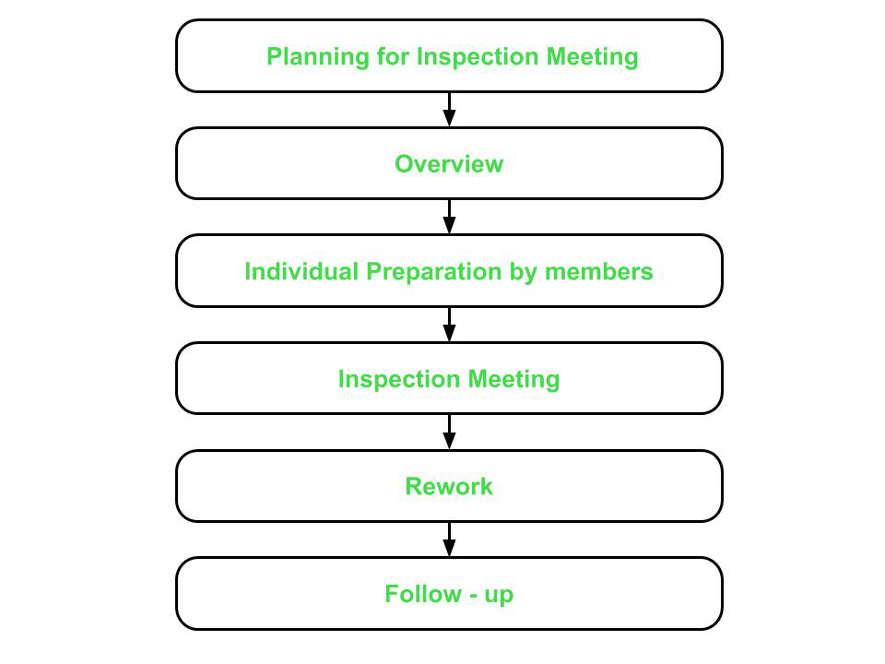
Inspection
Inspection:
The software inspection process may comprise six phases which are as follows :

Slide 6
Inspection
1 Planning for Inspection Meeting
This phase focuses on identifying the product to be inspected and the objective of this inspection.
（确定检查的产品和目标）
A moderator（主持人） – who manages the entire inspection process, is assigned in this phase.
The assigned moderator checks if the product is ready for inspection or not. The moderator also selects the inspection team and assigns them their roles.
Moderator also schedules the inspection meeting and distributes the required material to the inspection team.

Slide 7
Inspection
An inspection team can include:
The moderator:- The moderator leads the inspection process. His role is to determine the type of inspection, approach and the composition of the review team. The moderator also schedules the meeting, disseminates documents before the meeting, coaches other team members, paces the meeting, leads possible discussions and stores the data that is collected.

Slide 8
Inspection
An inspection team can include:
The author:- As the writer of the ‘document under inspection’, the author’s basic goal should be to learn as much as possible with regard to improving the quality of the document. The author’s task is to illuminate unclear areas and to understand the defects found.（阐明不清楚的地方，理解发现的错误）
The scribe/ recorder :– The scribe (or recorder) has to record each defect found and any suggestions or feedback given in the meeting for process improvement.

Slide 9
Inspection
An inspection team can include:
The reviewer（评审）: The role of the reviewers is to check defects and further improvements in accordance to the specifications, standards and domain knowledge.
The manager （经理）:- Manager is involved in the reviews as he or she decides on the execution of inspection, allocates time in project schedules and determines whether review process objectives have been met or not.

Slide 10
Inspection
2 Overview
In this phase, the inspection team is given all the background information for the inspection meeting.
The author – who is the coder or designer responsible for developing the product presents his logic and reasoning for the product including the product’s functions, its intended purpose and the approach or concept used while developing it.
It is made sure that each member of the inspection team has understood and is familiar to the objectives and purpose of the inspection meeting that is to be held.

Slide 11
Inspection
3 Individual Preparation by members
In this phase, the members of the inspection team individually prepare for the inspection meeting by studying the material provided in the earlier phases.
The team members identify the potential errors or bugs in the product and record them in a log.
The log is finally submitted to the moderator.
The moderator then compiles all the logs received from the members and sends a copy of it to the author.

Slide 12
Inspection
4 Inspection Meeting
This phase involves author’s discussion on the issues raised by the team members in the compiled log.
Members arrive at a decision of whether the issue raised is an error or not.
Moderator concludes the meeting and provides a summary of the meeting – which is a list of errors found in the product and are to resolved by the author.

Slide 13
Inspection
5 Rework
Rework is carried out by the author according the summary list presented by the moderator in the previous phase.
The author fixes all the bugs and reports to the moderator.

Slide 14
Inspection
6 Follow – up
Moderator checks if all errors have been resolved or not.
The moderator then prepares a report.
If all errors are fixed and addressed, the moderator releases the document.
Otherwise, unresolved issues are added to the report and another inspection meeting is scheduled.

Slide 15
Types of Static Testing
Static Testing
Inspection
Walkthrough
Review

Slide 16
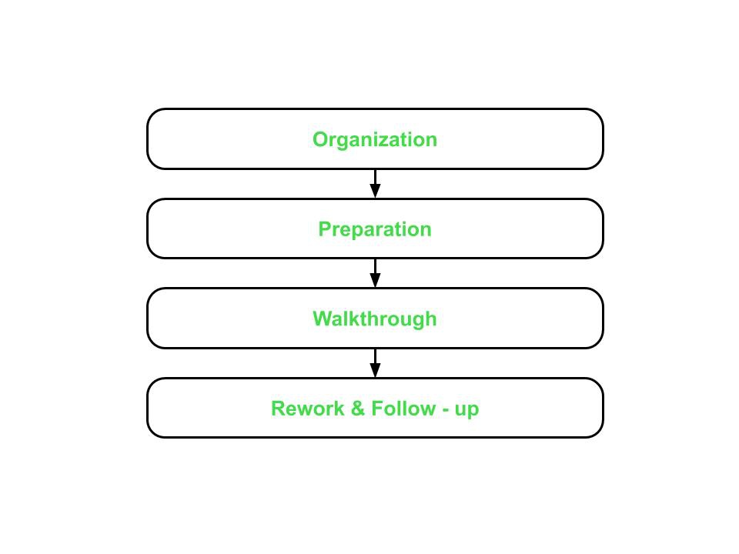
Types of Static Testing
Walk Through:
This type of static testing is less formal and not so rigorous.
It has a simpler process as compared to inspection process. It involves the following four steps :

Slide 17
Walkthrough
1 Organization This step involves assigning roles and responsibilities to the team selected for walkthroughs.
The team can consist of the following members :
Coordinator（协调员） – organizes and coordinates with all the members for the walkthrough related activities.
Presenter （介绍员）– introduces the item to be inspected.
Scriber – notes down all the issues and suggestions put forward by the members.
Tester – finds the defects or bugs in the item to be inspected.
The author.

Slide 18
Walkthrough
1 Organization
Suggestions for the other participants include
(1) a highly experienced programmer,
(2) a programming-language expert,
(3) a new programmer (to give a fresh, unbiased outlook),
(4) the person who will eventually maintain the program,
(5) someone from a different project,
(6) someone from the same programming team as the programmer.

Slide 19
Walkthrough
2 Preparation
In this step, focus lies on preparing for the walkthroughs which could include thinking of basic test cases that would be required to test the product.

Slide 20
Walkthrough
3 Walkthrough
Walkthrough is performed by a tester who comes to the meeting with a small set of test cases.
Test cases are executed by the tester mentally and results are noted down on a paper or a presentation media.

Slide 21
Walkthrough
4 Rework and Follow – up
This step is similar to that of the last two phases of the inspection process.
If no bugs are detected, then the product is approved for release.
Otherwise, errors are resolved and again, a structured walkthrough is conducted.

Slide 22
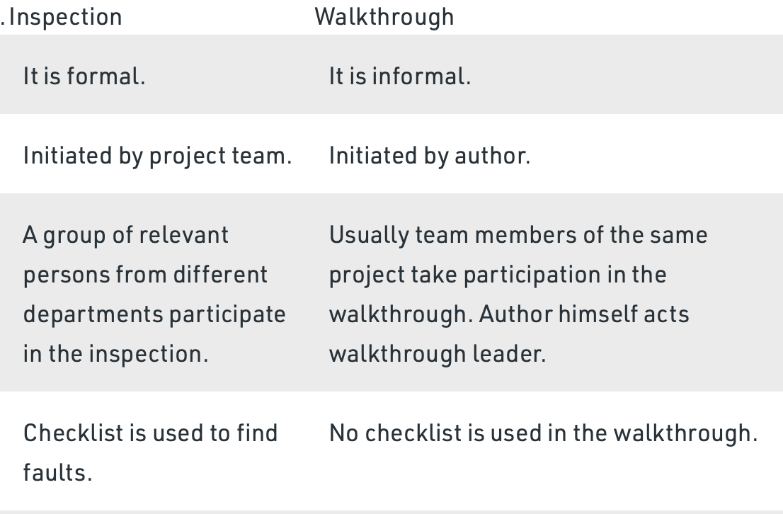
Inspection vs Walkthrough

Slide 23
Types of Static Testing
Static Testing
Inspection
Walkthrough
Review

Slide 24
Review
Review is used to assess and evaluate the product by checking its conformance to the development standards, guidelines and specifications.
It does not have a defined process and most of the work is carried out by the moderator as discussed below :
1 Moderator gathers and distributes the material and documentation to all team members.

Slide 25
Review
2 Moderator also prepares a set of indicators to evaluate the product with respect to the specifications and already established standards and guidelines :
consistency
documentation
adherence to standards
completeness
problem definition and requirements

Slide 26
Review
3 The results are recorded in a document which includes both defects as well as suggestions.
4 Finally, the defects are resolved and the suggestions are taken into account for improving the product.

Slide 27
Common programming mistakes
1、内存泄漏的故障（Memory Leak）
2、数组越界故障（Out of Bounds Array Access）
3．使用未初始化变量故障（Uninitialized Variable）
4．空指针使用故障（NULL Pointer Dereference）
5．非法计算类故障（Illegal Operation）
6．死循环结构(Dead Loop）
7 ．资源泄漏（Resource Leak）
8 ．并发故障 （Concurrency）
9. 安全漏洞故障 (Security vulnerability)
10，疑问代码故障 (Confused code)

Slide 28
1 Memory Leak
The requested memory is not released.（请求的内存没有被释放）
listrec *add_list_entry(listrec *entry,int value){
listrec *new_entry=(listrec *)malloc(sizeof(listrec));
if(!new_entry)
return NULL
Do something 。。。。
return NULL; ;
… …}
The request function and release function do not match
（请求函数和释放函数不匹配）
str=malloc(10) ; … ; delete(str) ; …
str=new(10);... ; free(str);...
malloc matchs free；new matchs delete

Slide 29
The pointer which points to to requested memory has changed（指向请求的内存指针已经改变）
char *p=malloc(10);
++p;
free(p);//no the original address
Repeatly release （反复释放）
char *str=new char[100];
char *p;
str="abc";
p=str;
delete str;
delete p;//release an address twice

Slide 30
1 Memory Leak
In computer science, a memory leak occurs when a computer program incorrectly manages memory allocations in a way that memory which is no longer needed is not released.
A memory leak may also happen when an object is stored in memory but cannot be accessed by the running code.
Because they can exhaust available system memory as an application runs, memory leaks are often the cause of or a contributing factor to software aging.

Slide 31
2 Out of Bounds Array Access （数组越界）
int data[10];
for(i=0; i<=10; i++){data[i]=...};
#define MAXPATTERN 3
#define MAXFILELEN 12
char l_Pat[MAXPATTERN+1][MAXFILELEN+1];
……
memset(l_Pat, 0, 20*(MAXFILELEN+1));

Slide 32
2 Out of Bounds Array Access
Programmer accidentally accesses any index of array which is out of bound, causing Undefined Behavior.
The program can access some piece of memory which is not owned by it, which can cause crashing of program such as segmentation fault.

Slide 33
3 Uninitialized Variable（未初始化变量）
char c;
while( c!=‘\n’ && c=getchar() && c!=EOF) ...;
listrec *new_entry=NULL;
new_entry->value=value;

Slide 34
3 Uninitialized Variable
An uninitialized variable is a variable that is declared but is not set to a definite known value before it is used.
It will have some value, but not a predictable one. As such, it is a programming error and a common source of bugs in software.

Slide 35
4 NULL Pointer Dereference
DirSettingLink *l_Link ;
while(l_Link)
{
g_DirRoot = l_Link->next;
l_Link->next = NULL;
delete l_Link->m_node.m_dirname;
delete l_Link;
l_Link = g_DirRoot;
}

Slide 36
4 NULL Pointer Dereference
A NULL pointer dereference occurs when the application dereferences a pointer that it expects to be valid, but is NULL, typically causing a crash or exit.
Because a null pointer does not point to a meaningful object, an attempt to dereference (ie. access the data stored at that memory location) a null pointer usually (but not always) causes a run-time error or immediate program crash.

Slide 37
5 Illegal Operation（非法操作）
int x=0;
int y=1;
int m= -1;
int z;
z = y/x;
z=log_{x}(Y);
z=sqrt(m);

Slide 38
5 Illegal Operation
An illegal operation is a command a computer cannot execute or does not understand.
（无法执行和理解）
The computer will return an error to the user, alerting her to the fact that it failed to execute a command, and the program a user is running may be terminated by the operating system.

Slide 39
6 Dead Loop
for(i=1; i<=100; j++ )
for(i=1;i++)
for(i=1;i!=100;i=i+2)

Slide 40
Using a single equal sign to check equality
char x='Y';
while(x='Y') {
//...
cout<<"Continue? (Y/N)";
cin>>x;
}
//"Why doesn't my loop ever end?"

Slide 41
6 Dead Loop
An Dead Loop/Infinite Loop/Endless Loop is a sequence of instructions in a computer program which loops endlessly, either due to the loop having no terminating condition, having one that can never be met, or one that causes the loop to start over.

Slide 42
7 Resource Leak
In computer science, a resource leak is a particular type of resource consumption by a computer program where the program does not release resources it has acquired. （程序不释放其获得的资源）
This condition is normally the result of a bug in a program. Typical resource leaks include memory leak and handle leak, particularly file handle leaks, though memory is often considered separately from other resources
QUIZ： How keys of your keyboard can be pressed at the same time?

Slide 43
8 Concurrency（并发）
The uncontrolled execution of concurrent transactions in a multi-user environment can lead to various problems.
This problem occurs when two transactions, accessing the same data items, have their operations interleaved in such a way, that one transaction will access the data before the other has applied any updates.

Slide 44
Solution to synchronization: Lock
Global ACCOUNT
1: Lock ACCOUNT;
2：increasement= 100;
3: count = increasement + ACCOUNT ;
4: ACCOUNT = count ;
5: Release ACCOUNT

Slide 45
Deadlock
Global ACCOUNT1, ACCOUNT2
Lock ACCOUNT1;
ACCOUNT1 = getchar()+ ACCOUNT1;
Lock ACCOUNT2;
ACCOUNT2= ACCOUNT1+ ACCOUNT2;
Release ACCOUNT2;
Release ACCOUNT1;
Global ACCOUNT1, ACCOUNT2
Lock ACCOUNT2;
ACCOUNT2 = getchar()+ ACCOUNT2;
Lock ACCOUNT1;
ACCOUNT1= ACCOUNT2+ ACCOUNT1;
Release ACCOUNT1;
Release ACCOUNT2;

Slide 46
deadlock
In concurrent computing, deadlock is any situation in which no member of some group of entities can proceed because each waits for another member, including itself, to take action, such as sending a message or, more commonly, releasing a lock.
Deadlocks are a common problem in multiprocessing systems, parallel computing, and distributed systems, because in these contexts systems often use software or hardware locks to arbitrate shared resources and implement process synchronization.

Slide 47
9 Security vulnerability（安全漏洞）
A security vulnerability is defined as an unintended characteristic of a computing component or system configuration that multiplies the risk of an adverse event or a loss occurring either due to accidental exposure, deliberate attack, or conflict with new system components.

Slide 48
10 Confused code （混乱的代码）
Some codes are hard to understand.
Such problems may not certainly result in system errors, but may potentially cause errors or lead to low performance.

Slide 49
An unspoken rule
The “666” rule in software programming
The first 6-line codes are usually for check error (fucntion, reference, I/O, loop, memery operation, etc)
60% codes are used for fault tolerance
6 hours per day for checking error
6 lines instead of 1 line

Slide 50
Static Testing
look at the codes/docs and find bugs in the check list

Slide 51
Summary
What is Static Testing?
Static Testing is a type of software testing in which software application is tested without code execution.
Static Testing techniques
Static Testing
Inspection
Walkthrough
Review

Slide 52
Summary
Common programming mistakes
1、内存泄漏的故障（Memory Leak）
2、数组越界故障（Out of Bounds Array Access）
3．使用未初始化变量故障（Uninitialized Variable）
4．空指针使用故障（NULL Pointer Dereference）
5．非法计算类故障（Illegal Operation）
6．死循环结构(Dead Loop)
7．资源泄漏（Resource leak）
8．并发故障 （Concurrency）
9. 安全漏洞故障 (Security vulnerability)
10. 疑问代码故障 (Confused code)

