Slide 1
What is Dynamic Testing
Under Dynamic Testing, a code is executed. （代码被运行）
Dynamic testing checks for functional behavior of software system, memory/cpu usage and overall performance of the system. （查看功能，系统整体性能）
The main objective of this testing is to confirm that the software product works in conformance with the business requirements. （与需求一致）
Dynamic testing executes the software and validates the output with the expected outcome.

Slide 2
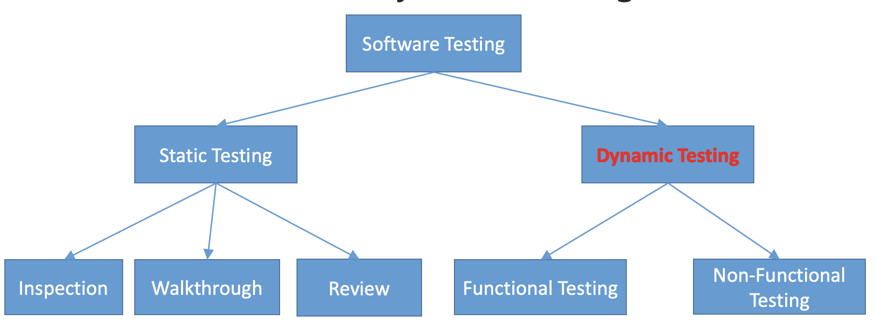
What is Dynamic Testing
To execute the process of dynamic testing, software testers use two different techniques- functional and non-functional testing.

Slide 3
What is Functional Testing
Functional Testing is a type of software testing that validates the software system against the functional requirements/specifications.
The purpose of Functional testing is to test each function of the software application, by providing appropriate input, verifying the output against the Functional requirements.
Functional testing mainly involves black box testing（黑盒测试） and it is not concerned about the source code of the application. This testing checks User Interface, APIs, Database, Security, Client/Server communication and other functionality of the Application Under Test.

Slide 4
Dynamic Testing
Functional Testing
Non-Functional Testing
Unit Testing
Integration Testing
System Testing
Acceptance Testing

Slide 5
What is Non-Functional Testing
Non-Functional Testing is defined as a type of Software testing to check non-functional aspects (performance, usability, reliability, etc.) of a software application.（性能、可用性、可靠性）
The focus of this testing technique is to test the non-functional attribute of the software, such as robustness of the software system, memory leaks, performance, and more.
An example of non-functional test would be to check how many people can simultaneously login into a software.
Non-functional testing is equally important as functional testing and affects client satisfaction.

Slide 6
Dynamic Testing
Functional Testing
Non-Functional Testing
Performance Testing
Recovery Testing
Security Testing
Usability Testing
Compatibility Testing

Slide 7
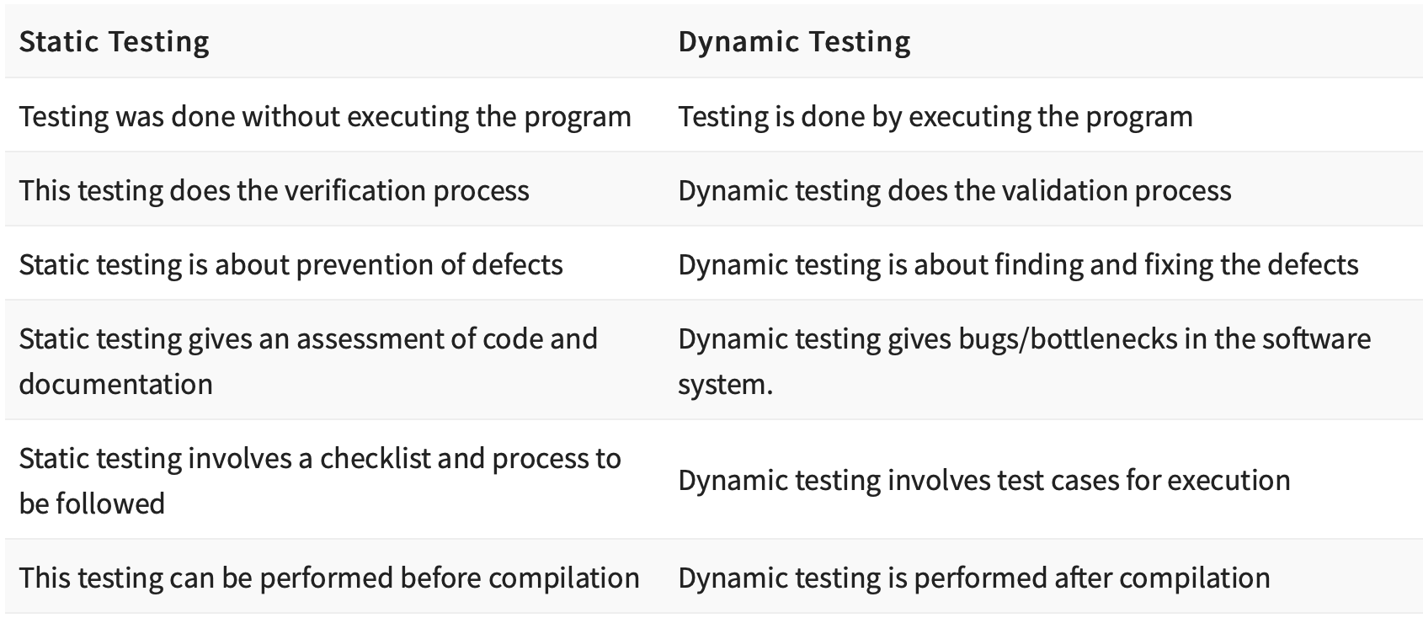

Slide 8
What we will cover today
Function Testing
Unit Testing（单元）
Integration Testing（集成）
System Testing（系统）
Acceptance Testing（验收）

Slide 9
What we will cover today
Non-Function Testing
Performance testing（性能）
Recovery testing（恢复）
Security testing（安全）
Usability testing（可用性）
Compatibility testing（兼容性）

Slide 10
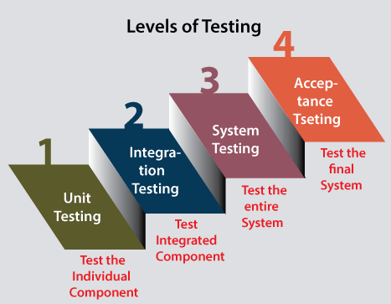
Software Testing Levels
From software development process perspective:
Software Test Levels are the different stages of the software development life cycle where testing is conducted.
There are four main levels of testing that need to be completed before a program can be cleared for use: unit testing, integration testing, system testing, and acceptance testing.

Slide 11
Unit Testing
Unit Testing
The most basic type of testing is unit, or component, testing.
Unit testing aims to verify each part of the software by isolating it and then perform tests to demonstrate that each individual component is correct in terms of fulfilling requirements and the desired functionality.

Slide 12
Unit Testing
Unit Testing
This type of testing is performed at the earliest stages of the development process, and in many cases it is executed by the developers themselves before handing the software over to the testing team.（由开发人员自行测试）
The advantage of detecting any errors in the software early is that by doing so the team minimizes software development risks, as well as time and money wasted in having to go back and undo fundamental problems in the program once it is nearly completed.

Slide 13
Integration Testing
Integration Testing
Integration testing is the second level of the software testing process comes after unit testing.
In this testing, units or individual components of the software are tested in a group.

Slide 14
Integration Testing
Integration Testing
The purpose of integration testing is to find interface defects between the modules/functions.（接口缺陷） This is particularly beneficial because it determines how efficiently the units are running together.

Slide 15
Integration Testing
Integration Testing
why Integration Testing is necessary?
No matter how efficiently each unit is running, if they aren’t properly integrated, it will affect the functionality of the software program.

Slide 16
System Testing
System Testing
System testing is the first level in which the complete application is tested as a whole.
As the name implies, all the components of the software are tested as a whole in order to ensure that the overall product meets the requirements specified.

Slide 17
Acceptance Testing
Acceptance Testing
The final level, Acceptance testing (or User Acceptance Testing), is conducted to determine whether the system is ready for release.
During this final phase, the user will test the system to find out whether the application meets their business’ needs.
Once this process has been completed and the software has passed, the program will then be delivered to production.

Slide 18
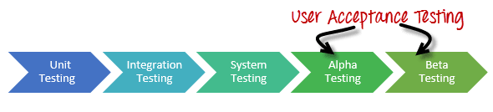
Acceptance Testing
Acceptance Testing
The acceptance test has two stages, Alpha testing and Beta Testing.

Slide 19
Acceptance Testing
Alpha testing is typically performed by internal employees（内部测试） and conducted in a lab environment.
An alpha test ensures the product really works and does everything it’s supposed to do.

Slide 20
Acceptance Testing
Beta testing is an opportunity for real users to use a product in a production environment to uncover any bugs or issues before a general release.
Beta testers are “real” users and conduct their testing in a production environment.

Slide 21
Acceptance Testing
Beta tests can either be open or closed.
In an open test, anyone can use the product and is usually presented with some messaging that the product is in beta and given a method for submitting feedback.
In closed beta, the testing is limited to a specific set of testers（特定的测试者）, which may be composed of current customers, early adopters, and/or paid beta testers.
Testing can either last for a set period or run until new issues stop being reported and all-important ones have been addressed.

Slide 22
Acceptance Testing
The primary difference between an alpha test and a beta test is who is doing the testing.
Alpha tests are typically performed by internal employees in a lab environment, while beta tests are conducted by actual users in a production setting（实际生产环境））.

Slide 23
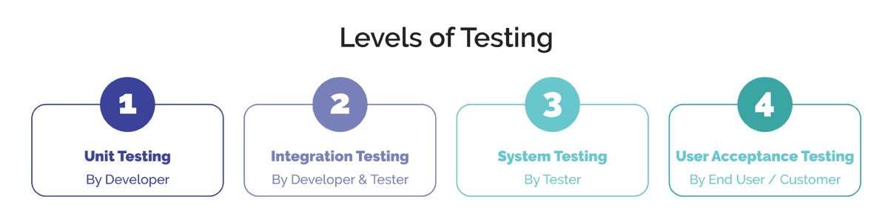
Question:
In different testing levels, who conducts the test?

Slide 24
Dynamic Testing
Functional Testing
Non-Functional Testing
Performance Testing
Recovery Testing
Security Testing
Usability Testing
Compatibility Testing

Slide 25
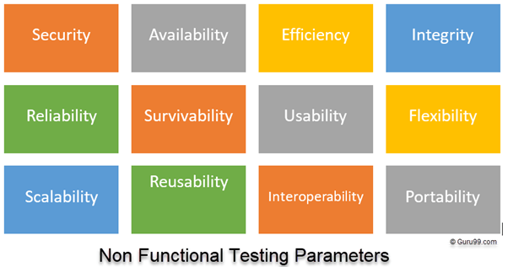
Non-Functional Testing
Non functional testing how well software works. Whereas functional testing verifies what software does.

Slide 26
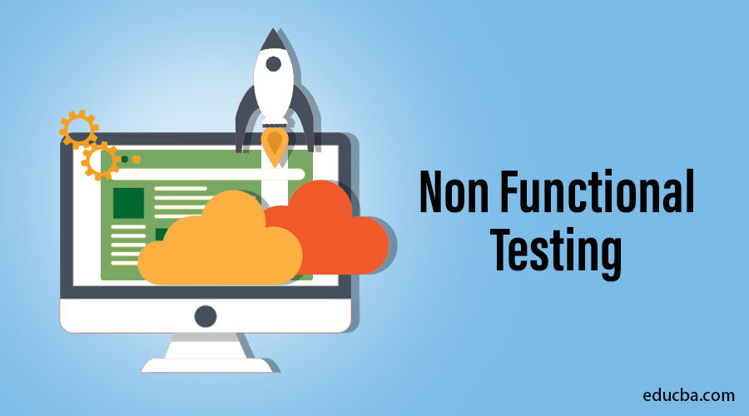
Non-Functional Testing
Performance testing
Recovery testing
Security testing
Usability testing
Compatibility testing

Slide 27
What is Performance Testing
Performance testing focuses on how a system running under a particular load. Generally, this testing defines how quickly the server responds to the user's request.

Slide 28
When we use Performance Testing
We will do performance testing once the software is stable and moved to the production, and it may be accessed by the multiple users concurrently, due to this reason, some performance issues may occur. To avoid these performance issues, the tester performs performance testing.
We go for performance testing when the application is functionally stable.

Slide 29
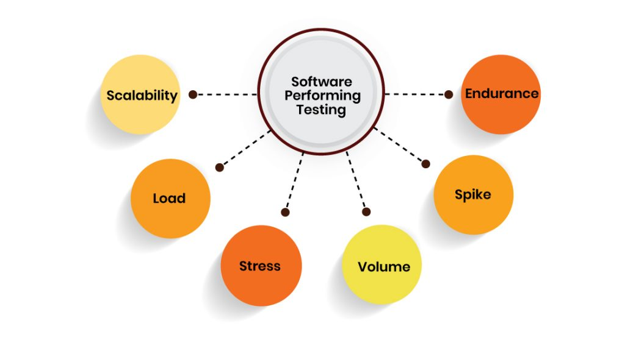
Types of Performance Testing
Every company uses different types of performance tests depending upon the testing environment. Here’s we list the popular performance testing:

Slide 30
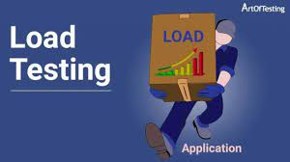
Load Testing（负载测试）
Load testing is used to check the performance of an application by applying some load which is either less than or equal to the desired load is known as load testing.
In other words, It verifies application behavior under normal and peak load conditions.
（正常和峰值负载下的行为）

Slide 31
Load Testing
Load testing determines how the software application behaves while being accessed by multiple users simultaneously. （多用户）
Load testing is conducted to verify that our application can meet our desired performance objectives.

Slide 32
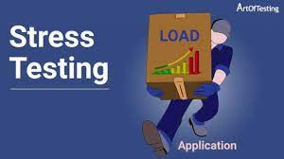
Stress Testing(压力测试）
Stress testing checks the behavior of an application by applying load greater than the desired load.
In other words, stress testing checks how the software behaves under abnormal conditions. This determines the limit at which the software will break.
It’s important to find out what happens when the system is under stress. Does the right error message display? Does the system fail? How will it recover?

Slide 33
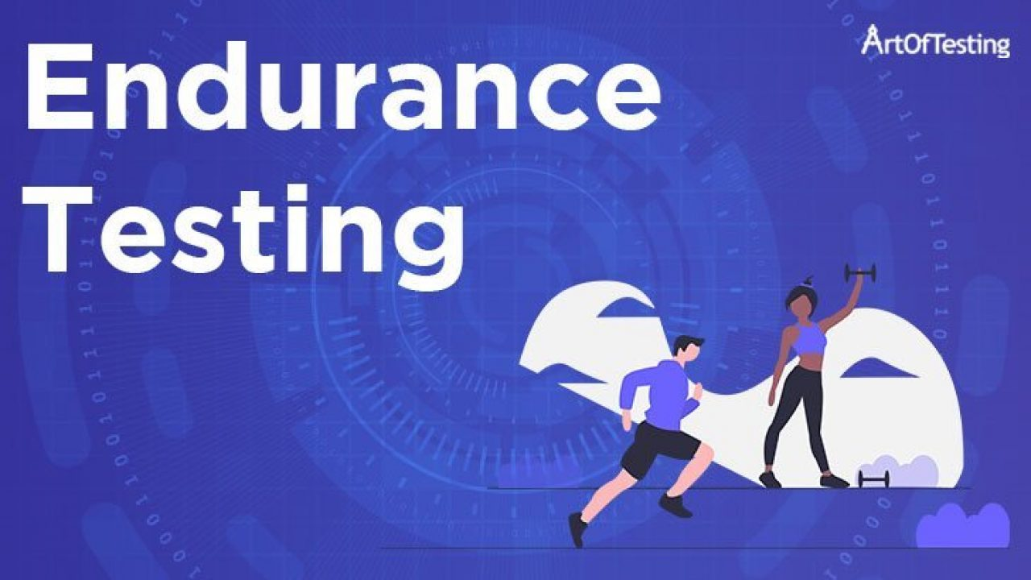
Endurance Testing（耐力测试）
Endurance testing is an evaluation of how the software performs with a normal workload under a huge expected load continued over a long period of time.

Slide 34
Why Endurance Testing
The main purpose of performing this testing is to identify any potential memory leaks. So, during this testing, memory utilization is closely monitored.
A memory leak is a failure in a software program to release discarded memory, causing impaired performance or failure.
A memory leak might not have a short-term impact but in the long-term, it slows down the system which leaves no free memory and thus finally leading to application or system crash.

Slide 35
Why Endurance Testing
Memory leak is an issue which becomes apparent only after a certain period of time.
Hence, we need endurance testing to uncover such issues.
It might be possible that with a huge significant load, your application works well for some period say, 1 hour. But, when exposed to the same amount of load continuously for a longer period say, 3-4 hours, your application gets crashed down due to resourcing issue and insufficient disk space.

Slide 36
Why Endurance Testing
Another important issue which endurance software testing targets to identify is its performance degradation. It needs to be ensured that the throughput or response times after prolonged use are equivalent to the beginning of the test.
Database connection issues（数据库链接问题） are also identified in the Endurance test. If the database connection is not closed successfully then it might result in system crash.

Slide 37
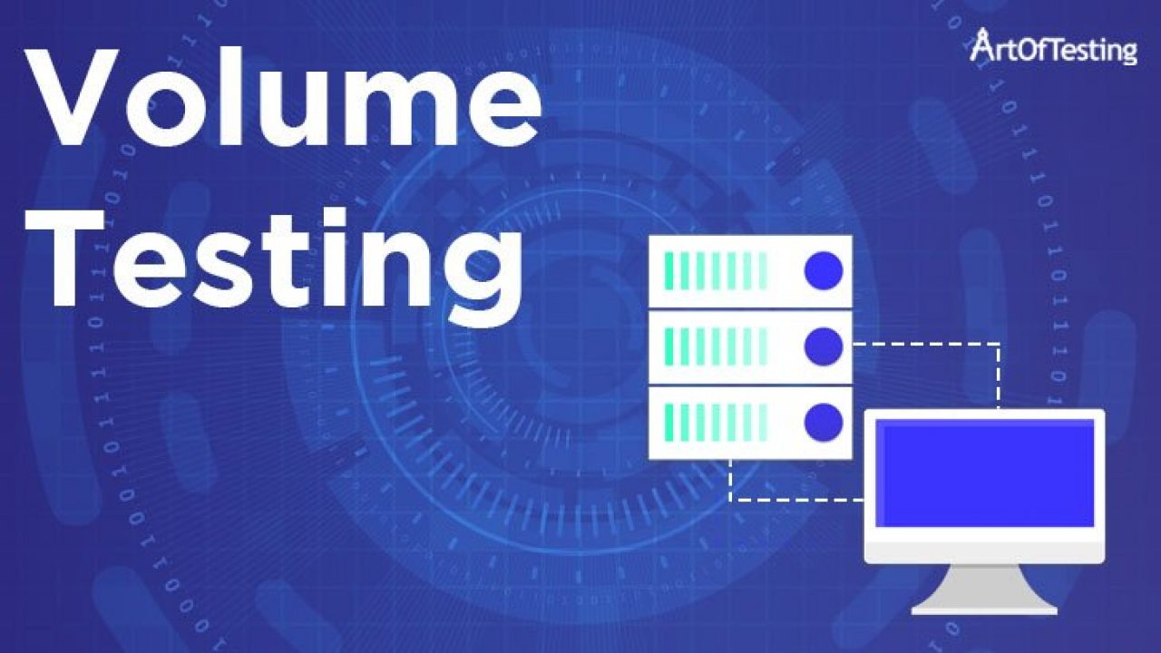
Volume Testing
Volume testing is a testing done on high volumes of data（大数据量）.
In Volume testing, a software product or application with high volume of data is tested, like huge number of input files, data records or heavy database table size in the system.
It is also known as Flood Testing.

Slide 38
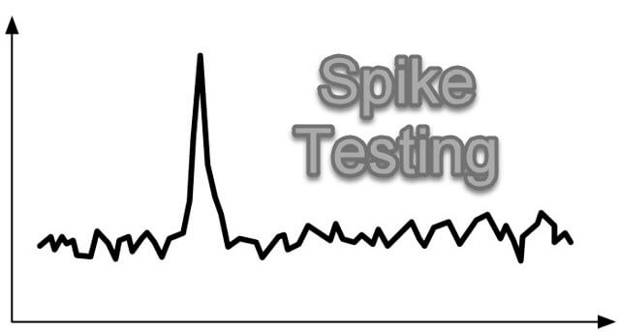
Spike Testing
In Spike Testing, a software application is tested with extreme increments and decrements in traffic load.
The goal of Spike testing is to see how the system responds to unexpected rise and fall of the user load.（骤增骤减）
Spike testing helps determine system performance deterioration when there is a sudden high load.
Another goal of Spike Testing is to determine the recovery time（回复时间）. Between two successive spikes of user load, the system needs some time to stabilize. This recovery time should be as low as possible.

Slide 39

Scalability Testing （可扩展性测试）
Scalability testing checks the performance of an application by increasing or decreasing the load in particular scales.（增减特定规模的负载）
The scales can be the volume of data, number of users using the system at a given interval of time, etc.
The basic goal of a scalability test is simple: to determine at which point the application stops scaling, and then figure out how to fix it.

Slide 40
Non-Functional Testing
Performance testing
Recovery testing
Security testing
Usability testing
Compatibility testing

Slide 41

Recovery Testing
Recovery Testing is software testing technique which verifies software’s ability to recover from failures like software/hardware crashes, network failures etc.
The technique involves failing the system and then verifying that the system recovery is performed properly.
To ensure that a system is fault-tolerant and can recover well from failures, recovery testing is important to perform. A system is expected to recover from faults and resume its work within a pre-specified time period.

Slide 42
Recovery Testing
To perform recovery testing software/hardware is forcefully failed to verify:
If recovery is successful or not.
Whether the further operations of the software can be performed or not.
The duration it will take to resume the operations.
Lost data can be recovered completely or not.
……
Before this testing is performed, backup is taken and saved to a secured location to avoid any data loss in case data is not recovered back successfully.

Slide 43
Recovery Testing
Common failures that should be tested for recovery:
Network issue
Power failure
Server not responding
External device not responding
Wireless network signal loss
……

Slide 44
Non-Functional Testing
Performance testing
Recovery testing
Security testing
Usability testing
Compatibility testing

Slide 45

Security Testing
Security Testing uncovers vulnerabilities of the system.
It ensures that the software system and application are free from any threats or risks that can cause a loss.
Security testing of any system is focuses on finding all possible loopholes and weaknesses of the system which might result into the loss of information or repute of the organization.

Slide 46
Security Testing
The goal of security testing is to:
To identify the threats in the system.
To measure the potential vulnerabilities of the system.
To help in detecting every possible security risks in the system.
To help developers in fixing the security problems through coding.

Slide 47
Non-Functional Testing
Performance testing
Recovery testing
Security testing
Usability testing（可用性测试）
Compatibility testing

Slide 48

Usability Testing
Usability Testing also known as User Experience(UX) Testing, is a testing method for measuring how easy and user-friendly a software application is.

Slide 49
Usability Testing
Aesthetics and design are important. A software application/website can fail due to following reasons –
Where do I click next?
Which page needs to be navigated?
Which Icon represents what?
Error messages are not consistent or effectively displayed.

Slide 50
Usability Testing
The goal of this testing is to satisfy users and it mainly concentrates on the following parameters of a system:
The effectiveness of the system
Is the system is easy to learn?
Are Content, Color, Icons, Images used are aesthetically pleasing?
Efficiency
Little navigation should be required to reach the desired screen or webpage, and scrollbars should be used infrequently.
Uniformity in the format of screen/pages in your application/website.

Slide 51
Usability Testing
Accuracy
No outdated or incorrect data like contact information/address should be present.
No broken links should be present.
User Friendliness
Controls used should be self-explanatory and must not require training to operate
Help should be provided for the users to understand the application/website
example: how we lock and unlock our phone?

Slide 52
Non-Functional Testing
Performance testing
Recovery testing
Security testing
Usability testing
Compatibility testing（兼容性测试）

Slide 53
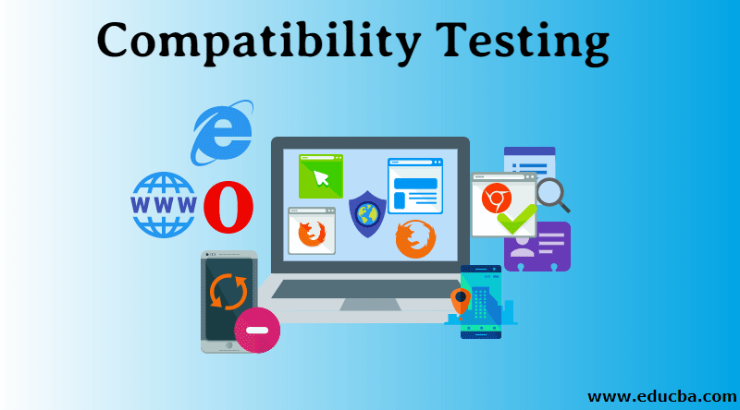
Compatibility Testing
Compatibility Testing checks whether your software is capable of running on different hardware, operating systems, applications, network environments or Mobile devices.
Once the application is stable, we moved it to the production, it may be used or accessed by multiple users on the different platforms, and they may face some compatibility issues, to avoid these issues, we do compatibility testing.

Slide 54
Compatibility Testing
Examples of Compatibility Testing :
Testing on PC, on different browsers like Safari, Chrome, Firefox, IE.
Testing on different mobile devices that have different platforms like iOS, Android or Windows.
Testing on networks like 4G, 3G or WIFI.
Testing on multiple operating systems such as Mac, Windows, Linux.

