Slide 1
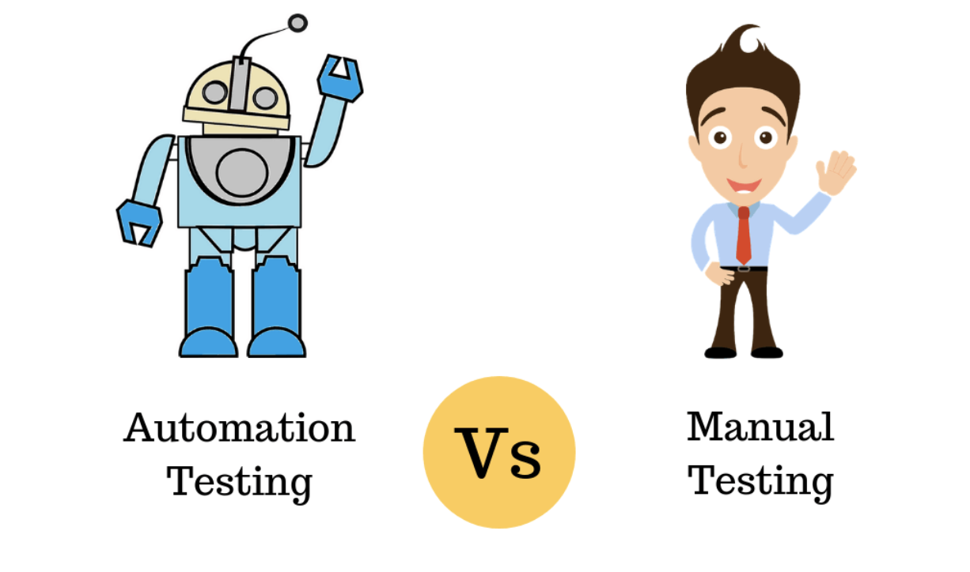
Manual Testing vs Automation Testing

Slide 2

What is Manual Testing
Manual Testing is the process of testing the software manually.
In Manual Testing, the tester plays an important role of end user and verifies that all the features of the application are working correctly.
The tester manually executes test cases without using any automation tools.
The skills, knowledge, and experience of the testers play an important role in Manual Testing.

Slide 3
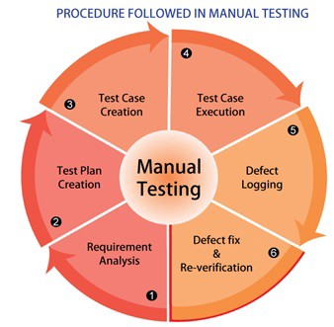
Procedure of Manual Testing
The tester prepares a test plan document which describes the detailed and systematic approach to testing of software applications.
Test cases are planned to cover almost 100% of the software application. As manual testing involves complete test cases it is a time consuming test.

Slide 4
Procedure of Manual Testing
The differences between actual and desired results are treated as defects.
The defects are then fixed by the developer of software application.
The tester retests the defects to ensure that defects are fixed.
The goal of Manual testing is to ensure that application is defect & error free and is working fine to provide good quality work to customers.

Slide 5
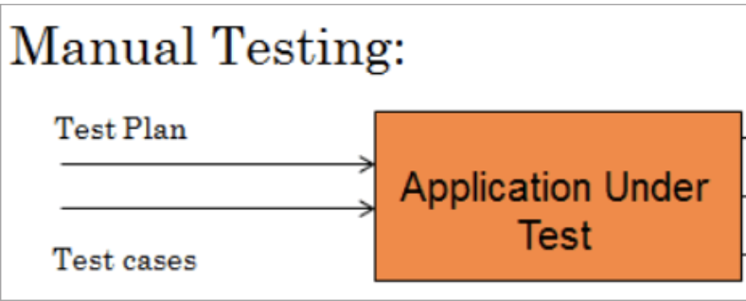
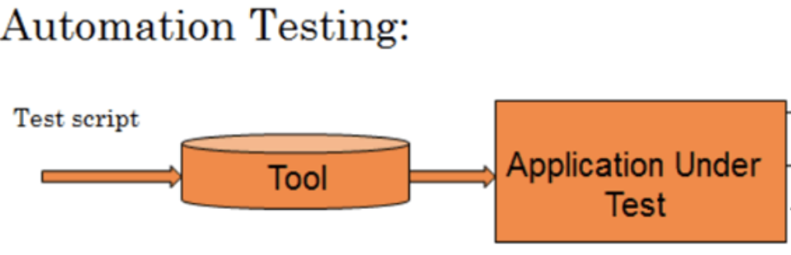
What is Automation Testing
Automation Testing is a method in software testing that leverages automation tools to control the execution of tests instead of a human tester.
Automated testing is also called test automation.

Slide 6
What is Automation Testing
Automation Testing includes the development and execution of test scripts to verify customer requirements using any automation tool.
Automation testing is not a replacement to manual testing. The idea of test automation is to automate some parts of the software test process, but not all of the testing process.

Slide 7
Question:
Which test case is suitable for Automation Testing

Slide 8
Which Test case to Automate
Test cases to be automated can be selected using the following criterion:
Test cases that are repeatedly executed.
Test cases that need to be tested with a different set of data or a large amount of data.
Test cases with the possibility of human making mistakes.
If there is any functionality that is having a high-risk condition.
Test cases that need to be tested with different browsers and different environments.

Slide 9
Question:
Give some testing types which can be considered for Automation Testing

Slide 10
Testing Types that can be considered for Automation
Performance Testing: It focuses on how a system running under a particular load. For example, load testing, volume testing, and etc.
Repeated Execution: When test is based on repeated execution of the task.
Regression Testing: Automation is the best thing for it.

Slide 11
What is Regression Testing
Regression testing is a software testing that ensures a software still functions as expected after any code changes, updates, or improvements.
Regression Testing is nothing but a full or partial selection of already executed test cases which are re-executed to ensure existing functionalities work fine.
This testing is done to make sure that new code changes should not have side effects on the existing functionalities. It ensures that the old code still works once the latest code changes are done.

Slide 12
Question:
Which test case is not suitable for Automation Testing

Slide 13
Which Test case not to Automate
The following category of test cases are not suitable for automation:
Test Cases that are newly designed and not executed manually at least once
Test Cases for which the requirements are frequently changing
Test cases which are executed on an ad-hoc basis.

Slide 14
What is Ad-hoc Testing
The term ad-hoc implies the lack of structure or something that is not methodical.
When you talk about ad-hoc testing, it means that it is a form of testing performed without any formal process in place.
The formal process here means having documentation like requirement documents, Test Plans, Test cases, and proper Test planning in terms of its schedule and order of performed tests.

Slide 15
What is Ad-hoc Testing
The purpose of ad-hoc testing is trying to uncover defects or flaws which cannot be captured through traditional or formal processes followed during the testing cycle.
In other words, ad-hoc testing does not having a formal or structured way of testing. When such kind of random testing techniques is performed, it is apparent that the testers perform this without any particular use case in mind with the aim to break the system.

Slide 16
Question:
Give some testing types which do not be considered for Automation Testing.

Slide 17
Testing Types that not to be considered for Automation
Ad-hoc Testing: no scenario, unplanned type of testing which is supposed to be done by human because the understanding is an important factor.
Usability Testing: when the test measures how user-friendly and convenient the particular software is.
Exploratory Testing - when the tester’s experience and intuition is required.

Slide 18
What is Exploratory Testing
Exploratory testing is a simultaneous learning, test design, and test execution process. In this testing, test planning, analysis, design and test execution, are all done together and instantly.
Exploratory testing involves concurrent test case design and test execution of an application or system under test. The tester will create or write down a test idea to give direction, and explore the system while testing to further create critical, practical and useful tests for the successful testing of an application.

Slide 19
Ad-hoc Testing vs Exploratory Testing

Slide 20
Ad-hoc Testing vs Exploratory Testing
Ad-hoc Testing | Exploratory Testing
Ad-hoc Testing begins with learning applications first and then work with the actual testing process. | Exploratory Testing begins with exploring the application while learning.
Documentation is not a basic need for this type of testing. | Documentation is mandatory in Exploratory Testing. To ensure quality, it’s necessary to documents the detail of the testing.
There is no target set or any goal to complete as it tests randomly. | Goals and targets can be set.

Slide 21
Question:
What is the difference between Manual Testing and Automation Testing?

Slide 22
Manual Testing vs Automation Testing
Manual | Automated
Time
Manual testing is a time consuming since it is based on human resources only. | Automated testing allows you to execute the test much faster than the manual approach.
Accuracy
The risk of human errors in this case is higher. | Automated testing is processed by scripts and tools which makes it reliable and accurate but in the same time the script can only act as it is set - it can miss errors that are obvious to the Manual tester.

Slide 23
Manual Testing vs Automation Testing
Manual | Automated
Test reports
Manual approach gives the opportunity for human observation and evaluation of user friendliness. Specialized programs / sites to support tests and record bugs are used. | Human consideration is not involved which could lead to lack of user- friendliness and experience evaluation. The execution results are saved and easily accessed in the automation system.
Investment
The initial investment in manual testing is lower compared to the automation but ROI is also lower in a long perspective. The investment in more human resources is required. | The automated testing usually require higher initial investment but the ROI is better in the long perspective
ROI, refers to Return on investment, which is a performance measure.
To calculate ROI, the benefit (or return) of an investment is divided by the cost of the investment.

Slide 24
Manual Testing vs Automation Testing
Manual | Automated
Knowledge
No need for programming skills. | Programming languages knowledge is required for the creation of scripts using most of tools.

Slide 25
Test Scenario vs Test Case

Slide 26
Test Scenario

Slide 27
What is a Test Scenario
A Test Scenario is defined as any functionality that can be tested.
As a tester, you should put yourself in the end user’s position and figure out the real-world scenarios and use cases of the Application Under Test.

Slide 28
Why Create Test Scenarios?
Test Scenarios are created for the following reasons,:
Creating Test Scenarios ensures complete Test Coverage.
Test Scenarios can be approved by various stakeholders like Business Analyst, Developers, Customers to ensure the Application Under Test is thoroughly tested.
It ensures that the software is working for the most common use cases.
They serve as a quick tool to determine the testing work effort and accordingly create a proposal for the client or organize the workforce.

Slide 29
How to Write Test Scenarios?
Refer to uses cases, books, manuals, etc. of the application to be tested.
For each requirement, figure out possible users actions and objectives.
List out different test scenarios that verify each feature of the software.
The created scenarios may be reviewed by your supervisor or any other Stakeholders in the project.

Slide 30
Some Tips for Writing Test Scenarios?
Each Test Scenario should be tied to a minimum of one Requirement.
Before creating a Test Scenario that verifies multiple Requirements at once, ensure you have a Test Scenario that checks that requirement in isolation.
Avoid creating overly complicated Test Scenarios spanning multiple Requirements.
The number of scenarios may be large, and it is expensive to run them all. Based on customer priorities only run selected Test Scenarios.

Slide 31
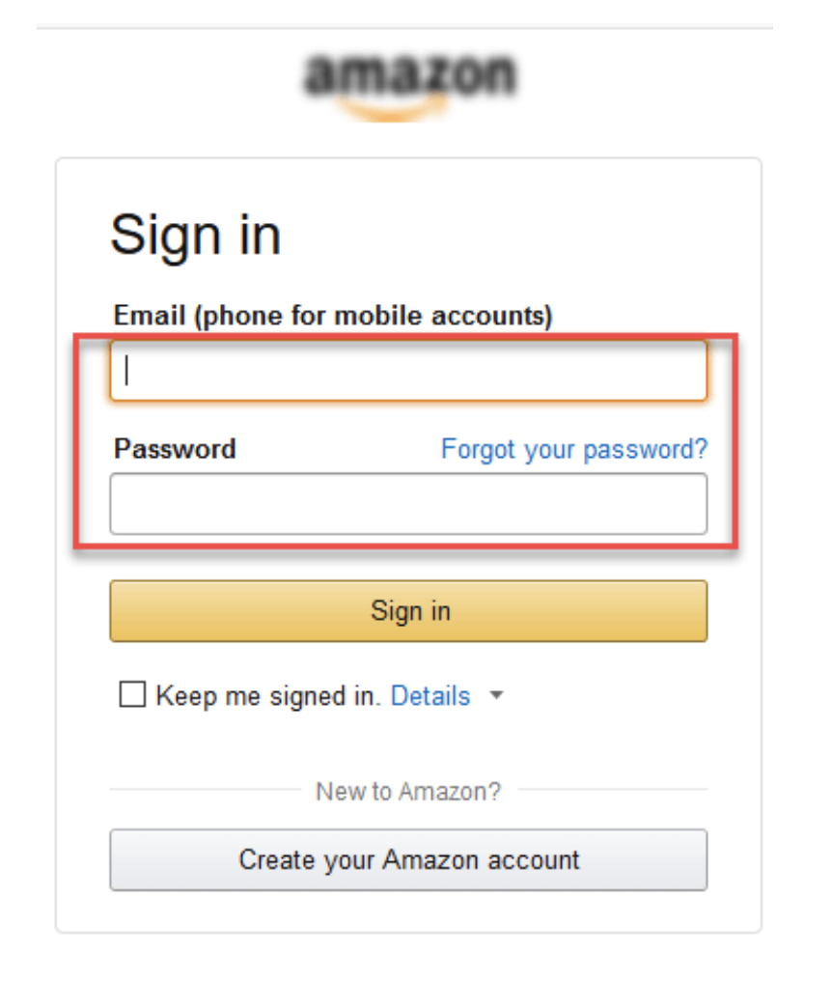
Examples for Test Scenario
For an eCommerce Application, a few test scenarios would be:
Test Scenario 1: Check the Login Functionality

Slide 32

Examples for Test Scenario
For an eCommerce Application, a few test scenarios would be:
Test Scenario 2:Check the Search Functionality

Slide 33
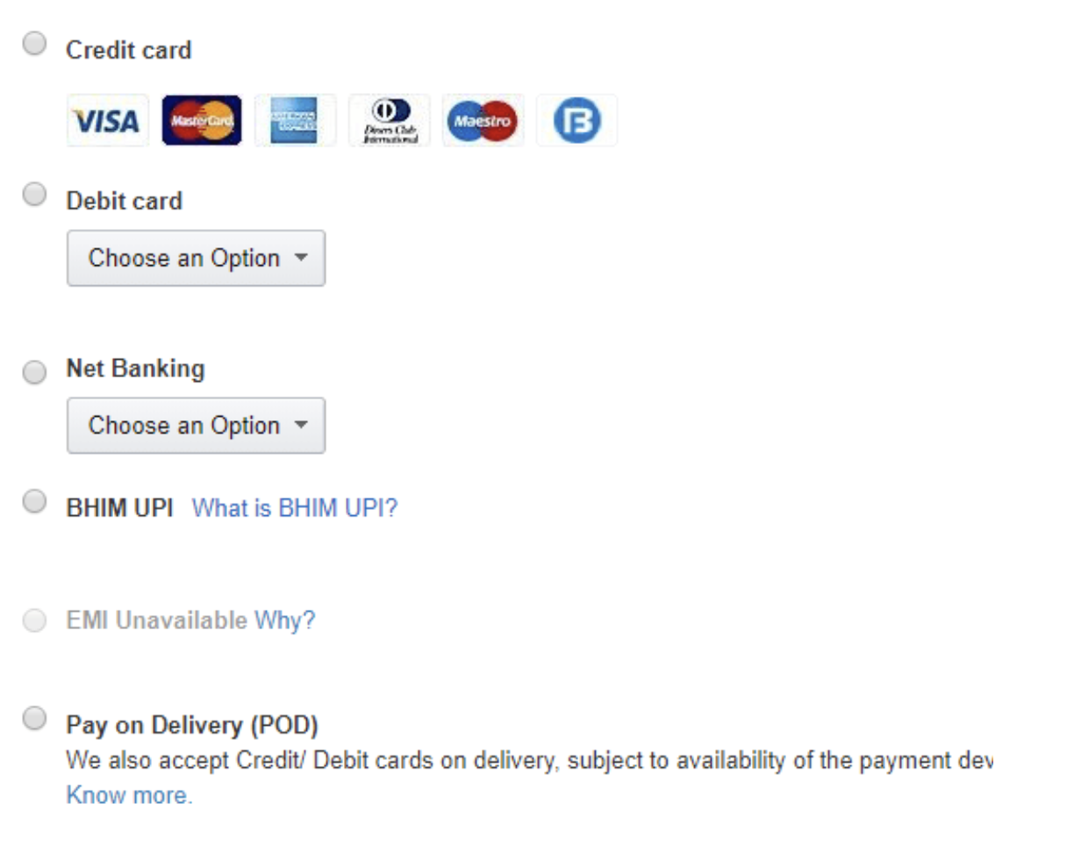
Examples for Test Scenario
For an eCommerce Application, a few test scenarios would be:
Test Scenario 3:Check the Payments Functionality

Slide 34
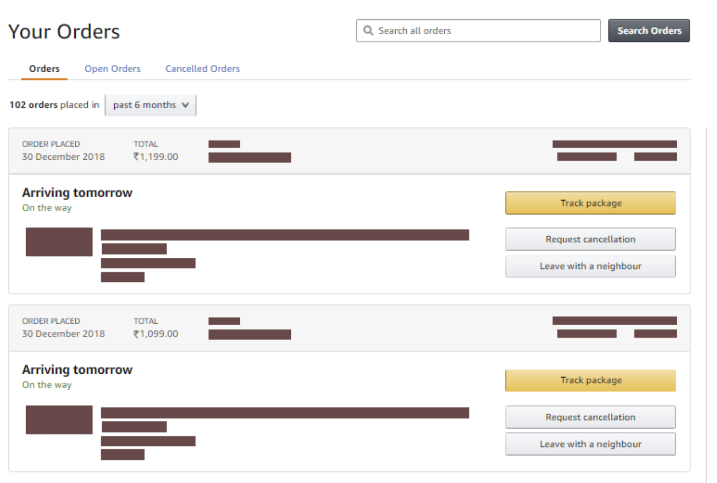
Examples for Test Scenario
For an eCommerce Application, a few test scenarios would be:
Test Scenario 4:Check the Order History

Slide 35
Question:
List possible Test Scenarios for a Banking Site.

Slide 36
Possible Test Scenarios for a Banking Site
Some possible Test Scenarios for a Banking Site:
Test Scenario 1: Check the Login and Authentication Functionality
Test Scenario 2: Check Money Transfer can be done
Test Scenario 3: Check Account Statement can be viewed
And so on……

Slide 37
Test Case

Slide 38
What is a Test Case
A Test Case is a set of actions executed to verify a particular feature or functionality of your software application.
The test case includes specific variables or conditions, using which a testing engineer can compare expected and actual results to determine whether a software product is functioning as per the requirements of the customer.

Slide 39
What is a Test Case
A Test Case can contain:
Test Case ID
Test case Description
Test Steps
Test Data
Expected Results
Actual Results

Slide 40
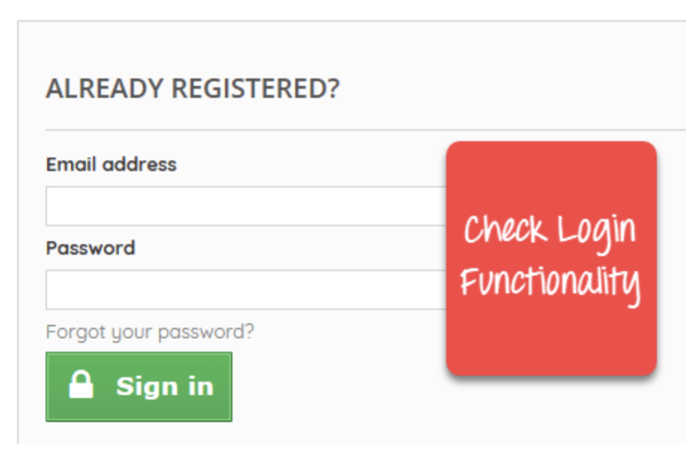
An Example to Create Test Cases
Let’s create a Test Case for the scenario: Check Login Functionality.

Slide 41
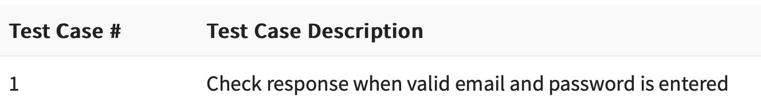
An Example to Create Test Cases
1: Use a Test Case Id to identify the Test Case and give a simple description to describe the Test Case

Slide 42
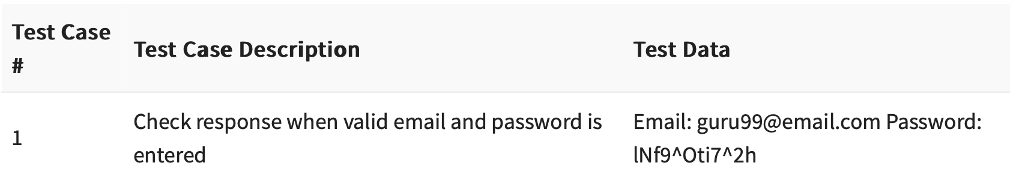
An Example to Create Test Cases
2:In order to execute the test case, Test Data is required.

Slide 43
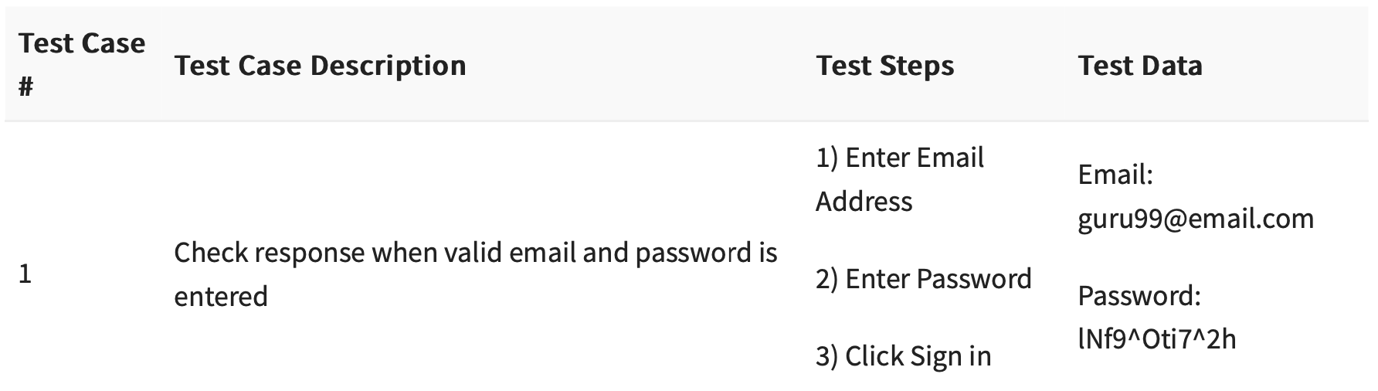
An Example to Create Test Cases
3:To execute a test case, a tester needs to perform a specific set of actions.

Slide 44
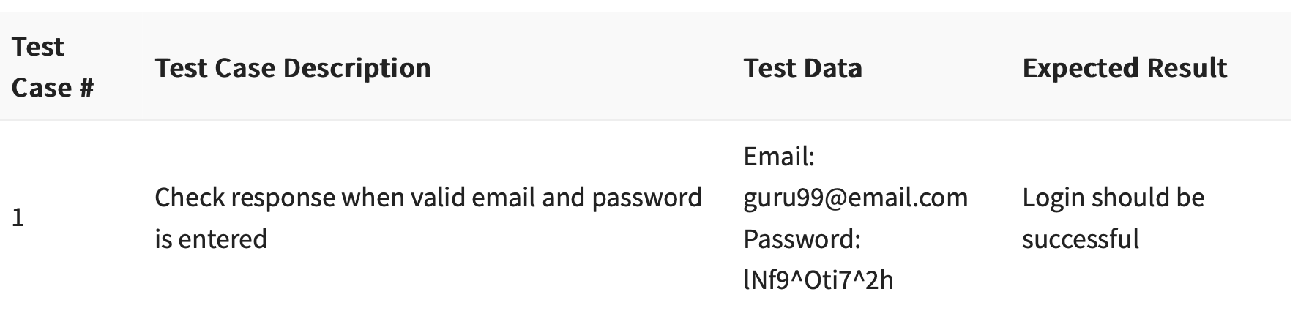
An Example to Create Test Cases
4:Expected results should be given as guidelines to determine whether a software product is functioning as per the requirements of the customer.

Slide 45
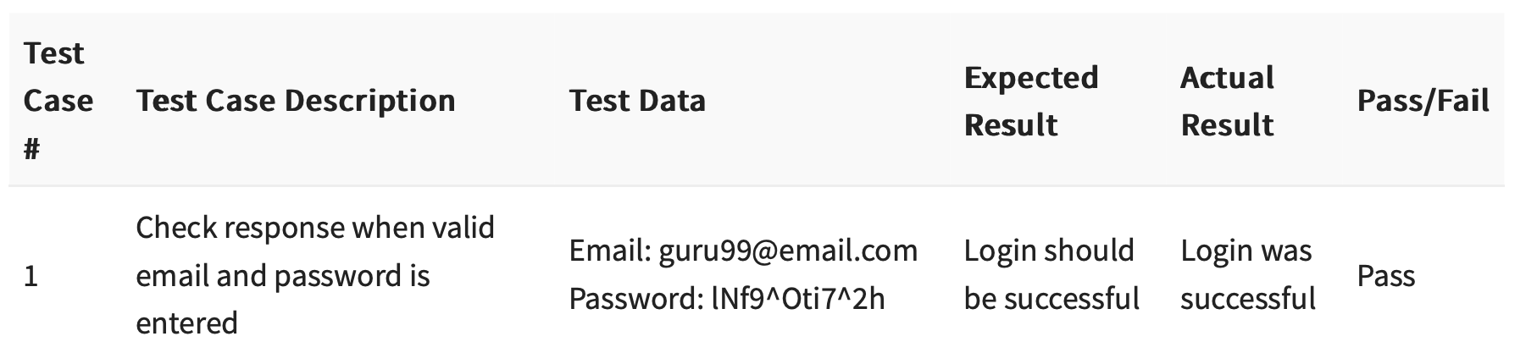
An Example to Create Test Cases
4:Acutal results are also required. So Testers can compare actual results with expected results to determine whether a software product is functioning as per the requirements of the customer.

Slide 46
An Example to Create Test Cases
Test cases may have a field named Pre – Condition.
Pre – Condition specifies things that must be in place before the test can run.
For our test case, a pre-condition would be to have a browser installed to have access to the site under test.

Slide 47
An Example to Create Test Cases
A test case may also include Post-Conditions.
Post-Conditions specifies anything that applies after the test case completes.
For our test case, a post-condition would be time & date of login is stored in the database.

Slide 48
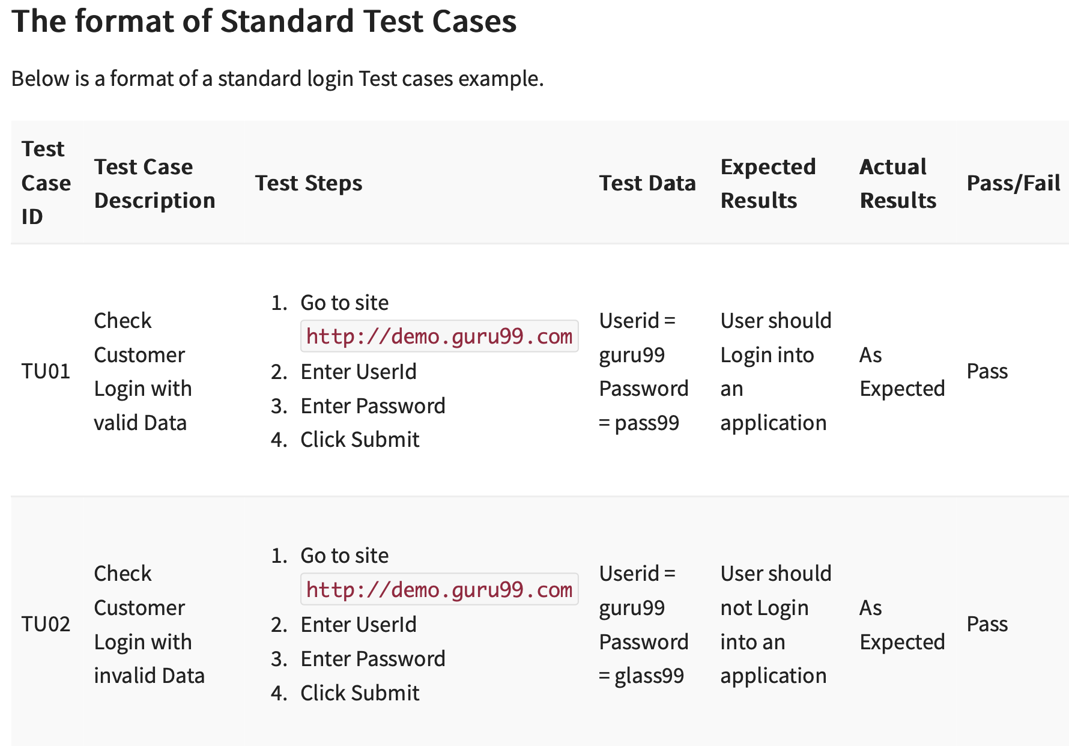
An Example to Create Test Cases

Slide 49
How to write Good Test Cases
Test Cases need to be simple and transparent:
Create test cases that are as simple as possible.
They must be clear and concise as the author of the test case may not execute them.
Use assertive language like go to the home page, enter data, click on this and so on. This makes the understanding the test steps easy and tests execution faster.

Slide 50
How to write Good Test Cases
Create Test Case with End User in Mind
We should create test cases that meet customer requirements and is easy to use and operate.
A tester must create test cases keeping in mind the end user perspective.
Avoid test case repetition.
Do not repeat test cases. If a test case is needed for executing some other test case, call the test case by its test case id in the pre-condition column.

Slide 51
How to write Good Test Cases
Do not Assume
Do not assume functionality and features of your software application while preparing test case. Stick to the Specification Documents.
Ensure 100% Coverage
Make sure you write test cases to check all software requirements mentioned in the specification document.
Test Cases must be identifiable.
Name the test case id such that they are identified easily while tracking defects.

Slide 52
How to write Good Test Cases
Repeatable and self-standing
The test case should generate the same results every time no matter who tests it.
Peer Review
After creating test cases, get them reviewed by your colleagues. Your peers can uncover defects in your test case design, which you may easily miss.

Slide 53
Group Discussion

Slide 54
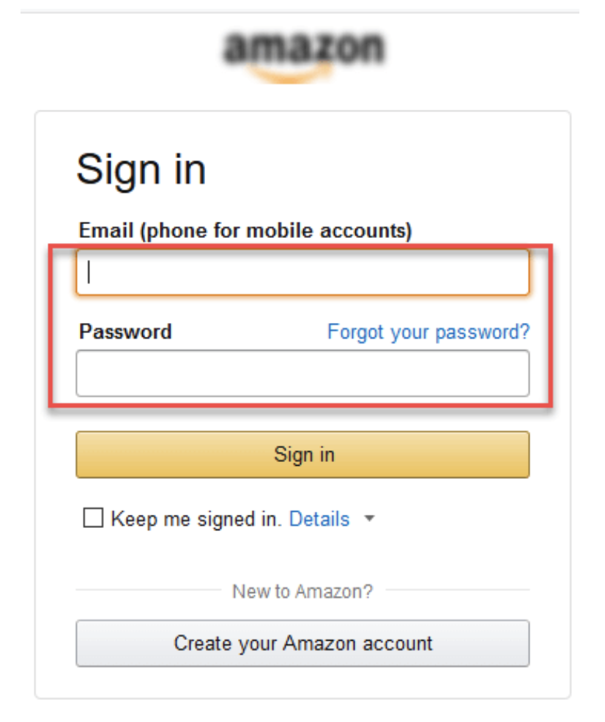
Group Discussion
List possible test cases for the Test Scenario: Check the Login Functionality:

Slide 55
Group Discussion
List possible test cases for the Test Scenario: Check the Login Functionality:
Check system behavior when valid email id and password is entered.
Check system behavior when invalid email id and valid password is entered.
Check system behavior when valid email id and invalid password is entered.
Check system behavior when invalid email id and invalid password is entered.
Check system behavior when email id and password are left blank and Sign in entered.
Check Forgot your password is working as expected
Check system behavior when valid/invalid phone number and password is entered.
Check system behavior when “Keep me signed” is checked.

Slide 56
Thanks

