Slide 1
White Box Testing

Slide 2
What We Will Cover Today
White Box Testing
What is White Box Testing
How to Perform White Box Testing
Code Coverage

Slide 3
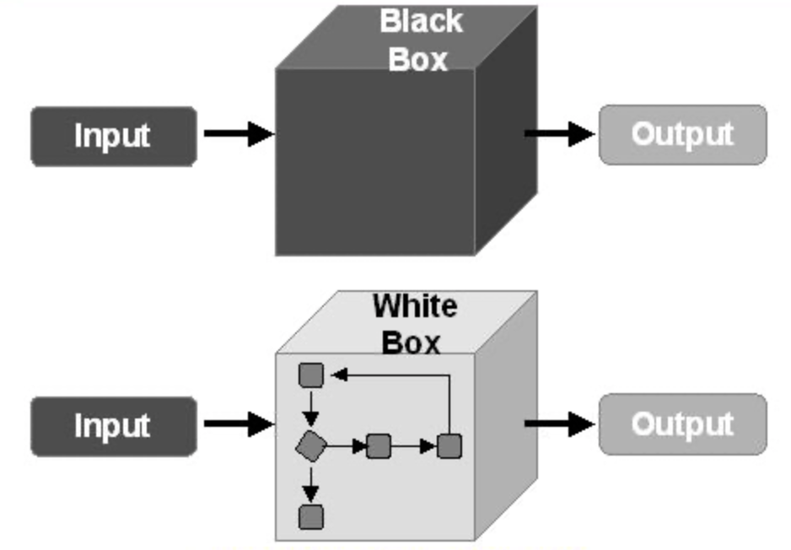
What is White Box Testing
White box is a type of software testing that assesses an application’s internal working structure and identifies its potential design loopholes.
The term “white box” is used because of the possibility to see through the program’s outer covering (or box) into its inner structure. It is also called glass box testing or clear box testing or structural testing.

Slide 4
What is White Box Testing
One of the basic goals of white box testing is to verify input-output flow for an application. It involves testing a series of predefined inputs against expected or desired outputs.
Therefore, when a specific input does not result in the expected output, you have encountered a bug.

Slide 5
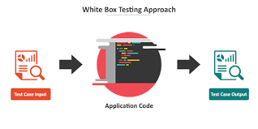
How to Perform White Box Testing
Here are two basic steps that testers can follow when they test an application using the white box testing technique:
Understand the source code
Create test cases and execute

Slide 6
How to Perform White Box Testing
Step 1: Understand the source code
The first thing a tester will often do is learn and understand the source code of the application.
Since white box testing involves the testing of the inner workings of an application, the tester must be very knowledgeable in the programming languages used in the applications they are testing.

Slide 7
How to Perform White Box Testing
Step 2:Create test cases and execute
The second basic step to white box testing involves testing the application’s source code for proper flow and structure.
One way is by writing more code to test the application’s source code.

Slide 8
How to Perform White Box Testing
Step 2:Create test cases and execute
The tester will develop little tests for each process or series of processes in the application.
This method requires that the tester must have intimate knowledge of the code and is often done by the developer.

Slide 9
White Box Testing Techniques
Code coverage is a major technique for performing white box testing.
Code coverage is a metric that gauges the extent to which the source code has been tested. It computes the number of lines of code that have been validated successfully by a test scenario.
Code coverage = (Number of lines of code executed / Total number of lines of code) * 100
With code coverage, you can determine the efficiency of the test implementation, quantitatively measure how your code is exercised, and identify the areas of your program not executed by test cases.

Slide 10
White Box Testing Techniques
Following are important White Box Testing Techniques:
Statement Coverage
Branch Coverage
Condition Coverage
Decision/Condition Coverage
Multiple Condition Coverage
Path Coverage

Slide 11
White Box Testing Techniques
Before Code coverage
Control Flow Graph

Slide 12
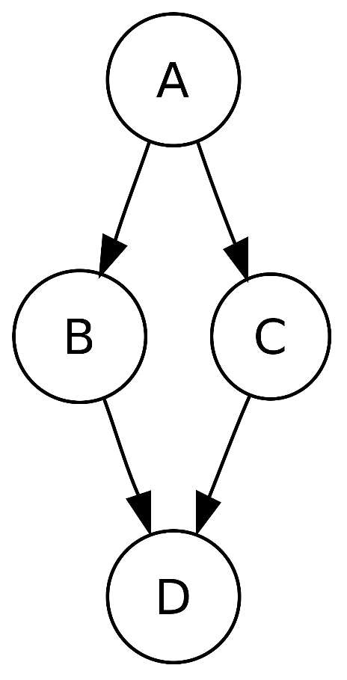
What is Control Flow Graph
Control Flow Graph (CFG) is the graphical representation of control flow or computation during the execution of programs or applications.
A CFG is a directed graph showing the flow of control through a segment of code. CFGs are mainly used at source code level.
Each node represents one or more indivisible statements in the source code.

Slide 13
What is Control Flow Graph
Each edge represents a jump or branch in the flow of control.
A node with two exits represents a block of code terminating in a decision, with true or false statement.
CFG can be used to represent basic programming constructs of sequences, selection (if-then-else), iteration(while), iteration (do-while) and iteration (for).

Slide 14
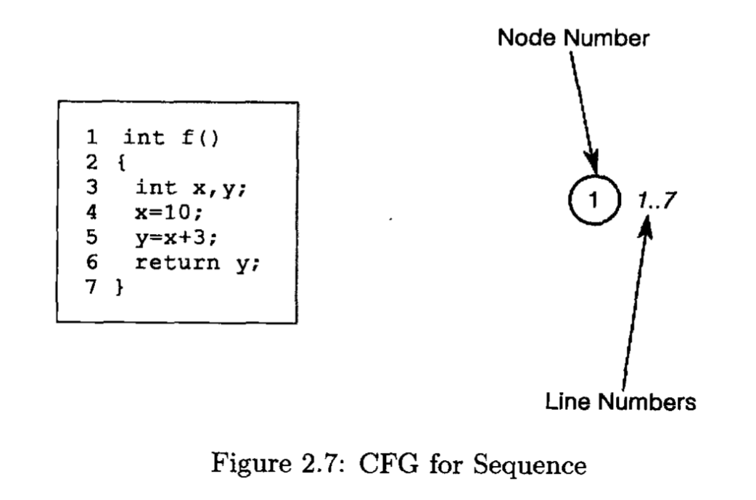
CFG for Sequence
The code in lines 1-7 is always executed as a sequence, so are represented as a single node.

Slide 15
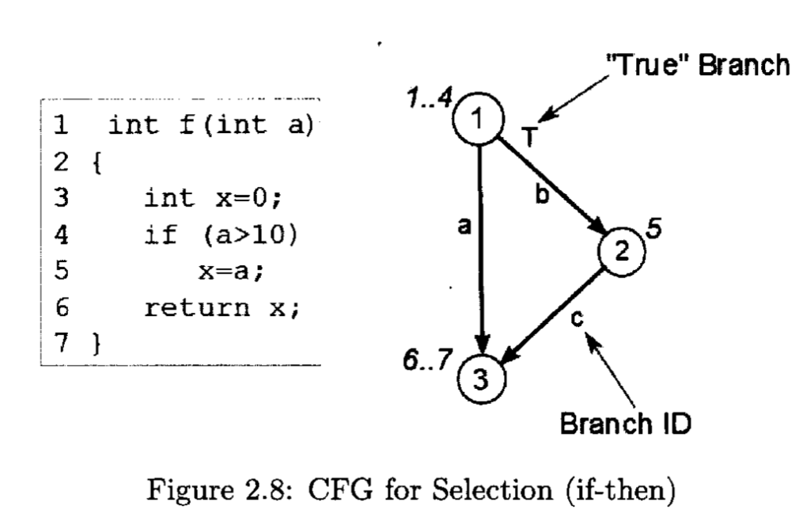
CFG for if-then
The code in lines 1-4 is always executed as a sequence (node 1).
If the decision on line 4 evaluates to true, then line 5 is executed (node 2) , and then control moves to line 6 (node 3).
If the decision on line 4 evaluates to false, then control jumps straight to line 6 (node 3).

Slide 16
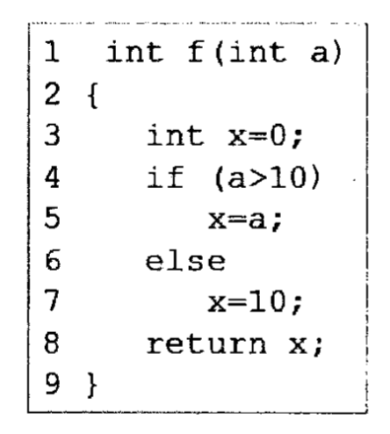
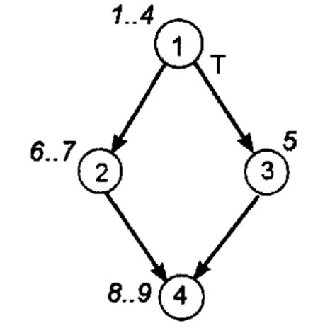
CFG for if-then-else
The code in lines 1-4 is always executed as a sequence (node 1).
If the decision on line 4 evaluates to true, then line 5 is executed (node 2) , and then control moves to line 8-9 (node 4).
If the decision on line 4 evaluates to false, lines 6-7 are executed (node 3), and then control jumps straight to line 8-9 (node 4).

Slide 17
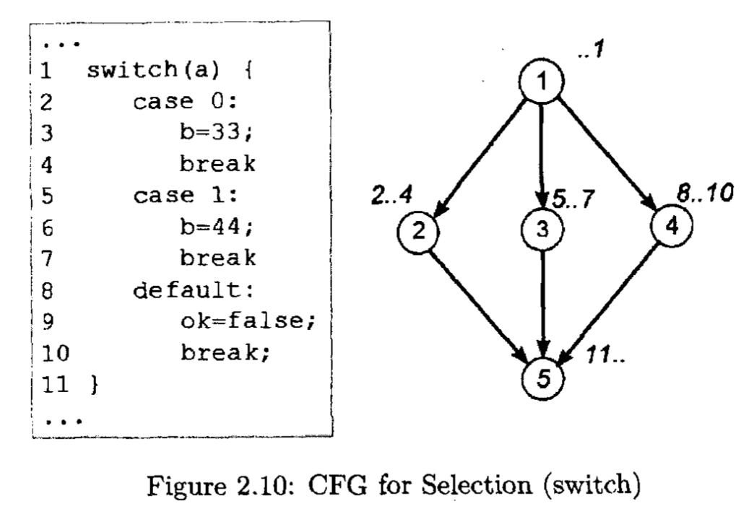
CFG for switch
The code ending on lines 1 is executed as a sequence (node 1).
Depending on the value of a, control then jumps to either line 2 (node 2), line 5 (node 3), or line 8 (node 4).
Lines 2-4 execute as a sequence, and control moves to line 11 (node 5).
Lines 5-7 execute as a sequence, and control moves to line 11 (node 5).
And lines 8-10 execute as a sequence, and control moves to line 11 (node 5).

Slide 18
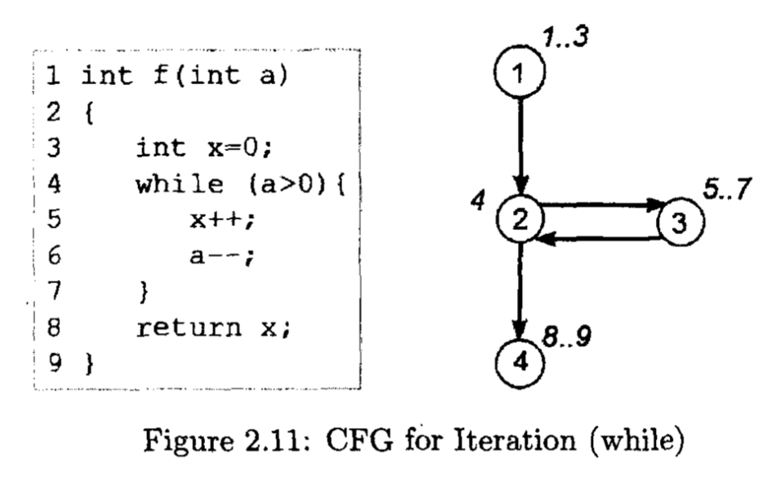
CFG for Iteration while
The code in lines 1-3 (node 1) is always executed as a sequences. Note that the while statement must be in its own node as the decision is evaluated every time through the loop.
If the decision on line 4 (node 2) evaluates to true, then lines (5-7) are executed (node 3), and then control returns to line 4 (node 2).
If the decision on line 4 (node 2) evaluates to false, then control jumps to line 8 (node 4).

Slide 19
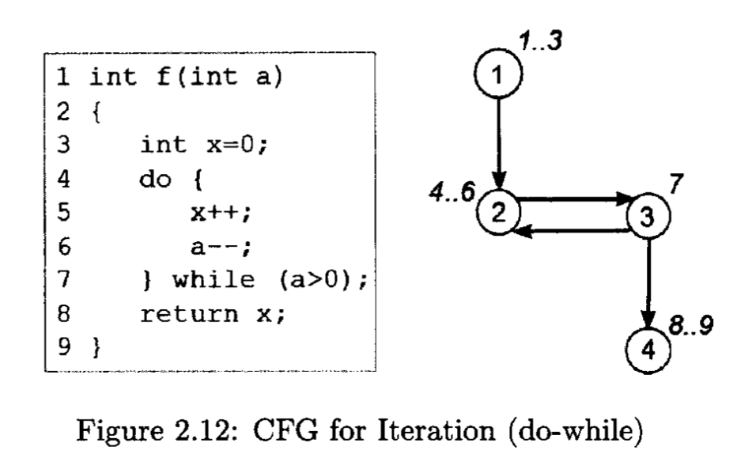
CFG for Iteration do-while
The code in lines 1-3 (node 1) is always executed as a sequences. The body of the do-while loop is then executed, lines 4-6 (node 2).
Note the difference in structure from the previous example.
If the decision on line 7 (node 3) evaluates to true, then control jump back to line 4 (node 2).
If the decision on line 7 (node 3) evaluates to false, then control jumps to line 8 (node 4).

Slide 20
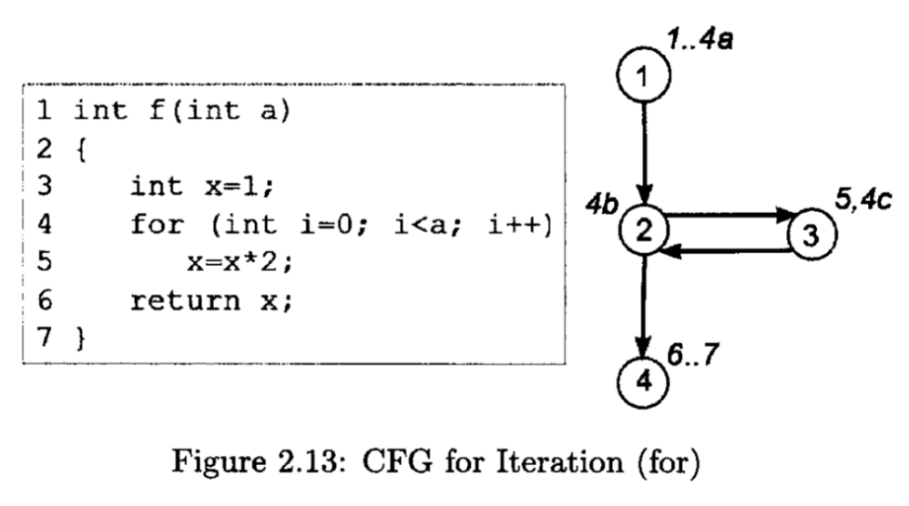
CFG for Iteration for
The code in lines 1-3 followed by the initial for-loop assignment (line 4a) is always executed as a sequence (node 1).
The decision in the for-loop, i < a on line 4b, is then evaluated (node 2).
If true, then the body of the for-loop, on line 5, is then executed, followed by the for-loop increment on line 4c (node 3).
When the decision evaluates to false, then line 6-7 are executed (node 4).

Slide 21

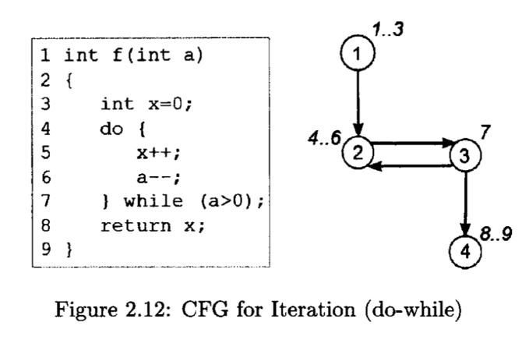
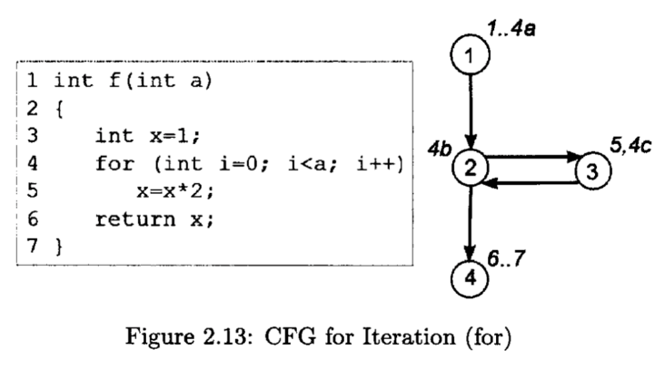
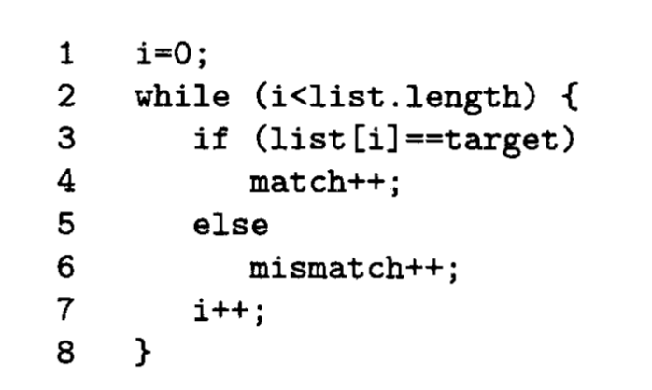
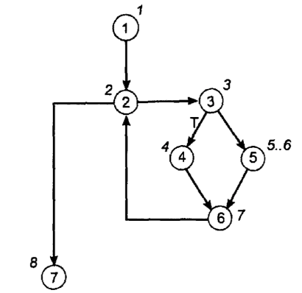
Summary: CFGs for Iterations
Can you draw the CFG of this function?

Slide 22
White Box Testing Techniques
Following are important White Box Testing Techniques:
Statement Coverage
Branch Coverage
Condition Coverage
Decision/Condition Coverage
Multiple Condition Coverage
Path Coverage

Slide 23
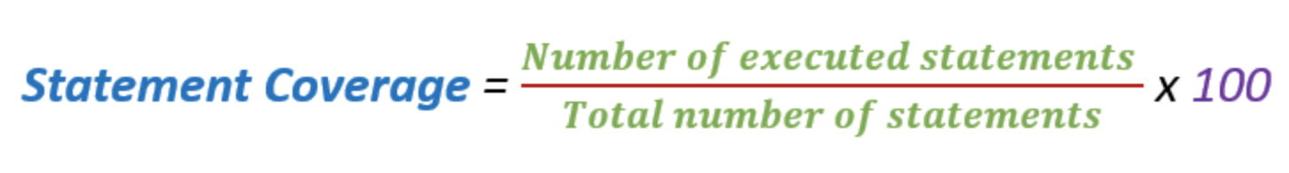
What is Statement Coverage
Statement Coverage is a white box testing technique in which all the executable statements in the source code are executed at least once.
It is used for calculation of the number of statements in source code which have been executed.
The main purpose of Statement Coverage is to cover all the possible paths, lines and statements in source code. In other words, the ideal test completion criteria is 100% statement coverage.

Slide 24
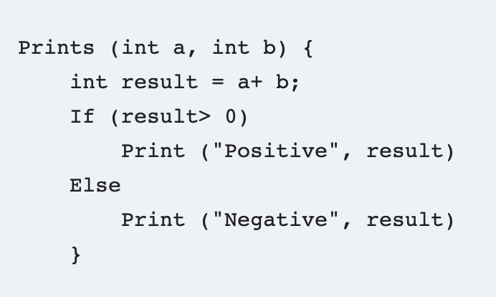
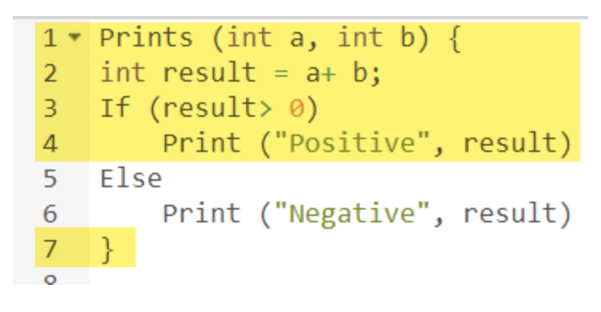
How to calculate Statement Coverage
test case: a = 3 b= 9
Number of executed statements = 5, Total number of statements = 7
Statement Coverage: 5/7 = 71%
Note that the statements marked in yellow color are those which are executed as per the scenario.

Slide 25
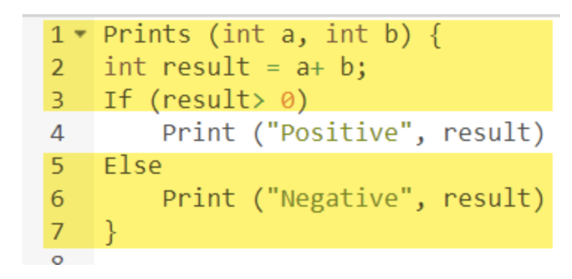
How to calculate Statement Coverage
test case: a = -3 b= -9
Number of executed statements = 6
Total number of statements = 7
Statement Coverage: 6/7 = 85%

Slide 26
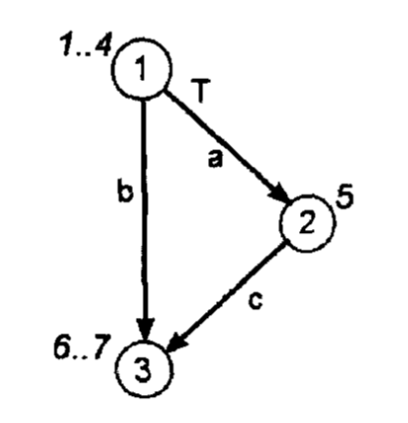
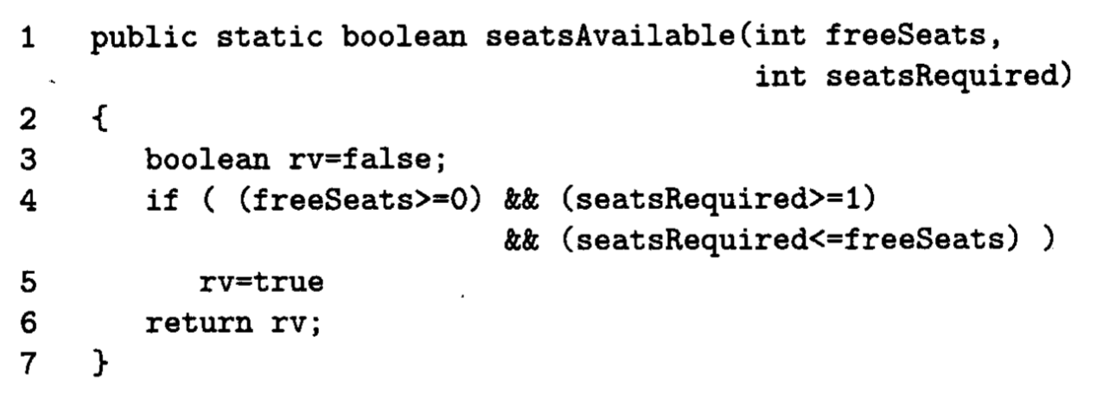
How to Design Test Cases Using Statement Coverage
1: First of all, draw a CFG for the program.

Slide 27
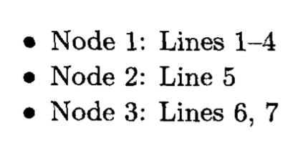
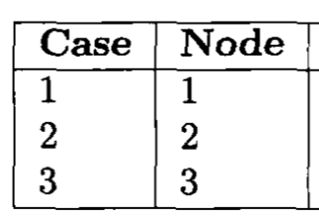
How to Design Test Cases Using Statement Coverage
2: Each node on the CFG, representing a sequence of indivisible source code statement, is a test case.

Slide 28
How to Design Test Cases Using Statement Coverage
3: Then working from the CFG, and the source code, work out input values required to ensure that every source code statement is executed.

Slide 29


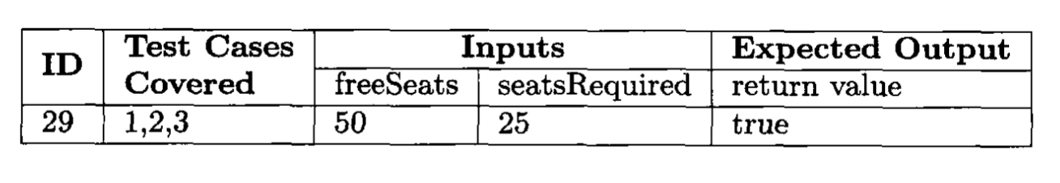
How to Design Test Cases Using Statement Coverage
The tests should generate data that will cover all the nodes 1–3.
Ensuring full coverage using the minimum set of tests to be developed.

Slide 30

How to Design Test Cases Using Statement Coverage
4:Finally, using the specification – NOT the source code – work out the correct output of each set of input values.

Slide 31
Advantages of Statement Coverage
Provides a minimum level of coverage by executing all statements at least once.
There is a significant risk in releasing software before every statement has been executed at least once during testing.
Statement Coverage can generally be achieved using only a small number of tests.

Slide 32
Disadvantages of Statement Coverage
Can be difficult to determine the required input parameter values
Does not provide coverage for “NULL else” conditions.
If (number < 3)
number ++;
Not demanding of compound logical conditions.
If ((a>1) || (b == 0))
x = x/a;

Slide 33
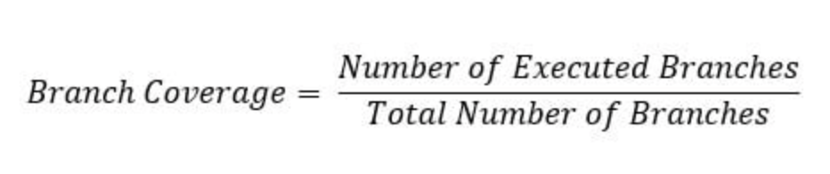
What is Branch Coverage
Branch Coverage is a white box testing method in which every branch in the source code is tested.

Slide 34
How to Design Test Cases Using Branch Coverage
1: Draw a CFG for the program.

Slide 35

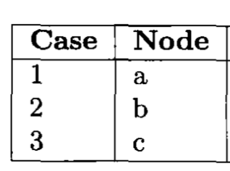
How to Design Test Cases Using Branch Coverage
2: Working from the CFG, and the source code, work out input values required to ensure that every source code branch is taken. In other words, each edge is a test case.

Slide 36

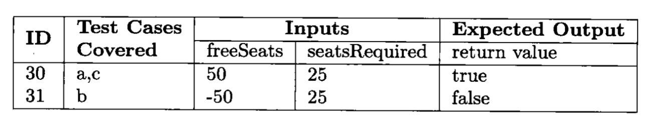
How to Design Test Cases Using Branch Coverage
3: Test data is selected to ensure every branch (edge) in CFG is executed.
Using the specification – NOT the source code – work out the correct output for each set of input values.

Slide 37
Advantages and Disadvantages of Branch Coverage
Advantages
Resolves the problem with “NULL else” condition.
Disadvantages:
Can be difficult to determine the required input parameter values
Undemanding of compound decisions, it only requires that each edge be followed, not that every reason for following each edge be tested.

Slide 38
What is Condition Coverage
Multiple (Boolean) conditions can form a complex decision.
Condition coverage extends Branch Coverage by ensuring that, for complex decisions, each condition within the decision is tested for its true and false values.
Note that: it is not necessary that the decision itself take on true and false values.
The goal of Condition Coverage is for every condition in every decision to take on the value True and False.

Slide 39
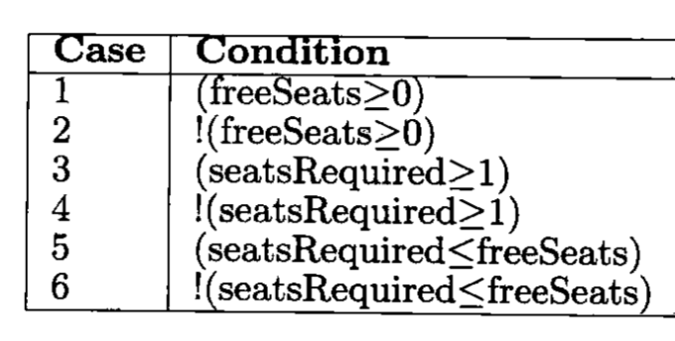
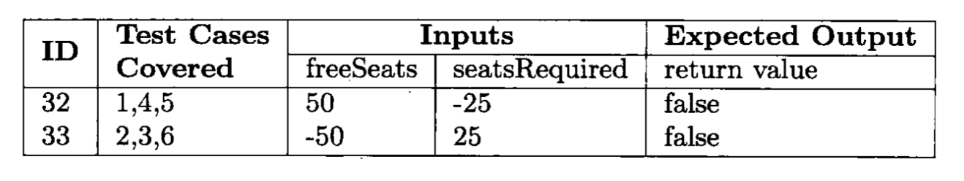
What is Condition Coverage
In the function there is one decision with three conditions on line 4.
Each Boolean value for each condition is a test case.

Slide 40
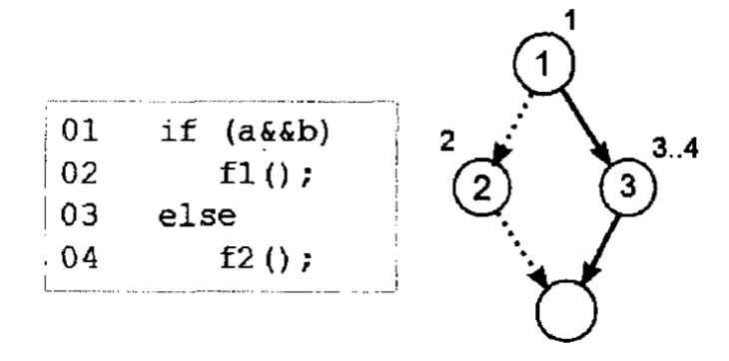
Advantages and Disadvantages of Condition Coverage
Advantages
Does focus on condition outcomes
Disadvantage
Can be difficult to determine the required input parameter values
Does not always achieve branch coverage.
Branch Coverage test cases:
1: a = true, b = false. 2: a = false b = true
Note that each conditions (a and b) has taken on the values true and false, but the decision on line 1 always evaluates to false.

Slide 41
Advantages and Disadvantages of Condition Coverage
Branch Coverage test cases:
1: a = true, b = false. 2: a = false b = true
Note that each conditions (a and b) has taken on the values true and false, but the decision on line 1 always evaluates to false.

Slide 42
Decision/Condition Coverage
In Decision/Condition Coverage, the possible outcomes of each condition and of each decision are tested at least once. This implies both Condition coverage and Decision coverage.
In other words, tests are generated to cause every decision to be taken at least once (Branch Coverage) and also every condition to be true and false at least once (Condition Coverage).
The goal is to achieve 100% coverage of every decision and 100% coverage of every condition.

Slide 43
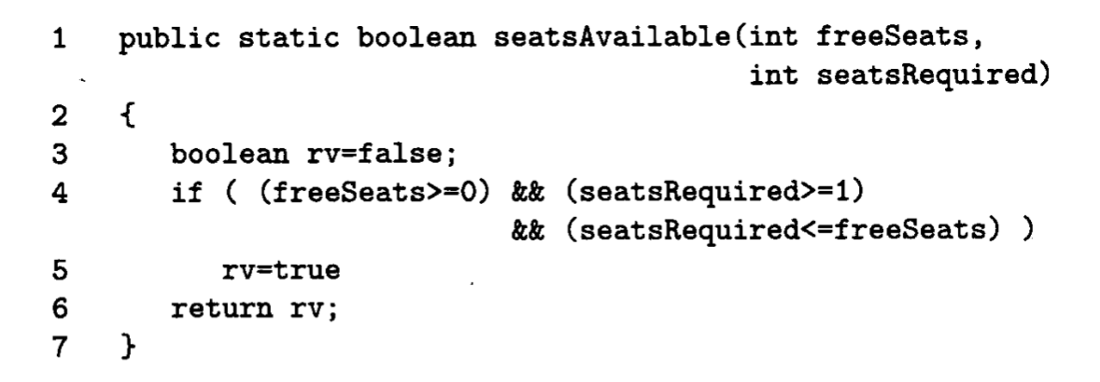
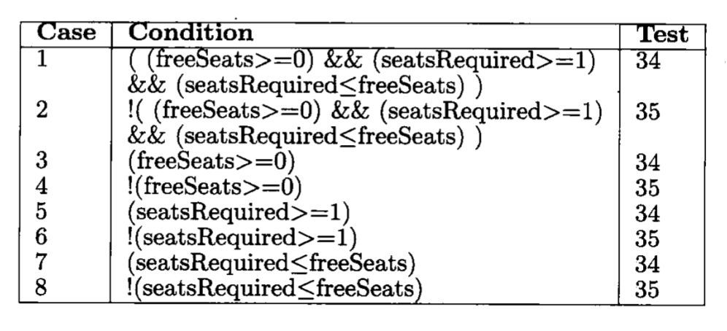
Decision/Condition Coverage
Each Boolean value for each decision is a test case.
Each Boolean value for each condition is a test case.

Slide 44
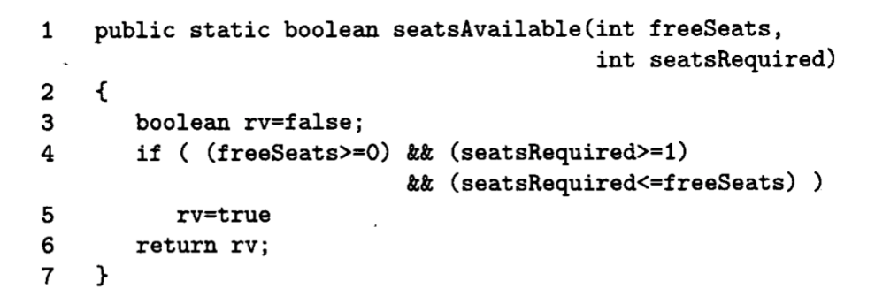
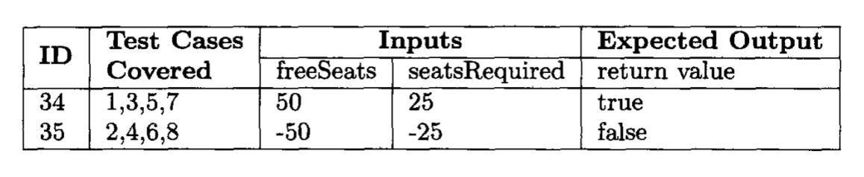
Decision/Condition Coverage

Slide 45

投票
最多可选1项
Decision/Condition Coverage is sufficient to test a code?
A
Yes
B
No，No，No, too simple too naive
C
I do not know
提交
Notes:
黑盒测试功能
白盒测试用以发现什么bug？
测试代码

Slide 46
Advantages and Disadvantages of Decision/Condition Coverage
Advantages:
Stronger coverage than just Condition Coverage or Decision Coverage
Decision Condition Coverage (DCC) subsumes Condition Coverage and Decision Coverage. It means that if we performed DCC testing, then no need to perform Condition Coverage and Decision Coverage.
Disadvantages:
Even though every decision is tested, and every condition is tested, not every possible combination of conditions is tested.
Can be difficult to determine the required input parameter values.

Slide 47
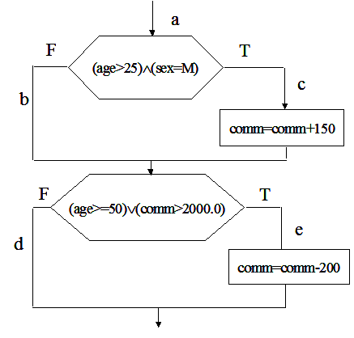
Disadvantages of Decision/Condition Coverage
if ((age>25)AND(sex=M)) then
commission = commission +150;
end if
if (age>=50 OR (commission >2000.0)) then
commission = commission -200；
endif

Slide 48
Disadvantages of Decision/Condition Coverage
The first decision：
age>25 ture， marked as T₁
age>25 false， marked as F₁
sex=M ture， marked as T₂
sex=M false， marked as F₂
The second decision:
Age>=50 ture， marked as T₃
Age>=50 false， marked as F₃
comm.>2000 ture， marked as T₄
comm.>2000 false， marked as F₄

Slide 49
Disadvantages of Decision/Condition Coverage
test case
age sex comm
path
覆盖条件
Test
1
50
M 2500.0
a c e
T1 T2 T3 T4
Test3
20 M 1500.0
a b d
50 F 1900.0
a b e
F1 T2 F3 F4
Test5
T1 F2 T3 F4
Problem: path acd is not tested

Slide 50
Multiple Condition Coverage
Tests are generated to cause every possible combination of conditions for every decision to be tested.
The goal is to achieve 100% coverage of every decision and 100% coverage of combiantion of conditions.
A Truth-Table is the best way to identify all the possible combinations of values.

Slide 51
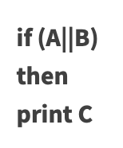
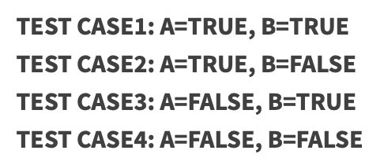
Multiple Condition Coverage
Let’s take an example:
Here we have 2 Boolean expressions A and B, so the test set for Multiple Condition Coverage will be:
As you can see that there are 4 test cases for 2 conditions. Similarly there will be 8 test cases for 3 conditions.
So you can say that if there are n conditions, there will be 2^{n} tests.

Slide 52

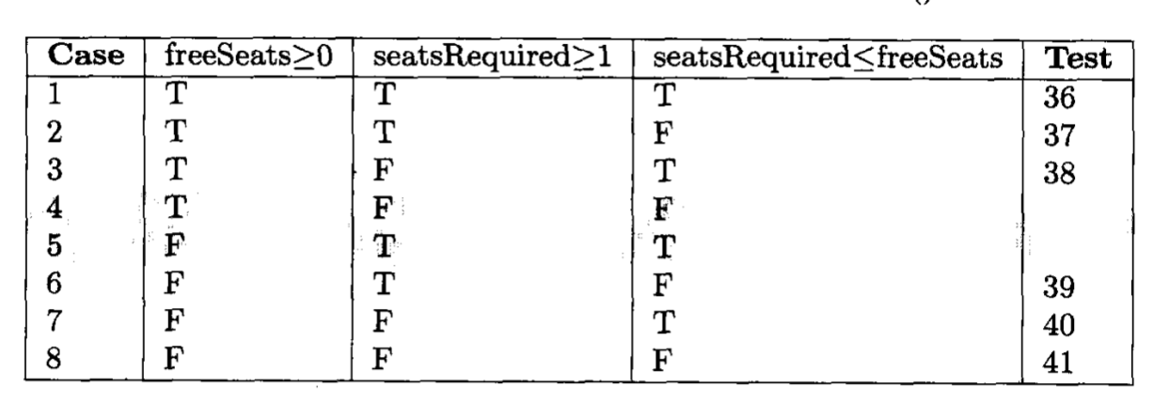
Multiple Condition Coverage
Each combination of values for conditions is a test case.
The shaded rows indicate impossible test cases, and therefore not covered by any of the tests.

Slide 53

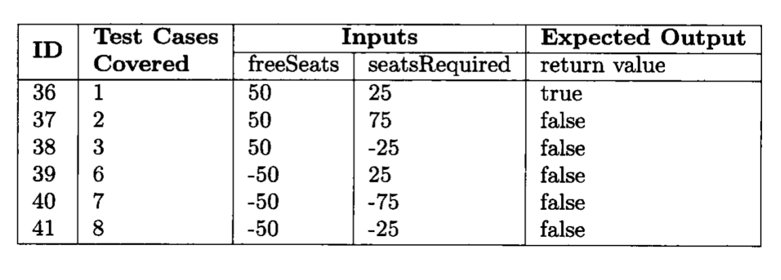
Multiple Condition Coverage

Slide 54
Advantages and Disadvantages of Multiple Condition Coverage
Advantages:
It tests all possible combinations of conditions in every decision.
Note that not all combinations of conditions are always possible.
Disadvantages:
Can be expensive: n conditions in a decision give 2^{n} test cases
Can be difficult to determine the required input parameter values

Slide 55
Path Testing
Path testing causes every possible path from entry to exit of the program to be taken during test execution.
By inspection of the code, input data is selected to cause execution of every path. Each unique path from start to finish is a test case.
For complex programs, some paths may not be possible.
Expected outputs are derived from the specification.

Slide 56
How to Perform Path Testing
Step 1: Drafting a control flow graph to identify the possible program paths.
Step 2: Figure out all the independent paths.
Step 3: Generate test cases to evaluate the program flow for each path.

Slide 57
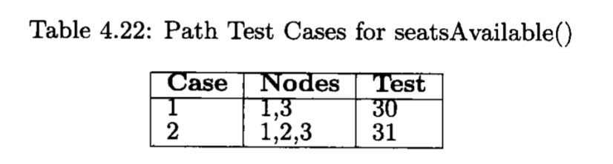
Path Testing
Examining the control flow graph, two paths can be see through the program:
Node 1-3
Node 1-2-3
Each path is a separated Test Case.

Slide 58
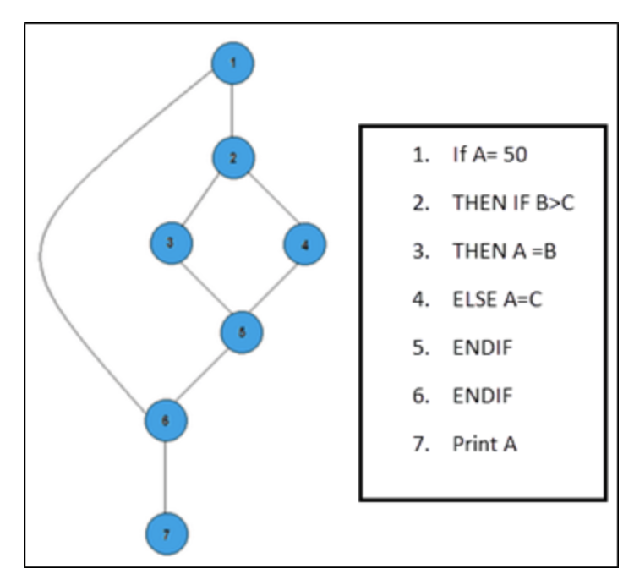
Path Testing
There are 3 paths
Path 1: 1-2-3-4-5-6-7
Path 2: 1-2-4-5-6-7
Path 3: 1-6-7

Slide 59
Advantages and Disadvantages of Path Testing
Advantages:
Test cases which exercise basis path set will execute every statement in a program at least once.
Disadvantages:
Can be computationally intensive if the program is complex and many paths are found.
Does not explicitly evaluate the condition in each decision.

Slide 60
Assignment
The basic cost of an insurance premium for drivers is 500. However, this premium can increase or decrease depending on three factors: their age, their gender and their marital status.
Specification:
Program Inputs:
Age: Integer.
Gender: ‘M’, ‘F’, invalid input
Married: True, False
Program Outputs:
Return value:
0: uninsurable age, or illegal inputs
200: married or female, and 45<=age<=65
300: married or female, and 16<=age<46
400: single male, and 45<=age <=65
500: single male, and 25<= age <45
2000: single male, less than 25

Slide 61
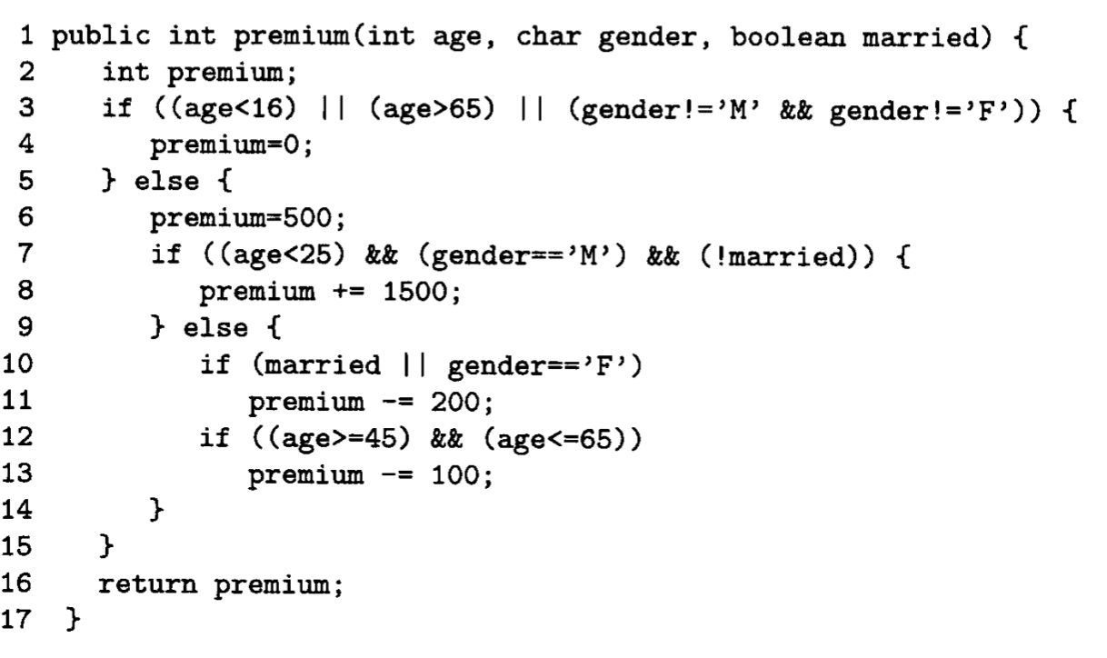

Slide 62
Using following White Box Testing techniques to design test cases
Statement Coverage
Branch Coverage
Condition Coverage
Decision/Condition Coverage
Multiple Condition Coverage
Path Testing

