Slide 1
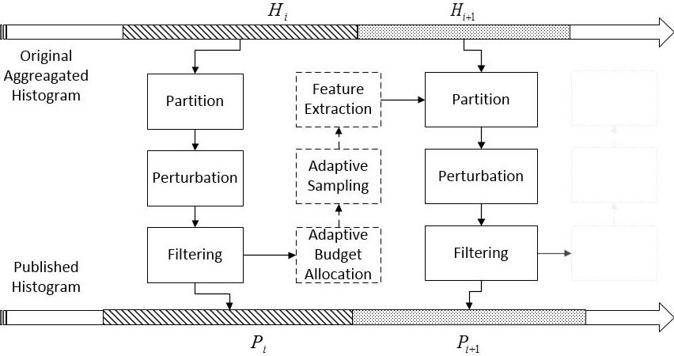
Fig. 1. Overview of Real-time e-doctor histogram releasing with differential privacy.

