Slide 2
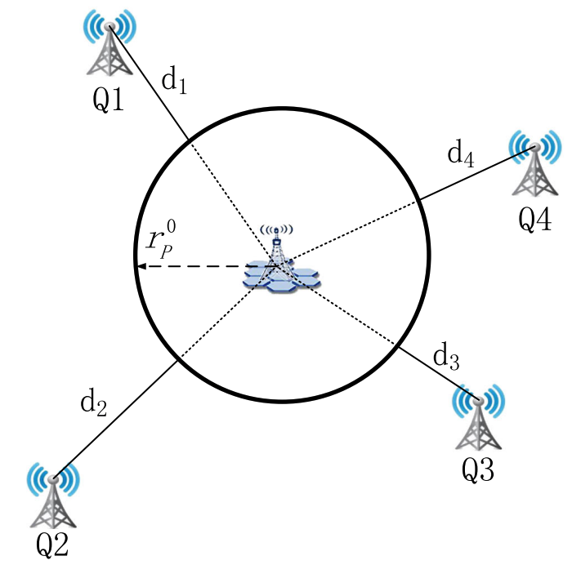
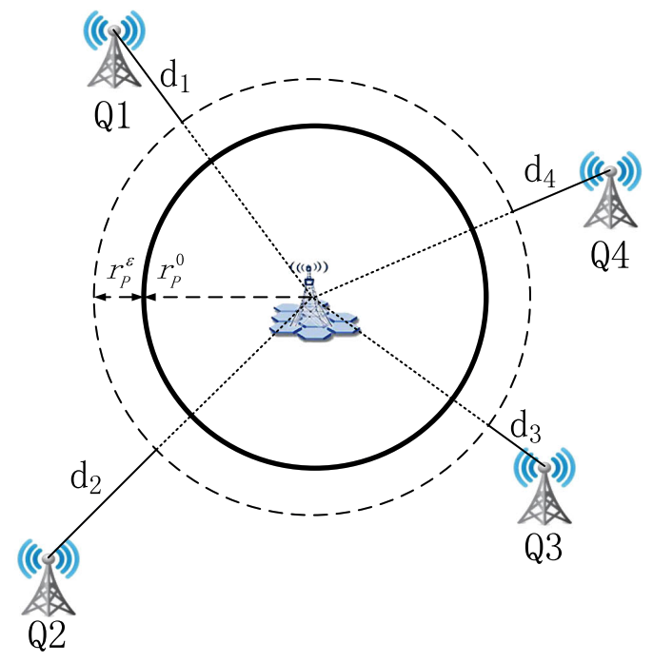
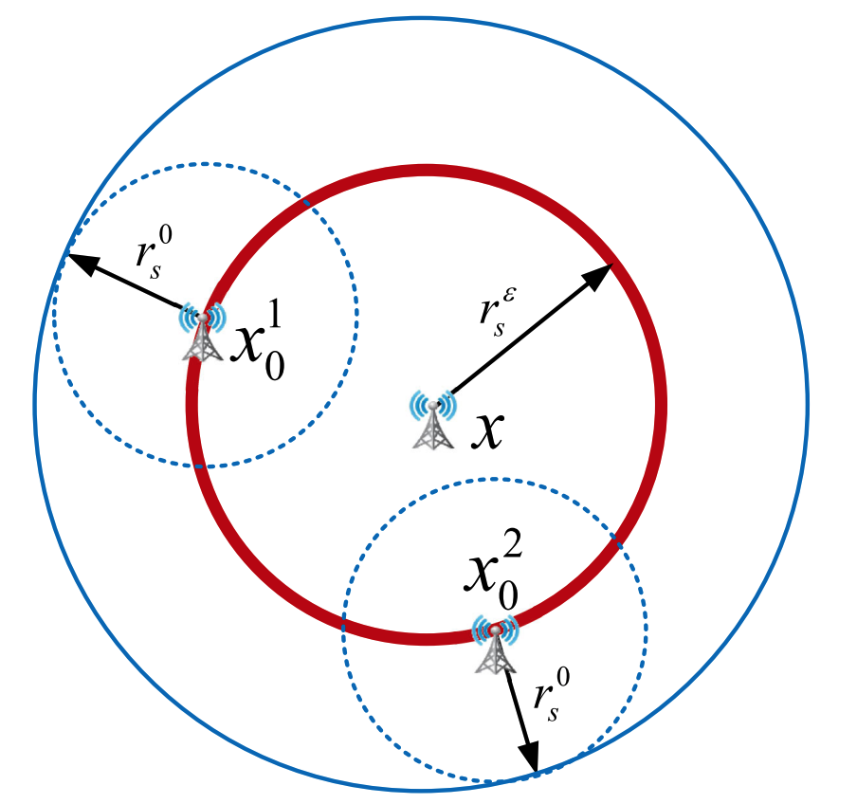
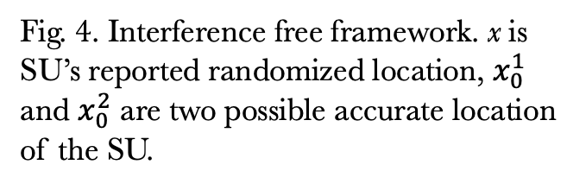
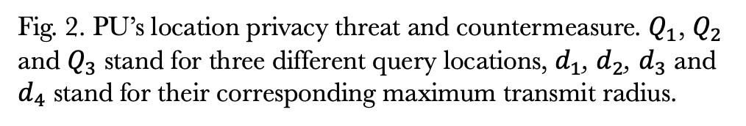
(a) Inference attack to PU.
(a) Privacy-preserving mechanism.
Fig. 4. Interference free framework. x is SU’s reported randomized location, $x_{0}^{1}$ and $x_{0}^{2}$ are two possible accurate location of the SU.
Fig. 2. PU’s location privacy threat and countermeasure. $Q_{1}$, $Q_{2}$ and $Q_{3}$ stand for three different query locations, $d_{1}$, $d_{2}$, $d_{3}$ and $d_{4}$ stand for their corresponding maximum transmit radius.

