Slide 1
ELE 492 Embedded Systems
The MSP430 Introduction
Ali Ziya Alkar

Slide 2
Outline
MSP430: An Introduction
The MSP430 family
Technology Roadmap
Typical Applications
The MSP430 Documentation
MSP430 Architecture
MSP430 Devices
Getting Started with EasyWeb2
MSP430 RISC core

Slide 3
The Family
Broad family of TI’s 16-bit microcontrollers
  from 1Kbytes ROM, 128 bytes RAM (approx. $1 )
  to 60Kbytes ROM, 10Kbytes RAM ( $10)
Three subfamilies
  MSP430x1xx: basic unit
  MSP430x3xx: more features
  MSP430x4xx: built-in LCD driver

Slide 4
Part numbering convention
MSP430M_{t}F_{a}F_{b}M_{c}
  Mt : Memory type
    C – ROM, F – Flash, P – OTP, E – EPROM
  Fa,Fb
    10, 11 – basic
    12, 13 – HW UART
    14 – HW UART, HW multiplier
    31, 32 – LCD Controller
    33 – LCD controller, HW UART, HW multiplier
    41 – LCD controller
    43 - LCD controller, HW UART
    44 - LCD controller, HW UART, HW multiplier

Slide 5
Part numbering convention
MSP430M_{t}F_{a}F_{b}M_{c}
  Mc : Memory capacity
    0: 1 Kb ROM, 128 b RAM
    1: 2 KB ROM, 128 b RAM
    2: 4 KB ROM, 256 b RAM
    ....
    9: 60 KB ROM, 2 Kb RAM

Slide 6
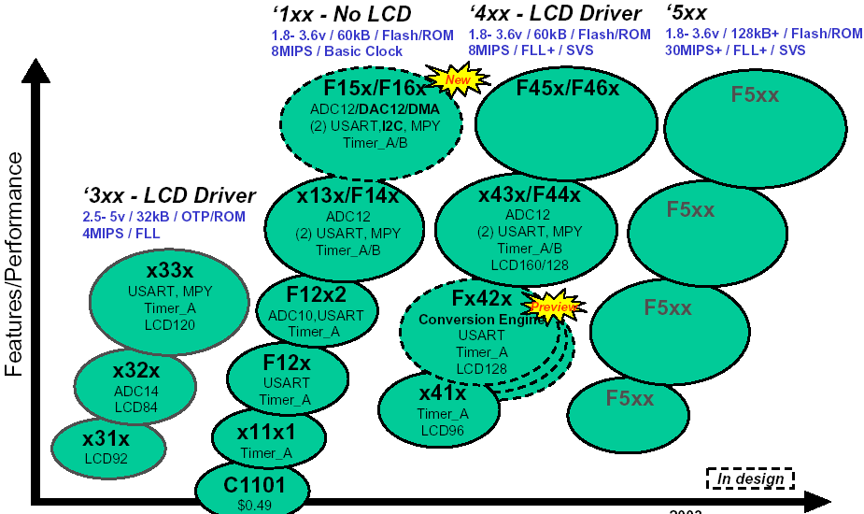
MSP 430 Roadmap

Slide 7
MSP430 Typical Applications
Handheld Measurement
Air Flow measurement
Alcohol meter
Barometer
Data loggers
Emission/Gas analyser
Humidity measurement
Temperature
measurement
Weight scales
Medical Instruments
Blood pressure meter
Blood sugar meter
Breath measurement
EKG system
Utility Metering
Gas Meter
Water Meter
Heat Volume Counter
Heat Cost Allocation
Electricity Meter
Meter reading system (RF)
Sports equipment
Altimeter
Bike computer
Diving watches
Security
Glass break sensors
Door control
Smoke/fire/gas detectors
Home environment
Air conditioning
Control unit
Thermostat
Boiler control
Shutter control
Irrigation system
White goods
(Washing machine,..)
Misc
Smart card reader
Taxi meter
Smart Batteries

Slide 8
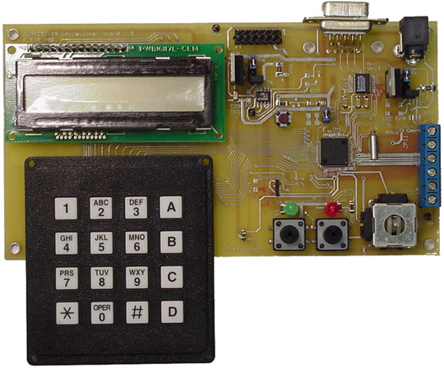
An MSP430-Based System
LCD
Adj. Vol. Regul.
RS232
RS232 controller
Analog I/O
2-axes joystick
LEDs
Switches
Thermistor
μC
Keypad

Slide 9
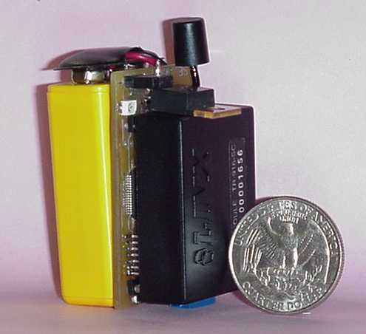
Another MSP430-Based System
Basic WISE
Battery
Microcontroller
  TI MSP430F149
  8-channel 12-bit AD conv.
Accelerometer
  Movement detection
  Analog Device ADXL202
Transceiver
  LINX 916 MHz

Slide 10
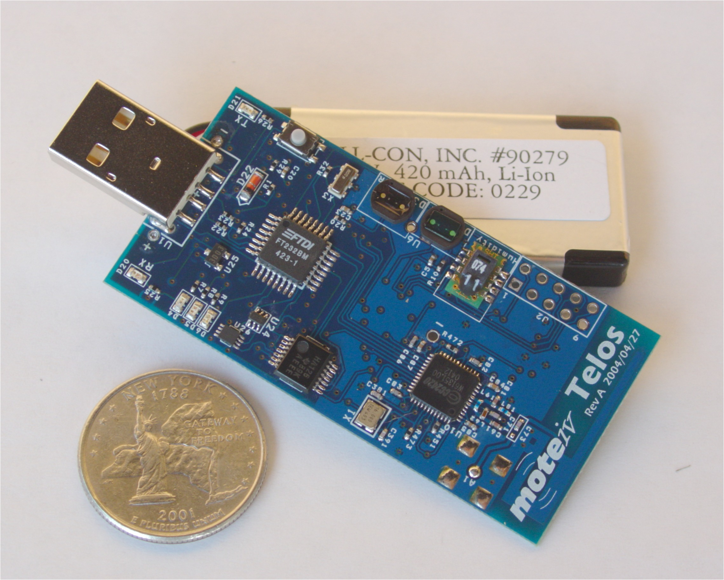
Tmote Sky Platform
Texas Instruments 16-bit MSP430F149 microcontroller (2KB RAM, 60KB ROM)
Chipcon 2420, 250kbps, 2.4GHz, IEEE 802.15.4 compliant wireless transceiver
with programmable output power
Integrated onboard antenna with 50m range indoors and 125m range outdoors
Integrated humidity, temperature, and light sensors

Slide 11
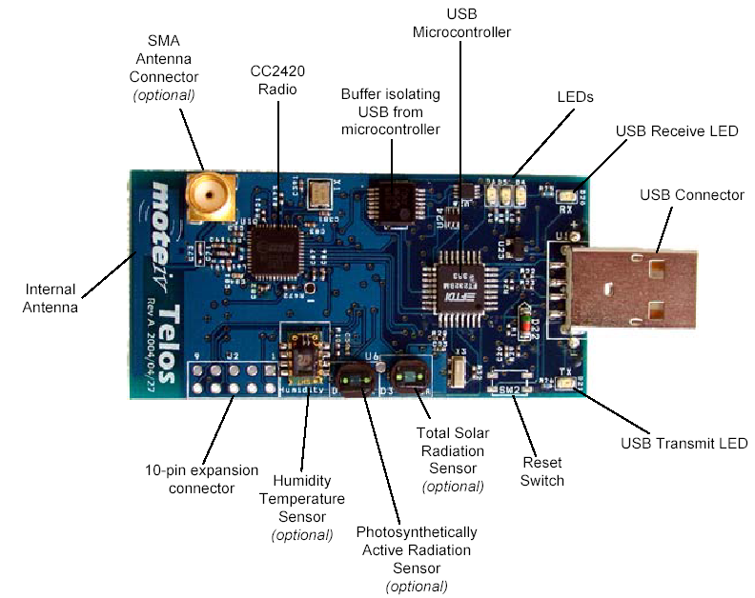
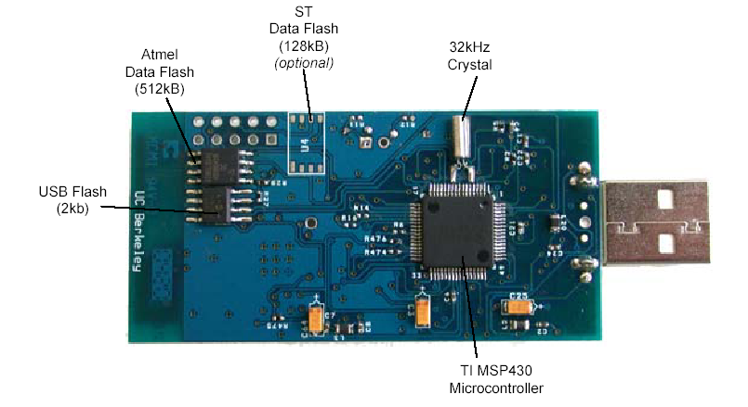
Tmote Sky Platform
http://www.moteiv.com

Slide 12
MSP430 Documentation
MSP430 home page (TI)
  www.ti.com/msp430
User’s manual (MSP430x1xx Family)
  http://www.ece.uah.edu/~milenka/cpe421-06S/docs/msp430/slau049e.pdf
Datasheet
  http://www.ece.uah.edu/~milenka/cpe421-06S/docs/msp430/msp430f149.pdf
TI Workshop document
  http://www.ece.uah.edu/~milenka/cpe421-06S/docs/msp430/430_2002_atc_workshop.pdf
IAR Workbench Tutorial
  http://www.ece.uah.edu/~milenka/cpe421-06S/docs/msp430/iar_tut.pdf

Slide 13
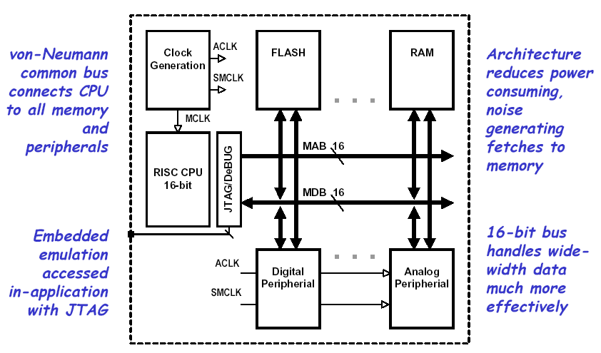
MSP 430 Modular Architecture

Slide 14
CPU Introduction
RISC architecture with 27 instructions and 7 addressing modes.
Orthogonal architecture with every instruction usable with every addressing mode.
Full register access including program counter, status registers, and stack pointer.
Single-cycle register operations.
Large 16-bit register file reduces fetches to memory.
16-bit address bus allows direct access and branching throughout entire memory range.
16-bit data bus allows direct manipulation of word-wide arguments.
Constant generator provides six most used immediate values and reduces code size.
Direct memory-to-memory transfers without intermediate register holding.
Word and byte addressing and instruction formats.

Slide 15
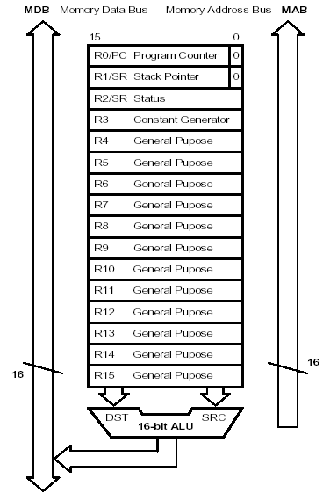
MSP430 16-bit RISC
Large 16-bit register file eliminates single accumulator bottleneck
High-bandwidth 16-bit data and address bus with no paging
RISC architecture with 27 instructions and 7 addressing modes
Single-cycle register operations with full-access
Direct memory-memory transfer designed for modern programming
Compact silicon 30% smaller than an ‘8051 saves power and cost

Slide 16
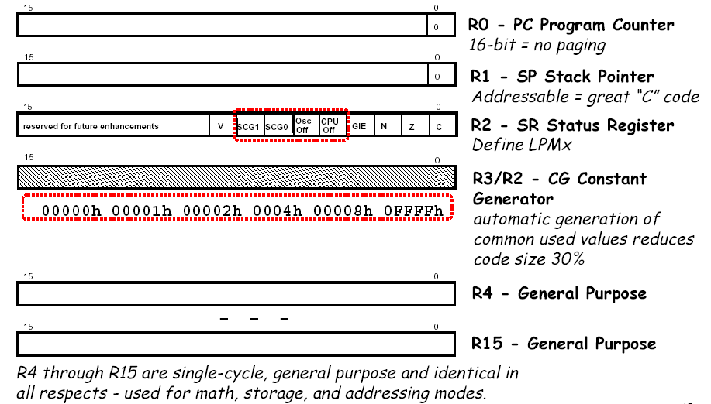
CPU Registers

Slide 17
Registers: PC (R0)
Each instruction uses
an even number of bytes (2, 4, or 6)
PC is word aligned (the LSB is 0)
MOV #LABEL,PC ; Branch to address LABEL
MOV LABEL,PC ; Branch to address contained in LABEL
MOV @R14,PC ; Branch indirect, indirect R14

Slide 18
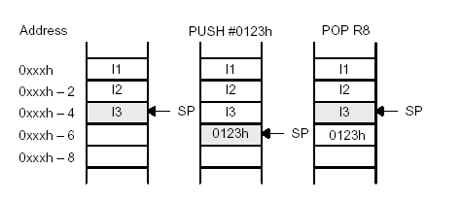
Registers: SP (R1)
Stack pointer for return addresses of subroutines and interrupts
SP is word aligned (the LSB is 0)
Pre-decrement/post-increment scheme
MOV 2(SP),R6 ; Item I2 –> R6
MOV R7,0(SP) ; Overwrite TOS with R7
PUSH #0123h ; Put 0123h onto TOS
POP R8 ; R8 = 0123h

Slide 19

Registers: SR (R2)
  C: SR(0)
  Z: SR(1)
  N: SR(2)
  GIE (Global interrupt enable): SR(3)
  CPUOff: SR(4)
  OSCOff: SR(5)
  SCG1, SCG0: SR(7), SR(6)
  V: SR(8)

Slide 20
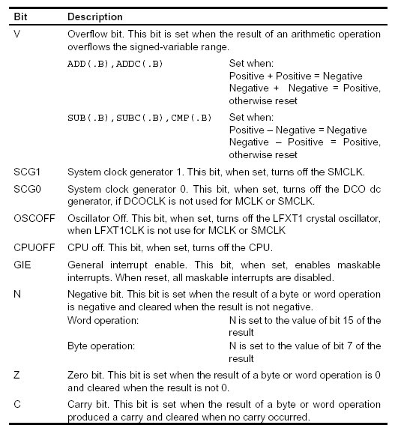
Status bits

Slide 21
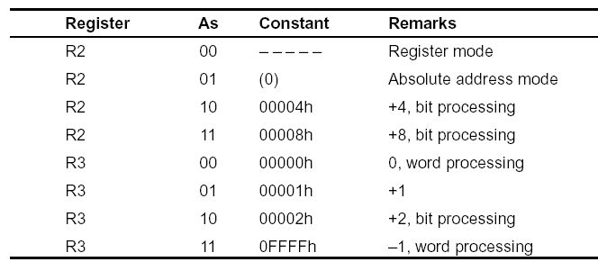
Constant Generators
As – source register addressing mode in the instruction word

Slide 22
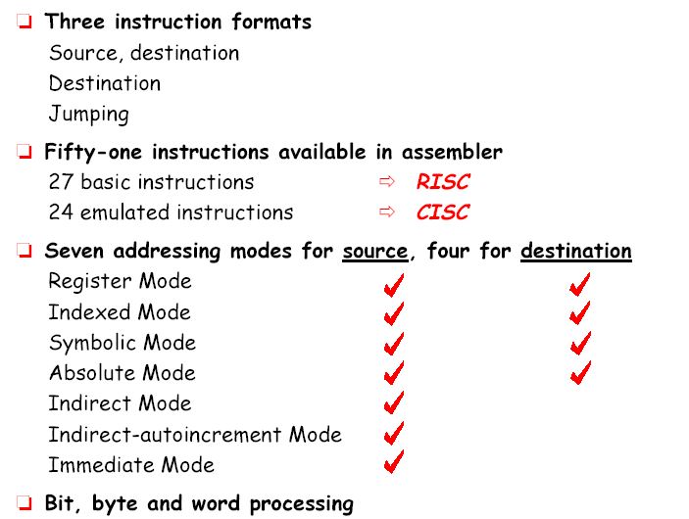
CISC / RISC Instruction Set

Slide 23
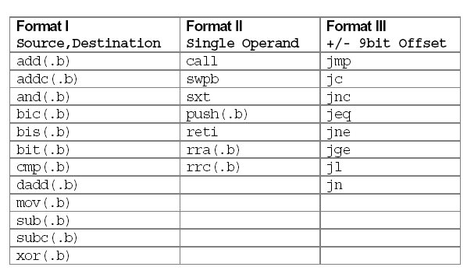
27 Core RISC Instructions

Slide 24
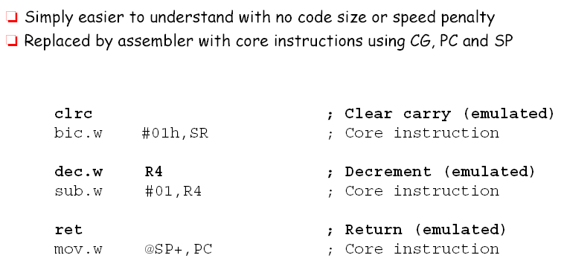
Emulated Instructions

Slide 25
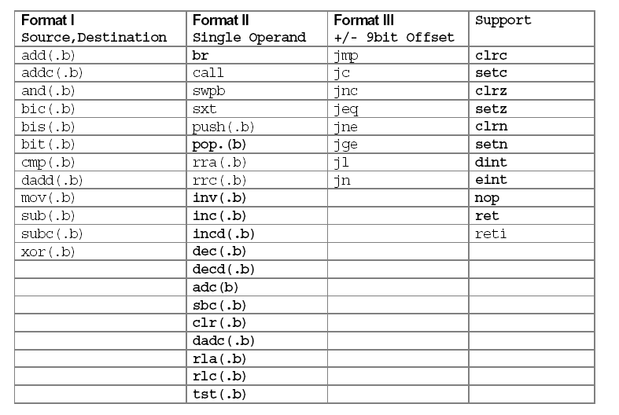
51 Total Instructions

Slide 26
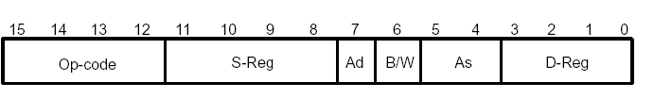
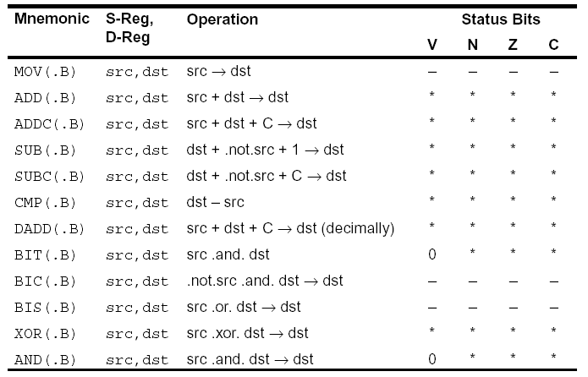
Double operand instructions

Slide 27

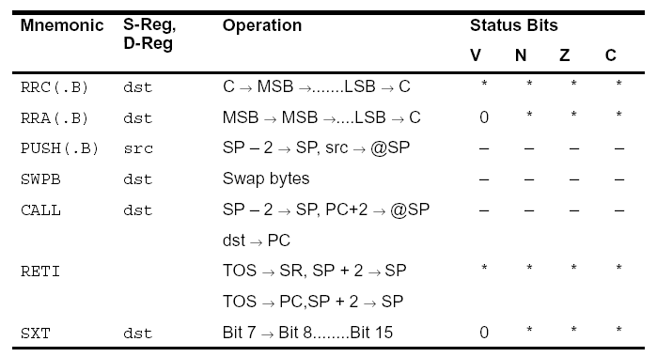
Single Operand Instruction

Slide 28

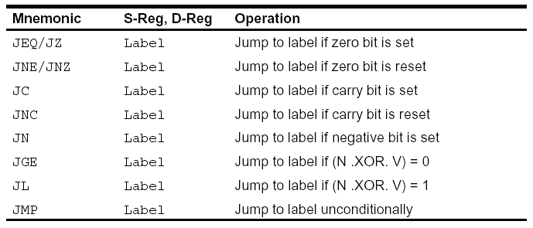
Jump Instructions

Slide 29
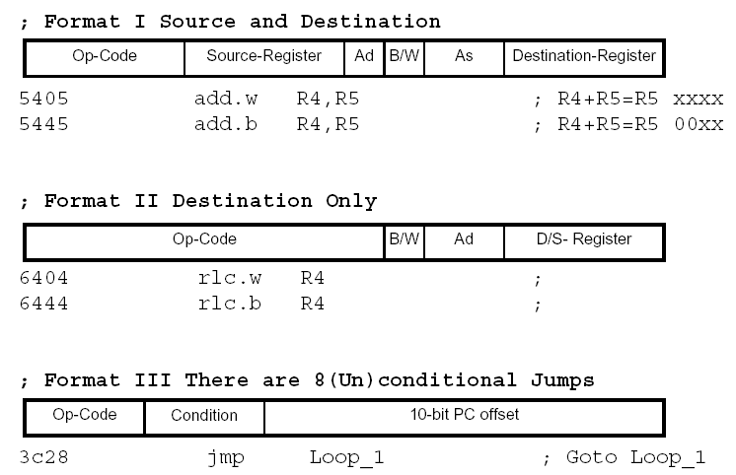
3 Instruction Formats

Slide 30
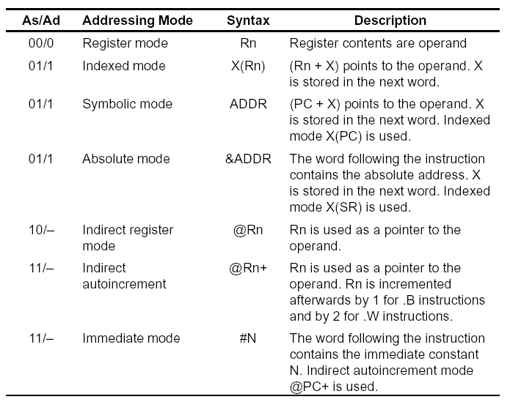
Addressing Modes

Slide 31
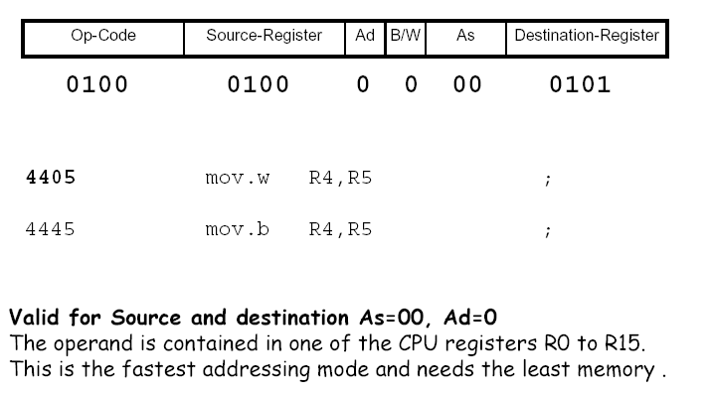
Register Addressing Mode

Slide 32
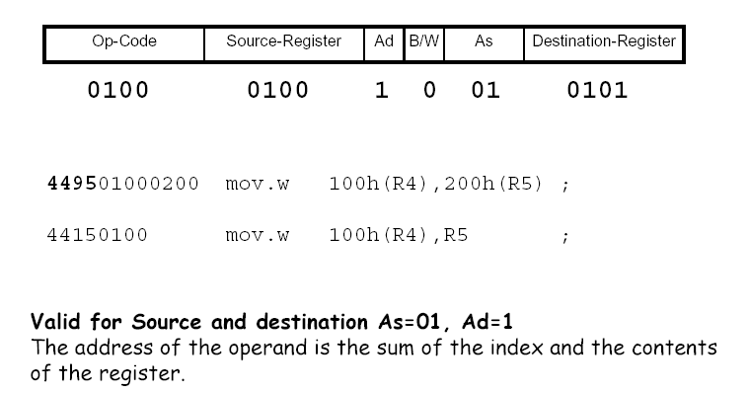
Register-Indexed
Addressing Mode

Slide 33
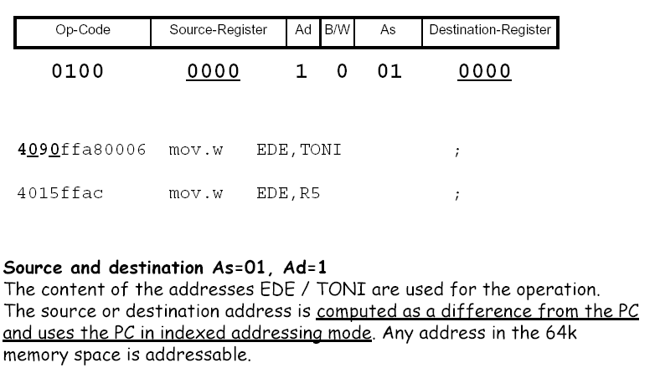
Symbolic Addressing Mode

Slide 34
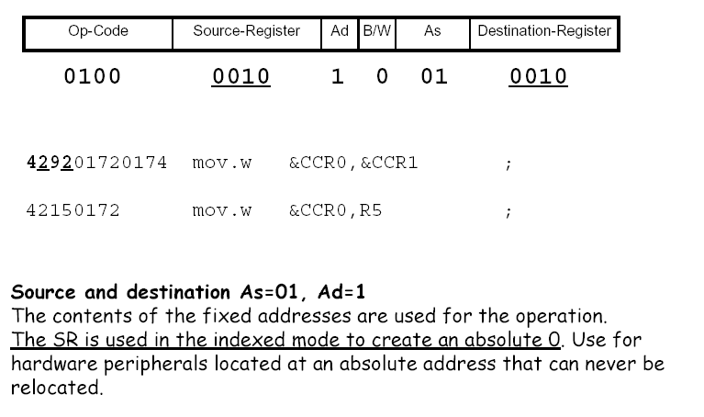
Absolute Addressing Mode

Slide 35
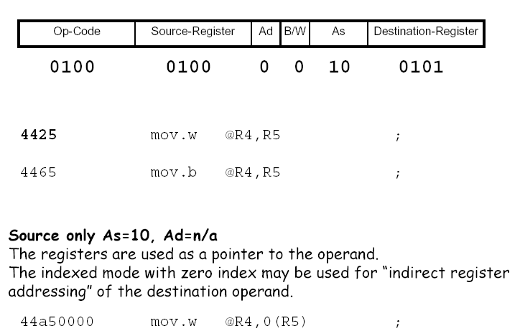
Register Indirect Addressing Mode

Slide 36
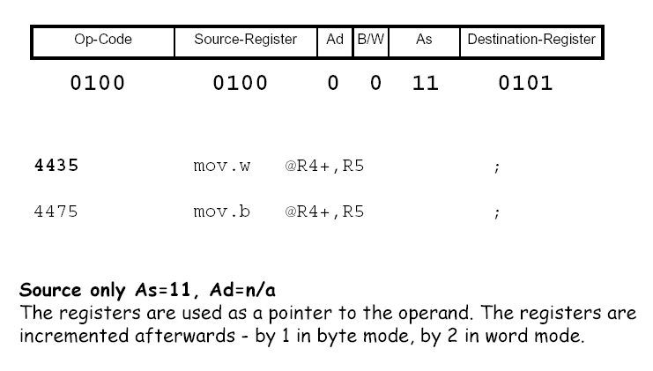
Register Indirect
Autoincrement Addressing Mode

Slide 37
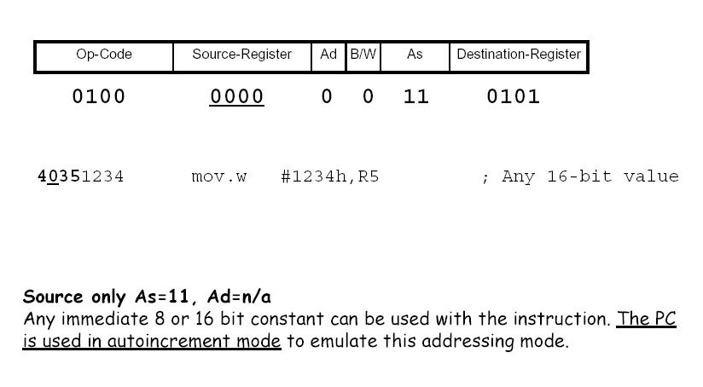
Immediate Addressing Mode

Slide 38
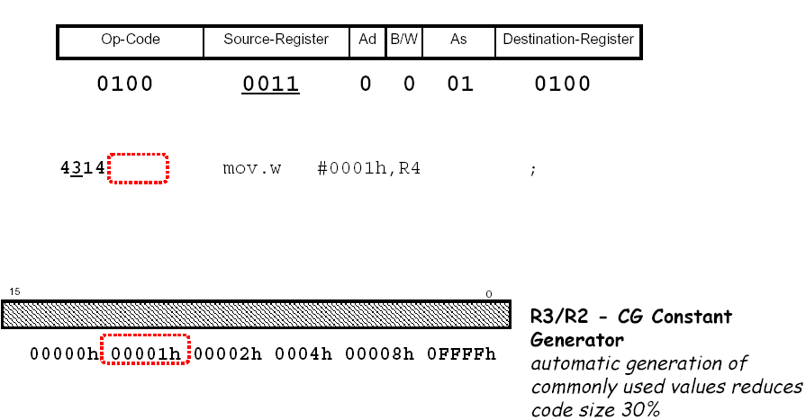
Code Reduction Effect of
Constant Generator

Slide 39
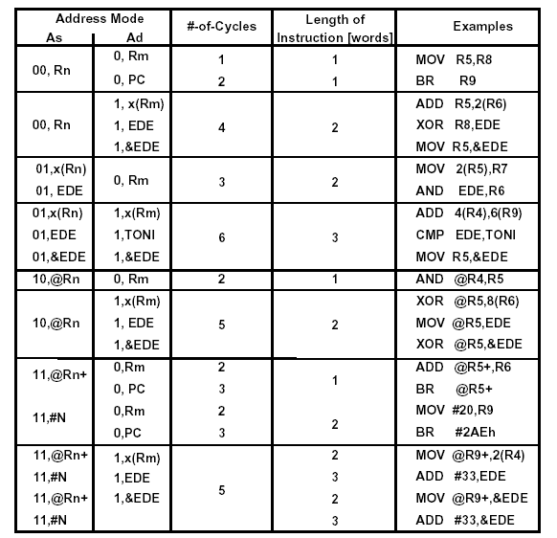
Machine Cycles for Format I Instructions

Slide 40
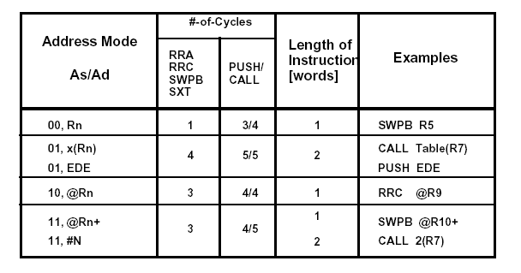
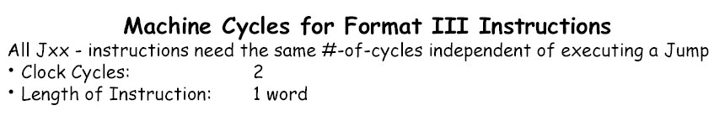
Machine Cycles for
Format II/III Instructions

Slide 41
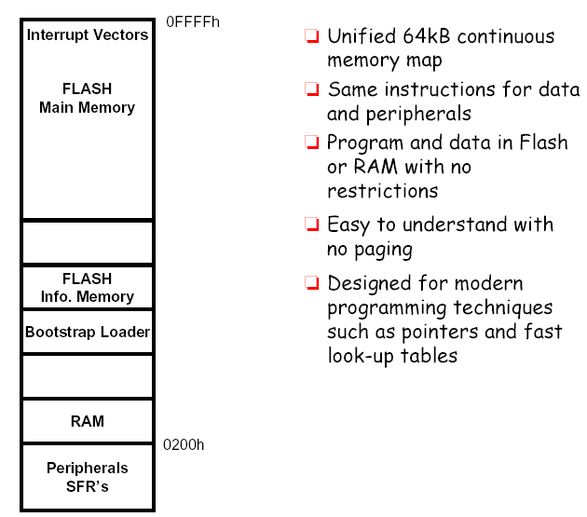
MSP430 Memory Model

Slide 42
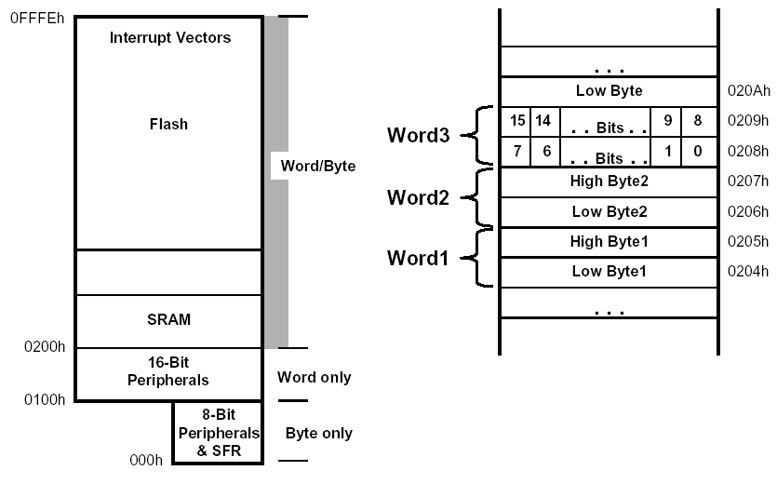
Memory Organization

Slide 43
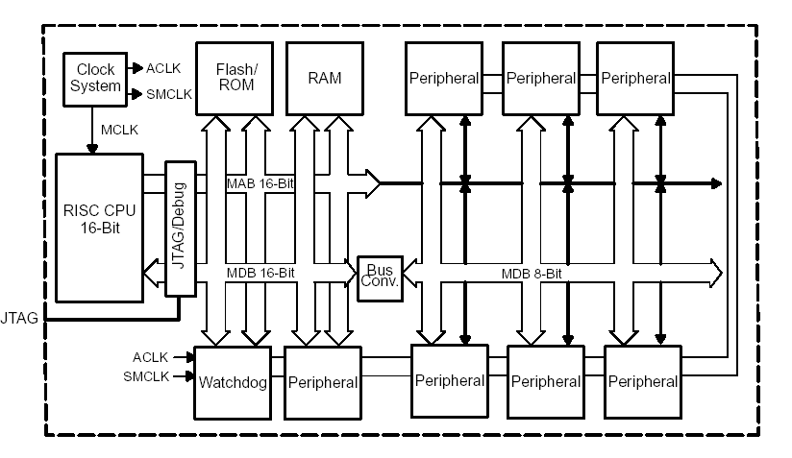
MSP 430 Architecture: A Closer Look

Slide 44
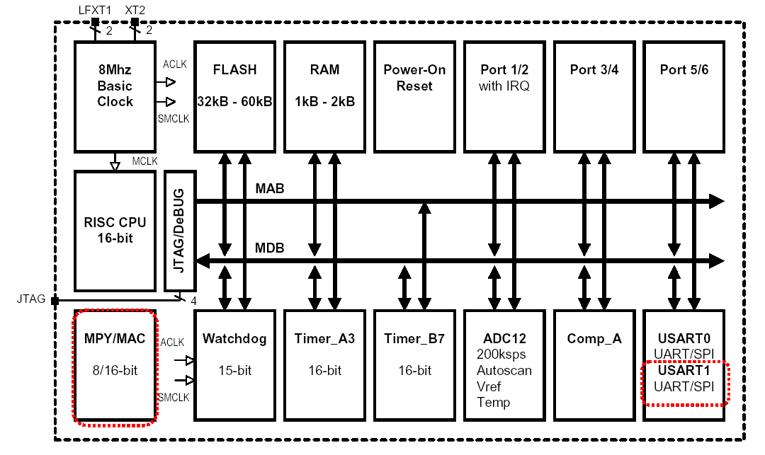
MSPx430x14x Architecture
64 TQFP (The The Thin Quad Flat Pack package

Slide 45
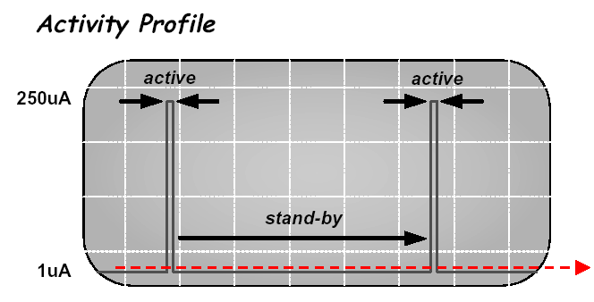
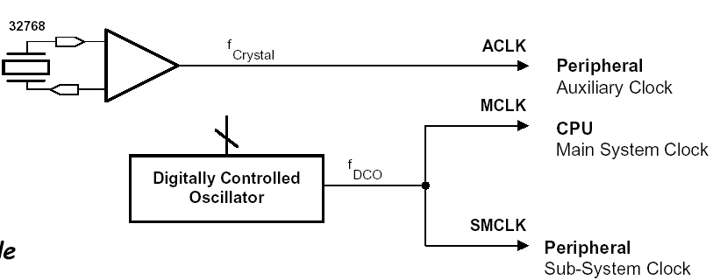
Basic Clock System
Basic Clock Module
provides the clocks for the MSP430 devices

Slide 46
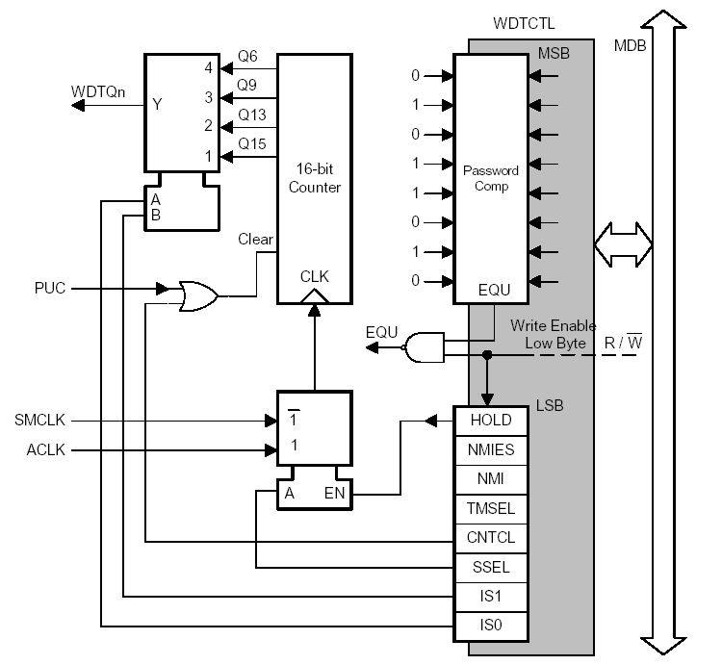
Watchdog Timer
WDT module performs a controlled system restart after a software problem occurs
Can serve as an interval timer (generates interrupts)
WDT Control register is password protected
Note: Powers-up active

Slide 47
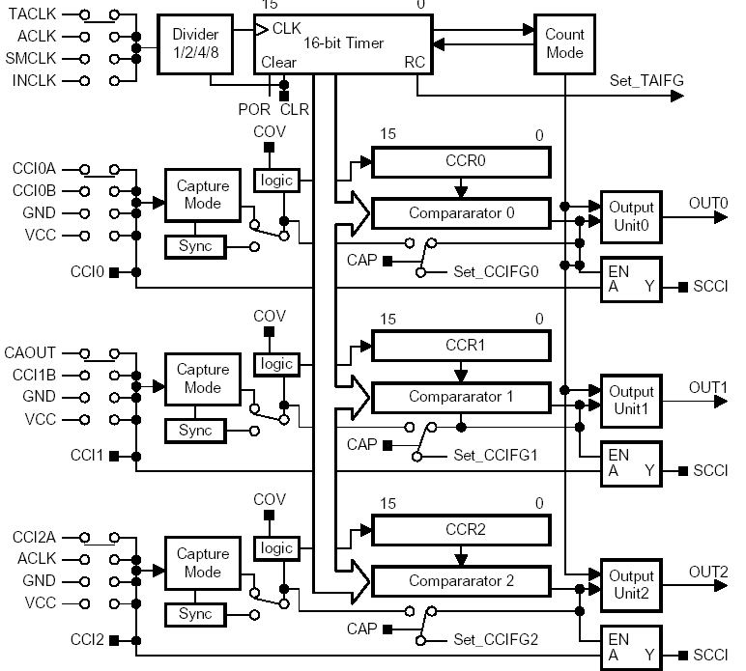
Timer_A
Timer_A is a 16-bit timer/counter with three capture/compare registers
Capture external signals
Compare PWM mode
SCCI latch for asynchronous communication

Slide 48
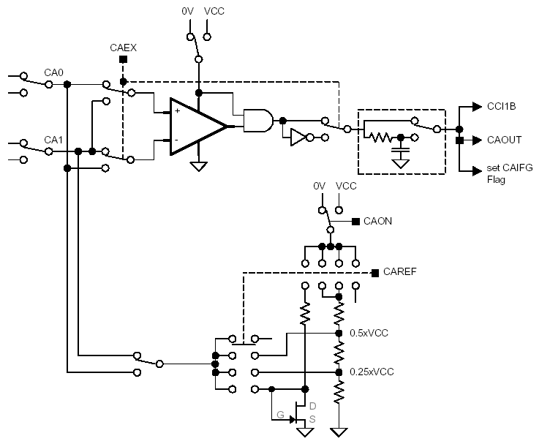
Comparator_A
Comparator_A is an analog voltage comparator
Supports precision slope analog-to-digital conversions
Supply voltage supervision, and
Monitoring of external analog signals.

Slide 49
Digital I/O
Independently programmable individual I/Os
Port1
Port3
Port2
…
Port6
Function Select Register PxSEL
yes
yes
Interrupt Edge Select Register PxIES
yes
no
Interrupt Enable Register PxIE
yes
no
Up to 6 ports (P1 – P6)
Each has 8 I/O pins
Each pin can be configured as input or output
P1 and P2 pins can be configured to assert an interrupt request
Interrupt Flag Register PxIFG
yes
no
Direction Register PxDIR
yes
yes
Output Register PxOUT
yes
yes
Input Register PxIN
yes
yes
P1.
P2.
P3.
7
6
5
4
3
2
1
0
P4.
P5.
P6.

Slide 50
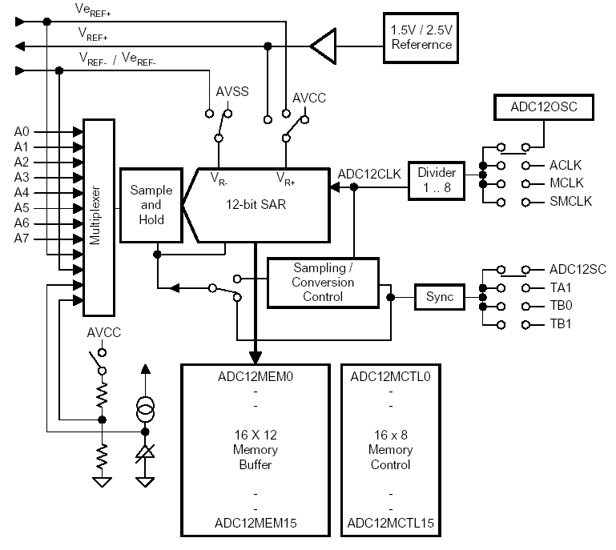
ADC12
High-performance 12-bit analog-to-digital converter
More than 200 Ksamples/sec
Programmable sample&
hold
8 external input channels
Internal storage

Slide 51
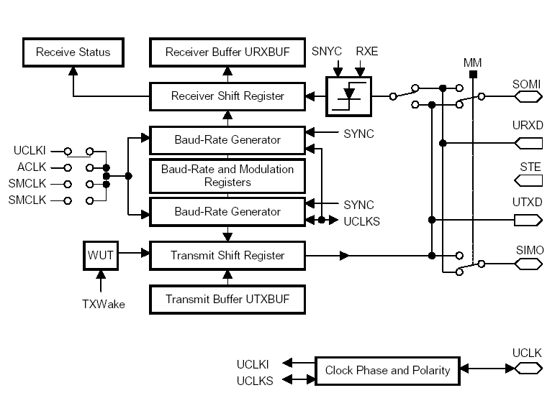
USART Serial Port
The universal synchronous/ asynchronous receive/transmit (USART) peripheral interface supports two serial modes with
one hardware module
UART or SPI (Synchronous Peripheral Interface) modes
Double-buffered
Baud-rate generator

Slide 52
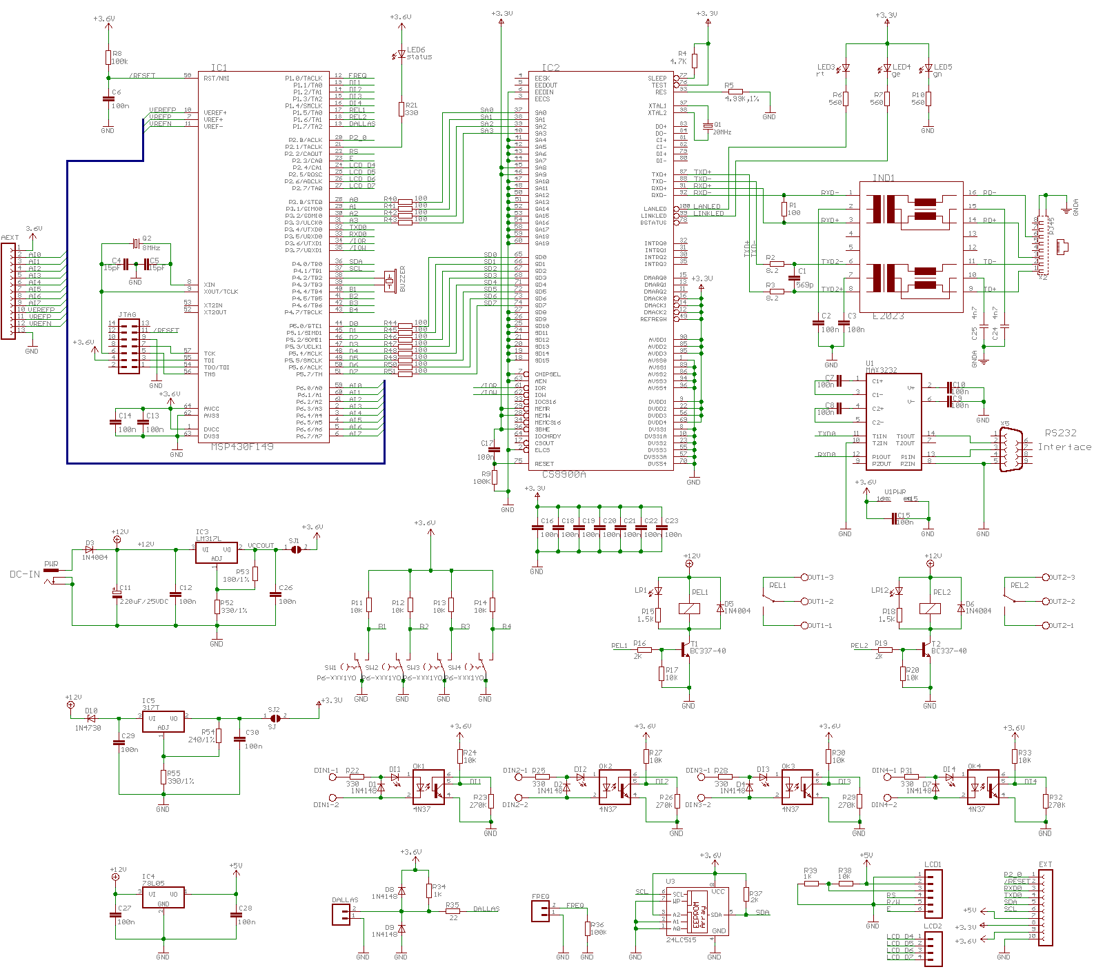
Getting Started with EasyWeb2

Slide 53
Getting Started with EasyWeb2
//********************************************
// MSP-FET430P140 Demo - Software Toggle P2.1
//
// Description; Toggle P2.1 by xor'ing P2.1
// inside of a software loop.
// ACLK = n/a, MCLK = SMCLK = default DCO ~ 800k
//
// MSP430F149
// -----------------
// /|\| XIN|-
// | | |
// --|RST XOUT|-
// | |
// | P2.1|-->LED
//
// M. Buccini
// Texas Instruments, Inc
// January 2002
// Built with IAR Embedded Workbench Version: 1.25A
//
// @Alex Milenkovich, milenkovic@computer.org
// The University of Alabama in Huntsville
// February 2005
// Modified for easyWeb2 board to blink
// the Status led (port P2.1)
//********************************************
#include <msp430x14x.h>
void main(void)
{
// Stop watchdog timer
WDTCTL = WDTPW + WDTHOLD;
P2DIR |= 0x02; // Set P2.1 to output direction
for (;;)
{
unsigned int i;
// Toggle P2.1 using exclusive-OR
P2OUT ^= 0x02;
i = 50000; // Delay
do (i--);
while (i != 0);
}
}

