Slide 1

G2M Case Study
Virtual Internship
13-Mar-2023

Slide 2
Background –G2M(cab industry) case study
XYZ is a private equity firm in US. Due to remarkable growth in the Cab Industry in last few years and multiple key players in the market, it is planning for an investment in Cab industry.
Objective: Provide actionable insights to help XYZ firm in identifying the right company for making investment.
Assumptions:
Outliers are present in Price_Charged feature but due to unavailability of trip duration details ,we are not treating this as outlier.
Profit of rides are calculated keeping other factors constant and only Price_Charged and Cost_of_Trip features used to calculate profit.
Users feature of city dataset is treated as number of cab users in the city. We have assumed that this can be other cab users as well (including Yellow and Pink cab)

Slide 3
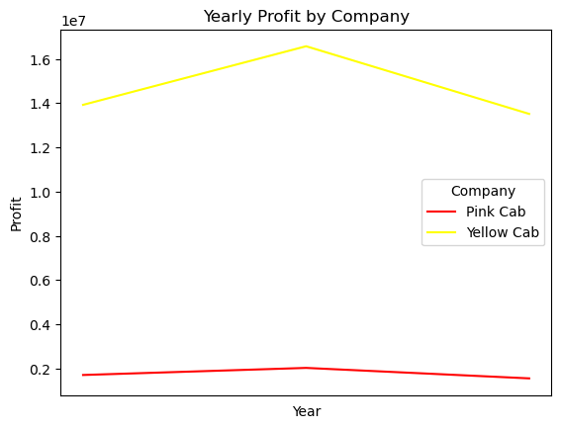
Yearly Profit Analysis
Yellow Cab makes much more profit than Pink Cab yearly, which shown that Yellow Cab is a larger volume company than Pink Cab. As both companies have similar trends of having growth in 2017 and loss in 2018, possibly the cab industry has a shock in 2018, resulting the loss.

Slide 4
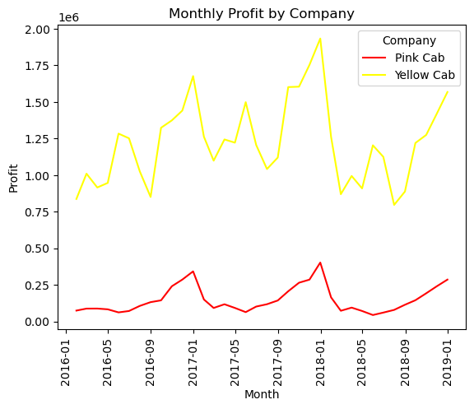
Profit Analysis
Profit Analysis
It’s clear that it have some seasonal trend in both company’s monthly profit. While having more than three times of total rides, Yellow Cab also has more than double of profit per ride comparing with Pink Cab. Yellow Cab is probably one of the magnate in cab industry with high customer loyalty, while Pink Cab is the newborn using low price strategy trying to take more market share.
Company | Profit | Total Rides | Profit Per Ride
Pink Cab | 5307328 | 84711 | 62.65
Yellow Cab | 44020373 | 274681 | 160.26

Slide 5
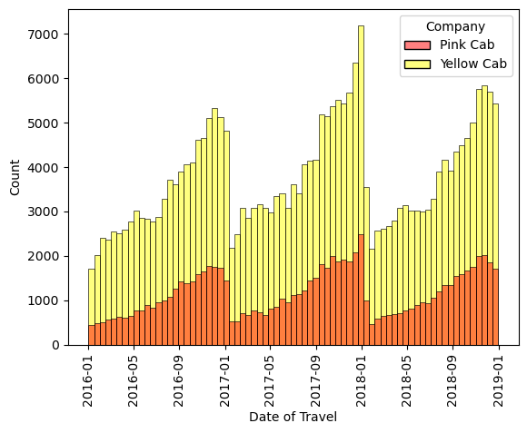
Seasonal ride base Analysis
The seasonal trends appear in both company’s total ride data. With peaks in December, around Christmas breaks. A company should put more vehicles into operation around this period to meet customers’ needs.

Slide 6
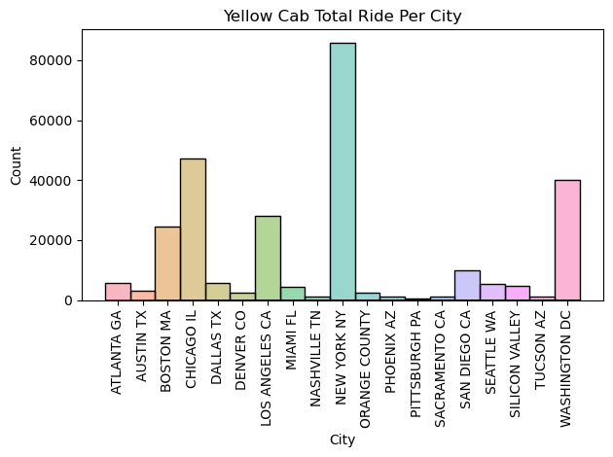
Location base Analysis
Yellow Cab has most of its ride from New York, Chicago, and Washington DC. Clustering relatively on the east. There is potential market in the west that is possible for Yellow Cab to dig into.

Slide 7
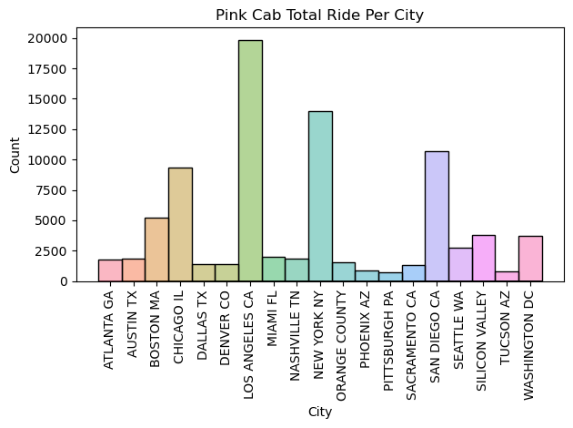
Location base Analysis
Pink Cab has most of its ride from Los Angelles, New York, and San Diego. Clustering relatively on the west. It is a good starting point for it to make differentiated competition with the magnate Yellow Cab. Pink Cab could continue its strategy of setting the west as its base camp and gradually open more market in the west with its relatively low price.

Slide 8
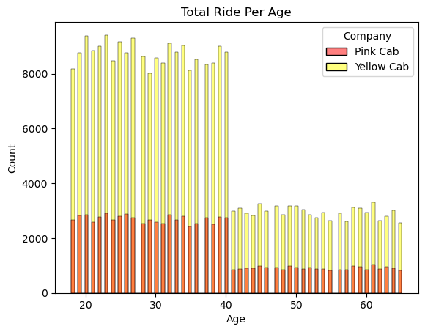
Age base Analysis
Both company have most of their customers from age range of 18-40. The sudden drop of customer number after 40 may possibly due to inappropriate sampling, but it still shows that Yellow Cab has much more customers in this age range than Pink Cab, even more than the customer numbers in age range 18-40 from Pink Cab.

Slide 9
Recommendations
We have evaluated both the cab companies on following points and found Yellow cab better than Pink cab:
Customer Reach: Yellow cab has higher customer reach relatively in the east while Pink cab has higher customer reach relatively in the west. We have also observed that Pink cab is doing good in equally covering other cab users as compared to Yellow cab.
Age wise Reach : Both company has customer mostly from 18-40 age groups. However, 60+ age group for Yellow Cab is still larger than the 18-40 age groups from Pink Cab.
Average Profit per ride: Yellow cab’s average profit per ride is almost three times the average profit per ride of the Pink cab.
Ride count and trend: Both the companies are facing loss in the profit and number of rides. However, Yellow Cab has more than three times of the total ride than Pink Cab. Yellow Cab is probably the magnate in cab industry.
On the basis of above point , we will recommend Yellow cab for investment as it’s the magnate of the industry and still has potential of growth with large new market in the west. Considering its possible competitor, Pink Cab, with relatively small company size, it is easy for Yellow Cab to adopt the investment and beat Pink Cab.

Slide 10
Thank You

