Slide 1
House Price
Prediction
Regression
Predict a continuous sale price from structured house features
Machine Learning Project
Validation RMSE
Presented by: [Student Name]
$43,995
Notes:
Introduce the project in one or two sentences. Say that this is a regression task because the goal is to predict a continuous sale price. Mention that the slide shows the final validation RMSE for the selected model.

Slide 2
Problem and Dataset
Objective
1,314
146
Predict residential property sale prices from house characteristics.
Training samples
Test samples
• Supervised regression task
• Target variable: SalePrice
• Id kept for output, excluded from model features
• Test rows preserved in original order
81
79
Raw columns
Model features
Regression output
A numeric price estimate in dollars, evaluated with MAE, RMSE, and R2.
Notes:
Explain the dataset size: 1,314 training rows and 146 test rows. Say that SalePrice is the target. Mention that Id was preserved for output but excluded from modeling.

Slide 3
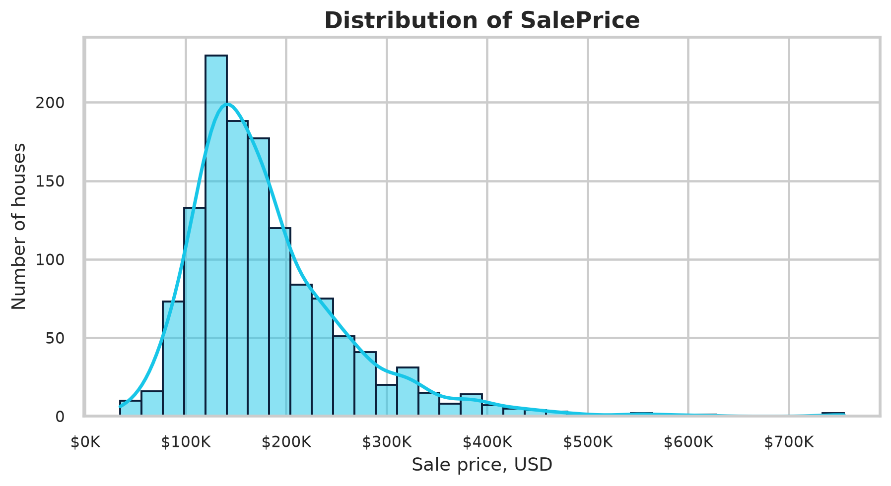
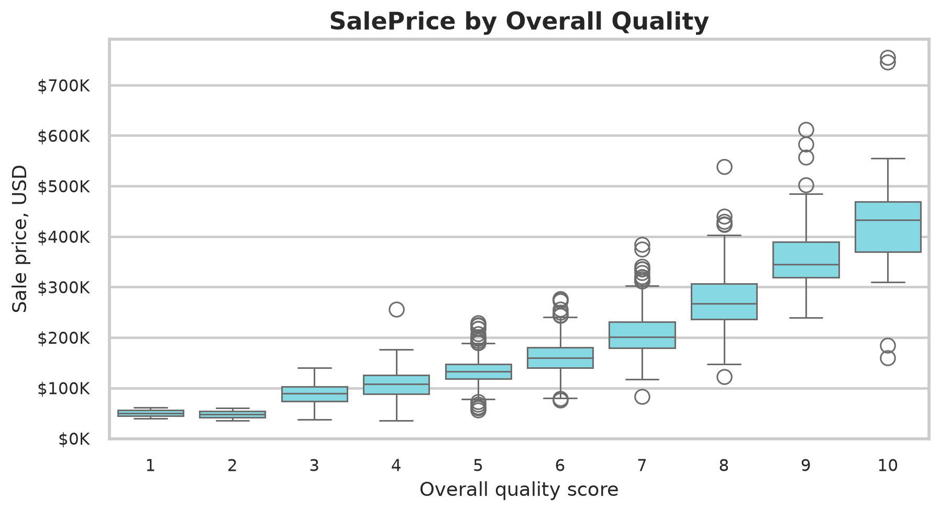
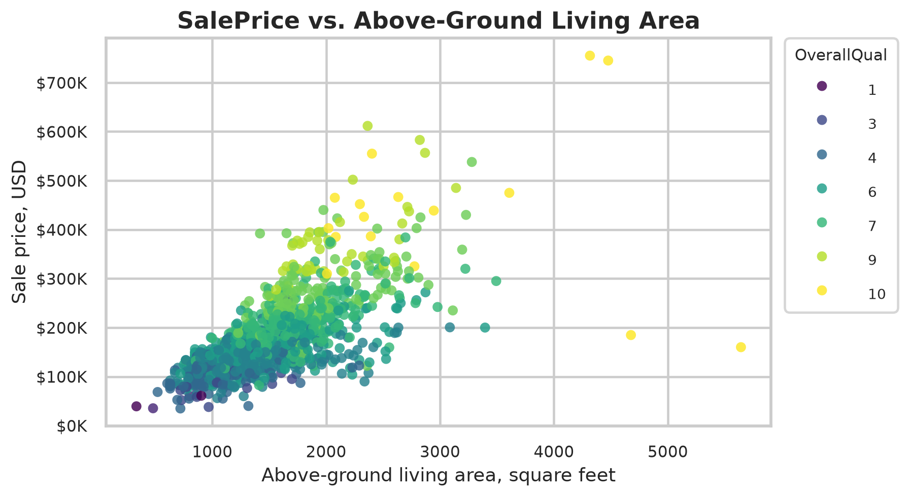
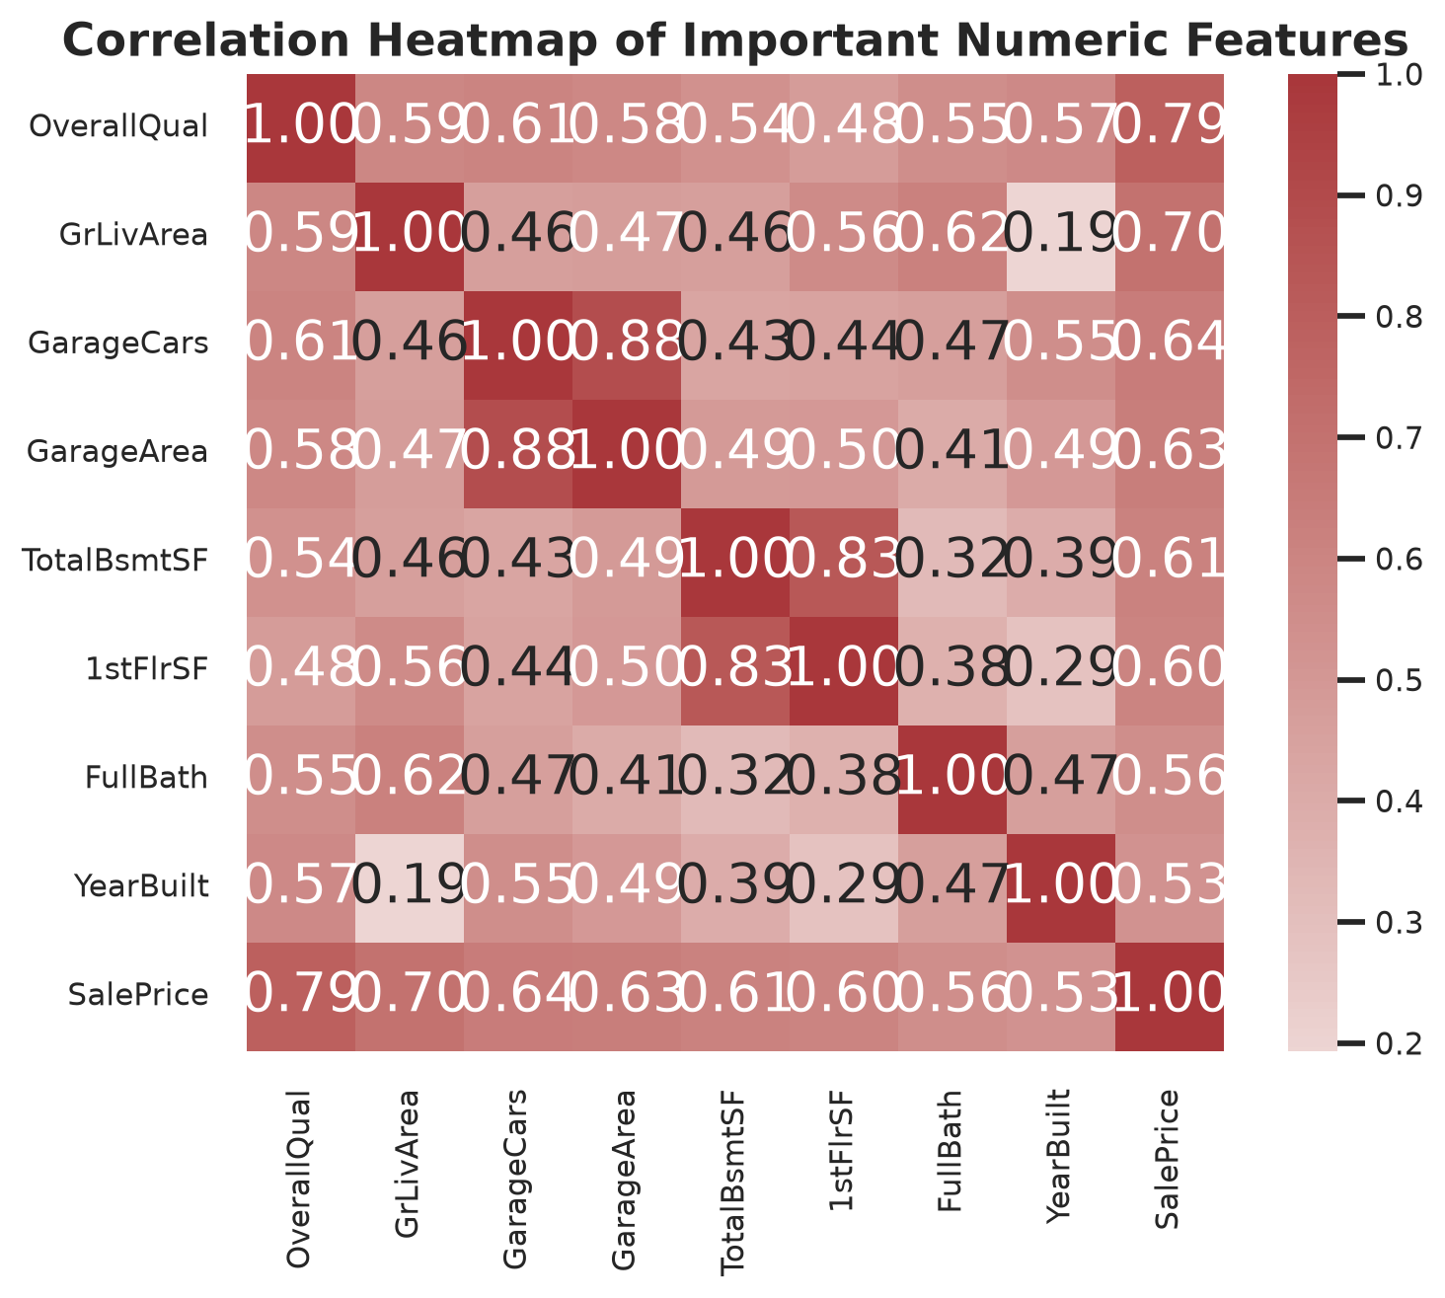
Exploratory Data Analysis
Evidence-based findings
• SalePrice is right-skewed; median $162,950 is below mean $181,045
• Overall quality shows a strong positive relationship with price
• Larger living area usually increases price, with some unusual high-area homes
Notes:
Point to each chart briefly. The target distribution is right-skewed. Higher OverallQual generally means higher price. GrLivArea has a positive relationship with price, but some large homes are still difficult cases.

Slide 4
Data Preprocessing
• Target separated from input features
• Numeric features: 35; categorical features: 44
• Documented absence values filled as None
• Other numeric values imputed with median or zero when justified
• One-hot encoding handled unseen categories
• Scaling applied inside the pipeline
Leakage prevention
Imputers, encoders, scalers, and models were fitted only on training data inside scikit-learn pipelines. The test file did not influence model selection.
Raw data
Split
Pipeline
Validate
Predict
train/test files
80/20 split
impute, encode, scale
same holdout set
146 test rows
Notes:
Explain the preprocessing pipeline. Missing categorical values that mean no basement, no garage, no pool, or no fence were handled as absence values. Validation data did not fit preprocessing, which prevents leakage.

Slide 5
Machine Learning Models
Six algorithms were evaluated on the same validation split.
Dummy Regressor
Random Forest
Median-price baseline
Bagged tree ensemble
Ridge Regression
Extra Trees
Regularized linear model
More randomized tree ensemble
Decision Tree
Gradient Boosting
Single nonlinear tree
Sequential error-correcting trees
The baseline sets a minimum standard. The tree ensembles test nonlinear relationships and interactions that are common in housing data.
Notes:
Describe why several models were compared. The Dummy Regressor is the baseline. Ridge gives a linear benchmark. Tree models handle nonlinear patterns and interactions in tabular housing data.

Slide 6
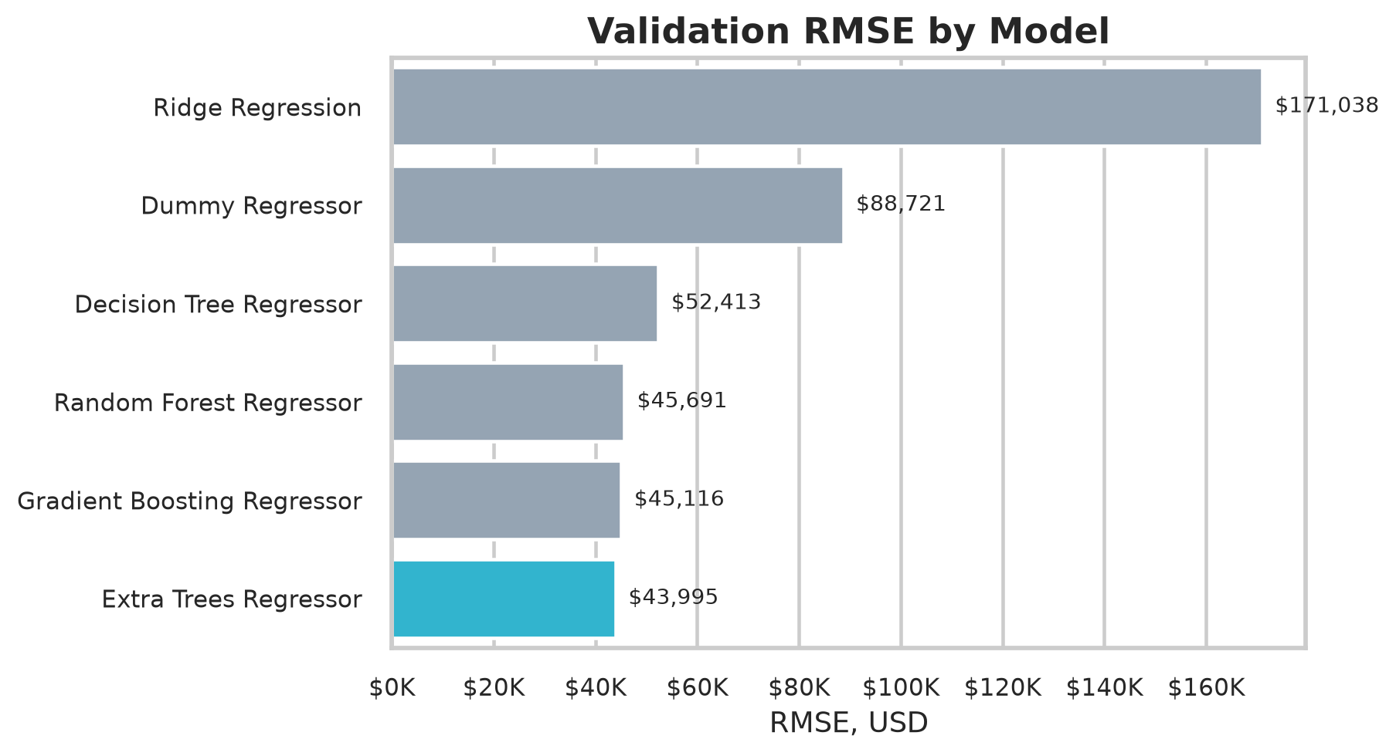
Model Performance Comparison
Rank | Model | MAE | RMSE | R2
1 | Extra Trees Regressor | $20,128 | $43,995 | 0.7399
2 | Gradient Boosting Regressor | $18,015 | $45,116 | 0.7265
3 | Random Forest Regressor | $19,130 | $45,691 | 0.7194
4 | Decision Tree Regressor | $27,700 | $52,413 | 0.6308
5 | Dummy Regressor | $56,855 | $88,721 | -0.0578
6 | Ridge Regression | $25,705 | $171,038 | -2.9314
Selection criterion
Extra Trees had the lowest RMSE. MAE and R2 support the same conclusion among the strongest models.
Notes:
Explain MAE, RMSE, and R2. Lower MAE and RMSE are better. Higher R2 is better. Extra Trees ranked first by RMSE with MAE $20,128.11, RMSE $43,994.54, and R2 0.7399.

Slide 7
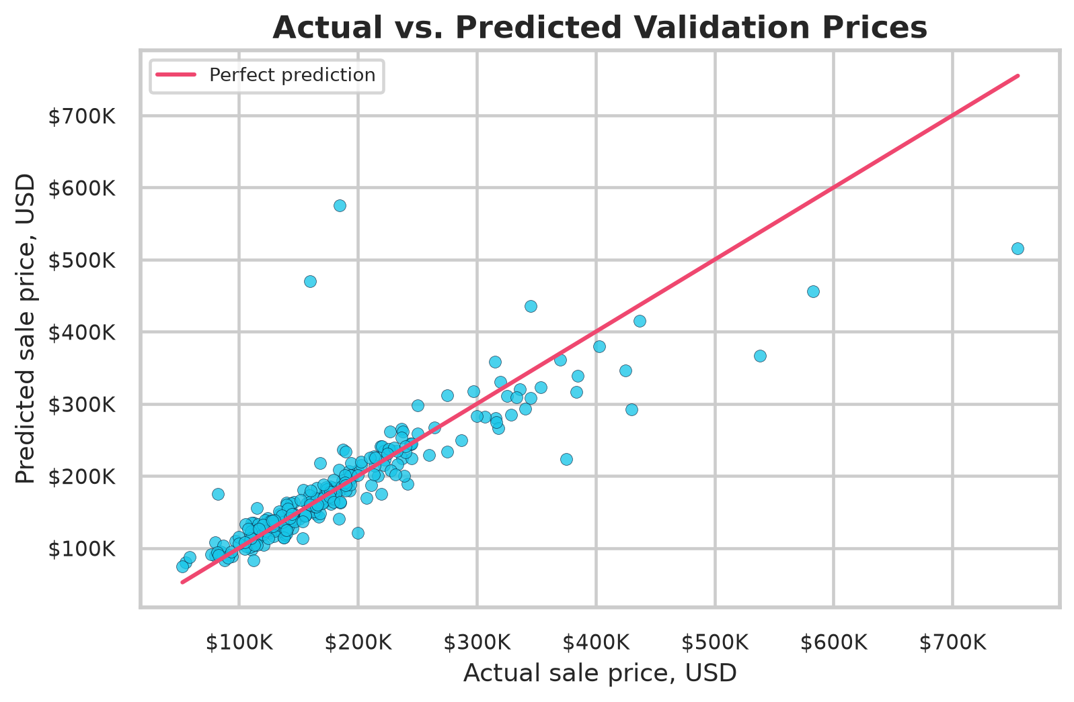
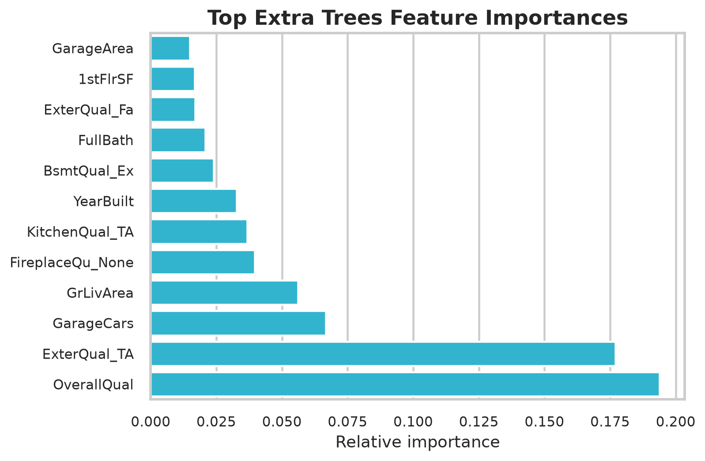
Best Model: Extra Trees Regressor
Extra Trees averages many randomized decision trees. This helps capture nonlinear feature effects while reducing variance compared with a single tree.
$20,128.11
MAE
$43,994.54
RMSE
0.7399
R2
Strength: strong tabular performance. Limitation: less interpretable than a linear model and weaker on rare extreme cases.
Notes:
Explain Extra Trees in simple terms: it averages many randomized decision trees. Use the actual versus predicted chart to show that points near the diagonal are good predictions. Use feature importance as model evidence, not as causal proof.

Slide 8
Conclusions
Main findings
• Sale price increases strongly with overall quality and living area
• Extra Trees achieved the best validation RMSE: $43,995
• The final prediction file preserves all 146 test rows and original IDs
Thank You
Questions?
Limitations and improvements
• Rare expensive houses remain difficult to predict
• More cross-validation could give a stronger performance estimate
• Feature engineering could add house age and total finished area
Notes:
Summarize the result. Extra Trees was selected by validation RMSE. Mention limitations such as rare expensive homes and possible future improvements like cross-validation and extra feature engineering. End by inviting questions.

