Slide 1
variational auto encoder
赵涵
zhaohan@alumni.itp.ac.cn

Slide 2
outline
Mathematical basis
model representation
code by python
simulation result

Slide 3
VAE

Slide 4
VAE

Slide 5
VAE

Slide 6
VAE

Slide 7
VAE

Slide 8
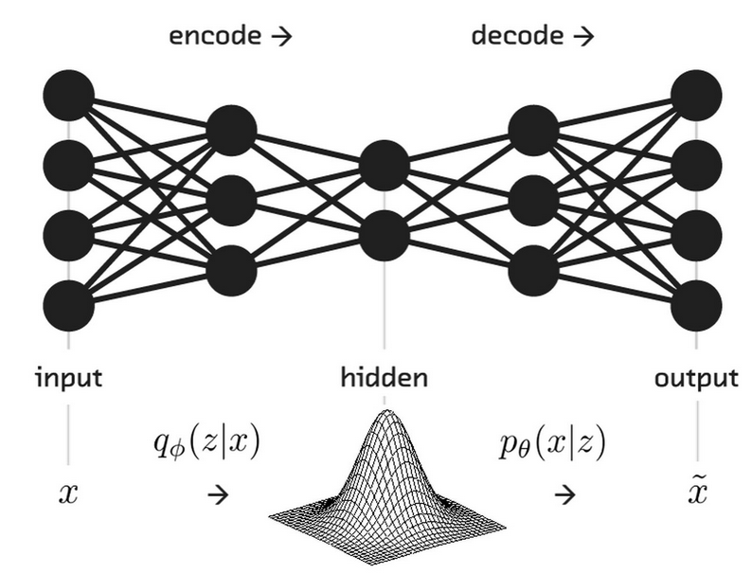
VAE

