Slide 1
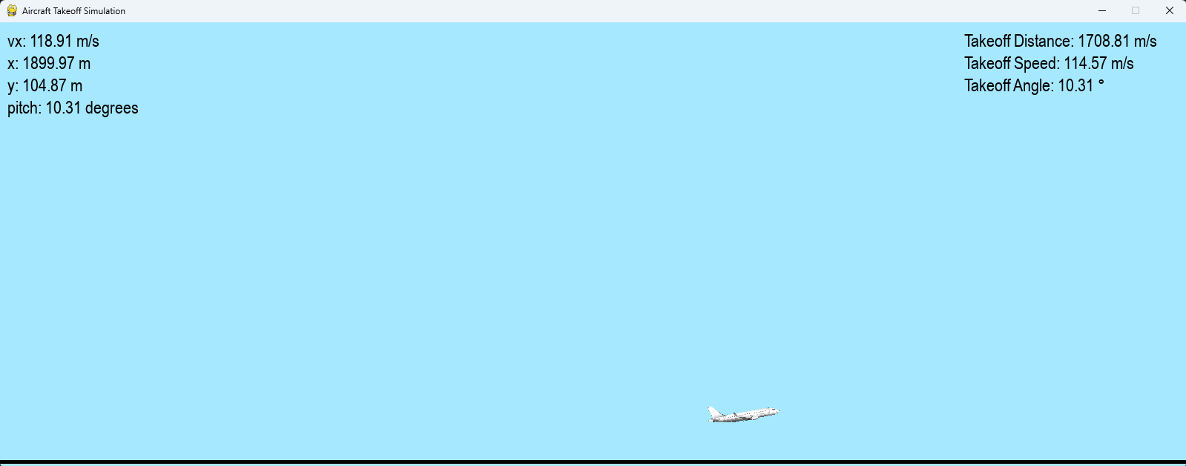
Aircraft Takeoff Distance Simulation

Slide 2
Purpose
Calculating takeoff distances are an important part of planning a takeoff.
Often done with the aid of onboard computers
Many factors are taken into consideration
Weight
Flap settings
Weather conditions
Surface conditions

Slide 3
Methodology
Using DOP853 as the solver
State variables: x, y, vx, vy
Acceleration calculated with additional variables like drag/lift coefficient or air density.
Visuals done with pygame

Slide 4
Results
It is a very simple simulation of an aircraft takeoff
Many factors not considered for simplicity
Ground Effect
Wheel/Tire friction
Accurate drag and lift calculations
Angle of Attack
Takeoff speeds are faster and takeoff distances are longer in the simulation

