Slide 1
Africa Thematic Analysis DCO ASG participation in Africa Retreat May 2025
Overview/mapping of data in the CF Joint Workplans of UN INFO in 2024
DECADE OF ACTION
[DRAFT] Overview/mapping of data in the Joint Workplans of UN INFO
April 2025
Prepared by: Development Coordination Office

Slide 2

Resident Coordinator Leadership in action
Notes on the analysis
Purpose / Objective
To analyze Cooperation Framework data in UN INFO relating to thematic areas for DCO ASG RC Africa retreat in May 2025.
Joint Workplan data
The data presented is provided from the country’s programming document (UNDAF/Cooperation Framework) uploaded in the UN INFO platform by UN country teams with the support of UNDCO. The data are being continuously validated and updated, and reflects data as uploaded on 17 April.
Methodology
Analysis of publicly available Cooperation Framework data (Joint Work Plans - CF JWPs) with respect to key terms relating to Youth; Access to Education; Education in crisis context (only Burkina Faso, Niger, Mali, Libya, Sudan, South Sudan, DR Congo, Chad, CAR); Access to digital tech & digital economy; IFF & transnational crimes; and Mining. Data is downloaded in both English and French.
The period of analysis is 2024 (January-December). All sub-outputs regardless of implementation status were analyzed.
AI Foundry Environment & Security
The UN Azure AI Foundry provides a secure and monitored environment to deploy and utilize Large Language Models (LLMs) such as OpenAI’s o1. All data processing is conducted in an enterprise-grade, private cloud infrastructure hosted on Azure, with strict role-based access controls, network isolation, and end-to-end encryption. No data is stored externally or used to train any external model. This setup aligns with UN data privacy and cybersecurity protocols and recent policy communicated by CITO.
Use of the Co-Pilot (LLM-Based Agent)
A custom-built AI Co-Pilot is leveraged using the “o1” model deployed via Azure OpenAI. This Co-Pilot is trained with specific prompts to assist in analyzing qualitative textual data collected from UN surveys. It operates within a closed environment and only performs analysis based on the responses it receives, never transmitting or learning from the data beyond the session.
How the Qualitative Methodology Works
1. Pre-processing: Raw responses to each open-ended question are filtered for clarity and length, removing any blanks or non-informative entries.
2. Instructional Prompting: The Co-Pilot is given a standardized instruction and prompt to conduct a qualitative analysis of the key areas of support.
3. Thematic Output: The model generates structured thematic outputs, including a summary of why the issue matters. These are saved as .txt files per question, allowing for future traceability and cross-checking.
4. Link to the Script: [Incoming]
Quality assurance process
A three-tiered quality assurance process was applied, employing human in-the-loop processes (human-machine-human). The entire analysis was cross-checked with Microsoft Co-pilot, a secure and compliant Co-pilot integrated within the UN enterprise account, as additional validation layer.

Slide 3

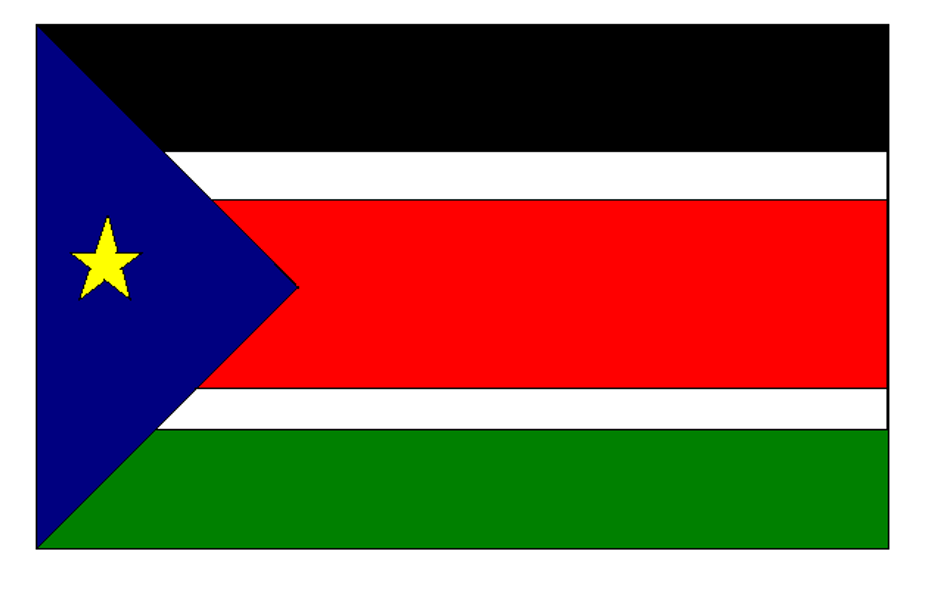


Thematic overview – support provided and potential challenges
Support for youth includes education, digital skills, and SRHR; access to education covers WASH, STEM, and environmental initiatives; education in crisis contexts involves infrastructure, school feeding, and support for vulnerable groups; IFF and transnational crimes focus on governance, education reform, health systems, and cross-border trade; mining focuses on small miner empowerment and safety.
Thematic area | Regional funding overview | Overview of support | Country
Youth | US$ 366.8 m required funding 34 % funding gap | Education, digital skills, SRHR, financial inclusion, governance participation
Access to education | US$ 630.6 m required funding 43 % funding gap | Education access for all, WASH & STEM initiatives, environmental education
Education in crisis contexts | US$ 198.3 m required funding 64 % funding gap | Access to formal and non-formal education, educational infrastructure, training teachers, school feeding programs, inclusive policies to ensure all children, including most vulnerable, receive quality education
Access to digital tech & digital economy | US$ 258.5 m required funding 14 % funding gap | Drives digital inclusion through e-learning, digital governance, fintech, and infrastructure expansion.
Illicit Financial Flows (IFF) & transnational crimes | US$ 119.6 m required funding 34 % funding gap | Strengthening institutional capacities, enhancing legal frameworks, promoting regional cooperation, and conducting specialized training for law enforcement and judicial officers
Mining sector | US$ 56.5 m required funding 39 % funding gap | Promoting environmental sustainability, enhancing health and safety standards, and fostering economic development.
Nigeria: Empower youth through investment in startups, civic engagement programs, and inclusive media participation.
South Sudan: Inclusive education, digital learning connectivity, policy development, infrastructure, support for vulnerable children.
South Sudan: Policy development, school feeding programs, policy, teacher training, CSE , provision of learning materials for vulnerable populations
Malawi: Inclusive digital transformation, sectoral integration & efficiency, education & digital literacy, digital financial services, identity systems
DRC: Institutional capacities, legal frameworks, promoting regional cooperation, and specialized training for law enforcement and judicial officers to combat IFF and transnational crimes
DRC: Improve living conditions, promoting sustainable resource management, enhancing climate resilience, supporting economic growth in mining communities

Slide 4
Top 20 UNCTs where key words are mentioned – Tanzania & Burkina Faso are on the top
Across Cooperation Framework JWP interventions (i.e. sub-outputs) “Youth” and “Education” is mentioned most frequently in Tanzania; in crisis contexts “Education” is mentioned most frequently in Burkina Faso; “IFF” & “Crime” is mentioned most in Burkina Faso; while “Mining” (not related to de-mining) has highest frequency of counts in Senegal.
YOUTH
EDUCATION
EDUCATION
In crisis context
DIGITAL
IFIs & CRIME
MINING
Tanzania
Tanzania
Burkina Faso
Senegal
Burkina Faso
Senegal
South Sudan
Kenya
Mali
Ghana
Mali
Mali
Egypt
Ghana
Libya
Tanzania
Guinea
Chad
Somalia
Egypt
Chad
Egypt
Cabo Verde
Guinea
Gambia
Lesotho
South Sudan
Burkina Faso
Chad
Cameroon
Ghana
Mozambique
DRC
Gabon
Senegal
DRC
Kenya
Gabon
Sudan
Kenya
Tunisia
Mauritania
Uganda
Gambia
CAR
Mauritania
Gabon
Congo
Nigeria
Uganda
Niger
Guinea
Tanzania
Mozambique
Angola
Nigeria
Uganda
Madagascar
Kenya
Malawi
Angola
Cabo Verde
Morocco
Burkina Faso
Ethiopia
Gambia
Namibia
Libya
Somalia
Cameroon
Tunisia
Sierra Leone
Sierra Leone
Cote d’Ivoire
Congo
Angola
Somalia
South Africa
Malawi
Sierra Leone
Guinea-Bissau
CAR
Rwanda
Sao Tome and Principe
Angola
Egypt
Botswana
Lesotho
Guinea-Bissau
Tunisia
Cote d’Ivoire
Sierra Leone
Tunisia
Namibia
Gambia
Mauritania
Rwanda
Botswana
South Sudan
Eritrea
Somalia
Morocco
Liberia
Rwanda
Nigeria
Kenya
Cote d’Ivoire
Guinea-Bissau
Sudan
Note. Key words searched are “youth/jeune”; education/ “éducation”; crime/ criminalité; for IFF & crime this is a combination of illicit/illicite and crime/criminalité; and mining/mine” in sub-output statements. For ”mining” interventions supported by UNMAS are removed to enhance focus on mining sector rather than de-mining. Certain CF JWPs may have a higher frequency due to a larger number of sub-outputs in the Cooperation Framework JWP relative to other CF JWPs.

Slide 5

Youth
In 2024, total required funding for youth amounted to US$ 366.8, with a funding gap of 34 %.
Main areas of support
US$ 366.8 million total required funding in 2024
Focus 1
Focus 3
Funding gap
Youth
Focus 2
Focus 4
Available funding

Slide 6
Required funding for Youth is highest in Nigeria followed by Kenya and Malawi
A total of 49 CF JWPs in the region explicitly refer to “Youth” in the Cooperation Framework JWP interventions.
Required Funding
Nigeria
54%
46%
$117.7 m
Kenya
51%
49%
$67.1 m
Malawi
84%
16%
$21.3 m
South Sudan
88%
12%
$19.9 m
Ghana
97%
3%
$18.3 m
Liberia
100%
0%
$16.7 m
Egypt
81%
19%
$14.3 m
Libya
14%
86%
$12.6 m
Uganda
97%
3%
$11.4 m
Funding situation for youth
Tanzania
60%
40%
$10.7 m
Sierra Leone
94%
6%
$10.6 m
Guinea-Bissau
100%
$7.0 m
Zambia
65%
$6.6 m
Ethiopia
99%
$6.3 m
Mozambique
$5.2 m
$5.2 m
Somalia
$2.1 m
$4.7 m
Niger
86%
$4.0 m
Angola
74%
$3.9 m
Zimbabwe
94%
$1.4 m
Sao Tome and Principe
7%
$1.3 m
Cote d’Ivoire
57%
$1.3 m
Available funding
Funding Gap
Note. Required funding for ”Youth” are < US$ 1 million in Algeria, Botswana, Burkina Faso, Burundi, Cabo Verde, Cameroon, Central African Republic, Chad, Congo, Democratic Republic of the Congo, Eritrea, Eswatini, Gabon, Gambia, Guinea, Lesotho, Madagascar, Mali, Mauritania, Mauritius, Morocco, Namibia, Rwanda, Senegal, Seychelles, South Africa, Sudan, Tunisia.

Slide 7
Education
In 2024, CF JWPs had a total required funding of US$ 366.8 million and funding gap of 44 % on education-related initiatives.
Main areas of support
US$ 630.6 million total required funding in 2024
Focus 1
Focus 3
Funding gap
Focus 2
Focus 4
Education
Available funding

Slide 8
Required funding for Education is highest for South Sudan followed by DRC and Ethiopia
A total of 53 CF JWPs in the region explicitly refer to “Education” in JWP interventions.
Required Funding
South Sudan
68%
$92.8m
Ethiopia
32%
68%
$52.6m
$57.0m
Malawi
14%
Kenya
64%
36%
$45.9m
Mozambique
0%
$43.9m
DRC
9%
91%
$28.0m
$40.4m
CAR
50%
50%
$27.9m
Somalia
55%
45%
$24.9m
Tanzania
19%
81%
$20.9m
Chad
60%
40%
$20.7m
Egypt
49%
51%
$17.2m
Nigeria
64%
36%
$16.6m
Zambia
57%
$16.3m
Sierra Leone
99%
$14.9m
Uganda
97%
$14.4m
Funding situation for ’Education’
Guinea-Bissau
100%
$9.6m
Guinea
91%
$9.4m
Burkina Faso
96%
$7.9m
Benin
$6.8m
Haiti
85%
$5.8m
Senegal
100%
$5.4m
Tunisia
81%
$5.4m
Zimbabwe
99%
$4.9m
Madagascar
100%
$4.8m
Mauritania
$4.5m
Ghana
88%
$4.2m
Liberia
74%
$4.1m
Libya
$3.6m
Gambia
84%
$3.5m
Burundi
$2.6m
Morocco
$2.4m
Eritrea
$2.4m
Sao Tome and Principe
$2.3m
Cote d’Ivoire
$2.1m
Niger
$1.9m
Angola
$1.6m
Label
$1.6m
Available funding
Funding Gap
Congo
Note. Required funding for “Education” where interventions < USD 1 million for ”Education” are: Algeria, Botswana, Burkina Faso, Burundi, Cabo Verde, Cameroon, Central African Republic, Comoros, Democratic Republic of the Congo, Eswatini, Gabon, Lesotho, Mali, Mauritius, Namibia, Rwanda, Seychelles, South Africa, Sudan, Togo, Tunisia.

Slide 9
Digital
In 2024, CF JWPs had a total required funding of US$ 258.5 million and funding gap of 14 % on digital initiatives.
Main areas of support
Focus 1
Focus 3
US$ 258.5 million total required funding in 2024
Funding gap
Digital
Focus 2
Focus 4
Available funding

Slide 10
Digital
A total of 48 CF JWPs in the region explicitly refer to “Digital” in the Cooperation Framework JWP interventions.
Required Funding
Malawi
88%
12%
$85.0 m
Senegal
100%
$45.6 m
Madagascar
52%
48%
$24.4 m
Burundi
100%
0%
$20.9 m
Zimbabwe
45%
55%
$12.3 m
Zambia
51%
49%
$8.6 m
Egypt
95%
$8.5 m
Ghana
81%
19%
$7.5 m
Kenya
62%
38%
$5.5 m
Cote d’Ivoire
73%
$4.5 m
Congo
99%
$4.0 m
Tunisia
100%
$3.8 m
Tanzania
56%
$3.5 m
Funding situation for Digital
Uganda
97%
$3.5 m
Sierra Leone
100%
$3.2 m
Eritrea
$3.1 m
Mauritius
$3.1 m
Chad
$3.0 m
Ethiopia
$2.3 m
Sao Tome and Principe
$2.0 m
Morocco
$1.7 m
Burkina Faso
$1.7 m
Equatorial Guinea
$1.5 m
Angola
$1.5 m
Benin
$1.4 m
Algeria
$1.2 m
Nigeria
$1.1 m
Available funding
Funding Gap
Note. Required funding for ”Digital” are < US$ 1 million in Botswana, Cabo Verde, Cameroon, Central African Republic, Democratic Republic of the Congo, Gabon, Gambia, Guinea, Guinea-Bissau, Lesotho, Liberia, Libya, Mali, Mauritania, Namibia, Rwanda, Seychelles, Somalia, South Sudan, and Togo.

Slide 11
IFF & Transnational Crime
In 2024, the required funding was US$ 119.6 m for “IFF” and “Crime” with a funding gap of 34 %.
Main areas of support
US$ 119.6 million total required funding in 2024
Focus 1
Focus 3
Funding gap
IFF & Transboundary Crime
Focus 2
Focus 4
Available funding
Note. As interventions include a key word search for “crime” this may include other crime beyond transboundary crime.

Slide 12
Required Funding for IFFs & Transboundary Crime
A total of 54 CF JWPs in the region explicitly refer to “IFFs and Transboundary Crime” in the Cooperation Framework JWP interventions.
Required Funding
DRC
28%
72%
$21.3m
Niger
100%
$11.6m
Burkina Faso
43%
57%
$10.0m
Haiti
53%
47%
$9.4m
Morocco
100%
$7.1m
Tanzania
39%
61%
$6.9m
Chad
66%
34%
$5.9m
Tunisia
86%
14%
$4.3m
South Sudan
32%
68%
$4.2m
Cote d’Ivoire
99%
1%
$4.1m
Funding Situation for IFF & Transboundary Crime
Benin
98%
2%
$3.9m
Nigeria
77%
23%
$3.8m
Senegal
95%
5%
$3.5m
Uganda
71%
29%
$3.1m
Madagascar
98%
2%
$3.1m
Angola
94%
6%
$2.3m
Guinea
76%
24%
$2.1m
Seychelles
87%
13%
$1.6m
Egypt
99%
1%
$1.5m
Libya
76%
24%
$1.5m
Botswana
100%
$1.3m
Algeria
9%
91%
$1.1m
Available funding
Funding Gap
Note. Required funding for “IFF & Transboundary crime” are < US$ 1 million for Burundi, Cabo Verde, Cameroon, Central African Republic, Congo Eritrea, Gambia, Ghana, Guinea-Bissau, Lesotho, Liberia, Mauritius, Namibia, Sierra Leone, Somalia, Sudan, and Togo. The following UNCTs provided interventions but there is no required or available funding provided: Comoros, Equatorial Guinea, Eswatini, Gabon, Kenya, Mali, Mauritania, Rwanda, Sao Tome and Principe, South Africa, and Zimbabwe.

Slide 13
Mining Sector
In 2024, the required funding was US$ 56.5 m for “Mining”, with a funding gap of 39%.
US$ 56.5 million total required funding in 2024
Main areas of support
Focus 1
Focus 3
Funding gap
Focus 2
Focus 4
Mining Sector
Available funding
Note. Interventions related to UNMAS are not included, as these sub-outputs relate to de-mining, rather than the mining sector.

Slide 14
Required funding in the Mining sector
A total of 42 CF JWPs in the region explicitly refer to “Mining” in the Cooperation Framework JWP interventions.
Required Funding
DRC
47%
53%
$34.6m
Somalia
100%
$14.0m
Congo
23%
77%
$2.4m
Zambia
$1.0m
Sierra Leone
99%
$0.8m
Madagascar
100%
$0.7m
Funding Situation for Mining Sector
Mozambique
100%
$0.7m
Cameroon
78%
$0.6m
Chad
98%
$0.5m
Tunisia
100%
$0.3m
Namibia
100%
$0.2m
Nigeria
$0.1m
Togo
$0.1m
Sudan
$0.1m
South Sudan
$0.1m
Available funding
Funding Gap
Note. Interventions related to UNMAS are not included, as these sub-outputs relate to de-mining, rather than the mining sector. Required funding for “Mining” are < USD 100,000 in the following CF JWPs: Angola, Benin, Botswana, Burkina Faso, Central African Republic, Comoros, Cote d'Ivoire, Egypt, Gabon, Gambia, Ghana, Guinea, Kenya, Lesotho, Libya, Liberia, Malawi, Mali, Mauritania, Morocco, Rwanda, Senegal, Seychelles, South Africa, Tanzania, Uganda, and Zimbabwe.

