Slide 1
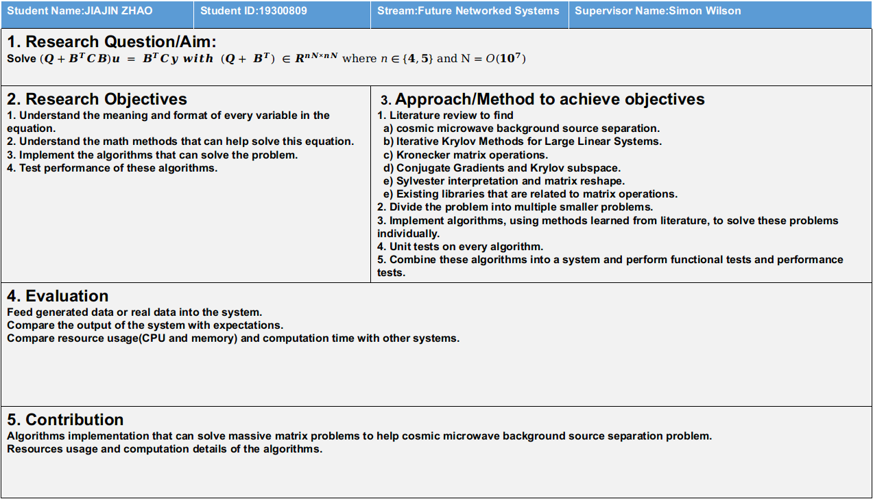
Student Name:JIAJIN ZHAO | Student ID:19300809 | Stream:Future Networked Systems | Supervisor Name:Simon Wilson
1. Research Question/Aim: Solve $(Q+B^{T}CB)u = B^{T}Cy with (Q+ B^{T}) ∈R^{nN×nN}$ where $n∈\{4,5\}$ and $N=O({10}^{7})$
2. Research Objectives 1. Understand the meaning and format of every variable in the equation. 2. Understand the math methods that can help solve this equation. 3. Implement the algorithms that can solve the problem. 4. Test performance of these algorithms. |  | 3. Approach/Method to achieve objectives 1. Literature review to find a) cosmic microwave background source separation. b) Iterative Krylov Methods for Large Linear Systems. c) Kronecker matrix operations. d) Conjugate Gradients and Krylov subspace. e) Sylvester interpretation and matrix reshape. e) Existing libraries that are related to matrix operations. 2. Divide the problem into multiple smaller problems. 3. Implement algorithms, using methods learned from literature, to solve these problems individually. 4. Unit tests on every algorithm. 5. Combine these algorithms into a system and perform functional tests and performance tests.
4. Evaluation Feed generated data or real data into the system. Compare the output of the system with expectations. Compare resource usage(CPU and memory) and computation time with other systems.
5. Contribution Algorithms implementation that can solve massive matrix problems to help cosmic microwave background source separation problem. Resources usage and computation details of the algorithms.

Slide 2
Motivation statement
Cosmic Microwave Background (CMB) can provide information about the formation of the early universe, and we use source separation to separate CMB from other diffuse sources such as synchrotron radiation, galactic dust emission, and free-free emission. Large matrix operation is very common in CMB source separation due to the size of WMAP(3×106 pixels at 5 channels) and Planck data(12×106 pixels at 9 channels).
The research in this paper will implement an efficient way to perform large matrix operations, which will require less memory and computing time.
With the rise and development of big data and machine learning, large size matrix operations will also become increasingly common. And the research in the paper may provide some insights to address these problems.

Slide 3
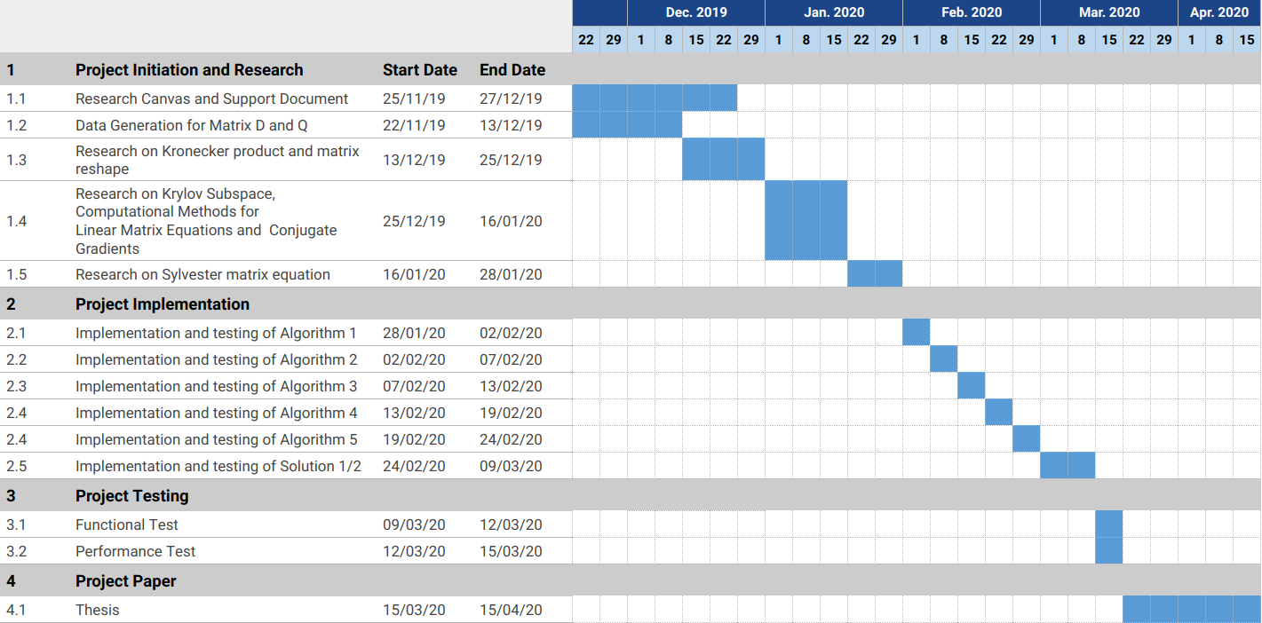
Gannt Chart

Slide 4
Skills List
Technical Skills:
Efficient matrix-vector product.
Large matrix computation.
Krylov subspace.
Iterative Methods for Large Linear Systems.
Kronecker product and its applications.
Research Skills:
How to understand a research question.
How to identify key problems in research.
How to solve a research question.
How to write a good dissertation.
How to find useful papers and books for research.
How to manage References and Citations.

Slide 5
Reference List
BAU, D. 1997. Numerical linear algebra, Philadelphia, Society for Industrial and Applied Mathematics.
CALABRETTA, M. R. & ROUKEMA, B. F. 2007. Mapping on the HEALPix grid. 381, 865-872.
COOLS, S., CORNELIS, J. & VANROOSE, W. 2019. Numerically Stable Recurrence Relations for the Communication Hiding Pipelined Conjugate Gradient Method. 30, 2507-2522.
DURRER, R. 2008. The cosmic microwave background / Ruth Durrer.
LIESEN, J. 2013. Krylov subspace methods : principles and analysis / Jörg Liesen, Zden?k Strako?
MOHAMED, A. R., NAGLAA, M. E. S. & BASEM, I. S. 2019. Iterative algorithm for the reflexive solutions of the generalized Sylvester matrix equation. 27, 1-16.
NASEL?SKI, P. D. 2006. The physics of the cosmic microwave background / Pavel D. Naselsky, Dmitry I. Novikov, Igor D. Novikov.
SAAD, Y. 1996. Iterative methods for sparse linear systems / Yousef Saad.
SIMONCINI, V. 2016. Computational Methods for Linear Matrix Equations. 58, 377-441.
VORST, H. A. V. D. 2009. Iterative Krylov methods for large linear systems, Cambridge, Cambridge University Press.

Slide 6
Ethics statement
No, I don’t need to ethics approval. The research problem in this dissertation is a math problem.

