Slide 1


SG Hangout Guide: Application of Generative Search Engine and Chatbot-As-A-Service
Zhao Qixian U2321752L

Slide 2
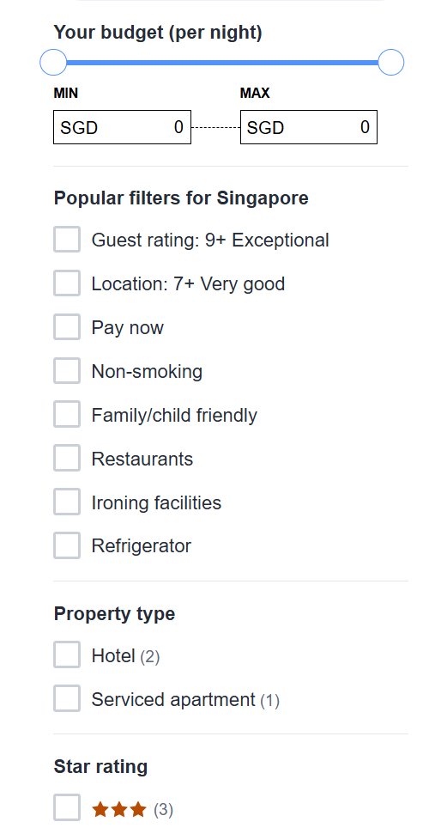
What We Solve
Introduction:
Transforms free‑form queries (e.g. “cozy café near Chinatown for two”) into precise location‑based recommendations
NLP via GPT‑4.1‑mini for grammar correction & AI‑aided suggestions
OneMap API for up‑to‑date venue data
SO
MANY
BOXES
TO
TICK!!!
Problem:
Rigid keyword fields vs. natural language friction
Challenges: extracting structured parameters, API rate limits & CORS, inconsistent geodata
Need: real‑time prompts + scalable cloud infra for low‑latency, personalized results

Slide 3
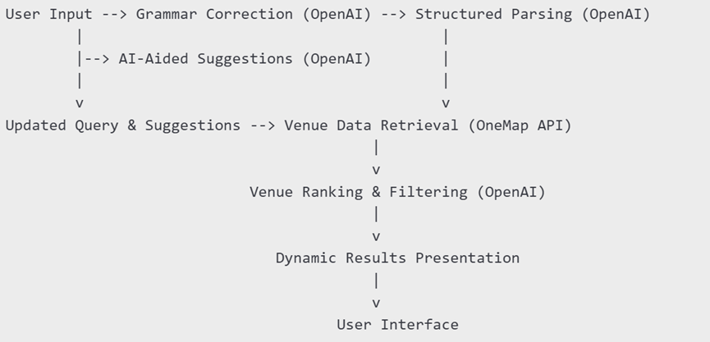
Solution Design & Flow
Cloud‑Native Microservices: React.js frontend + Express.js backend
AI Functions: Grammar correction, query parsing, suggestions via OpenAI API targeting search criterias
Streamlined data processing
Great human-computer interactions

Slide 4
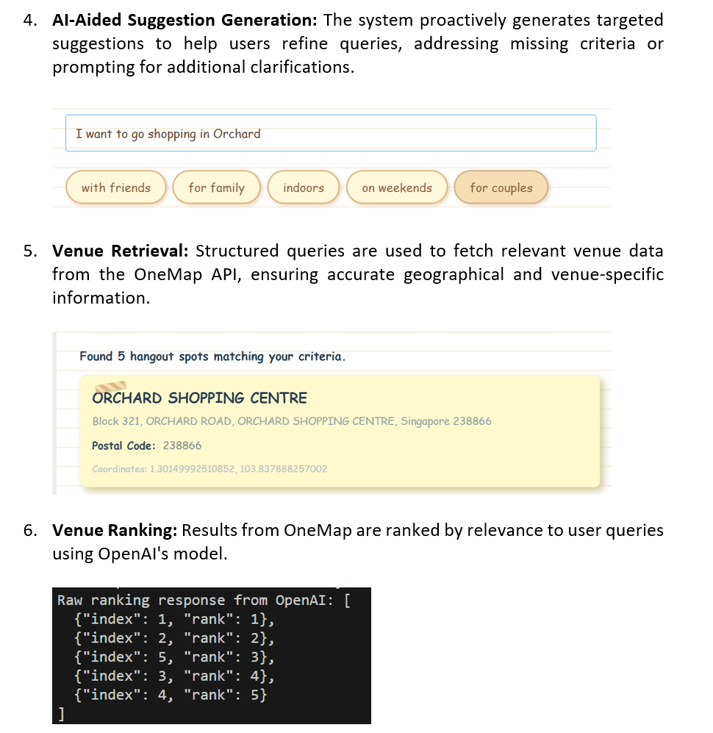
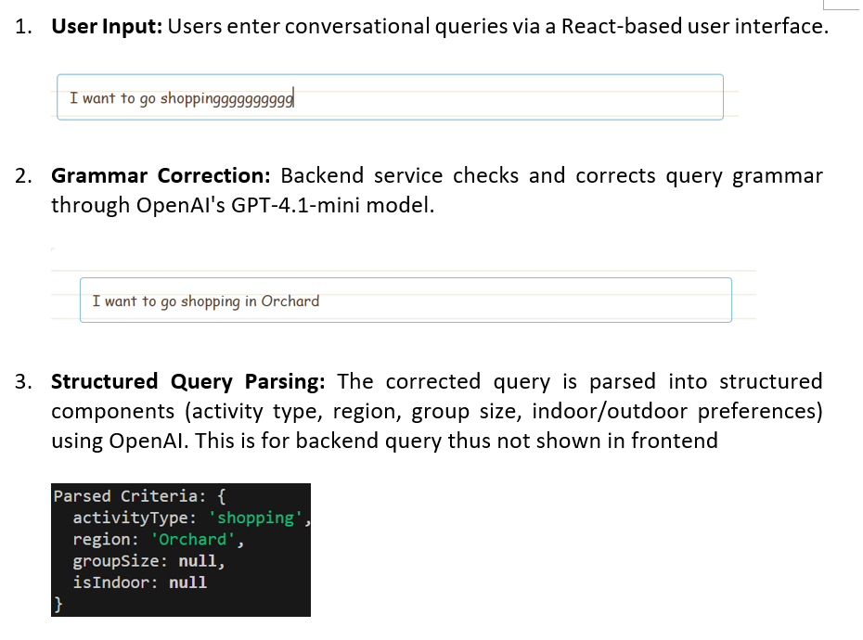
Illustrative Examples

Slide 5
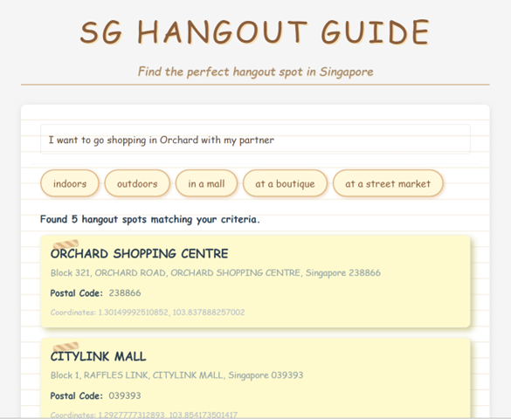
Illustrative Examples
Users may choose to keep query as they wish or choose AI recommended query supplements to refine their queries and make searching more precise, yet in their natural language. No box ticking needed!

Slide 6
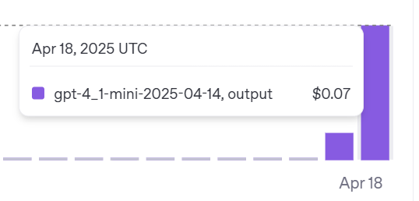
Evaluations
Advantage
Minimal dev‑knowledge barrier (standard React/Express skills)
Single unified query API → low complexity & <$0.10 cost per dev test, core feature in 200 lines
Debounce & React hooks for efficient state management
Complexity irrelevant to dababase size but attributes number
Limitation
OneMap rate limits, downtime & format inconsistencies
Rate concern for database with more attributes options

Slide 7
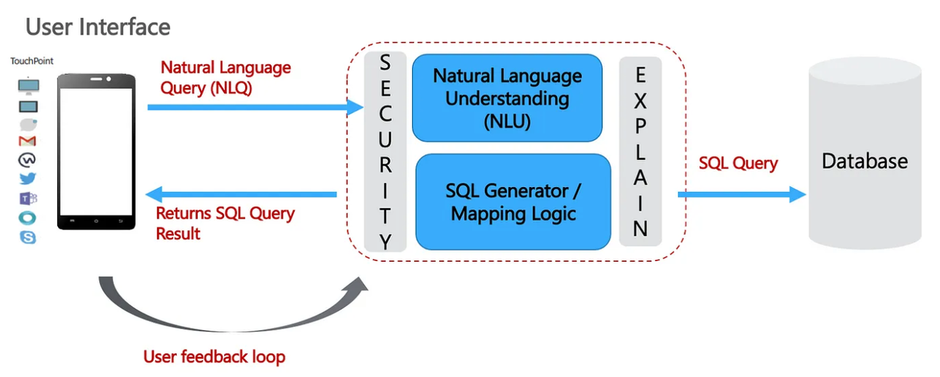
Future Applications
Natural‑language DB querying → generate SQL + AI summaries/visuals
OLAP conversational BI for analysts
Domain‑specific generative search: finance, supply chain, healthcare
Natural Language Queried Database/Searching

Slide 8
Thank you

