Slide 1

Cross-Platform Calibration of Whole-Genome Sequencing Genotype Quality Control Parameters Using Array-Based Genotypes
A Multi-Objective Framework for Pareto-Optimal Calibration and Knee-Point Selection
ZHAO TIE
2026-09-16
tuning.concordance

Slide 2
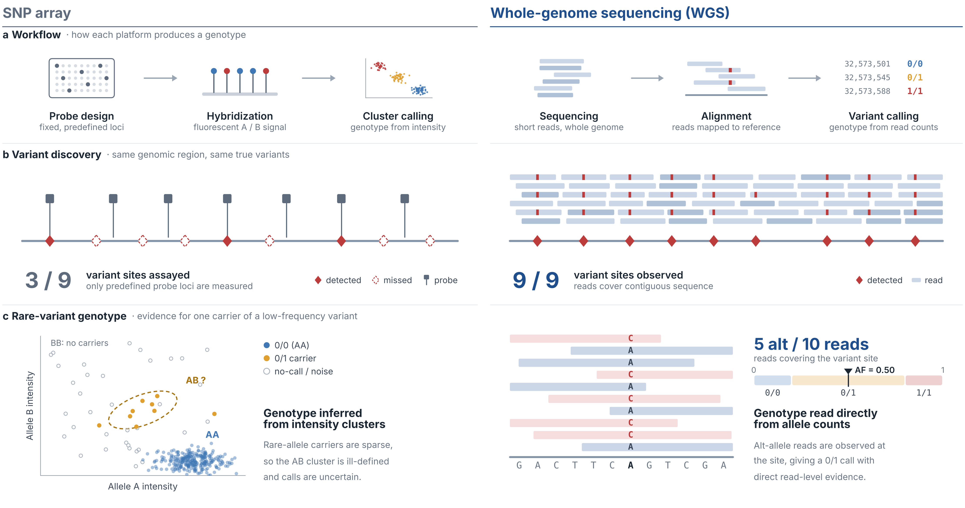
WGS Detects More Variants and Gives Direct Read-Level Evidence
Notes:
Before getting into the practical pitfalls, I’d like to first briefly compare whole-genome sequencing and array genotyping, because this difference is really the starting point of our study design.
At the workflow level, they are fundamentally different.
For WGS, we start from sequencing reads, then perform mapping, and finally variant calling.
So, the genotype is inferred from read-level evidence across the genome.
In contrast, array genotyping is based on predefined probe loci.
The genotype is inferred from probe hybridization intensity patterns, so it is limited to sites that were designed in advance.
Because of this difference, WGS has two major advantages.
First, it can detect variants beyond predefined probe loci, offering much broader genomic coverage.
Second, especially for low-frequency variants, WGS provides more direct evidence from the reads themselves.
In array data, rare-allele carriers are sparse, so cluster separation can be weaker, and genotype inference can become less robust.
Overall, WGS provides a much richer and more flexible view of genetic variation than array genotyping.
But at the same time, this also means the analysis depends much more directly on sequencing quality and genotype-calling behavior, which leads to some of the practical challenges I’ll discuss next.

Slide 3
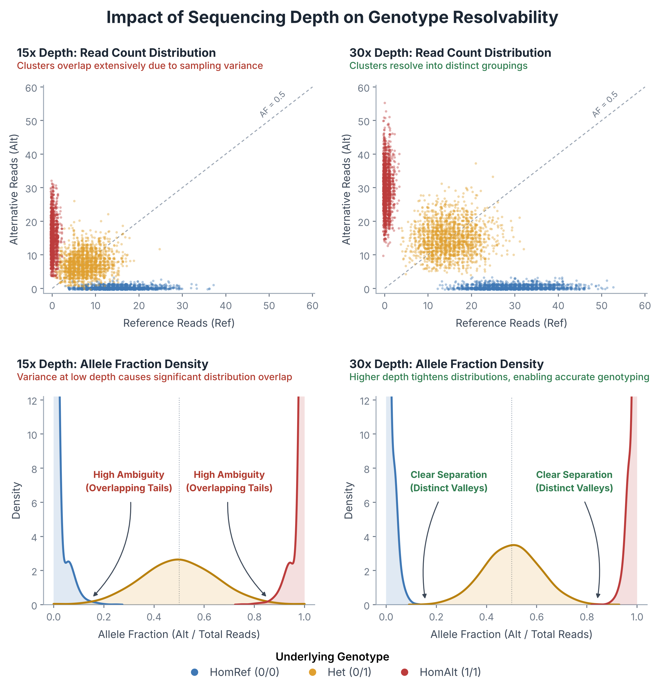
Genotype Resolution in WGS Depends on Sequencing Depth
Although WGS provides broader variant discovery and more direct read-level evidence than array genotyping, genotype inference in WGS is inherently depth-dependent.
Upper panels: reference vs alternate read counts
Lower depth gives more diffuse, overlapping genotype clusters because of increased sampling variance
Higher depth gives more compact, distinctly separated genotype groups
Lower panels: allele-fraction space
Lower depth broadens the distributions and increases overlap between genotype classes
Higher depth narrows the distributions and produces clearer valleys between states, improving genotype discrimination
Implication for our data
The ability to resolve genotypes relies directly on depth; when depth varies across samples, genotype certainty also varies
This can cause systematic differences in missingness, calling uncertainty and error patterns, leading to technical noise, imbalance and bias downstream, which matters in our mixed 15x/30x cohort
Most cases are sequenced at 30x and all controls at 15x, so depth-driven QC differences can bias case/control comparisons.
Notes:
As we just saw in the previous slide, unlike array genotyping, WGS infers genotypes directly from sequencing reads after mapping and variant calling.
So, while WGS gives us broader coverage and more direct evidence, it also means that genotype inference depends much more directly on the sequencing data itself.
One of the most important consequences is that genotype inference in WGS is inherently depth-dependent.
On the right, the upper panels show this in read-count space.
At lower sequencing depths, such as 15x, the genotype groups are much more diffuse and overlap more.
This is because when the total number of reads is limited, sampling variance increases, making the separation between genotype states less clear.
By contrast, at higher depth, such as 30x, the genotype groups become much tighter and more clearly separated.
The lower panels show the same effect in allele-fraction space.
At lower depth, the allele-fraction distributions are broader, and the tails overlap more strongly, so the boundaries between genotype classes become ambiguous.
At greater depth, the distributions become narrower, and the valleys between genotype states become more distinct, making genotype discrimination much more stable.
So, this is really the practical side of what I mentioned on the previous slide.
Because WGS relies on read-level evidence, the confidence of genotype inference is not constant.
It changes with sequencing depth.
And once sequencing depth varies across samples, genotype certainty, missingness, and error patterns can vary systematically as well.
So, in real WGS-based GWAS, depth heterogeneity is not just a technical detail.
It can become a real source of technical bias in downstream analysis.

Slide 4
Study Population
 |  |  | Case (CTEPH) | Ctrl (AGP3K)
Sample Information | Sample Size |  | 457 | 3,135
 | Age at DNA Collectionᵃ |  | 64.75 ± 12.16 | 59.90 ± 14.07
 | Sex (Male/Female) |  | 100/357 | 1,243/1,892
 | Collection Facility |  | Okayama Medical Center (n=451) Hokkaido University Hospital (n=2) Osaka Metropolitan University Hospital (n=3) Yamaguchi University Hospital (n=1)
Clinical Information | DVT Presence (Yes/No/Unknown)ᵇ |  | Earlier study: 103/0/138 (n=241)
 |  |  | RADDAR-J: 64/151/1 (n=216)
 | Max mPAP (mmHg)ᶜ |  | 42.14 ± 11.20
Genotyping Information | WGS | Sample Size | 457 | 3,135
 |  | Platform | DNBSeq-T7 30x (n=331) NovaSeq 30x (n=52) DNBseq-G400RS 15x (n=31) DNBseq-G400RS 30x (n=43) | HiSeqX 15x (n=3,135)
 |  | Operator | Macrogen Japan (n=383) CGM (n=74) | Macrogen Korea (n=3,135)
 | Array | Sample Size | 321 | 1,442
 |  | Platform | Illumina ASA24v1 (n=321) | Illumina ASA24v1 (n=7) Illumina JSA24v1 (n=1,433) Illumina ASA24v1 & JSA24v1 (n=2)ᵈ
a: Not recorded for 68 CTEPH and 66 AGP3K samples.
b: DVT, deep vein thrombosis; Unknown, not recorded.
c: mPAP, mean pulmonary arterial pressure; highest value recorded per patient, available for all CTEPH samples.
d: Two samples are genotyped on both Illumina ASA24v1 and JSA24v1.

Slide 5
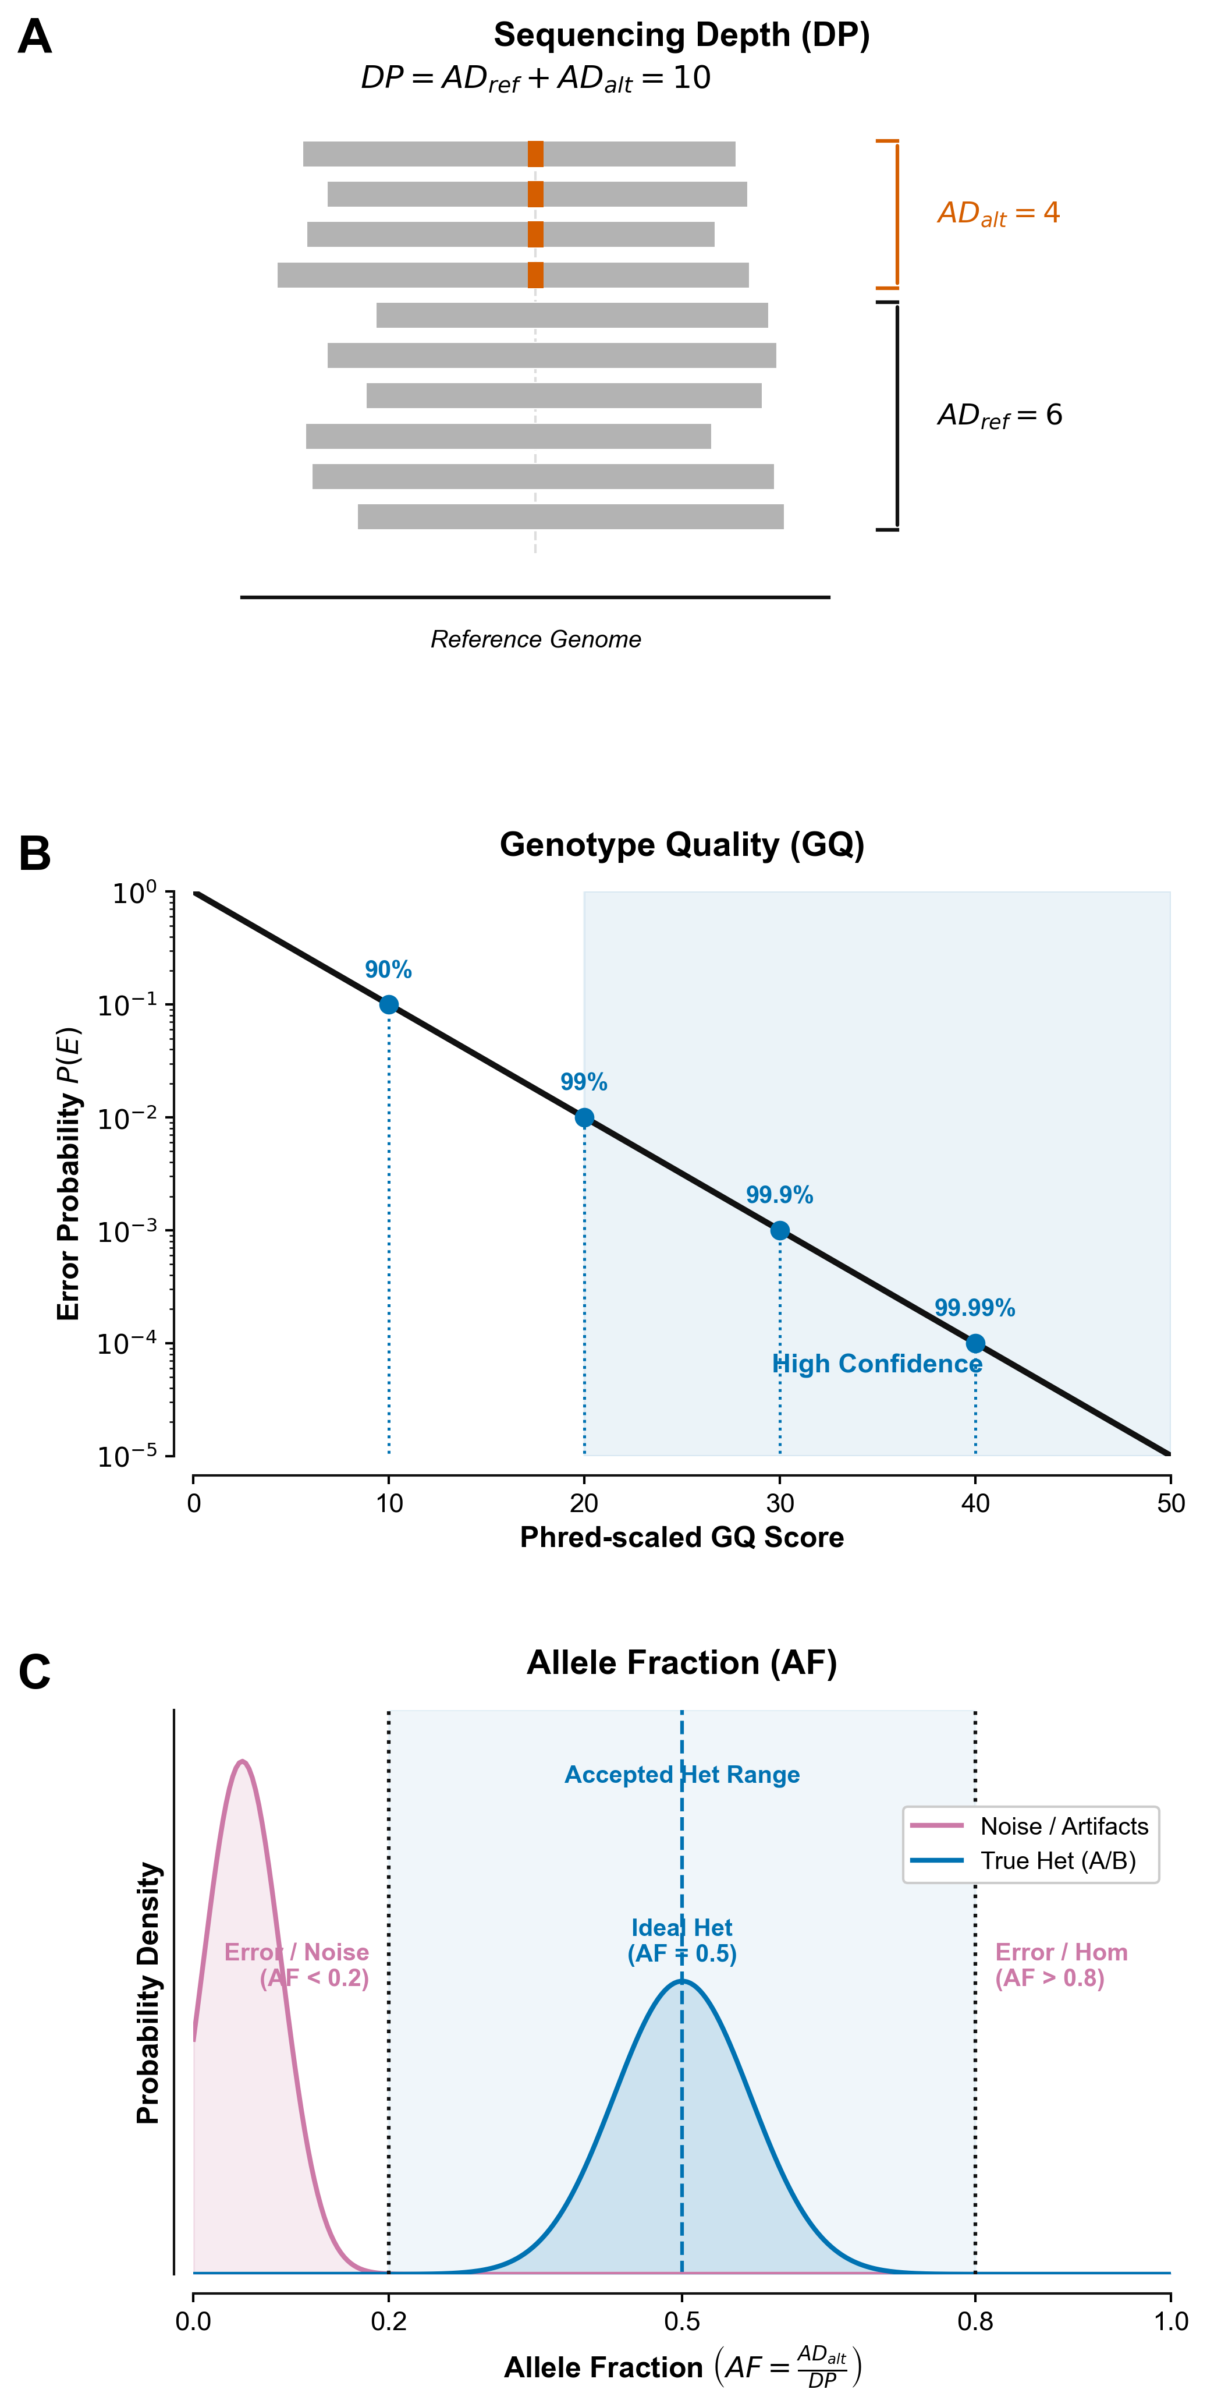
Three Call-Level Parameters: DP, GQ and AF
To calibrate WGS genotype calls, we focused on three core call-level parameters: depth (DP), genotype quality (GQ) and allele fraction (AF).
Sequencing depth (DP)
Total reads covering a position: the sum of reference- and alternate-supporting allele depths.
Higher DP usually gives more reliable genotypes
Low DP increases random sampling error, which can cause unstable calls or data gaps
Genotype quality (GQ)
Confidence of the assigned genotype, from the PL (Phred-scaled likelihood) difference between the most and second-most likely genotypes.
Higher GQ means lower error probability
GQ 10 / 20 / 30 / 40 ≈ 90% / 99% / 99.9% / 99.99% call accuracy
A practical threshold for filtering uncertain calls
Allele fraction (AF)
Proportion of reads supporting the alternate allele. A true heterozygote should sit near 0.5, but real data deviate because of:
Allelic imbalance during sequencing
Reference bias in read alignment
Allele-specific mapping quality differences
AF far outside the heterozygous range more likely reflects noise; bounding AF reduces false heterozygous calls
Each parameter removes a different kind of unreliable call, so we tune DP, GQ and AF together.

Slide 6
Array QC Keeps 1,750 Samples and 409,088 Variants
Phase | Exclusion Criteria | Retained |  |  |  |  |  | Excluded
 |  |  |  |  |  |  |  | Samples （Case/Ctrl） | Variants
 |  | illuminaASA24v1 |  | illuminaJSA24v1 | illuminaJSA24v1
 |  | Samples: 330 (CTEPH/AGP3K=321/9) |  | Samples: 1,435 (CTEPH/AGP3K=0/1,435) | Samples: 1,435 (CTEPH/AGP3K=0/1,435)
 |  | Variants: 633,357 |  | Variants: 691,920 | Variants: 691,920
 |  | illuminaASA24v1 |  | illuminaJSA24v1 | illuminaJSA24v1
Sample QC | SMISS ≥ 0.01 | Samples: 316 (CTEPH/AGP3K=309/7) |  | Samples: 1,434 (CTEPH/AGP3K=0/1,434) | Samples: 1,434 (CTEPH/AGP3K=0/1,434)
 |  | Variants: 633,357 |  | Variants: 691,920 | Variants: 691,920 |  |  | 15 (12/3)ª
 |  | Merged
Merge | Non-shared Variants | Samples: 1,750 (CTEPH/AGP3K=309/1,441)
 |  | Variants: 578,970
 |  | Merged
Variant QC | Multiallelic Variants | Samples: 1,750 (CTEPH/AGP3K=309/1,441)
 |  | Variants: 574,240 |  |  |  |  |  |  | 4,730
 | VMISS ≥ 0.01 | Variants: 565,224 |  |  |  |  |  |  | 9,016
 | Non-autosomal Variants | Variants: 535,182 |  |  |  |  |  |  | 30,042
 | MAF < 0.01 | Variants: 409,321 |  |  |  |  |  |  | 125,861
 | Ctrl HWE P < 1e-06 | Case HWE P < 1e-10 | Variants: 409,088 |  |  |  |  |  |  | 233
a: Two samples are duplicated; since SMISS, only the samples in illuminaJSA24v1 are retained.
SMISS: Sample Missing Rate
VMISS: Variant Missing Rate
MAF: Minor Allele Frequency
HWE P: P-value of Hardy-Weinberg Equilibrium

Slide 7
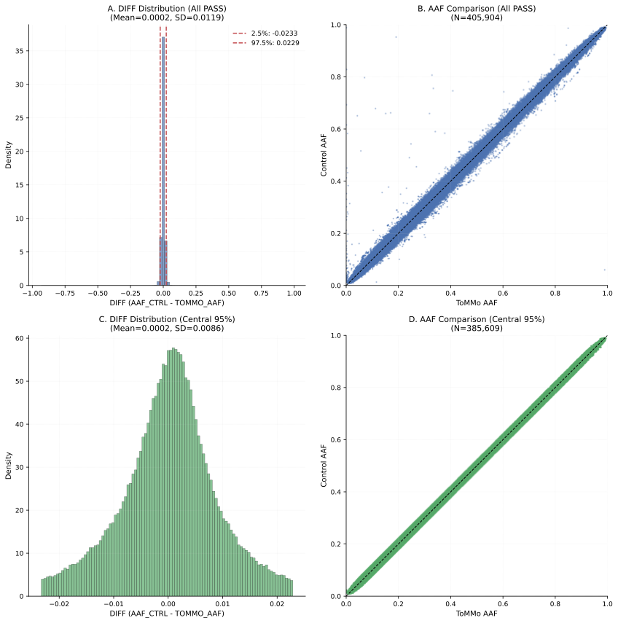
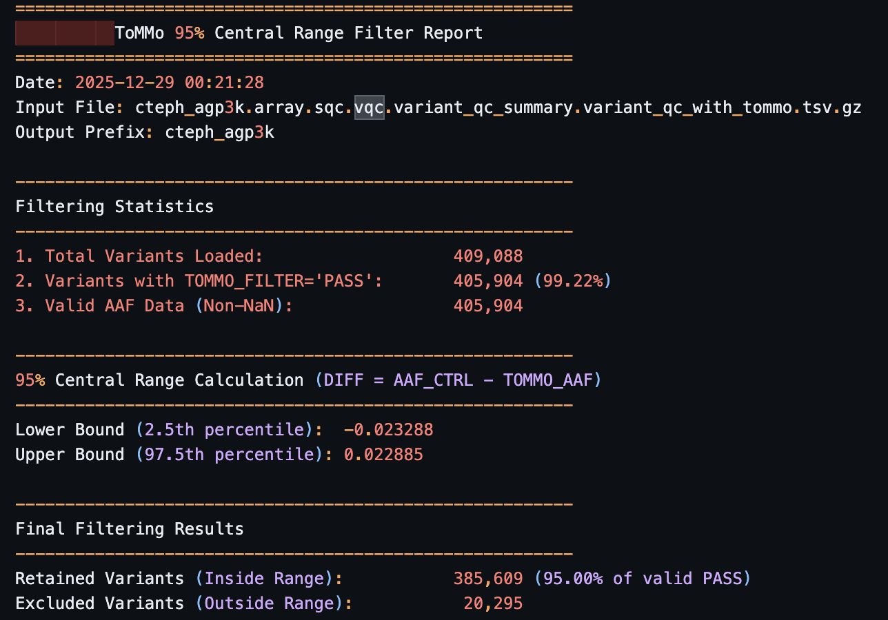
ToMMo Frequency Filter Keeps 385,609 High-Confidence Variants
Why filter against ToMMo
Array QC removes genotyping noise; ToMMo, a larger Japanese reference, flags low-confidence and population-specific variants
Keep variants whose control AAF − ToMMo AAF falls in the central 95% range (−0.023 to 0.023)
Result: 385,609 of 405,904 valid variants kept as high-confidence anchors

Slide 8
382,521 Variants Shared by Array and WGS Form the Test Set
Truth set: array genotypes
1,750 samples after array QC
385,609 variants after the ToMMo filter
Test set: WGS calls
Same 1,750 samples
41,179,812 variants called
Comparison set
382,521 variants present on both platforms
True Genotype (Array)
Samples: 1,750
Variants: 385,609
Call Genotype (WGS)
Samples: 1,750
Variants: 41,179,812
Select Shared Variants
Samples: 1,750
Variants: 382,521
Every metric that follows compares WGS and array genotypes at the same 382,521 sites in the same 1,750 samples.

Slide 9
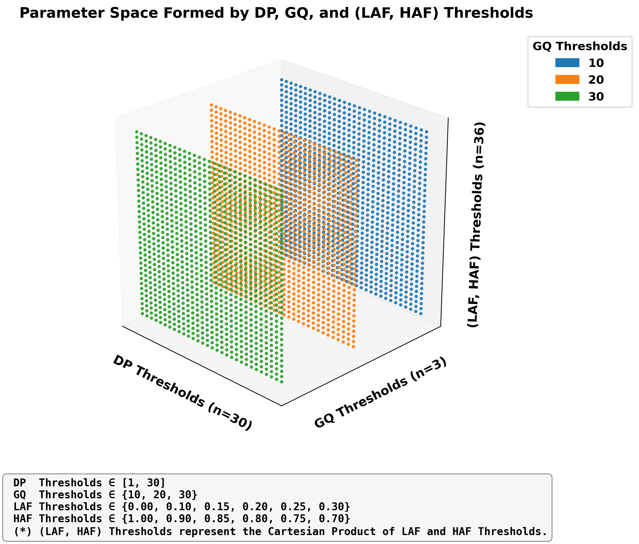
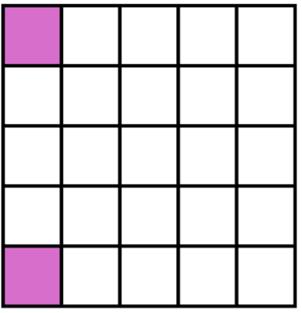
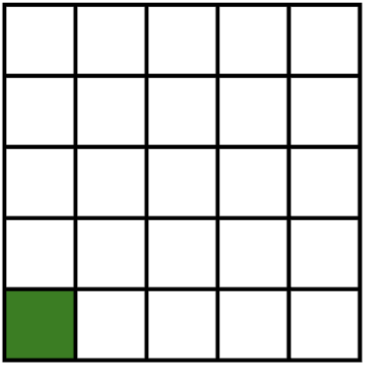
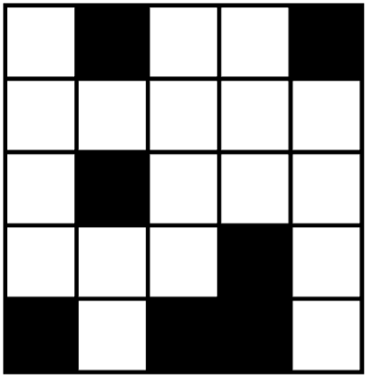
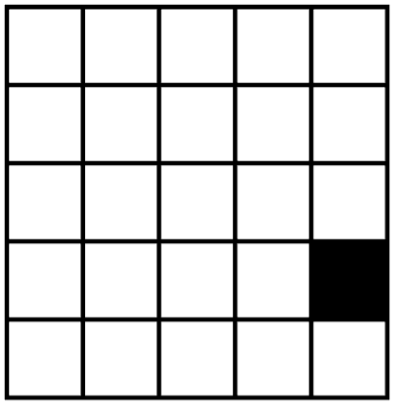
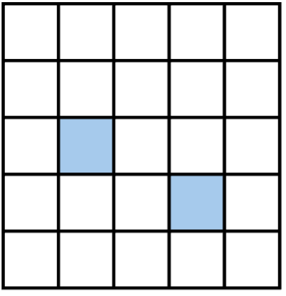
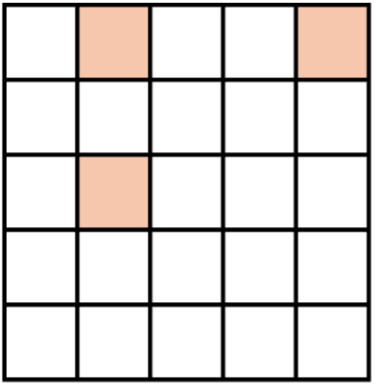
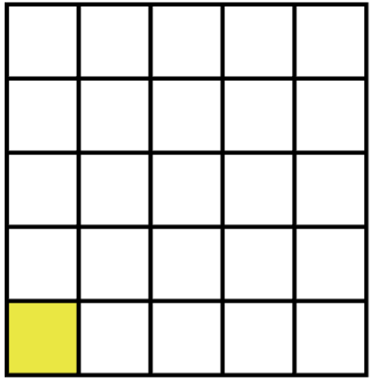
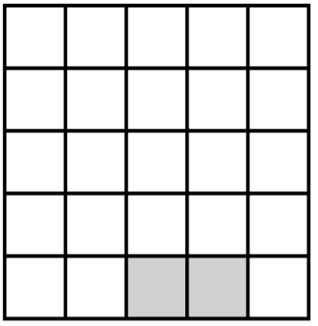
Each DP/GQ/AF Combination Yields One Confusion Matrix
GT=1 Mask
+
Call Genotype under Candidate Parameter Combination (WGS)
True Genotype (Array)
AF Outlier Mask
+
Call Heterozygous Genotype
AF Outlier
No-call
Genotype Confusion Matrix
 |  | WGS
 |  | RR | RA | AA | NC
Array | RR
 | RA
 | AA
DP No-call Mask
GQ No-call Mask
AF No-call Mask
Call Genotype (WGS)
+
No-call under DP Threshold
No-call under GQ Threshold
Original No-call
Genotype Consistency Metrics
No-call under AF Threshold

Slide 10
Genotype Confusion Matrix: WGS Calls Against Array Truth
FP: False Positive
 |  | WGS
 |  | Ref / Ref | Ref / Alt | Alt / Alt | No-call
Array | Ref / Ref
 | Ref / Alt
 | Alt / Alt
TP: True Positive
TN: True Negative
FN: False Negative
Missing
Reading each cell
TN: array Ref/Ref and WGS Ref/Ref
TP: WGS matches a non-reference array genotype (Ref/Alt or Alt/Alt)
FP: WGS calls more alternate alleles than the array
FN: WGS calls fewer alternate alleles than the array
Missing: WGS No-call, whatever the array genotype
How cells are counted
Rows: array genotype (truth); columns: WGS genotype under the tested DP, GQ and AF thresholds
In WGS data, No-calls include both original missing values and genotypes reclassified as missing under each parameter threshold
The confusion matrix and consistency metrics follow Kishikawa et al. (2019) [1]
Each threshold combination produces one 3 × 4 matrix; every consistency metric is a ratio of its cells.
[1] Kishikawa, T., Momozawa, Y., Ozeki, T., Mushiroda, T., Inohara, H., Kamatani, Y., Kubo, M., & Okada, Y. (2019). Empirical evaluation of variant calling accuracy using ultra-deep whole-genome sequencing data. Scientific Reports, 9(1), 1784.

Slide 11
Consistency Metrics (1): Concordance and Miss Rate
Each metric is the sum of the highlighted cells in the numerator matrix divided by the sum in the denominator matrix.
 |  | WGS
 |  | RR | RA | AA | NC
Array | RR
 | RA
 | AA
 |  | WGS
 |  | RR | RA | AA | NC
Array | RR
 | RA
 | AA
Genotype Concordance
=
Genotype Miss Rate
=
 |  | WGS
 |  | RR | RA | AA | NC
Array | RR
 | RA
 | AA
 |  | WGS
 |  | RR | RA | AA | NC
Array | RR
 | RA
 | AA
Concordance and miss rate come from the same matrix, so any threshold change moves both at once.

Slide 12
Consistency Metrics (2): False Positive and False Negative Rates
Same reading as the previous slide: highlighted numerator cells over highlighted denominator cells.
 |  | WGS
 |  | RR | RA | AA | NC
Array | RR
 | RA
 | AA
 |  | WGS
 |  | RR | RA | AA | NC
Array | RR
 | RA
 | AA
False Positive
Rate
=
False Negative
Rate
=
 |  | WGS
 |  | RR | RA | AA | NC
Array | RR
 | RA
 | AA
 |  | WGS
 |  | RR | RA | AA | NC
Array | RR
 | RA
 | AA
False positive and false negative rates split discordant calls by direction, which concordance alone cannot show.

Slide 13
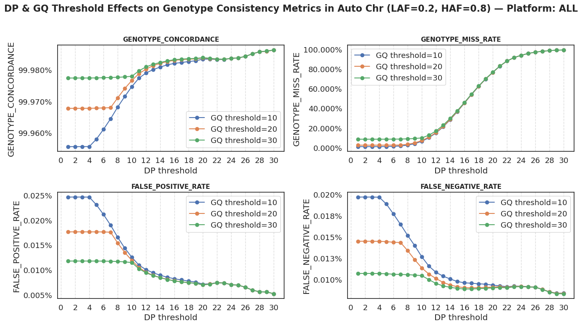
Higher DP and GQ Raise Concordance; Miss Rate Climbs Past DP 10
AF range fixed at (0.20, 0.80); autosomes, all platforms; DP threshold 1–30, GQ threshold 10 / 20 / 30.
Genotype concordance
The concordance rate steadily increases with higher DP thresholds
Higher GQ thresholds give a better baseline concordance
All settings converge to nearly 100% concordance at high DP
Genotype miss rate
Remains low at low DP thresholds
Begins to rise once the DP threshold exceeds ~10, eventually reaching about 100% by DP 30
Above DP ≈ 10, further concordance gains are small while the miss rate rises fast.

Slide 14
Higher DP and GQ Lower False Positive and False Negative Rates
AF range fixed at (0.20, 0.80); autosomes, all platforms; DP threshold 1–30, GQ threshold 10 / 20 / 30.
False positive rate
Initial values decrease as the GQ threshold increases
Continuously decreases with increasing DP threshold
False negative rate
Shows similar trends to the false positive rate: a lower starting value at higher GQ, then a steady decline as the DP threshold rises
Both error rates fall with stricter DP and GQ, and the GQ settings converge above DP ≈ 10.

Slide 15
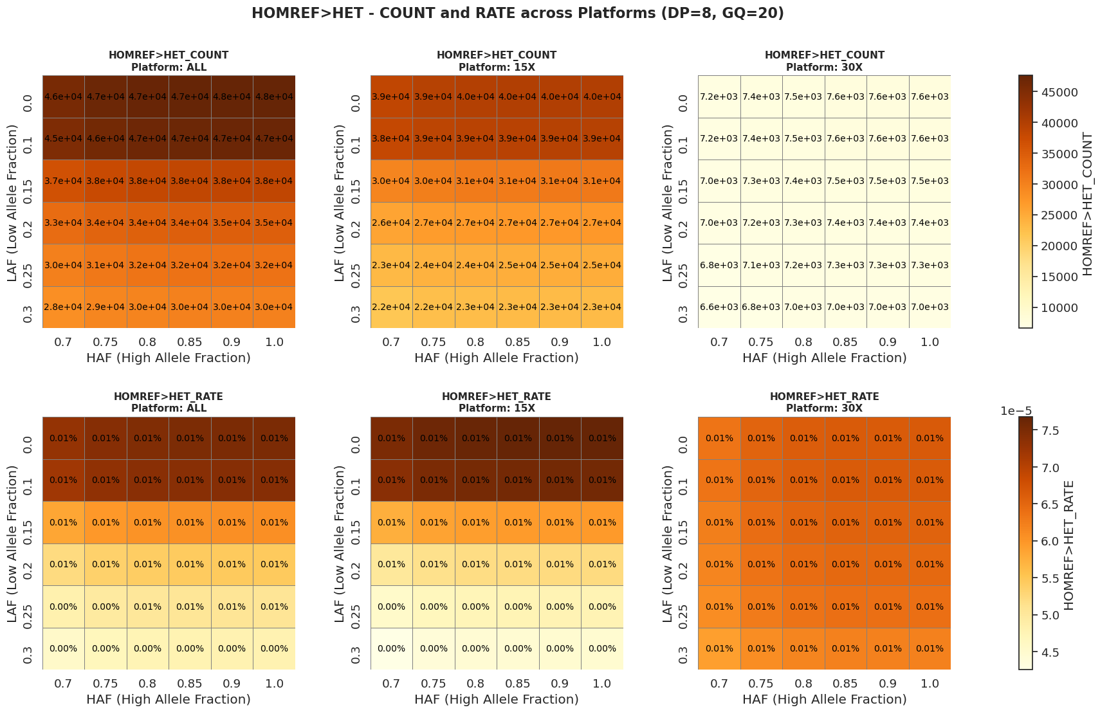
Tighter AF Bounds Cut HOMREF>HET Errors, Mostly at 15x
DP threshold 8, GQ threshold 20; LAF (low allele-fraction bound) by HAF (high bound); top: counts, bottom: rates.
The heatmaps show how the HOMREF>HET conversion rate changes as the AF bounds vary.
Effect of the AF bounds
Stricter AF settings (higher LAF, lower HAF) notably decrease the conversion rate
Platform differences
30x samples genotype more consistently as the thresholds change
15x samples show higher misclassification under more lenient thresholds
Tighter AF bounds reduce the difference between 15x and 30x
Tight AF bounds matter most for 15x samples, where loose bounds let reference homozygotes through as heterozygotes.

Slide 16
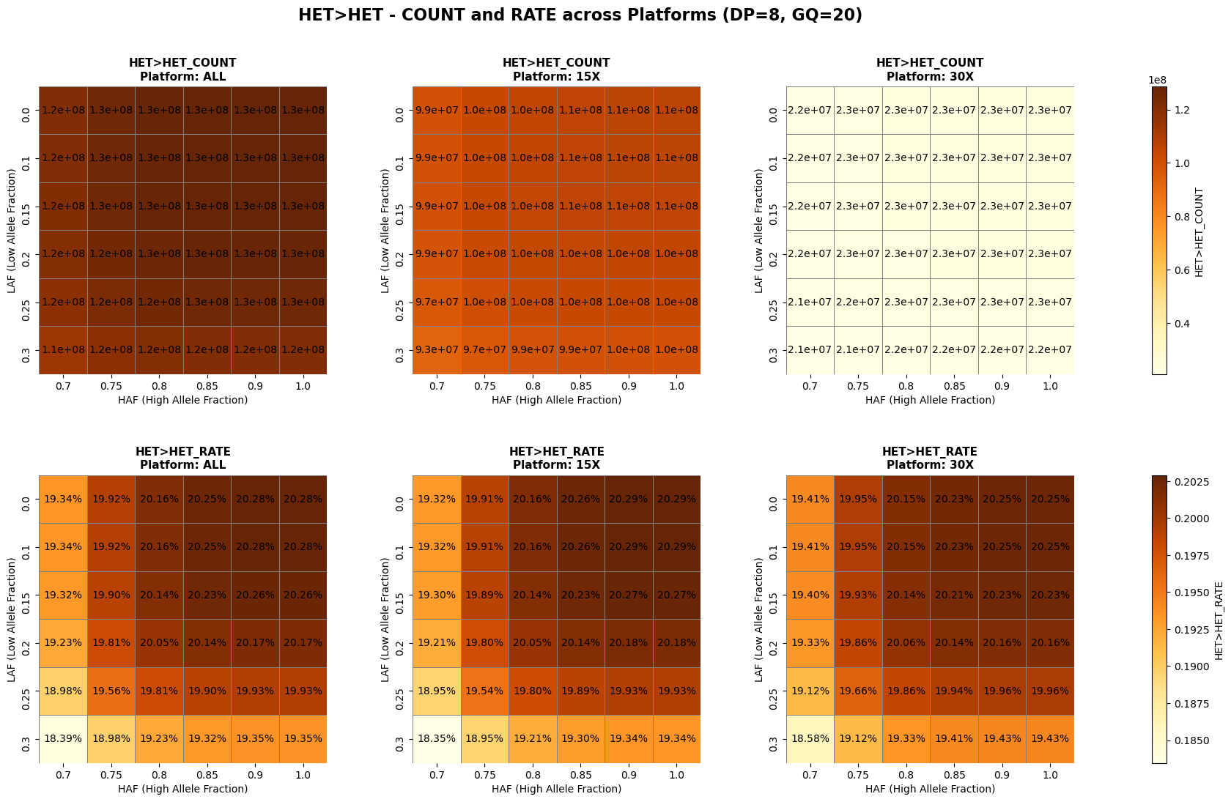
Tighter AF Bounds Also Lose True HET>HET Calls
DP threshold 8, GQ threshold 20; LAF (low allele-fraction bound) by HAF (high bound); top: counts, bottom: rates.
The heatmaps show how the rate of correctly identified HET>HET calls changes as the AF bounds vary.
Effect of the AF bounds
Implementing stricter AF thresholds (higher LAF, lower HAF) leads to fewer correctly identified HET>HET cases
Cost of tight bounds
The same settings that remove HOMREF>HET errors on the previous slide also discard true heterozygous calls
AF bounds trade false heterozygous calls against lost true ones, so they cannot simply be set as tight as possible.

Slide 17

Stricter Thresholds Trade Data Retention for Accuracy
What the threshold scans show
Stricter thresholds for DP, GQ and AF improve genotype call accuracy: higher concordance, lower false positive and false negative rates
They also filter more data, which raises the genotype miss rate
What we need
In practical use, we must find a balance between accuracy and data retention
This is a multi-objective optimization problem, introduced on the next slides
No single threshold maximizes accuracy and retention together; the choice is a trade-off.

Slide 18
Threshold Choice Is a Two-Objective Problem
Multi-objective optimization identifies the best solutions when several goals compete. Unlike single-objective problems, which usually have one clear solution, multi-objective problems have a set of optimal solutions, the Pareto solutions, where improving one objective typically requires sacrificing another.
In genotype QC we must balance two metrics: genotype concordance and genotype miss rate.
Two goals in genotype QC
Maximize genotype concordance
Minimize genotype miss rate
Why it is a classic trade-off
Trade-offs are unavoidable: improving concordance often increases the miss rate
The metrics are interconnected: adjusting QC parameters changes concordance and miss rate at the same time
No perfect solution exists: both cannot be optimized at once
Our objectives
Identify a set of optimal QC parameters (the Pareto front)
Maximize the retention of valid data while ensuring data quality
Provide clear trade-off information across parameter configurations so we can select the most suitable one
We need a rule that picks one point from the Pareto front, not a single best value for each metric.

Slide 19
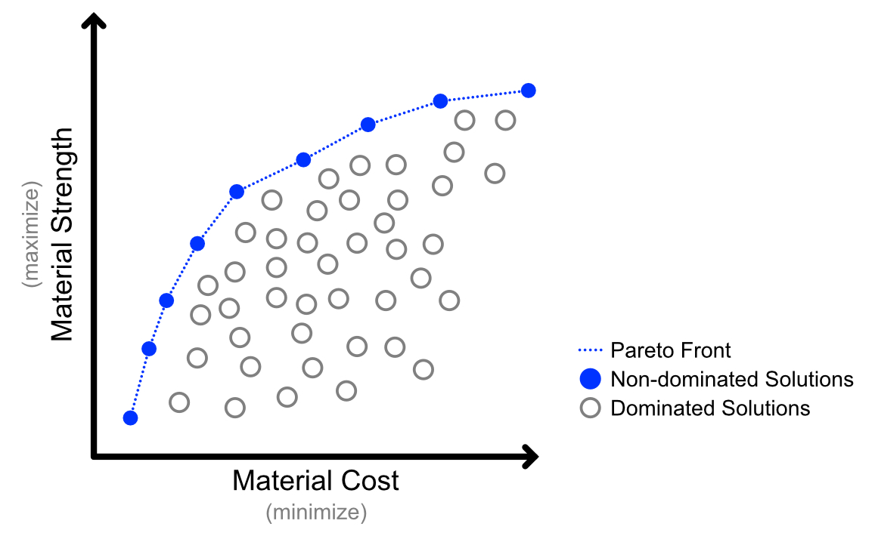
Pareto Front: Settings No Other Setting Beats on Both Goals
Pareto optimization is a fundamental technique for multi-objective optimization. It relies on three concepts:
Key concepts
Dominated solution (gray points): performs worse on both objectives than some point on the Pareto front
Non-dominated solution (blue points): no other solution is better on all objectives
Pareto front (blue curve): the set of all non-dominated solutions; on this curve, improving one objective inevitably compromises the other
Reading the diagram
The diagram shows a bi-objective problem; each point on the Pareto front is an optimal balance between the two objectives
Only points on the Pareto front are worth considering; every other point can be improved on both goals.

Slide 20
Applied to QC: Miss Rate Against Concordance
In our example, the x-axis is genotype miss rate and the y-axis is genotype concordance; each point is the result of one parameter setting.
What the points mean
Gray points (dominated): some parameter combination achieves both a lower miss rate and higher concordance
Blue points (non-dominated, on the Pareto front): the best trade-offs; no other setting is better on both metrics
Blue curve (Pareto front): moving along it, increasing concordance requires accepting a higher miss rate
How we use it
This lets us focus only on the optimal parameter combinations: the non-dominated solutions on the Pareto front
Are dominated by
Genotype Concordance
Genotype Miss Rate
We only choose among Pareto-front settings; the dominated settings are discarded.

Slide 21
We Pick the Knee Point on the Pareto Front
Why the knee point
In practice we select QC parameters from the Pareto front according to research needs
The knee point gives the best balance among the metrics; optimizing beyond it significantly harms the other metric
Fine-tuning from the knee
Shift toward data completeness for large-scale analyses
Shift toward genotype accuracy for studies that need high confidence
Next challenges
Identify the knee point: the result depends on the scale and dimensions of both x and y
Weighted methodology: let us prioritize one objective when optimizing the parameters
Knee Point
We take the knee point as the default choice and next need a method to find it and to weight it.

Slide 22
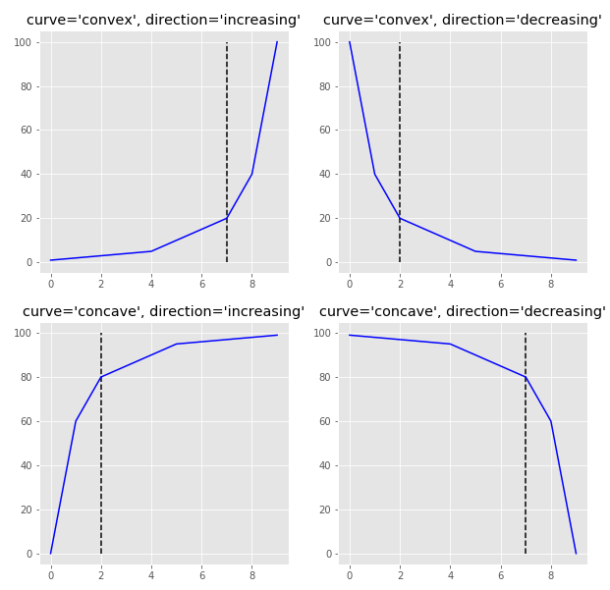
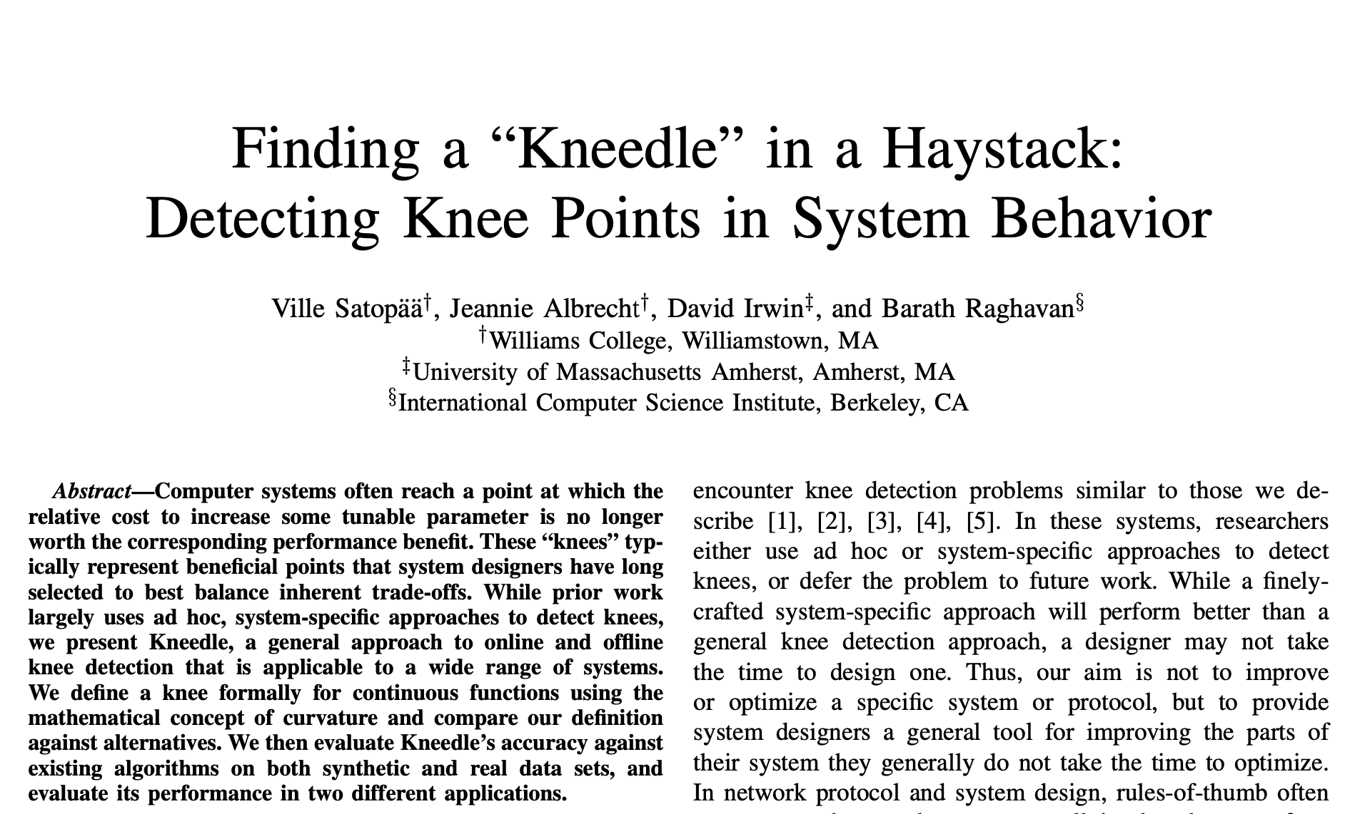
Kneedle Finds the Knee Point of a Monotonic Curve
We use the Python kneed library to detect knee points. Its algorithm, Kneedle [1], identifies the knee point of a monotonic curve. The next two slides walk through the implementation on the concave increasing example from the original paper (red box).
Kneedle gives a reproducible rule for picking the knee point on our Pareto fronts.
[1] Satopää, V., Albrecht, J., Irwin, D., & Raghavan, B. (2011). Finding a “Kneedle” in a haystack: Detecting knee points in system behavior. 31st International Conference on Distributed Computing Systems Workshops, 166–171. Code: github.com/arvkevi/kneed

Slide 23
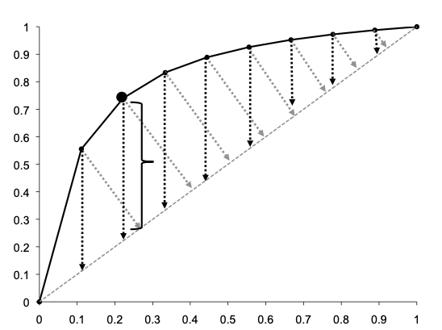

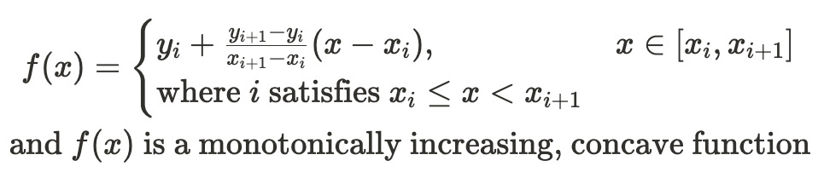

Kneedle (1): From Input Points to the Difference Curve
1 Input curve
Monotonically increasing points; here x = miss rate and y = concordance.
2 Smooth curve
Linear interpolation (scipy.interpolate.interp1d) turns the points into a continuous f(x) and damps noise.
3 Normalize
MinMax scaling maps x and f(x) onto [0, 1], so the two axes are comparable.
4 Difference curve
Compare f with the line y = x (linear growth). A curve that rises fast and then flattens sits above the line early and approaches it later; D(x) measures that gap.
A larger D(x) means the curve sits further above y = x: the region of greatest gain.

Slide 24
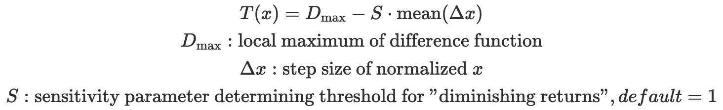
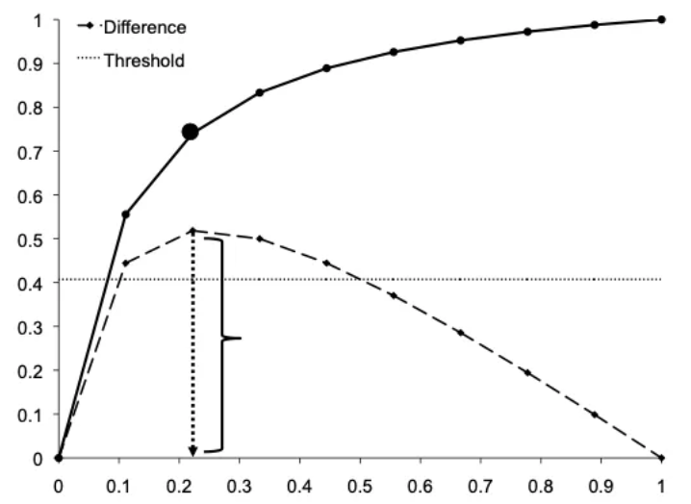

Kneedle (2): From Difference-Curve Peaks to the Knee Point
5 Local maxima become candidates
Each local maximum of D(x) marks a peak in deviation from y = x and is a knee candidate.
6 Threshold
A threshold T below each maximum keeps small fluctuations from being taken as knees; S sets its sensitivity (default 1).
7 Detect the knee
Moving right from the first maximum, take the first point xⱼ that meets:
The curve has entered the diminishing-returns region, and xⱼ is reported as the knee point.
Kneedle returns one knee per curve, set by where gains in y stop outpacing x.

Slide 25
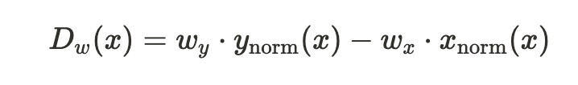
Weighted Kneedle Lets One Objective Count More
Limitation of basic Kneedle
The basic algorithm treats all objectives as equally important, which limits it in multi-objective optimization
In real-world scenarios objectives often carry different weights, for example accepting a higher miss rate to improve concordance, or prioritizing fewer false positives and false negatives
Weighted extension
We introduce a weighted extension implemented through a Weighted Difference Curve (right)
Weighted difference curve
Miss rate (x) and concordance (y) are MinMax-normalized to [0, 1]
The y weight scales the benefit (concordance); the x weight scales the cost (miss rate)
W = y weight : x weight is the ratio used on the result slides
How the weight ratio moves the knee point
W < 1: favour retention
Miss rate costs more than concordance gains
The knee appears earlier: looser thresholds, more genotypes kept
W = 1: basic Kneedle
The weighted curve reduces to the original difference curve D(x)
Both objectives count equally
W > 1: favour concordance
Concordance gains outweigh extra missingness
The knee moves right: stricter thresholds, higher miss rate
One weight ratio turns a stated preference into a single, reproducible knee point.

Slide 26
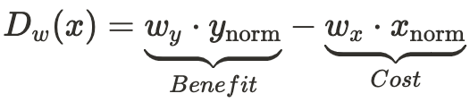
Why the Weighted Difference Curve Is Valid
Mathematical: a linear transformation
D_{w}(x) is a linear combination of x_{norm} and y_{norm}: a projection onto one score axis, like a PCA projection
A linear combination keeps convexity and the extreme points, so Kneedle's detection logic still holds
Logical: encodes a stated preference
A weight slider sets how much extra cost we accept for a gain in concordance
Geometric: tilts the reference line
The reference line's slope changes from 1 to w_{y} / w_{x}
w_{y} > w_{x}: the line tilts up, more x is needed to offset a gain in y, and the knee moves right
w_{x} > w_{y}: the line tilts down and the knee appears earlier
Weighted difference curve
Why it matters
It changes how the trade-off between improvement and cost is measured, not the knee-search procedure
Tilting the reference line makes knee detection more sensitive or more conservative
Low weight on concordance (W = 1/7 – 1/4)
Reference line tilts down; knee stays early at DP 8, GQ 20, AF 0.20–0.80 (miss rate 3.53%)
High weight on concordance (W = 2 – 6)
Reference line tilts up; knee moves right to DP 11, GQ 30, AF 0.25–0.75 (miss rate 13.23%)
Weighting changes only the slope of the reference line, so the knee search is unchanged and the weight sets where the knee lands.

Slide 27
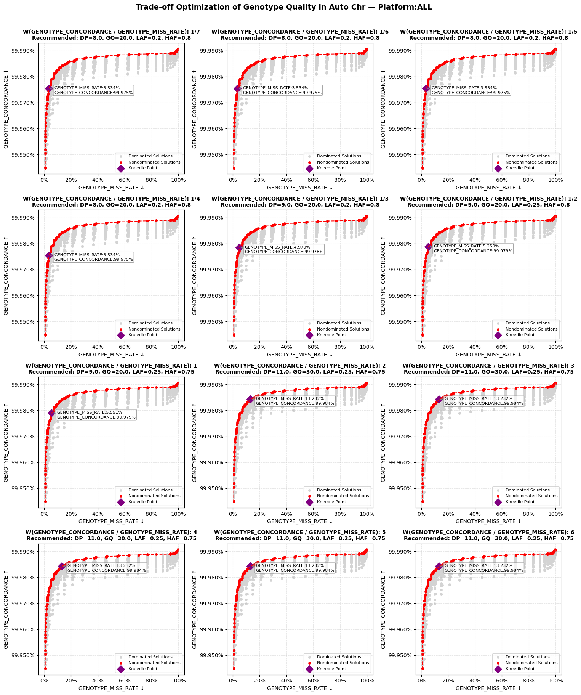
W = 1/7 to 1/2: DP 8, GQ 20 Holds Through W = 1/4
From W = 1/7 to 1/4 the knee stays at DP 8, GQ 20, LAF 0.20, HAF 0.80.

Slide 28
W = 1 to 6: Thresholds Tighten as Concordance Weighs More
As W rises from 1 to 6, the knee moves to stricter DP, GQ and AF thresholds.

Slide 29
More Weight on Concordance Raises Thresholds and Miss Rate
Knee point and metrics at each weight interval (W = weight on concordance : weight on miss rate; shaded column = recommended setting)
 | W = 1/7 – 1/4 | W = 1/3 | W = 1/2 | W = 1 | W = 2 – 6
DP threshold | 8 | 9 | 9 | 9 | 11
GQ threshold | 20 | 20 | 20 | 20 | 30
LAF | 0.20 | 0.20 | 0.25 | 0.25 | 0.25
HAF | 0.80 | 0.80 | 0.80 | 0.75 | 0.75
Concordance | 99.975% | 99.978% | 99.979% | 99.979% | 99.984%
Miss rate | 3.534% | 4.370% | 5.259% | 5.551% | 13.232%
Weights and recommended parameters
As W shifts from 1:7 to 6:1, the selection prioritizes concordance more
DP rises from 8 to 11 and GQ from 20 to 30: stricter depth and quality criteria
AF: LAF rises from 0.20 to 0.25 and HAF falls from 0.80 to 0.75, so the heterozygote allele-fraction interval narrows as W increases
Consistency metrics
Concordance rises from 99.975% to 99.984% (+0.009 percentage points)
Miss rate rises from 3.534% to 13.232%, nearly 4 times higher
The knee moves toward the upper right as W increases: the algorithm trades data volume for consistency
Beyond the low-W range, a 0.009-point concordance gain costs almost 10 percentage points more missing genotypes.

Slide 30
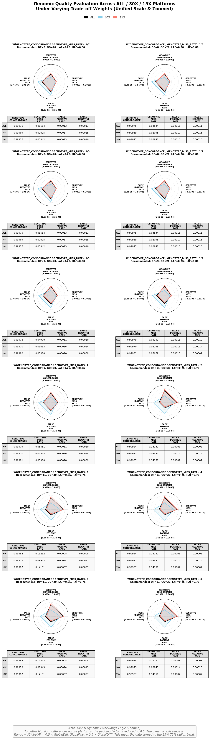
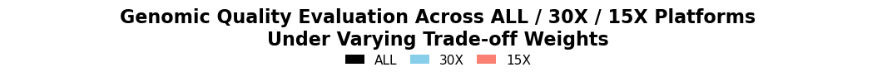
W = 1/7 to 1/4: One Setting, and 15x Misses More Genotypes
Same knee for all four weights
DP 8, GQ 20, LAF 0.20, HAF 0.80
All samples: concordance 99.975%, miss rate 3.53%
15x against 30x
Miss rate: 3.84% at 15x against 2.10% at 30x
Concordance: 99.977% against 99.969%
False positive and false negative rates: ≤ 0.017% on both
At the recommended setting the platforms agree on accuracy and differ only in missingness.

Slide 31
W = 1/3 to 2: Miss Rate Rises from 4.4% to 13.2%
Knee moves to stricter settings
W = 1/3: DP 9, GQ 20, LAF 0.20, HAF 0.80
W = 1/2 and 1: DP 9, GQ 20, LAF 0.25 (HAF 0.80, then 0.75)
W = 2: DP 11, GQ 30, LAF 0.25, HAF 0.75
All samples
Concordance: 99.978% → 99.984%
Miss rate: 4.37% → 13.23%
From W = 1 to 2, a 0.005-point concordance gain more than doubles the miss rate.

Slide 32
W = 3 to 6: Knee Stays at DP 11, GQ 30
No further change past W = 2
DP 11, GQ 30, LAF 0.25, HAF 0.75 for every weight
All samples: concordance 99.984%, miss rate 13.23%
15x against 30x
Miss rate: 14.15% at 15x against 8.94% at 30x
Concordance: 99.987% against 99.973%
Strict settings widen the 15x–30x missingness gap to 5.2 points.

Slide 33
After Tuning, 15x and 30x Differ Mainly in Miss Rate
Across all weights tested (W = 1/7 to 6), comparing 15x, 30x and all samples.
Genotype concordance
Remains high for all three platforms across all weight settings
After global tuning, 15x and 30x show highly comparable concordance
Cross-platform differences in concordance have been substantially reduced
Genotype miss rate
Remains the major residual difference across platforms
Under every setting, 15x consistently shows higher missingness than 30x
Depth-related missingness cannot be fully eliminated by parameter tuning alone
False positive & false negative rates
After tuning, 15x and 30x are broadly comparable on both rates
The remaining discrepancy is no longer driven by concordance or error rates
It is mainly reflected in the persistent imbalance of missingness
At the recommended setting (DP 8, GQ 20, LAF 0.20, HAF 0.80)
Platform | Concordance | Miss rate | False positive rate | False negative rate
All | 99.975% | 3.53% | 0.013% | 0.011%
30x | 99.969% | 2.10% | 0.017% | 0.015%
15x | 99.977% | 3.84% | 0.013% | 0.010%
Global tuning largely harmonized 15x and 30x on concordance and error rates; the remaining cross-platform gap is driven mainly by a persistent imbalance in genotype missingness.

Slide 34
Conclusion
Recommended: DP = 8, GQ = 20, LAF = 0.20, HAF = 0.80
Stable trade-off across a weight interval
The same combination is selected for every W from 1/7 to 1/4, so it is not specific to a single weighting scheme
Within this interval it stays on the Pareto front and is identified as the knee point, supporting its robustness as a practical trade-off
Balanced overall performance
Concordance stays high (99.975%) while the miss rate stays moderate (3.534%): a reasonable balance between reliability and retention
Substantial cross-platform harmonization
15x and 30x are highly comparable in concordance, false positive rate and false negative rate; global tuning reduces platform differences in the main accuracy metrics
Residual discrepancy driven by missingness
15x consistently shows higher missingness than 30x (3.84% vs 2.10%); depth-related missingness cannot be fully eliminated by tuning alone
Use DP 8, GQ 20, AF 0.20–0.80 as the default WGS genotype QC for this cohort.

Slide 35
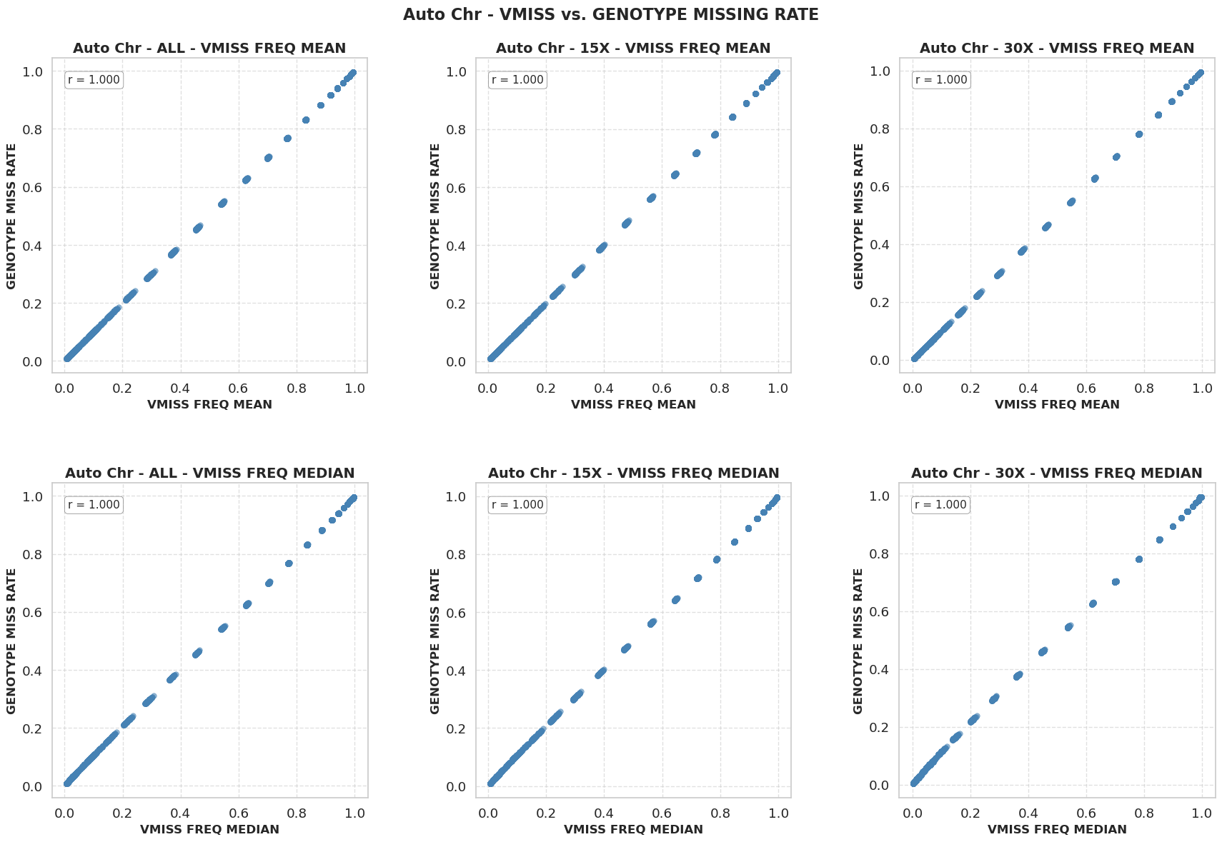
Genotype Miss Rate Tracks Variant Missingness (VMISS) Exactly, r = 1.000

Slide 36
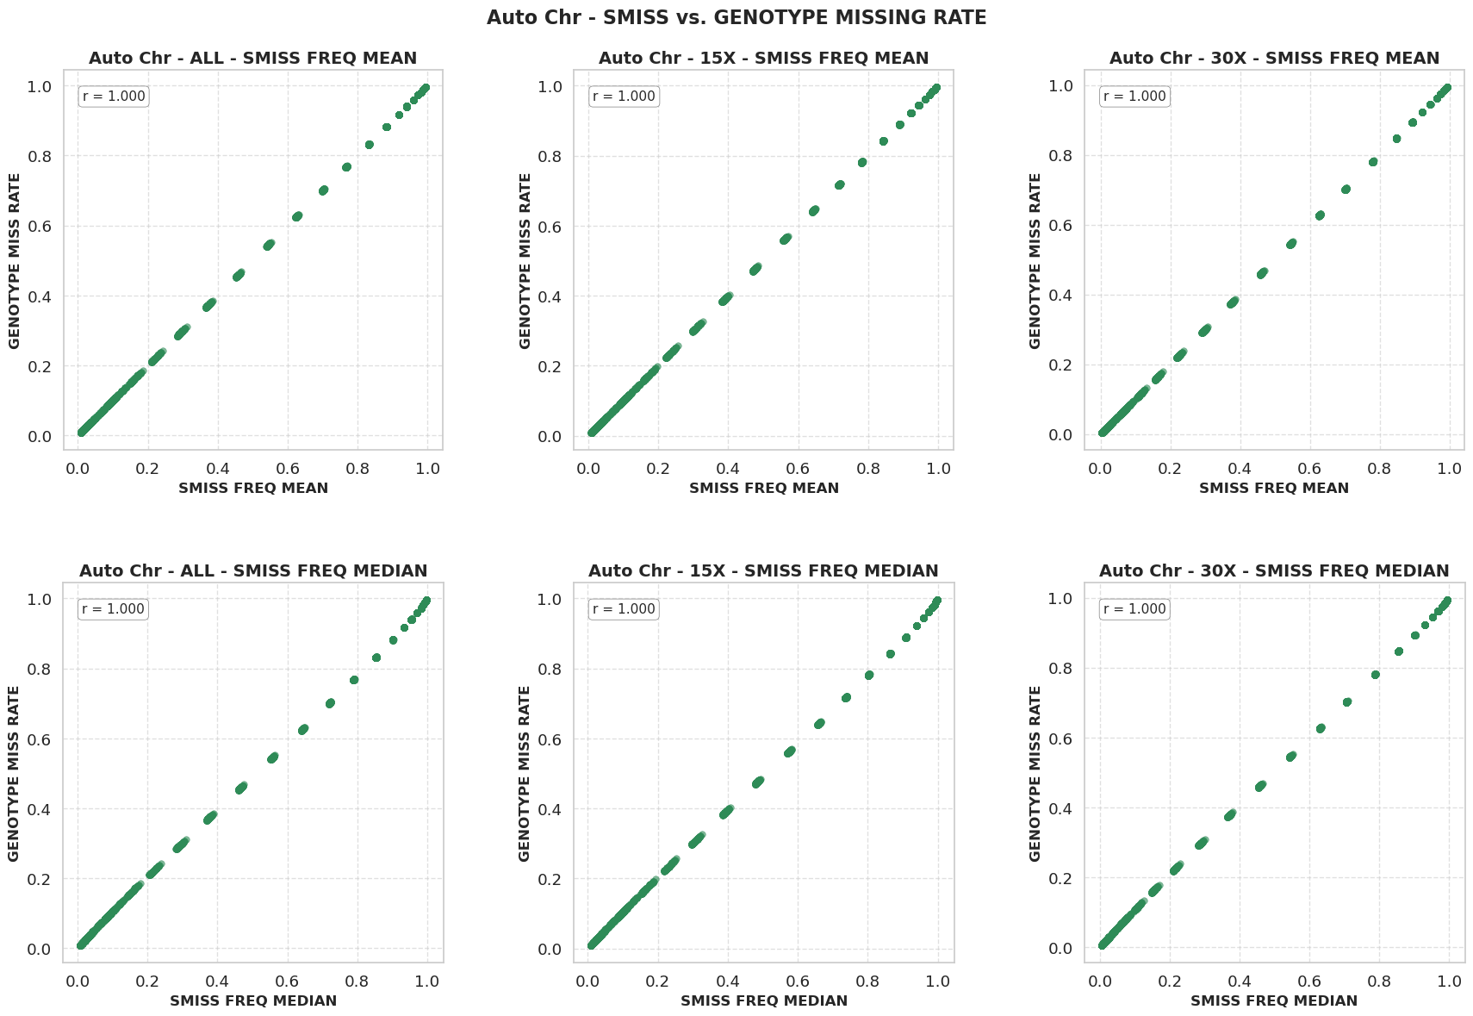
Genotype Miss Rate Tracks Sample Missingness (SMISS) Exactly, r = 1.000

Slide 37
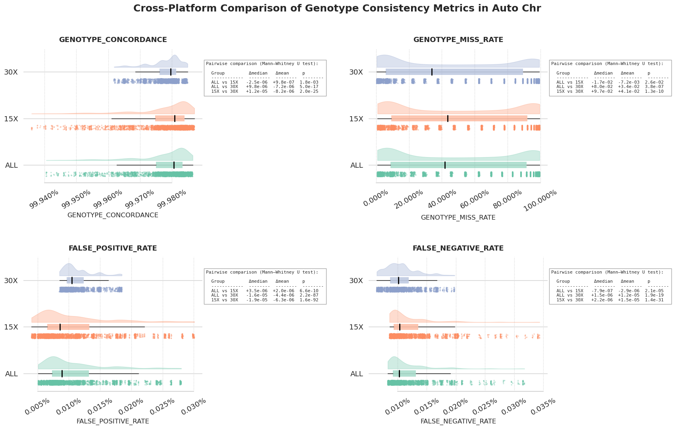
Consistency Metric Distributions by Platform (Autosomes)

Slide 38
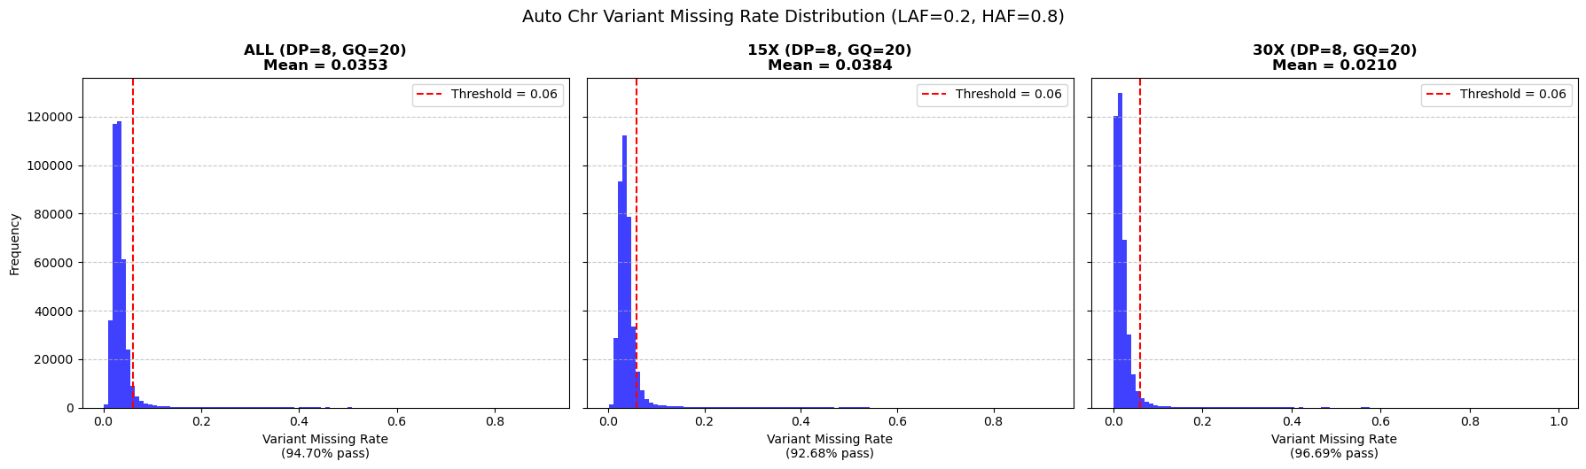
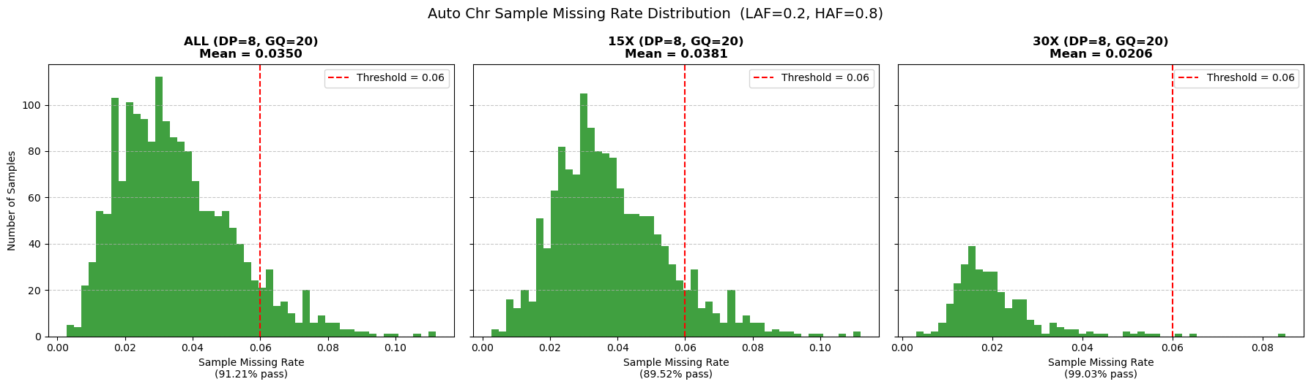
Missingness at DP 8, GQ 20: 15x Averages 3.8%, 30x 2.1%

