Slide 1
INFO7390_ Assignment3
Group 8:
Zhao Wang;
Lezi Wang;
Qiaoyi He

Slide 2
1. Problem Statement & Requirements
Nowadays, energy consumption has become a critical requirement in multiple industry fields. Therefore, we are planning to explore the datasets, which contained the power consumption of 9 different industries, and 58 different locations in City of Boston, and then develop short-term prediction models (kWh, Power Factor, and KVarh) for each location, in order to meet following requirements:
1.Supply and demand balancing: forecast the future energy usage and peak leveling to avoid overload.
2.Market making: help government to set power price.
3.Electricity grid operational optimization: government can response according to the demand for avoids energy waste.
4.Fault and anomaly record detection.

Slide 3
2. Business Goal & Solutions
Business Goal
Predict short-term power consumption for each location in City of Boston, in order to
1) Balance supply and demand;
2) Predict the daily peak leveling for avoid some emergency event like power failure, and lowest leveling for avoid the power waste;
3) Help different industries to plan for future power consumption, reduce power cost and save energy.
Solutions
Implement Micro Analysis to predict following power consumption for one day in future.
1) Total kWh for one day.
2) Average Power Factor for one day.
3) Total KVarh for one day.

Slide 4
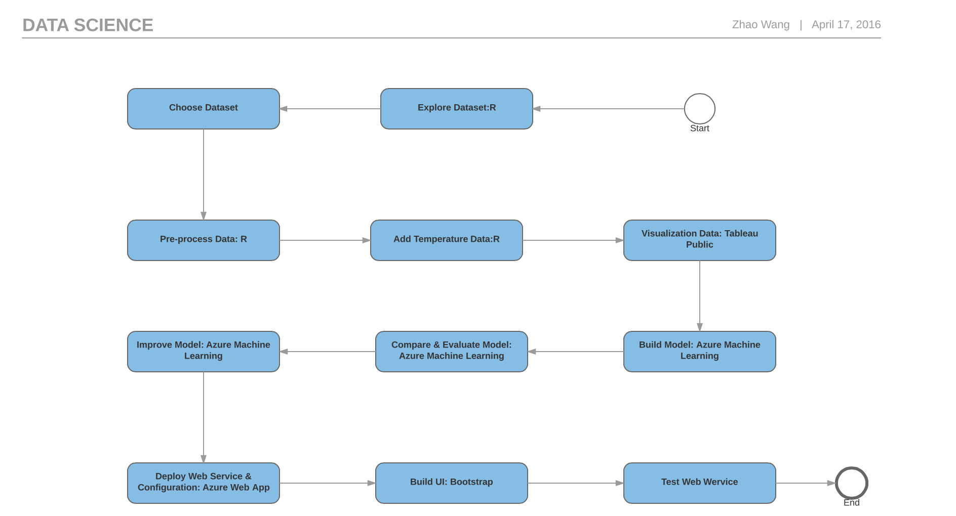
3. Process Steps & Technologies

Slide 5
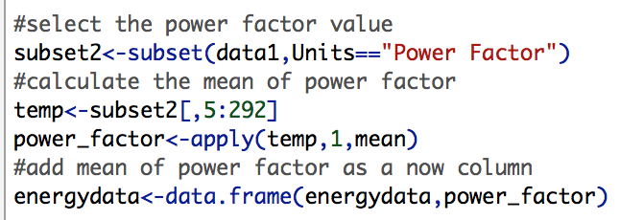
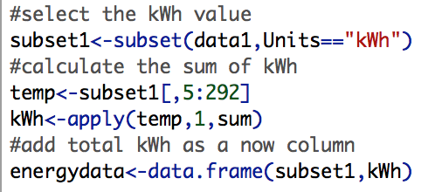
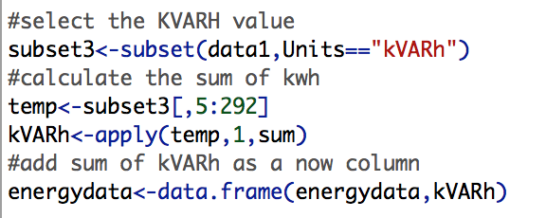
4. Data process 4.1 Calculate the value
After thorough explore the data, we think temperature has a great impact on energy consumption, so we add three different parameters relatively the temperature into dataset – maximum temperature, minimum temperature and average temperature. we need the calculate the sum of kWh and kVARh and the mean of power factor.

Slide 6
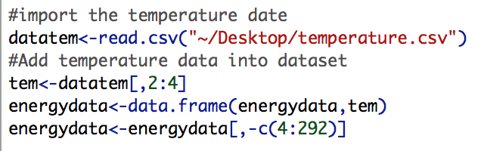
4.2 Add temperature parameter
After thorough explore the data, we think temperature has a great impact on energy consumption, so we add three different parameters relatively the temperature into dataset – maximum temperature, minimum temperature and average temperature.
We got the Daily Temperature Record 2014 from following URL and calculate the average temperature based it:
http://www.usclimatedata.com/climate/boston/massachusetts/united-states/usma0046/2014/1

Slide 7
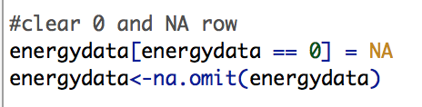
4.3 Clean the data
After we restructure the data set, we need to clean abnormal or missing data for improving the usability and stability of data. The following picture is the R code which we use to process clean the data. We delete rows which contain “0” value or missing value.

Slide 8
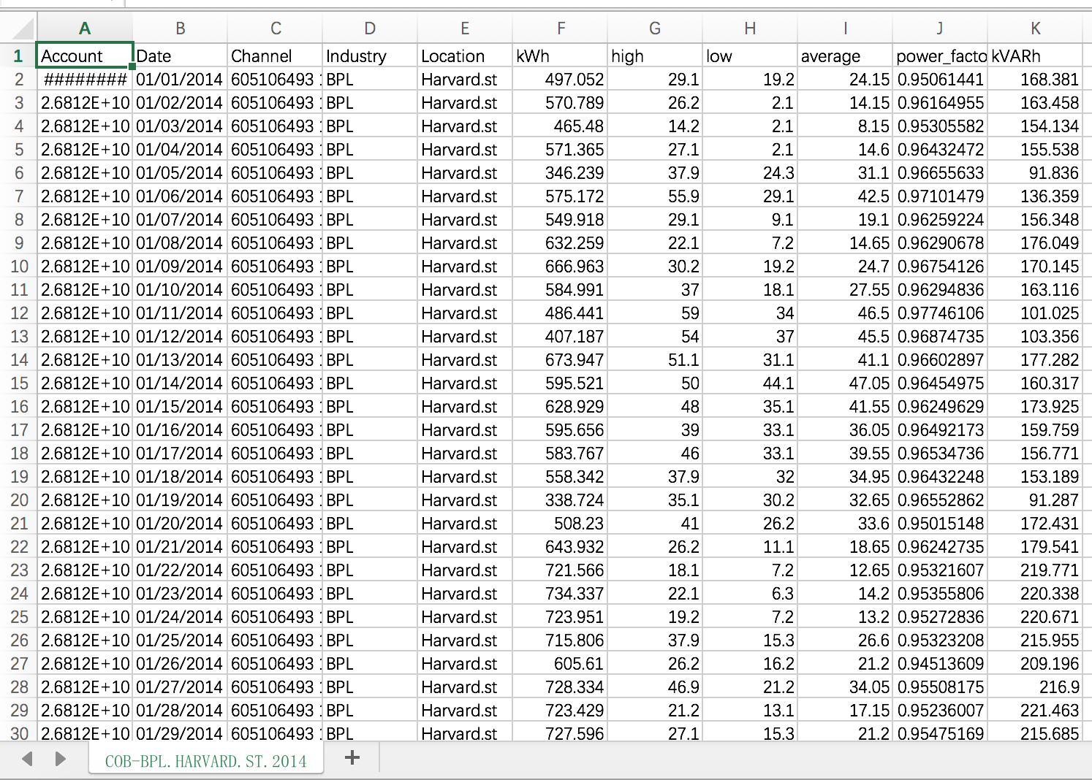
4.3 Clean the data
Dataset format after cleaning

Slide 9
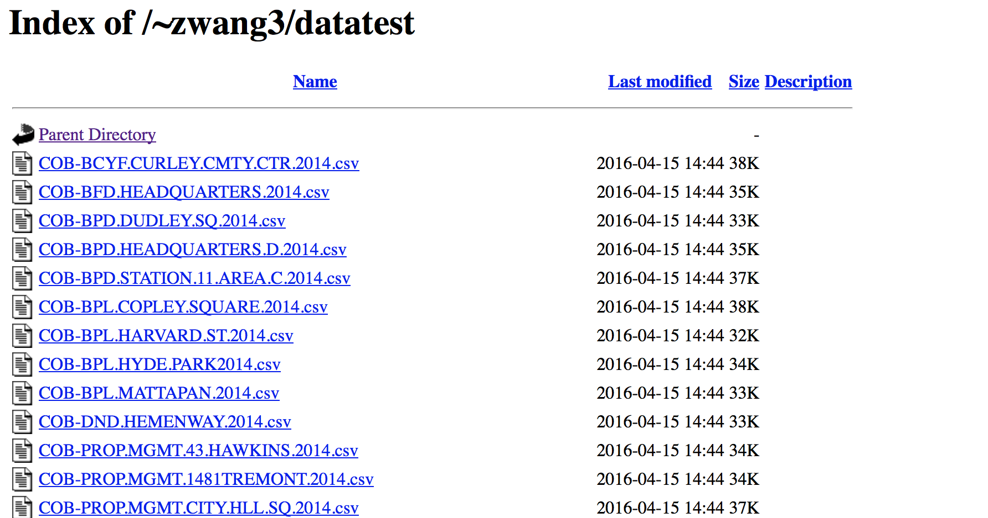
4.4 Upload Dataset
After pre-process, we upload all data set through COE serve. So customers can easy change the data source by change the URL of reader. You can find all representative datasets from following URL:
http://www1.ece.neu.edu/~zwang3/datatest/

Slide 10
5. Visualization Data
For Visualization, we use Tableau Public tools.
We choose 22 dataset in total, and we do visualization for each dataset separately. Here we just show two typical analysis for BPL at Copley Square and SCH Arts, and all others can be viewed on our website, under visualization tab.

Slide 11
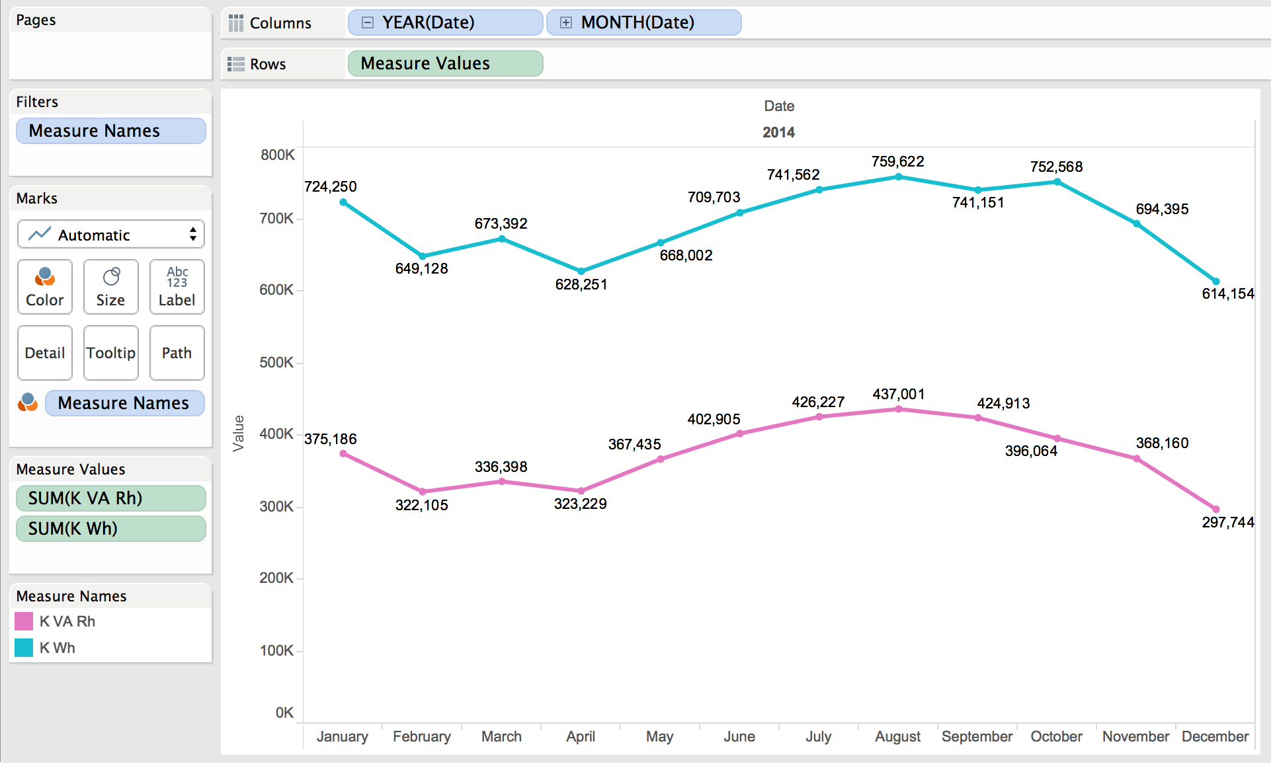
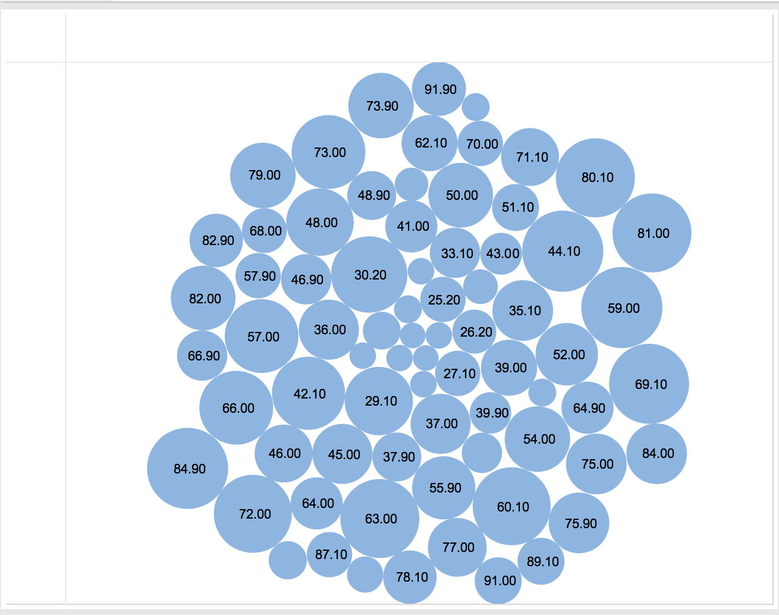
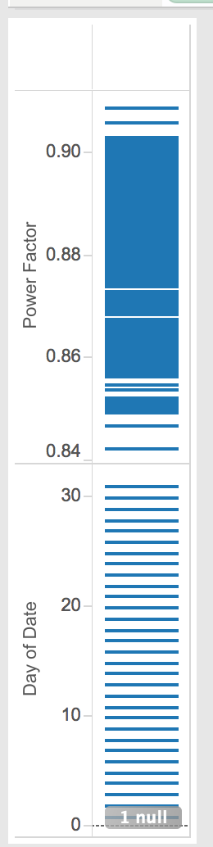
5.1 Visualization for BPL at Copley Square Energy Consumption

Slide 12
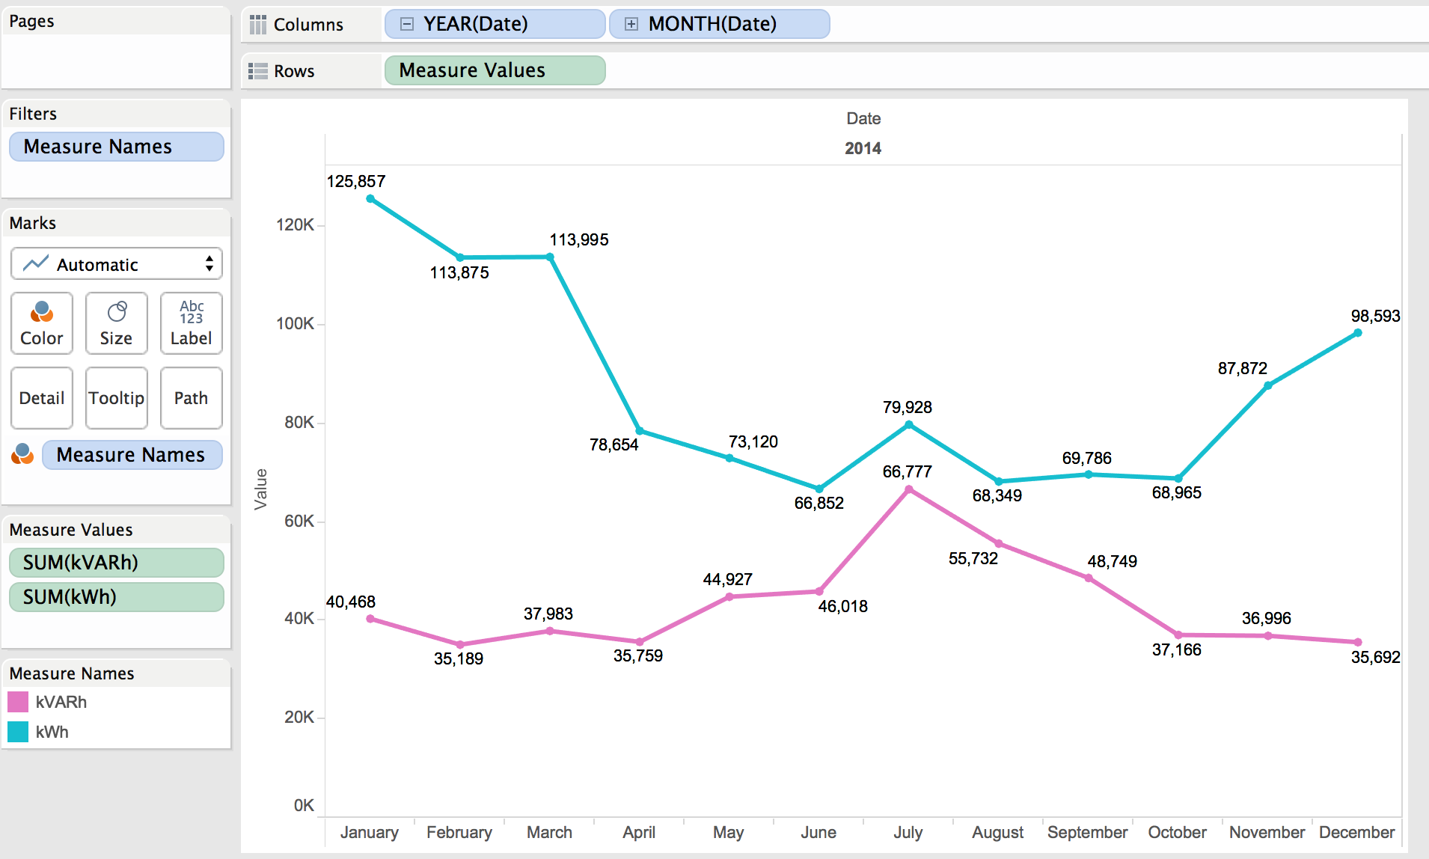
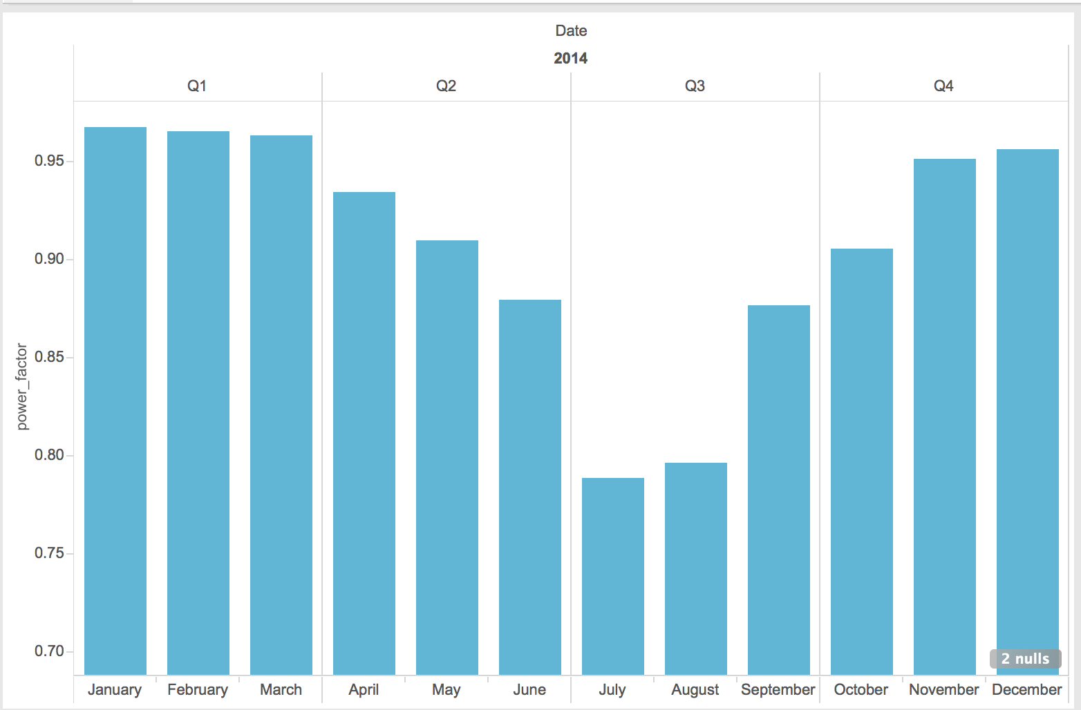
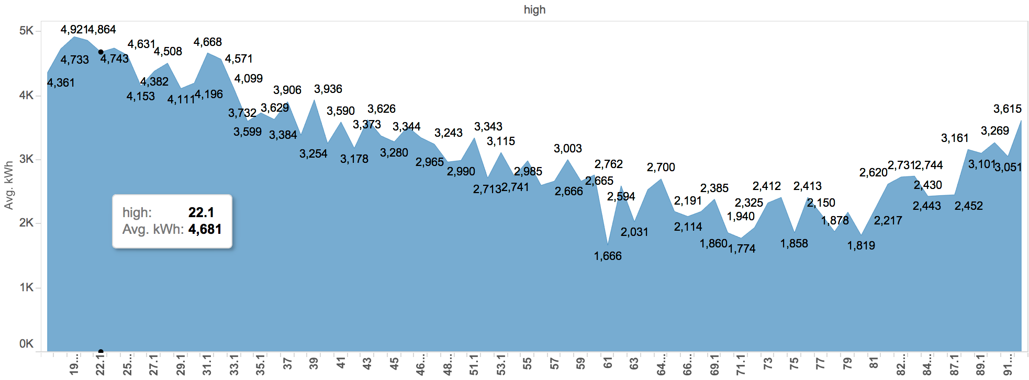
5.2 Visualization for SCH Arts Energy Consumption

Slide 13
6. Azure Machine Learning
We created three machine learning models in Azure Machine Learning Workspace to predict value. The first is the total kWh value for one day, the second is the average power factor for one day, and the third is the total Kvarh for one day.
We created three models for each result in Azure Machine Learning. In first experiment, we created three models to select the best variables subset. In the second experiment, we created two models to choose a better performance algorithm. In the third experiment, we use the best variables subset and a better performance algorithm.

Slide 14
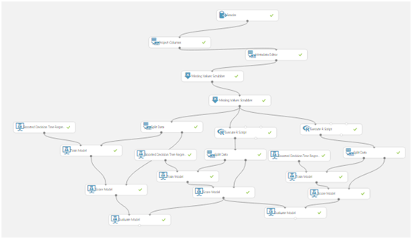
6.1 Prediction Model for kWh

Slide 15
6.2 Reader Console in Azure
For user Convenience, in Azure Workspace, we use Reader console to get the input dataset instead of using saved dataset. The reason is, if we used the dataset saved in Azure, the dataset is fixed, the model is only for this dataset, and user only can use this model for only one time. However, if we use Reader-Web URL via HTTP, we can input a dataset URL. Also, we can set URL as the Web Service Parameter. In this way, user can input the URL of one dataset they want to use, and use our models to predict values based on their preferred dataset. Our models are more flexible and more useful.

Slide 16
6.3 Compared Variables Subsets
In this experiment, we created three models which use same machine learning algorithm- Boosted Decision Tree Regression as Training Algorithm. But we use three different variables subsets for each compared models.
The three training models that we constructed were all based on the same input data, but we added different additional features to each training set. Because this model is for predicting kWh value, so the output of this model is kWh.
Set A = Date + Highest Temperature + Lowest Temperature+ Average Temperature
Set B = Date + Average Temperature
Set C = Date + Highest Temperature +Lowest Temperature

Slide 17
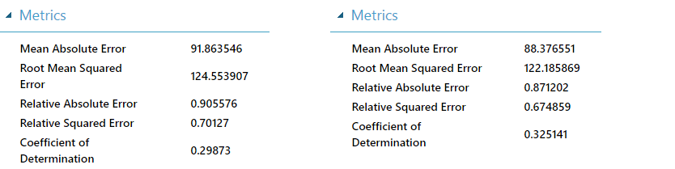
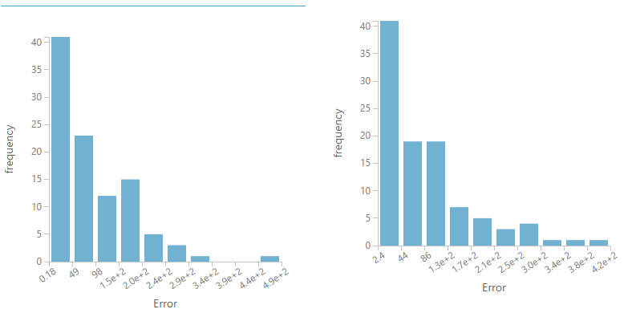
6.4 Evaluate Models

Slide 18
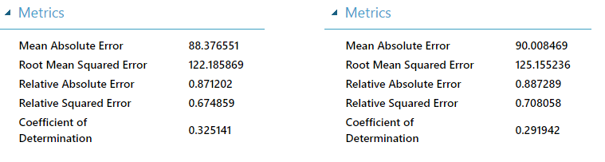
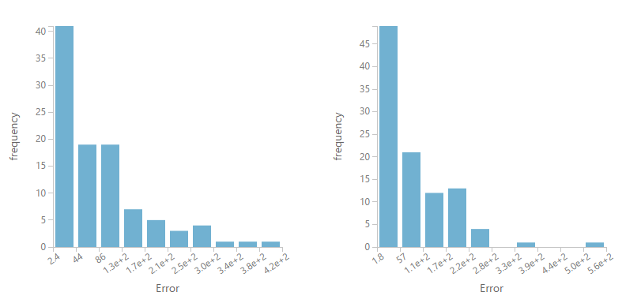
6.4 Evaluate Models (CON’T)

Slide 19
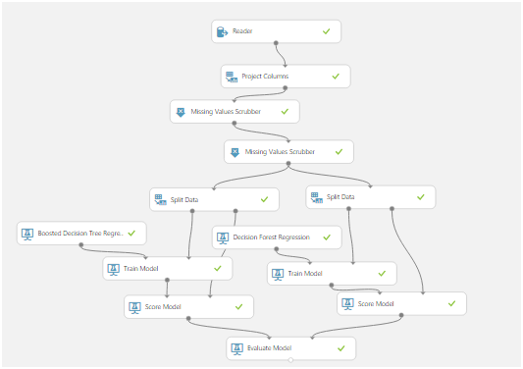
7. Prediction Model For Power Factor

Slide 20
7.1 Compared Algorithm
In this experiment, we use two different algorithms for each compared model.
The first algorithm is Boosted Decision Tree Regression, it enables to create an ensemble of regression trees using boosting. Boosting means that each tree is dependent on prior trees, and learns by fitting the residual of the trees that preceded it. Thus, boosting in a decision tree ensemble tends to improve accuracy with some small risk of less coverage. This regression method is a supervised learning method.
Another algorithm is Decision Forest Regression. It is used to create a regression model using an ensemble of decision trees. Decision trees are non-parametric models that perform a sequence of simple tests for each instance, traversing a binary tree data structure until a leaf node (decision) is reached.

Slide 21
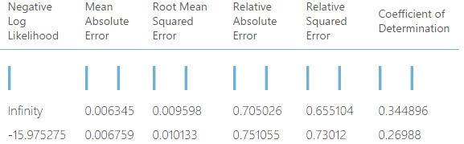
7.2 Evaluate Models
Compared the first and second models, we can see the mean absolute error of second is slightly bigger than second, that means that the error rate of second is bigger than second’s, and the average difference of first model between predictive values and real values are bigger than first’s. Also, the RMS of second is bigger than first’s, RMS stand for same situation as absolute error, but just squared it. For Negative Log Likelihood value, the smaller the better, so infinity negative is better than -15.
For this result, we can say that first model which used Boosted Decision Tree Algorithm is slightly better than second used Decision Forest Regression Algorithm. So we choose the Boosted Decision model.

Slide 22
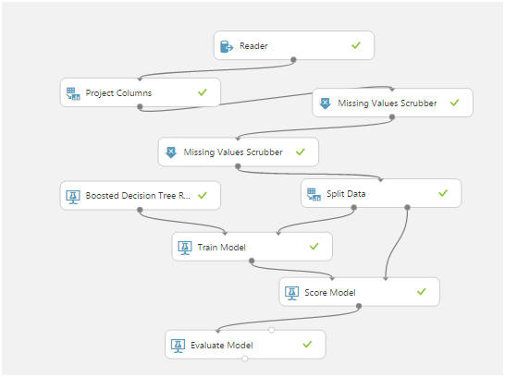
8. Prediction Model For KVarh

Slide 23
8.1 Improved Prediction Model
In this experiment, we created only one model which uses Date, Highest Temperature, and Lowest Temperature. And it uses the Boosted Decision Tree Regression to train the model.
We have already compared different variables subsets and different training algorithm. And based on prior two experiment, we found the best solution. And used them in this prediction model.

Slide 24
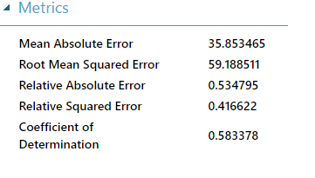
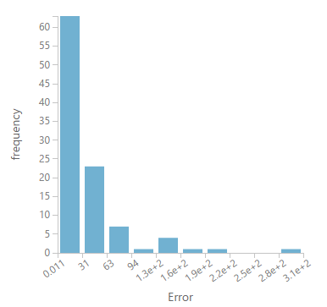
8.2 Evaluate Model
The Absolute Error, RMS and RSE of this model are acceptable. That means that the difference between predictive value and real value is acceptable. So, if these values are small, that means this model can predict kVarh value accurately.
Also, the Error Frequency indicates that this model will not make an error prediction very usual.

Slide 25
9. Deploy Web Service
After creating three training models, Azure Machine Leaning Workspace can created three predictive models automatically. These three predictive models are similar with that three training models we created before.
After predictive models were created, we deployed Web Service in Azure to get models’ APIs and URIs. These two values are very important for developing an integration of model.

Slide 26
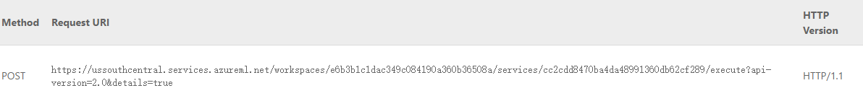
9.1 API Key And URI
API stands for application programming interface. It can be helpful to think of the API as a way for different apps to talk to one another. For many users, the main interaction with the API will be through API keys, which allow other apps to access your account without you giving out your password.
To paraphrase the World Wide Web Consortium, Internet space is inhabited by many points of content. A URI (Uniform Resource Identifier; pronounced YEW-AHR-EYE) is the way you identify any of those points of content, whether it be a page of text, a video or sound clip, a still or animated image, or a program. The most common form of URI is the Web page address, which is a particular form or subset of URI called a Uniform Resource Locator (URL).

Slide 27
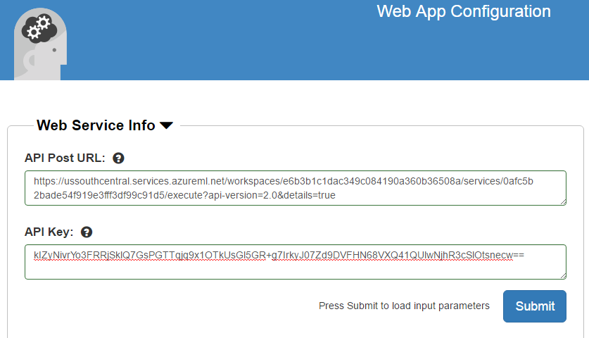
9.2 Models Integration
We used Azure Web Service to create Web App. In Azure studio, we create an Azure ML Request-Response Service Web App, and input the API key and URL of models.

Slide 28
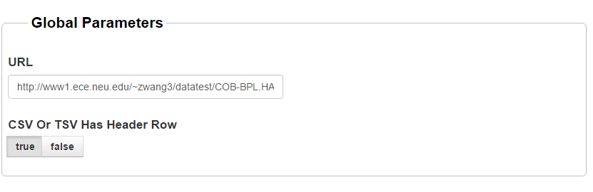
9.3 Result Testing
We have uploaded all datasets to COE server. Thus, each dataset has its own URL. We set one of dataset’s URL as the URL default value. Of course, users can change URL value to the URL of the dataset they want to use.

Slide 29
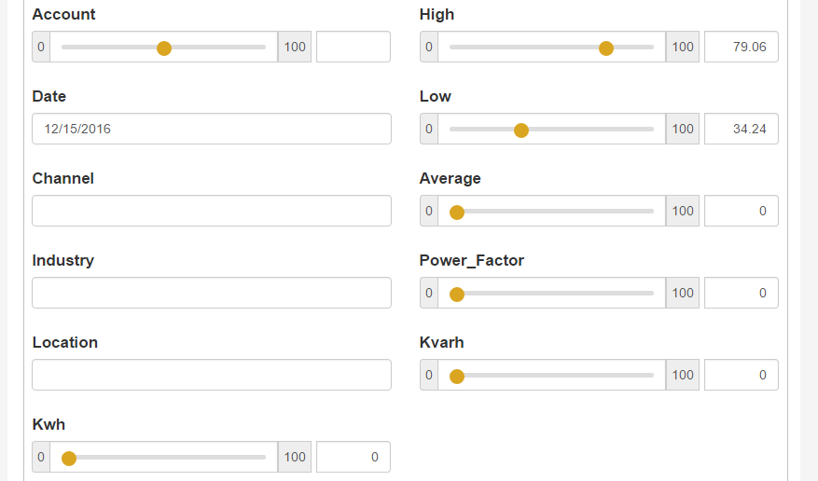
9.4 Result Testing (CON’T)
For each dataset, the Location, Industry, and Account are same. So, user need not input these three parameters. Our models do not use Average Temperature and Channel feature. And users should not input the feture they want to predict.
In conclusion, users only should input the Date they want to predict, the Highest Temperature and Lowest Temperature of that day.

Slide 30
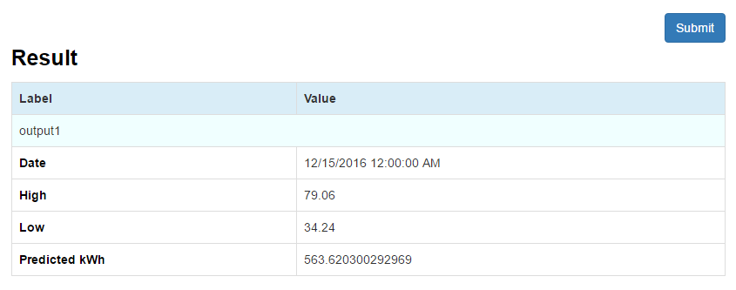
9.4.1 Result of kWh Prediction
The predicted total kWh value in 12/15/2016 was shown in the last line. This result come from the kWh prediction model created in Azure Machine Learning Workspace. About the result accuracy, we talked about it in Creating Models part before.

Slide 31
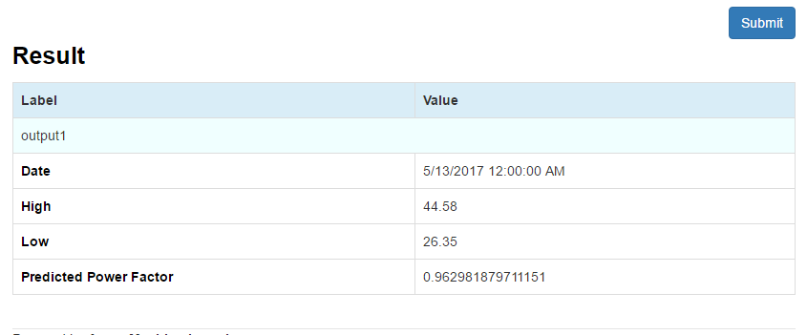
9.4.2 Result of Power Factor Prediction
After clicking Submit button, we can get a result table. The predicted average power factor value for the 5/13/2017 was shown in the last line. This result come from the power factor prediction model created in Azure Machine Learning Workspace. About the result accuracy, we talked about it in Creating Models part before.

Slide 32
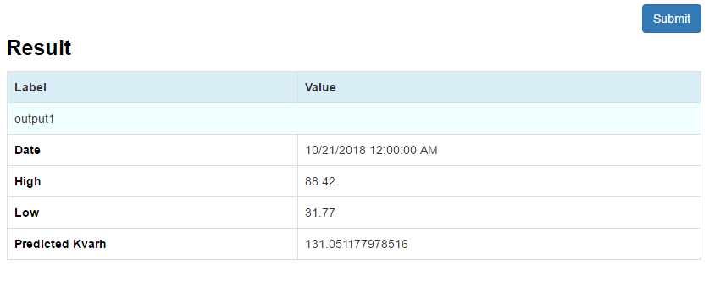
9.4.3 Result of kVarh Prediction
After clicking Submit button, we can get a result table. The predicted total kVarh value for 10/21/2018 was shown in the last line. This result come from the kVarh prediction model created in Azure Machine Learning Workspace. About the result accuracy, we talked about it in Creating Models part before.

Slide 33
10. Web App & UI
UI Tools
We develop our User Interface using HTML, CSS and Bootstrap. And we also combine our UI with web service UI from Azure.

Slide 34
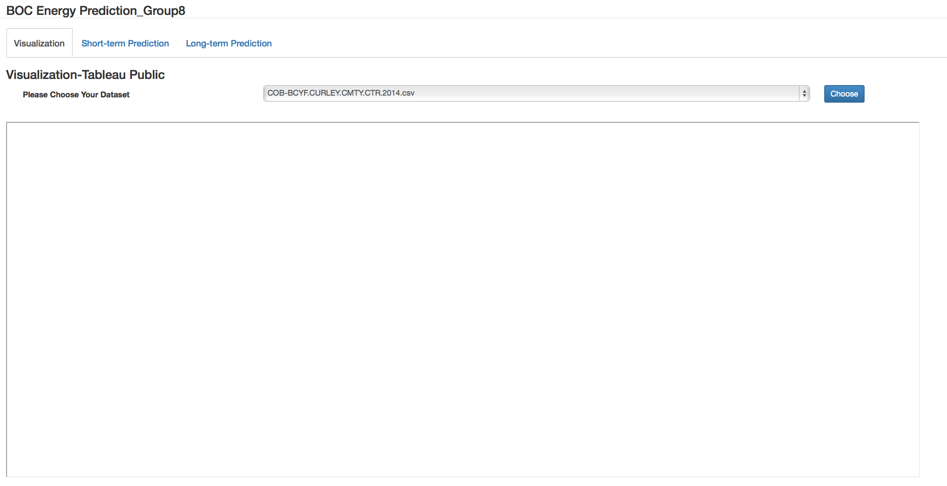
10.2 Web Pages
Home Page
URL: http://www1.ece.neu.edu/~zwang3/energy_prediction_group8.html
The home page contains two parts: Visualization, Short-term prediction.

Slide 35
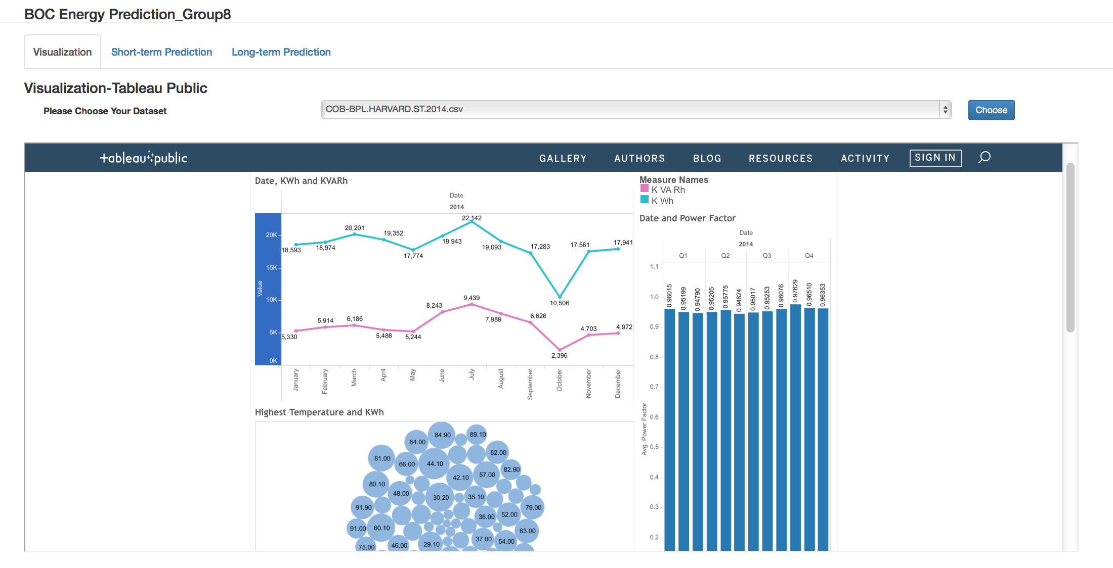
10.2 Web Pages
Visualization Page
After click the “Visualization” tab, user can choose the dataset he want to analyze and predict with. After choose dataset and click “Choose” button, the visualization analysis for the chosen dataset will occur below. We use Tableau public for that.

Slide 36
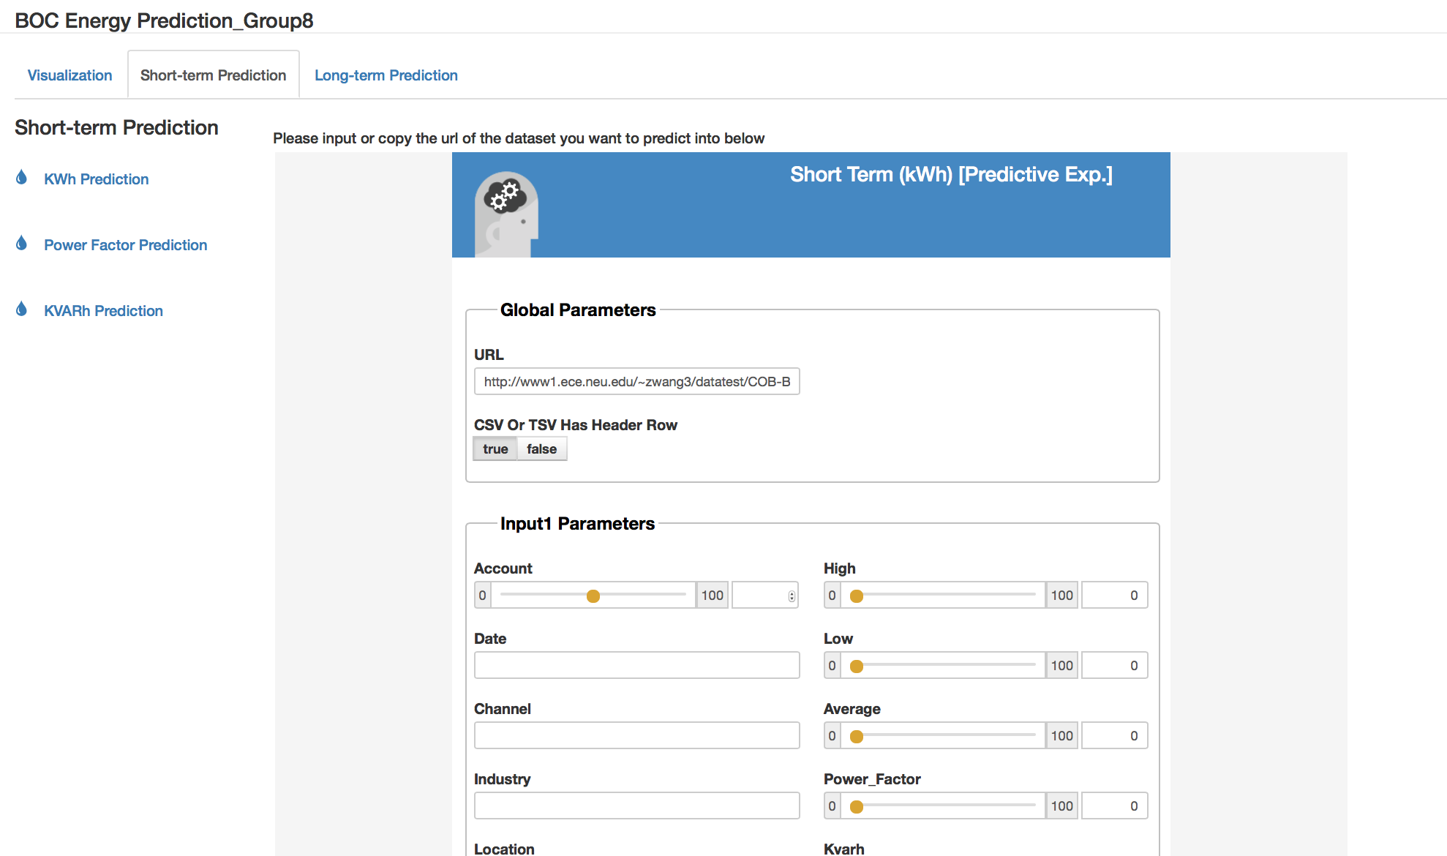
10.2 Web Pages
Short-term Prediction Page
After click “Short-term Prediction” tab, user will enter short-term prediction page. And it contains three prediction models: kWh, Power Factor, KVarh. The default one is for kWh.

Slide 37
10.2 Web Pages
Short-term kWh Prediction Page
After choosing kWh prediction model, user can input or copy the URL of the dataset he want to predict into input box, and then fill the prediction forms with parameters, and click “submit” button. Then the prediction output will show in the bottom.

Slide 38
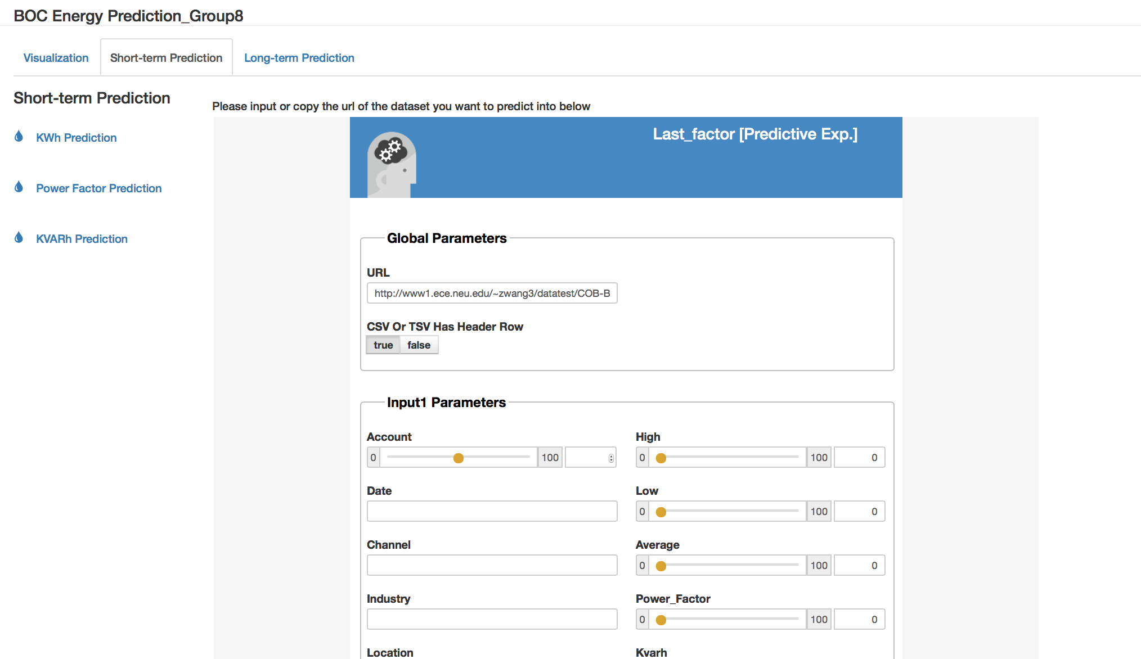
10.2 Web Pages
Short-term Power Factor Prediction Page
After choosing Power Factor prediction model, user can input or copy the URL of the dataset he want to predict into input box, and then fill the prediction forms with parameters, and click “submit” button. Then the prediction output will show in the bottom.

Slide 39
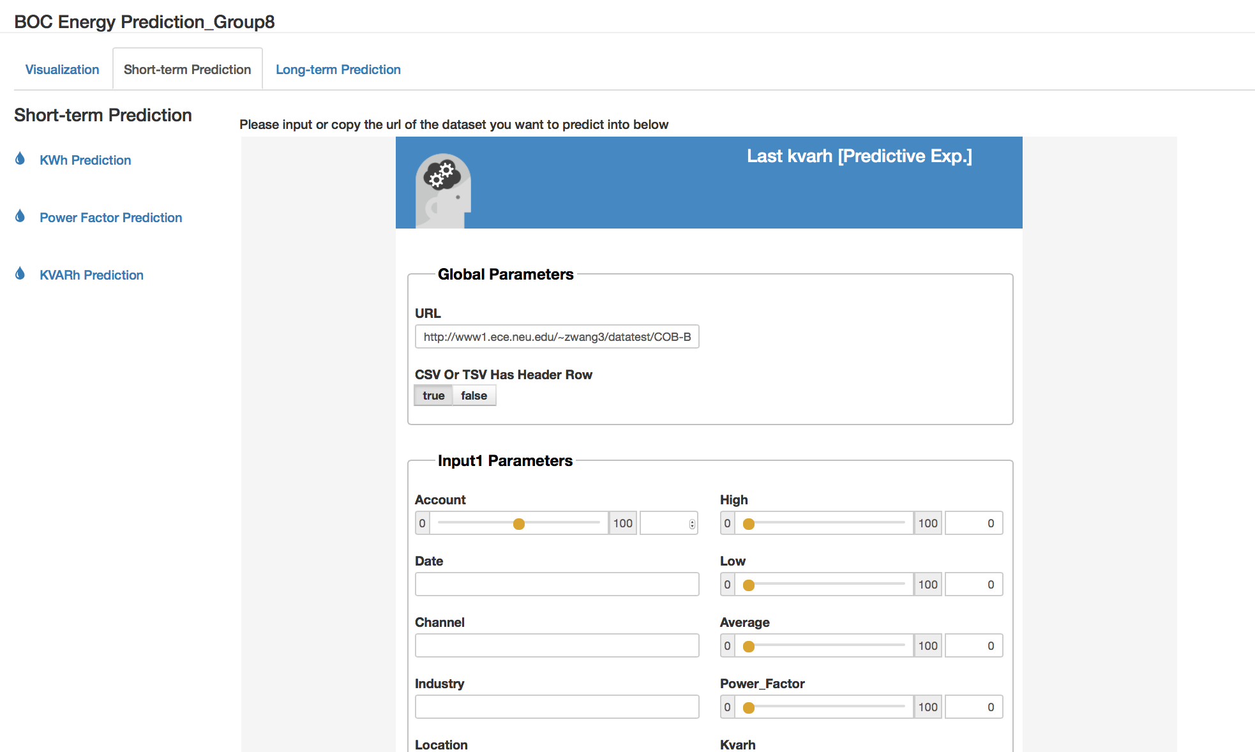
10.2 Web Pages
Short-term KVarh Prediction Page
After choosing KVarh prediction model, user can input or copy the URL of the dataset he want to predict into input box, and then fill the prediction forms with parameters, and click “submit” button. Then the prediction output will show in the bottom.

Slide 40
11. Challenges & Improvement in the Future
We should offer the long-term prediction to the customer. The Macro Analysis can predict energy consumption for future 1 week to 3 months, in order to help different industries to plan for future energy consumption, reduce power cost and save energy.
The most important challenge to complete that part is data quality and size, since the data set is proved by customers. The customer can easy change the data set by change the URL. For long-term scenarios, it is important to have high quality data that covers a span of multiple years (minimum 3 years, preferable 5-10 years). Unfortunately, data sets which we used now is only cover a single year, so the performance of the long-term predict model will decline and hard to predict the meaningful value.

Slide 41
11. Challenges & Improvement in the Future(CON’T)
Only the model we used can only prediction a single result each time. But for both short-term and long-term prediction, it will be better, if we can predict multiple result at once. For example, for the short- term prediction, if the customer wants to predict the energy consumption for next 24 hours, the website will general the total amount of energy consumption for a single day. It’s will be better if the website can predict hourly amount of energy consumption and draw a line chart to show the trend of energy consumption.
We should prove the better user experience by design the better user interface and offer better interactive. We should combine the visualization part with the prediction part better.

Slide 42
Thank you

