Slide 1
INFO7390 Final Project: Hawaii Tourism Prediction
Group 8:
Zhao Wang: Lezi Wang: Qiaoyi He

Slide 2
Topic- Hawaii Tourism Prediction
As we all know, tourism industry is the largest capital source of Hawaii economy.
The end user of our project is Hawaii government and related workers
MODEL1 - Goal: Predict monthly visitor amount in each island from multiple countries, diversify Hawaii’s global and domestic major markets.
MODEL2 - Goal: Predict monthly total visitor amount for one specific island in Hawaii area, in order to build more accurate prediction models for different islands.
MODEL3 - Goal: Predict monthly total visitor amount in entire Hawaii area, enhance strategic plans to incorporate marketing programs that drive travel demand, visitor arrivals and spending.
MODEL4 - Goal: Predict monthly total visitors’ expenditures in entire Hawaii area, in order to enhance and promote the profits of Hawaii’s tourism industry.

Slide 3
Data Set Source
1.Get Hawaii monthly visitor records from Hawaii government website.
http://dbedt.hawaii.gov/visitor/tourism/
2. Get Hawaii temperature records from US climate websites.
http://www.usclimatedata.com/climate/honolulu/hawaii/united-states/ushi0026
3. Get US monthly vacation days from timeanddate.com.
http://www.timeanddate.com/holidays/us/
4. Get Hawaii monthly tourism incomes (total visitors’ expenditures) data from Hawaii Tourism website.
http://www.hawaiitourismauthority.org/research/reports/historical-visitor-statistics/

Slide 4
Pre-Process data
We use R to pre-process the data
1. Uniform units (the unit of expenditure is million and the unit of visitors’ amount is ten thousand )
2.Separation time into year and month
3. Add More variable (average maximum temperature, average minimum temperature and average temperature, and vacation day of each month, island and country)Clean data
4. Clean data
5.Combine data set

Slide 5
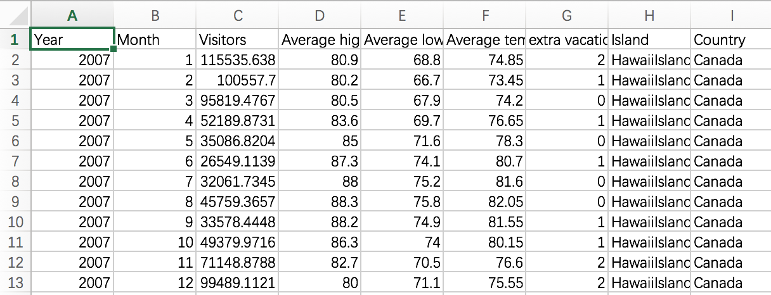
Model 1 Data Set
The data set contains two additional columns – island and country for predict monthly visitor number in each island from multiple countries,

Slide 6
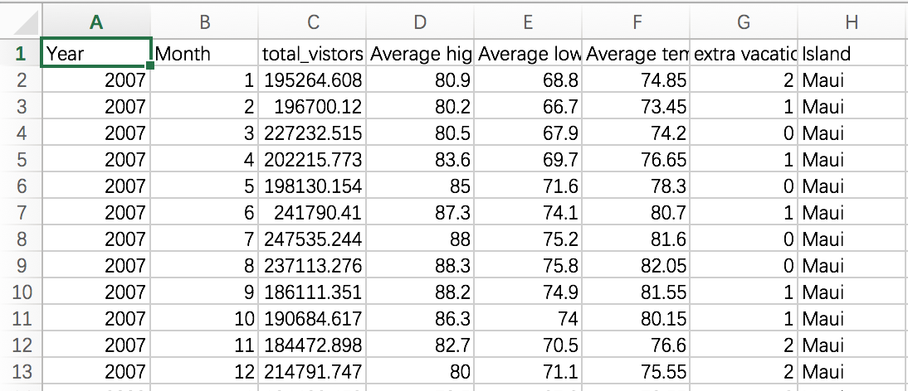
Model 2 Data Set
The data set contains an additional columns – island for predict monthly total visitor number for one specific island in Hawaii area.

Slide 7
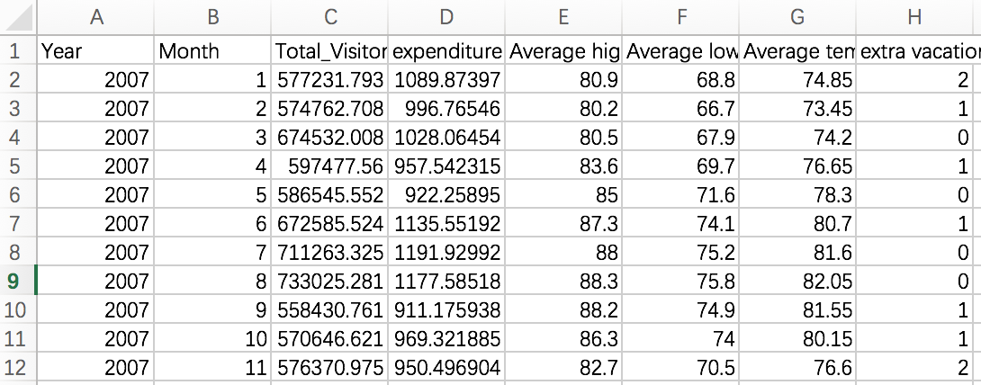
MODEL 3 DATA SET
Predict monthly total visitor number in entire Hawaii area.

Slide 8
MODEL 4 DATA SET
Predict monthly total visitors’ expenditures in entire Hawaii area.

Slide 9
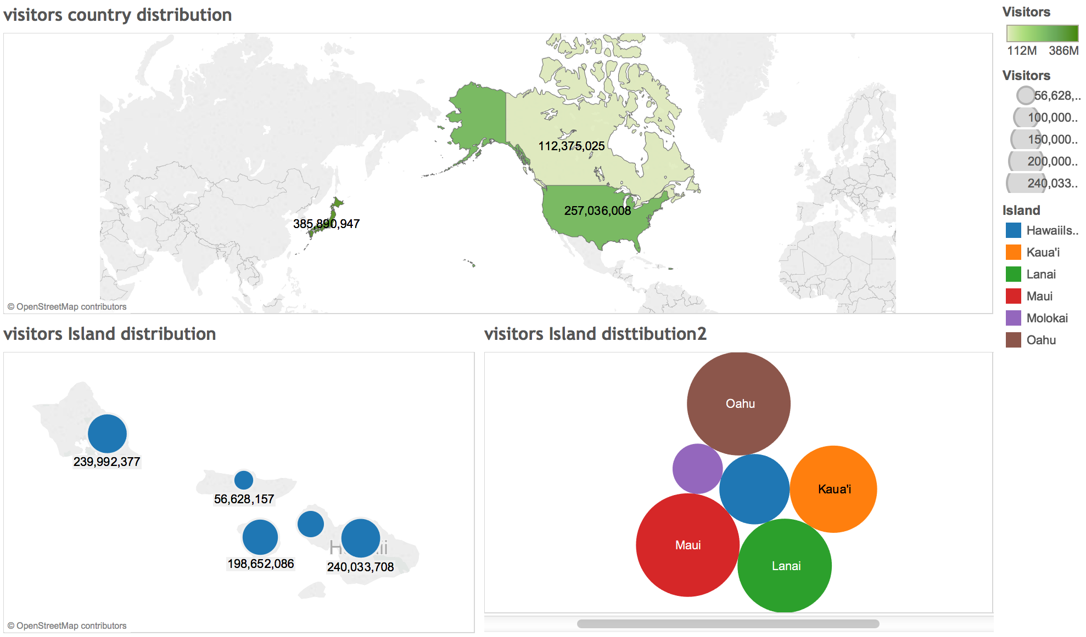
Visualization-Model1
We do visualization for each model separately.

Slide 10
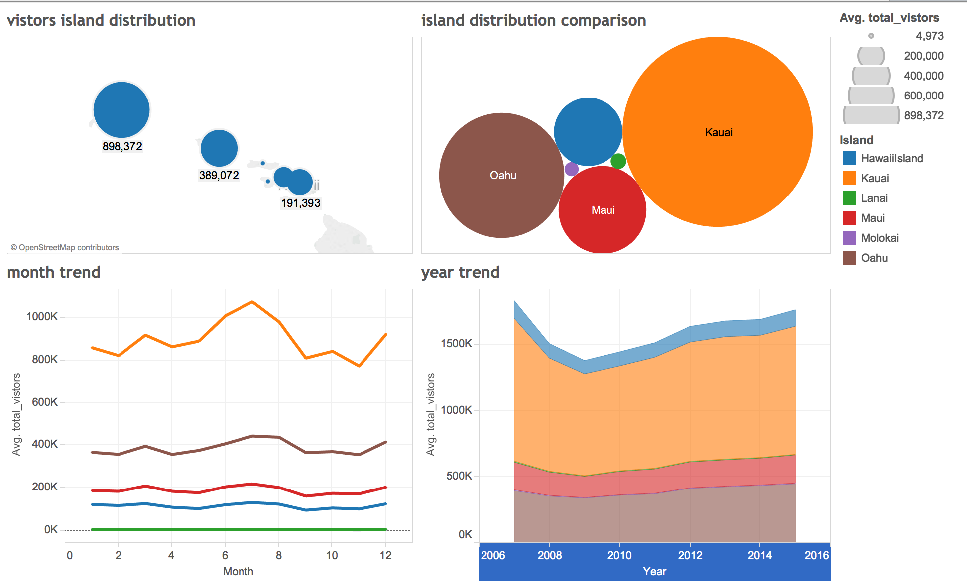
Visualization-Model2

Slide 11
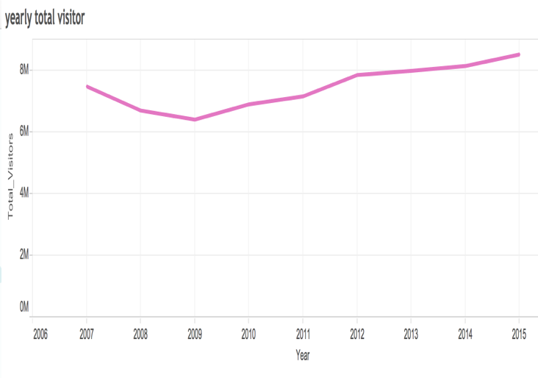
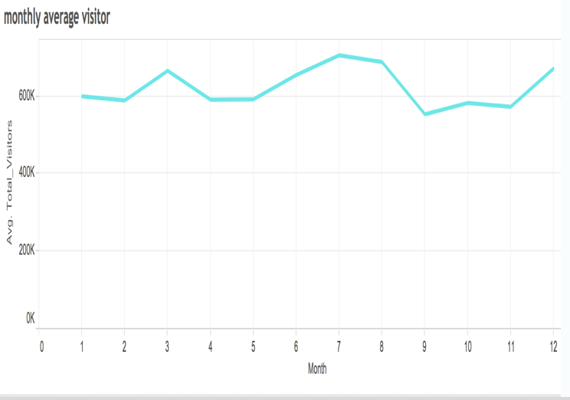
Visualization-Model3

Slide 12
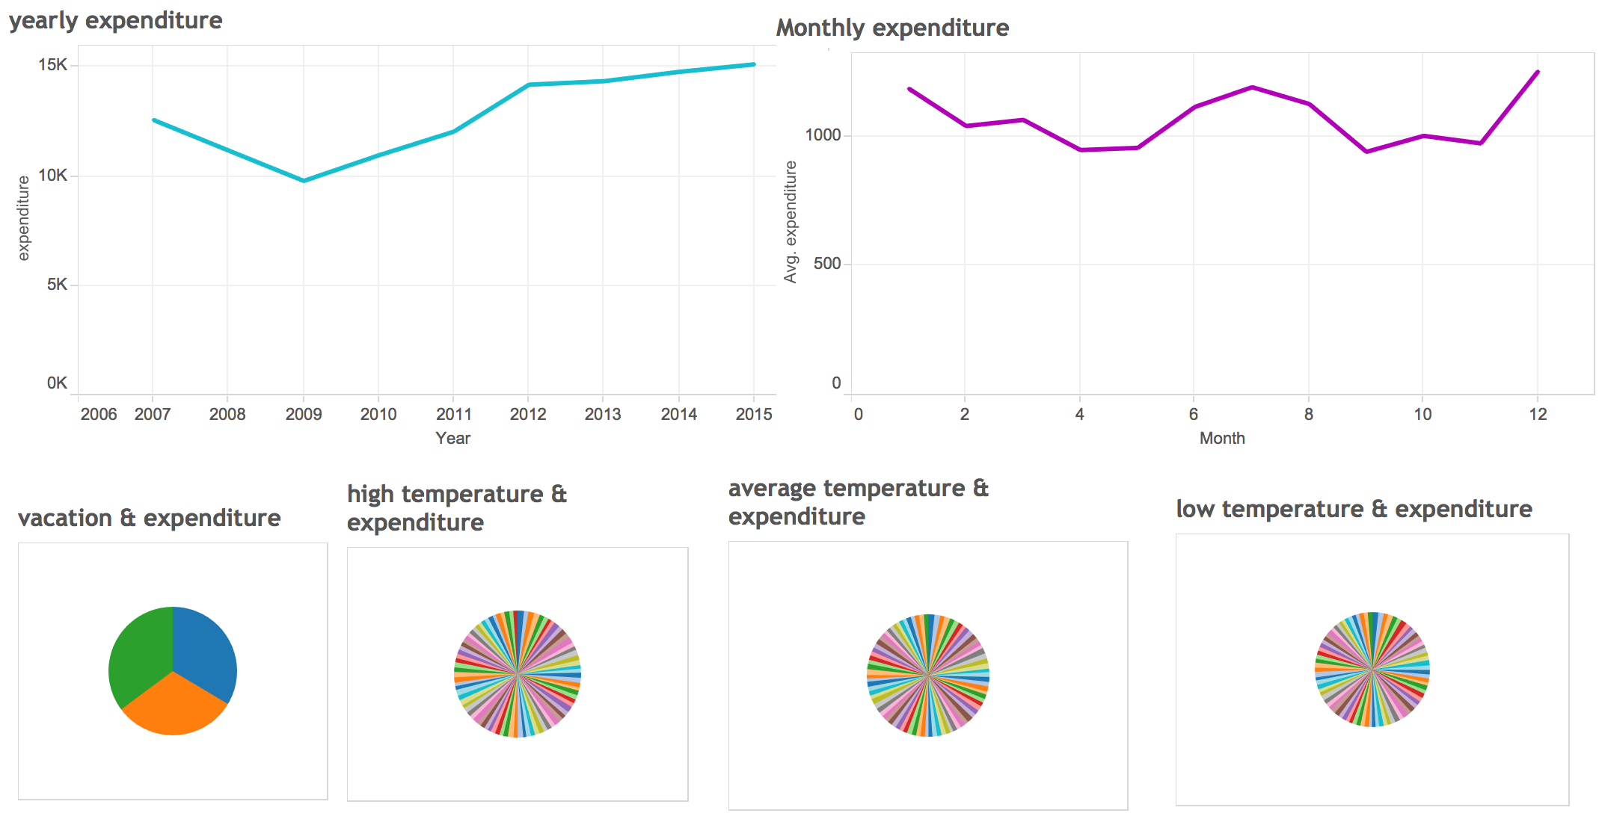
Visualization-Model4
Notes:
it is hard to find a relationship between temperature and expenditure and relationship between vacation day and expenditure. In other words, expenditure is independence of those parameters.

Slide 13
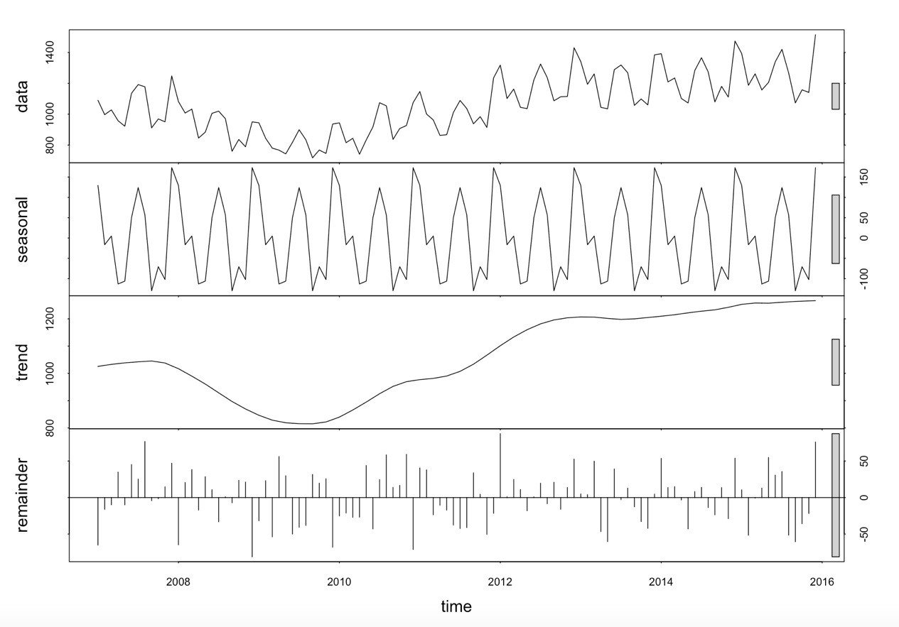

Model4: Time series - R
Predict monthly total visitors’ expenditures in entire Hawaii area.
Notes:
We use STL function to decompose season of time series by loess for observing the trend. As you can see the expenditure shows clear season trend and be less influence by other variables. So we decide use the time series to building the model of expenditure prediction.

Slide 14
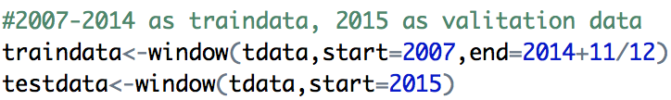
Partition Data
We separate the data set into training dataset and testing dataset according to time. We use the data from 2007 to 2014 for building model, and use 2015 data to validate the result. The following picture is the R code which we use to separate the data set.

Slide 15
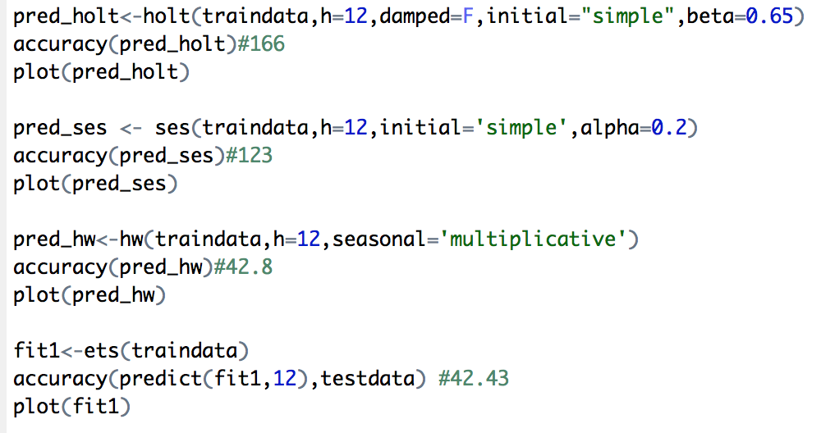
Exponential smoothing state space model(ETS)
We use four different function - Ses, holt, hw and ets, to build the Exponential smoothing state space model. In fact, Ses, holt and hw are simply convenient wrapper functions for forecast(ets(...)). And for the fit1, since we not specify the model, R returns the best model automatically. The following picture is the R code and the note of accuracy is the RMS of the model.

Slide 16
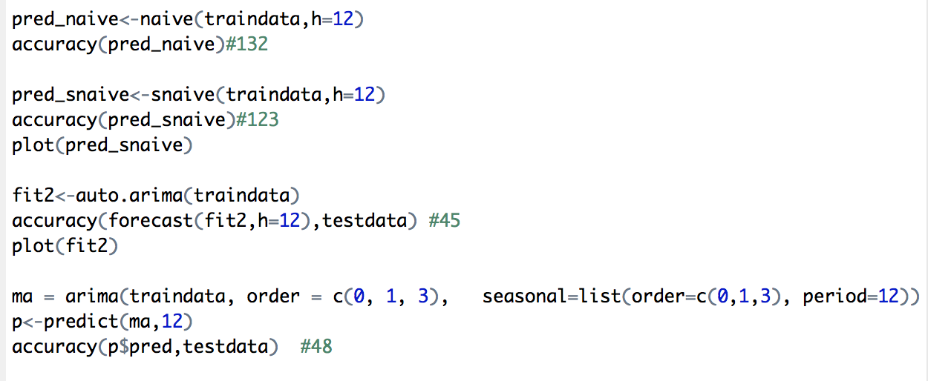
Arima
We use four different function-naive, snaive, arima and auto.arima , to build the ARIMA model. Naive() returns forecasts and prediction intervals for an ARIMA(0,1,0) random walk model applied to x. Snaive() returns forecasts and prediction intervals from an ARIMA(0,0,0)(0,1,0)m model where m is the seasonal period. The different between the auto.arima function and the rest is the auto.arima returns best ARIMA model according to either AIC, AICc or BIC value. So the only argument auto,arima need is dataset. The following picture is the R code and the note beside accuracy is the RMS of the model.

Slide 17
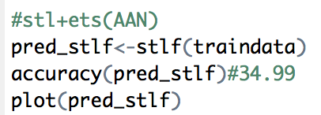
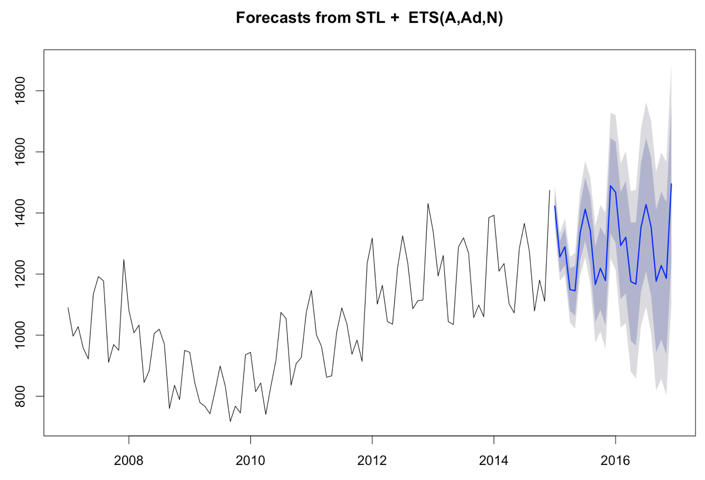
STLF
Stlf combines STL decomposition and ETS model.
The deep gray area represents the 80% forecast period, and the light gray area represents the 95% forecast period.

Slide 18
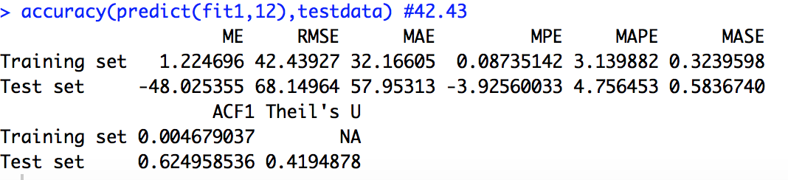
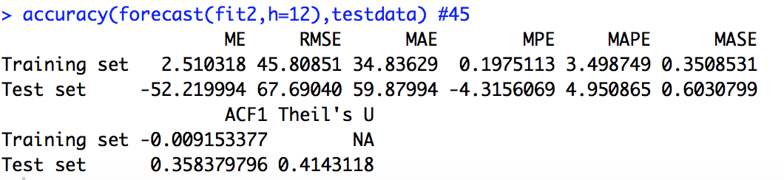
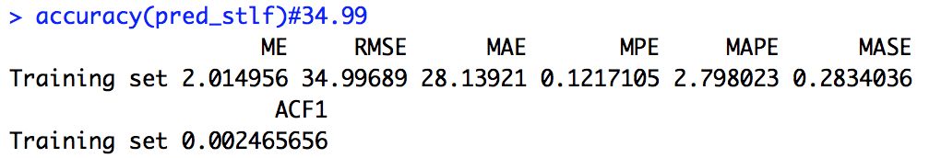
Compare models
fit1 - ETS function,
fit2 - Arima function,
pred_stlf - STLF function.
As you can see, the third model has lower ME, RMSE, MAE, MAPE and MASE than ARIMA model. What’s more, compare to ETS functions, STLF function can avoid seasonality being ignored. The ets models is a better choose if the data are non-seasonal or the seasonal period is 12 or less and if the seasonal period is 13 or more stlf is a better option.

Slide 19
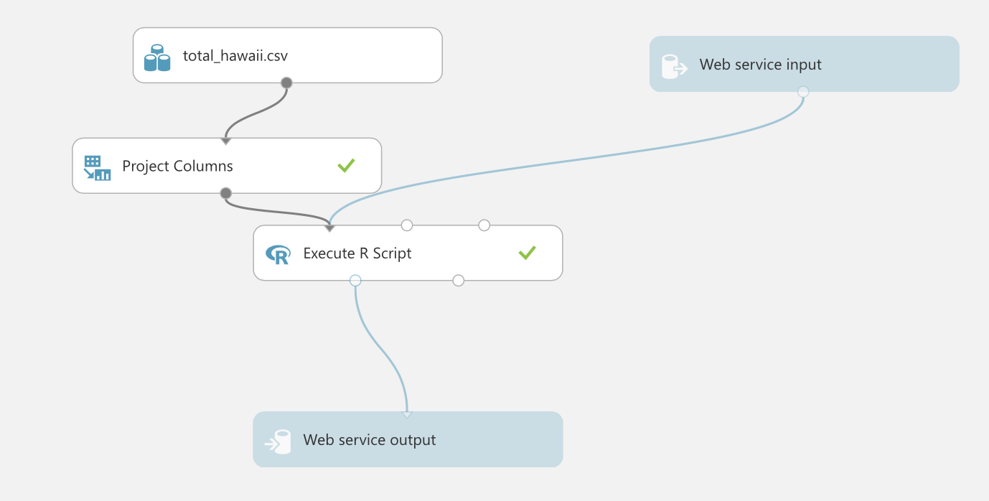
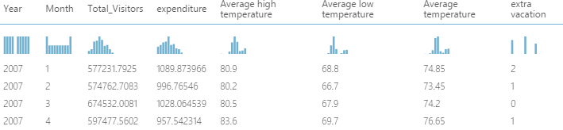
Building model in azure

Slide 20
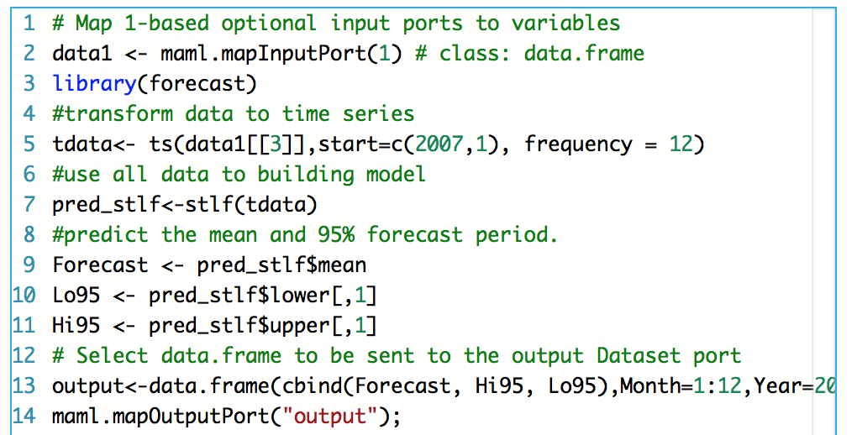
R code
Notes:
The out put of the model is the predict result for the next two years, and the Hi95 and Lo95 represents the boundary of 95% forecast period.

Slide 21
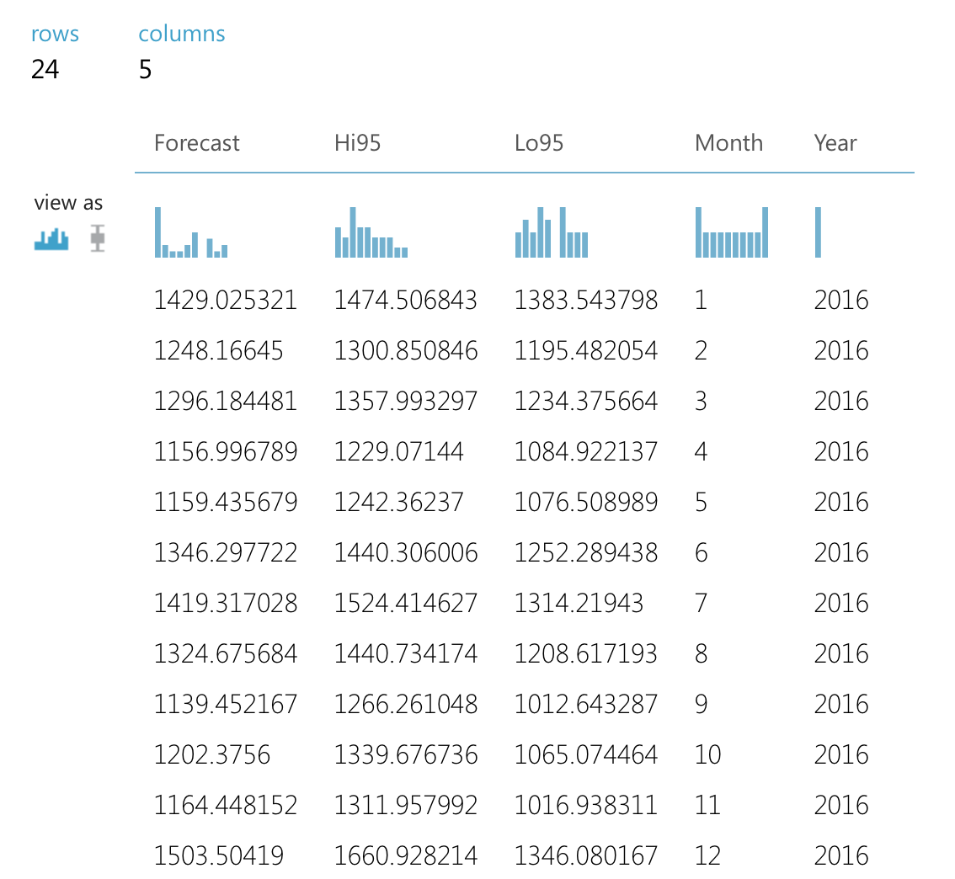
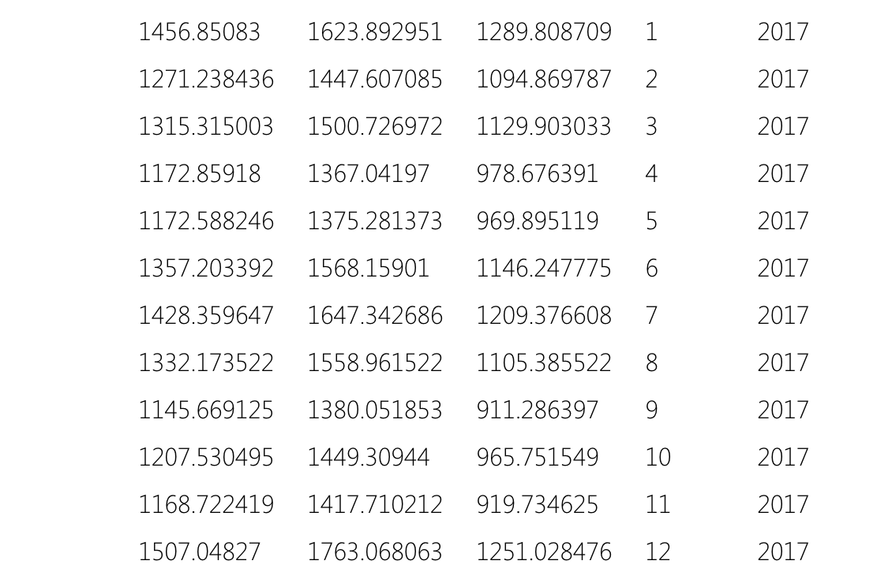
Output

Slide 22
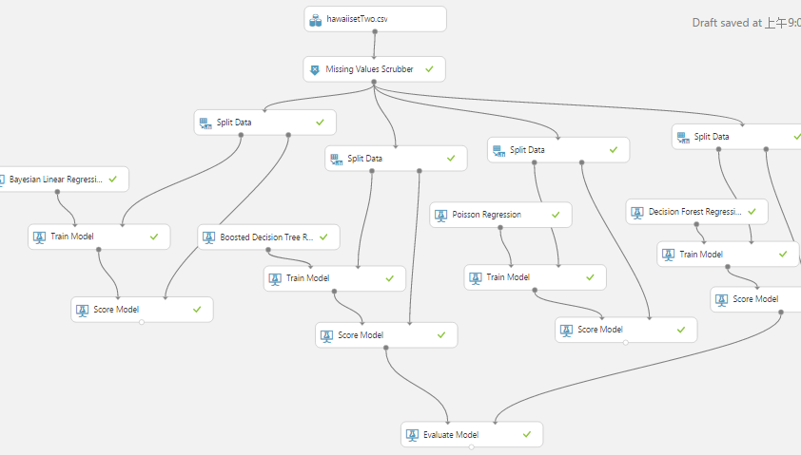
Comparing Algorithms

Slide 23
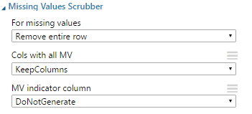
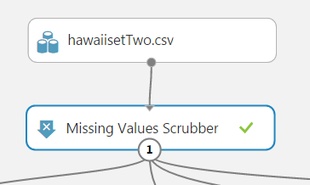
Get dataset and Pre-process
We used the dataset which is saved in Azure Machine Learning Studio to build prediction models.
After importing the dataset, we used the Missing Values Scrubber to remove the entire row which contains missing data. Because missing data will affect the prediction result, we must deal with it before building models. Sometimes, you may replace missing data with median or average of that column, but for this model we remove that row.

Slide 24
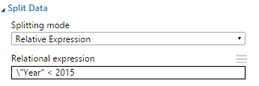
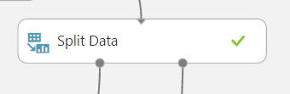
Split Data Based on Year
Because these data satisfy the requirements of Time Series Model, we followed the rule of Time Series Model for splitting data—splitting data based on Year. In our dataset, there are 9 years records (2007-2015). Thus, we split these data into 2007-2014’s records for training data and 2015’s recodes for validation data. As you can see in right picture, the Relation expression is “Year <2015”, this is for splitting 2007-2014’s records from all records.

Slide 25
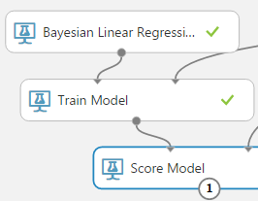
Train Model with Bayesian Linear Regression
The first algorithm is Bayesian Linear Regression. In statistics, it is an approach to linear regression in which the statistical analysis is undertaken within the context of Bayesian inference. When the regression model has errors that have a normal distribution, and if a particular form of prior distribution is assumed, explicit results are available for the posterior probability distributions of the model's parameters.

Slide 26
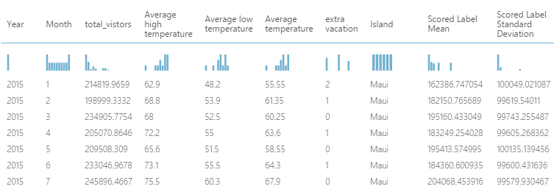
Bayesian Linear Regression Score
The Score of this algorithm model posted above, you can the difference between the real value and the mean of predicted value is not small. The differences are almost 50000, and the unit is myriad(Ten Thousand). For scoring part, this algorithm does not have a good performance.

Slide 27
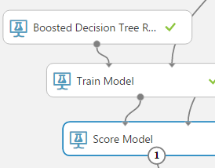
Train Model with Boosted Decision Tree Regression
The second algorithm is Boosted Decision Tree Regression. It enables to create an ensemble of regression trees using boosting. Boosting means that each tree is dependent on prior trees, and learns by fitting the residual of the trees that preceded it. Thus, boosting in a decision tree ensemble tends to improve accuracy with some small risk of less coverage. This regression method is a supervised learning method.

Slide 28
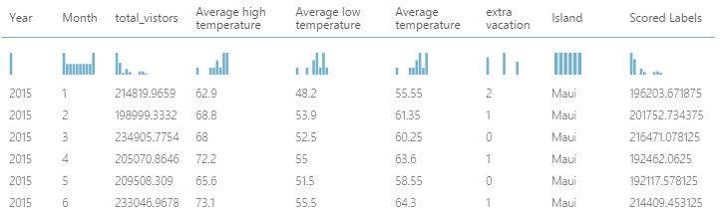
Boosted Decision Tree Regression Score
The Score of this algorithm model posted above, you can the difference between the real value and the predicted value is not that much big. The differences are roughly 20000, and the unit is million, it smaller than the first algorithm’s. For scoring part, this algorithm has a normal performance.

Slide 29
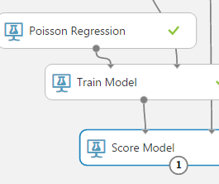
Train Model with Poisson Regression
The third algorithm is Poisson Regression. In statistics, it is a form of regression analysis used to model count data and contingency tables. Poisson regression assumes the response variable Y has a Poisson distribution, and assumes the logarithm of its expected value can be modeled by a linear combination of unknown parameters. A Poisson regression model is sometimes known as alog-linear model, especially when used to model contingency tables.

Slide 30
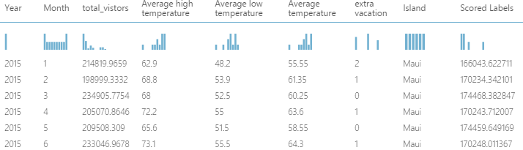
Poisson Regression Score
The Score of this algorithm model posted above, you can the difference between the real value and the predicted value is not that much big. The differences are roughly greater than 30000, and the unit is million, it smaller than the first algorithm’s but bigger than second’s. For scoring part, this algorithm has a not that bad performance. So far, the second algorithm has the best performance in scoring part.

Slide 31
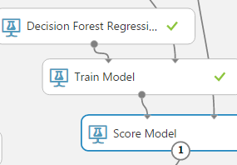
Train Model with Decision Forest Regression
The fourth algorithm is Decision Forest Regression. It is used to create a regression model using an ensemble of decision trees. Decision trees are non-parametric models that perform a sequence of simple tests for each instance, traversing a binary tree data structure until a leaf node (decision) is reached.

Slide 32
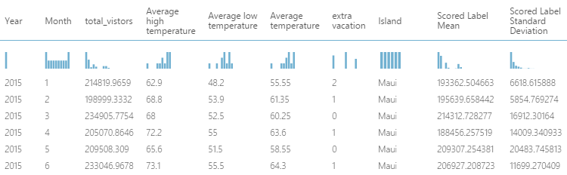
Decision Forest Regression Score
The Score of this algorithm model posted above, you can the difference between the real value and the mean of predicted value is not that much big. The differences are roughly 20000, and the unit is million, it is similar with second algorithm. For scoring part, this algorithm has a normal performance similar with second algorithm.

Slide 33
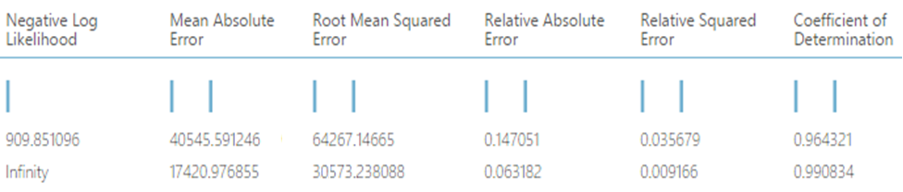
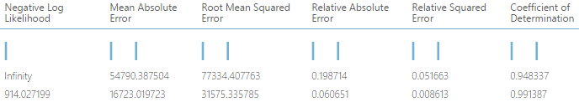
Comparing Algorithm Result
Model1
Model2
Model3
Model4

Slide 34
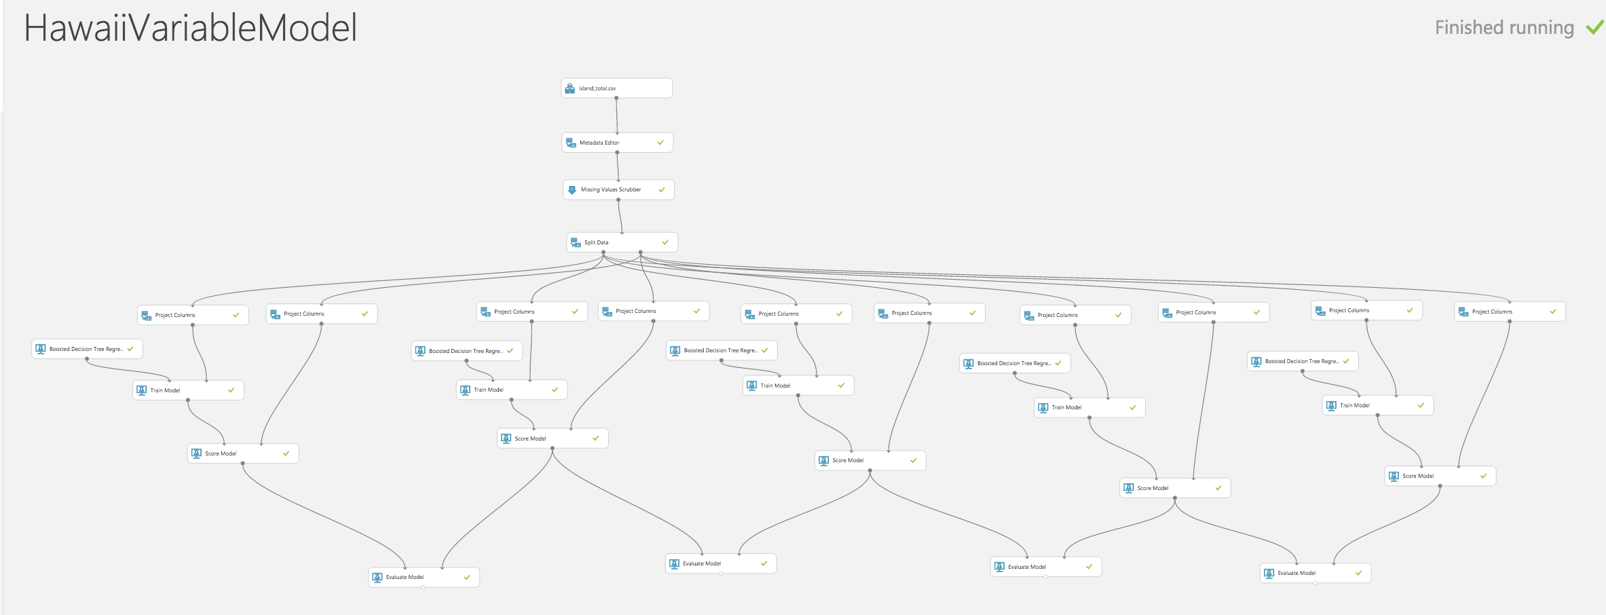
Variable Selection
We build prediction models with different variables in Azure ML. We choose dataset2 (monthly total visitors in different islands) to build four kinds of monthly total visitor prediction models with different variable subsets, and then compare models’ performance and choose the best variable subsets for further prediction models.

Slide 35
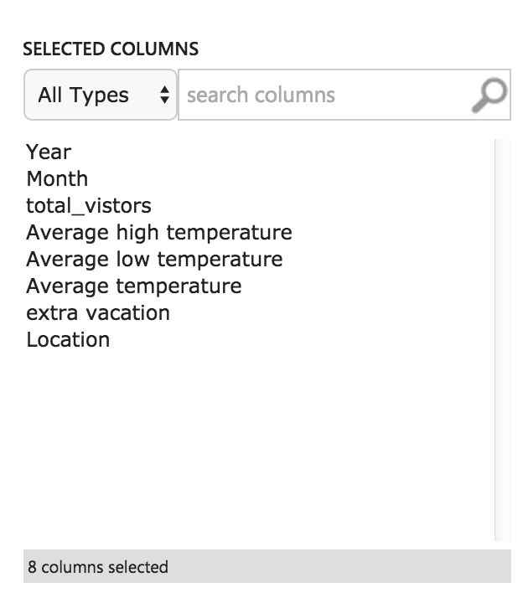
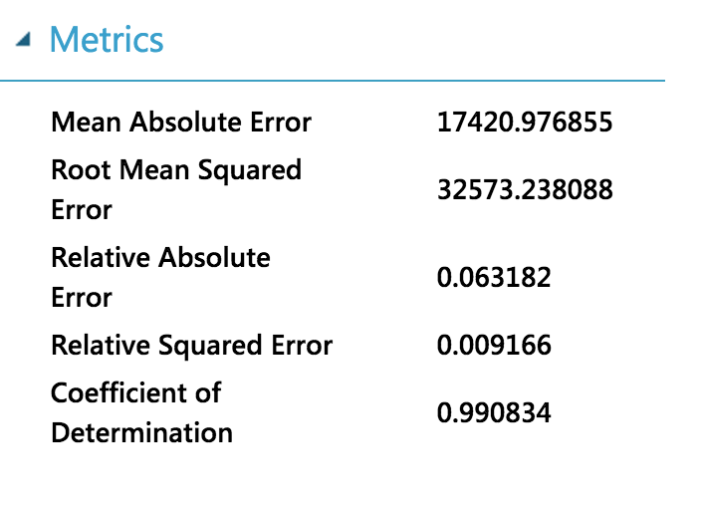
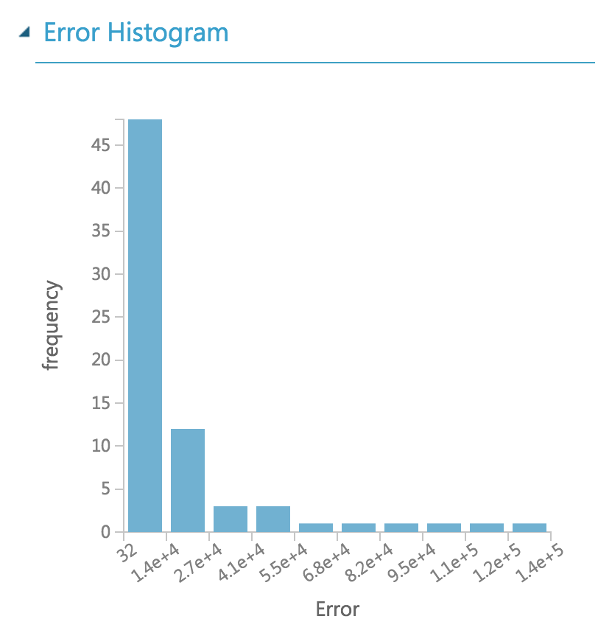
Variable Selection-Model1
Use all 8 variables to build the prediction model, and the model performance is shown below. The RMS of this prediction model is 32573.

Slide 36
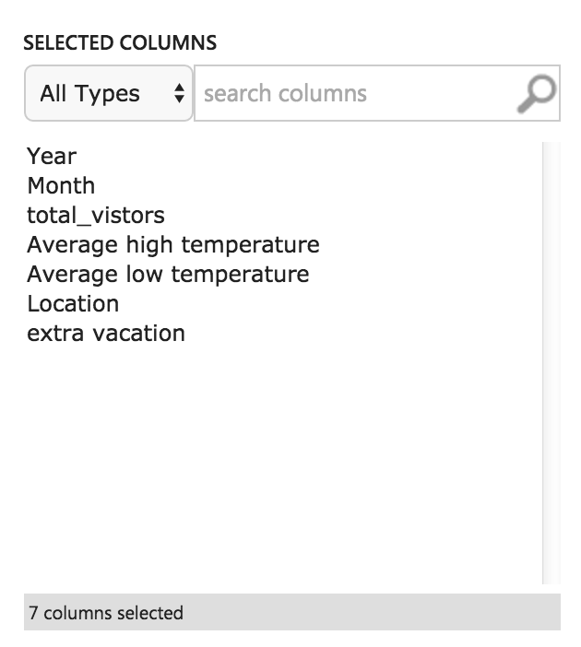
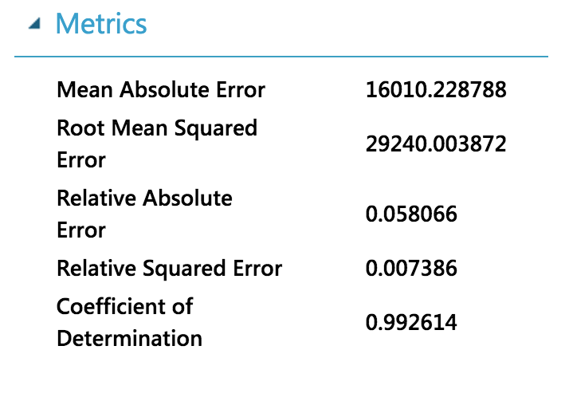
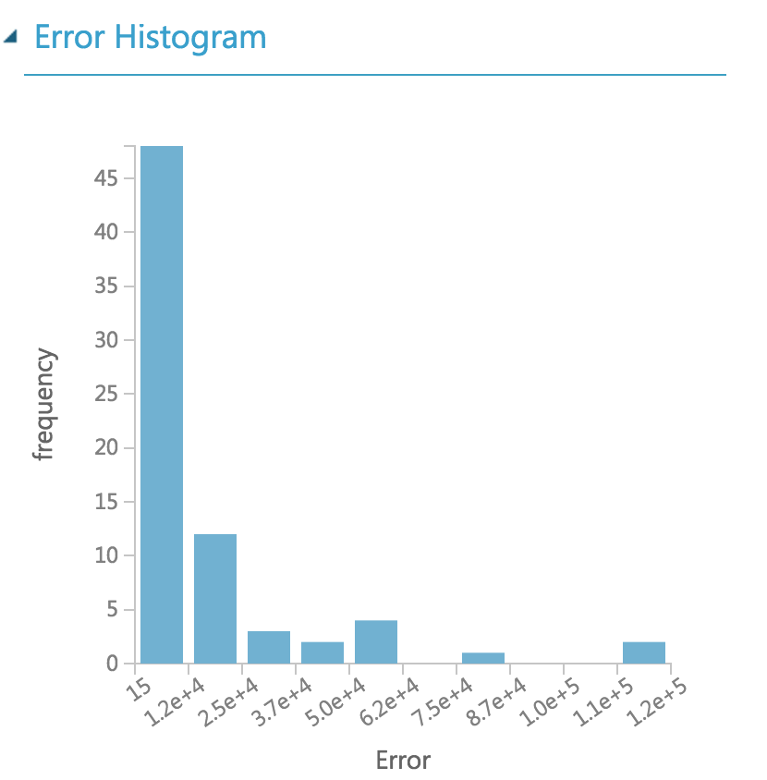
Variable Selection-Model2
Remove the average temperature variable to build the prediction model, and the model performance is shown below. The RMS of this prediction model is 29240 .

Slide 37
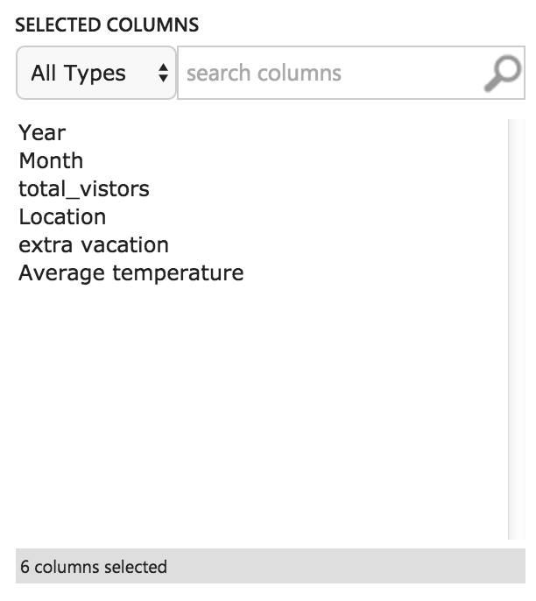
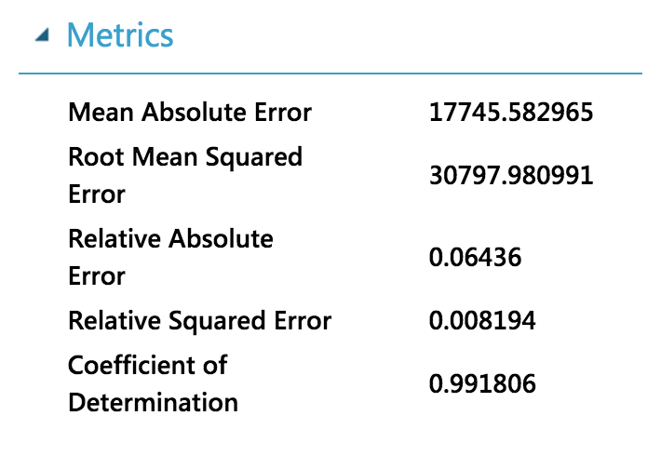
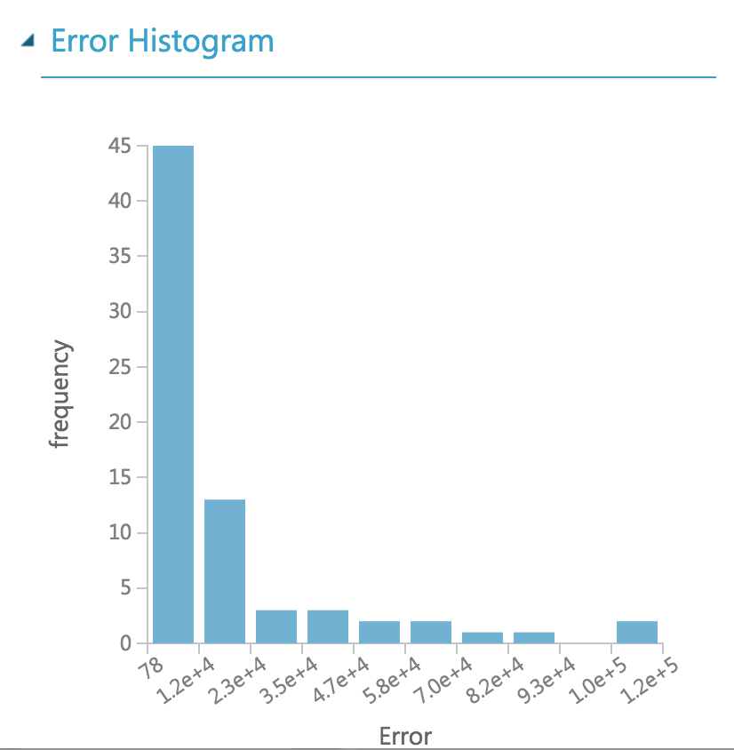
Variable Selection-Model3
Remove the high and low temperature variables to build the prediction model, and the model performance is shown below. The RMS of this prediction model is 30797 .

Slide 38
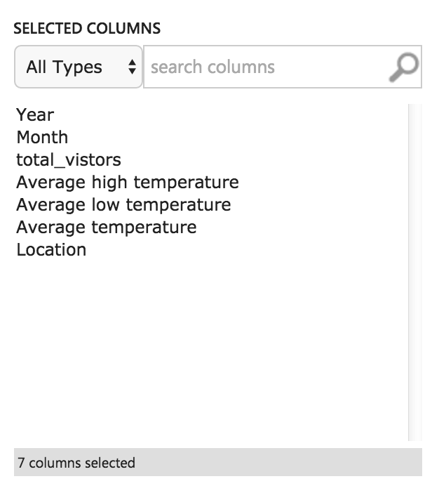
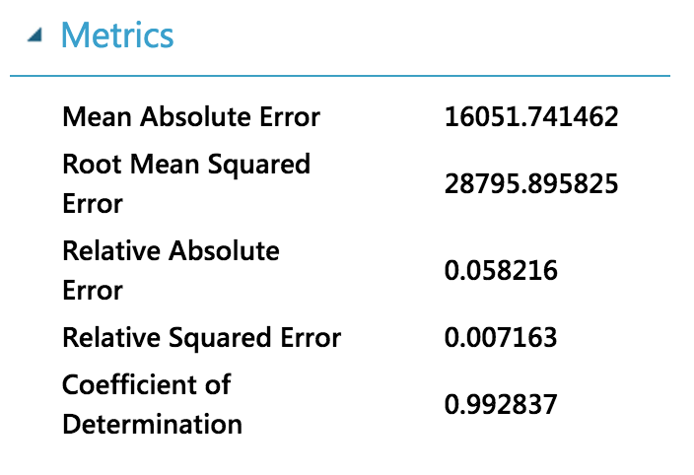
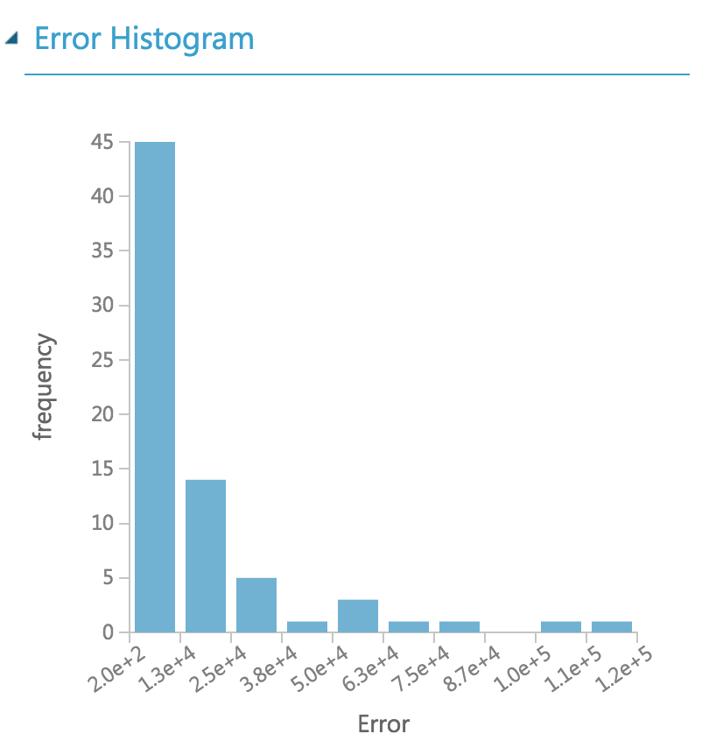
Variable Selection-Model4
We remove the extra vacation days variable to build the prediction model, and the model performance is shown below. The RMS of this prediction model is 28795 .

Slide 39
Variable Selection-Result
After comparison, we decide to remove extra vacation day variable.
choose following variables to build prediction models: Year, Month, monthly high temperature, monthly low temperature, monthly average temperature, Location (island name).
 | Model1 | Model2 | Model3 | Model4
RMS | 32573 | 29240 | 30797 | 28795

Slide 40

Azure Machine Learning Model 1
The first model is for predicting the Visitor Amount of Each Island from multiple countries.
Input: Year, Month, High Temperature,
Low Temperature, Average Temperature,
Island, Country.
Output : Visitor

Slide 41

Model 2
The second model is for predicting the Total Visitor Amount of Each Major Island of Hawaii
Input: Year, Month, High Temperature,
Low Temperature, Average Temperature,
Island.
Output: Total Visitor

Slide 42

Model 3
The third model is for predicting Total Visitor Amount of Hawaii for one future Month.
Input: Year, Month, High Temperature,
Low Temperature, Average Temperature
Output: Total Visitor

Slide 43
Deploy Web Service & Configuration Deploy Web Service
After predictive models were created, we deployed Web Service in Azure to get models’ APIs and URIs. These two values are very important for developing an integration of model.
API stands for application programming interface. It can be helpful to think of the API as a way for different apps to talk to one another. For many users, the main interaction with the API will be through API keys, which allow other apps to access your account without you giving out your password.
To paraphrase the World Wide Web Consortium, Internet space is inhabited by many points of content. A URI (Uniform Resource Identifier; pronounced YEW-AHR-EYE) is the way you identify any of those points of content, whether it be a page of text, a video or sound clip, a still or animated image, or a program. The most common form of URI is the Web page address, which is a particular form or subset of URI called a Uniform Resource Locator (URL).

Slide 44

Storage Account
We assume users who want to use our webpage to predict visitor amount should have an Azure Storage account. In this way, they can use their own dataset as the input of the prediction models. Also, our prediction model can store the prediction results to their own storage accounts. This method improves the security of this prediction model, and it can guarantee customers confidentiality.
Storage Account Components

Slide 45
Storage Components
Storage Account: All access to Azure Storage is done through a storage account. This storage account can be a General Purpose Storage Account or a Blob Storage Account which is specialized for storing objects/blobs.
Container: A container provides a grouping of a set of blobs. All blobs must be in a container. An account can contain an unlimited number of containers. A container can store an unlimited number of blobs. Note that the container name must be lowercase.
Blob: A file of any type and size. Azure Storage offers three types of blobs: block blobs, page blobs, and append blobs.

Slide 46
Upload Files
Azure Storage Account is similar with GitHub, we cannot directly upload files to this account. We must use the third party tools like Azure Powershell or .Net studio to upload files to Blob Storage Account.
Now, we will show the process of uploading files to storage account using Azure Powershell. All screen shot came from Powershell Command Window.

Slide 47


Upload Files (CON’T)
Log-in to Azure: A pop-up log in window will show, and customer should log in to their Azure account.
2. Check Azure Subscription: It will give you the subscription information about you Azure account, such as Subscription Name, Id and State.

Slide 48


Upload Files (CON’ T)
3. Check Azure Context: It will give where you are, and which Azure account you are connecting to. But we have not yet set which Storage Account you want to connect, so that line is empty.
4. Set Storage Account
We should give the Storage Account name, and the Group your account belongs to. Now, you can see the Current Storage Account is “customer1215”.

Slide 49

Upload Files (CON’T)
5. Set Account Parameters
You can create several parameters, such as “$accountName”, “$containerName”, “$storage AccessKey”, and “blobContext”. It is convenient to give a uploading files command.
6. Upload Files: Use parameters created before, and give the address of file which you want to upload.

Slide 50
Models Integration
We used Azure Web Service to create Web App. For the first model, we allow users to upload their own CSV files as that model’s input, and the model will generate a CSV file as the output of prediction. Thus, we used Batch Execution Web App for first model.
For second and third model, we allow users to input each variable value, and models will give them one prediction value for the certain input. Thus, we used Request-Response Web App.

Slide 51
Web API
http://www1.ece.neu.edu/~zwang3/final_project_UI/home.html
Account Name: customer1215
AccountKey: 6lcGoWsDu9wTEZki0RsNHAV3fttcQwcRYKxBE7pBTvZ26T5z8N5Y9fnNGHKFXqGW8qu4smyPK+0OcAAYJ9w4Zw==
Container Name: container1

Slide 52
THANK YOU

