Slide 1
Likelihoods

Slide 2
The likelihood principle
Not just a method for obtaining a point estimate of parameters
The entire likelihood function captures all the information in the data about a certain parameter
Likelihood-based methods are inherently computational
Numerical methods are needed to find the MLE
Likelihood principles play a central role in statistical modeling and inference

Slide 3

Support
Expresses how well the data support a parameter value or hypothesis
Probability = knowing parameters → predicting data
Likelihood = knowing data → estimating parameters
Like residual sum of squares, but more useful: not only point estimate, but also uncertainty
$$L(p|Data)$$

Slide 4
Combine data sources
We can fit a model to many types of data at once and combine the likelihood components with simple multiplication
The likelihood of the data D = D₁ + D₂ is the product of the likelihoods of each D₁ and D₂:
Integrated models: e.g. tag resighting, abundance index, etc.
Unified framework, for simple or complex models
Data point 1
Data point 2

Slide 5

Model selection
Likelihood ratio test
$$2log\frac{L_{1}}{L_{0}}\sim χ^{2}∆df$$
AIC = -2logL + 2k
BIC = -2logL + log(n)k

Slide 6
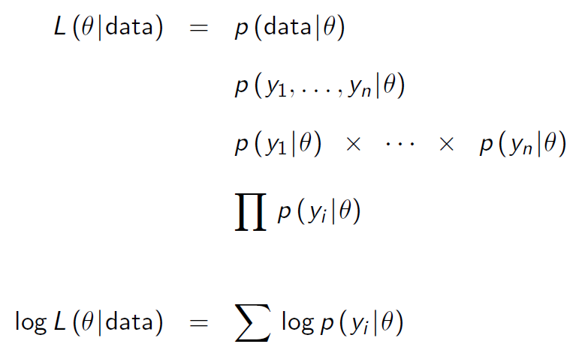
Log transformation helps maximum likelihood estimation

Slide 7
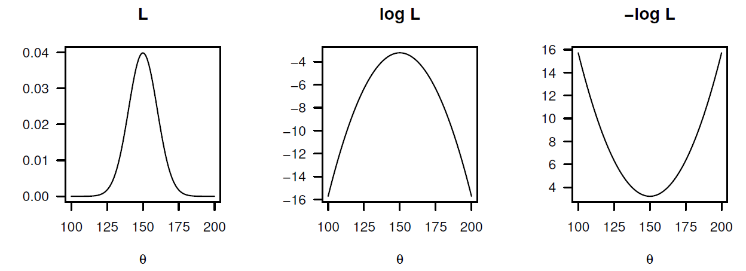
Log transformation helps maximum likelihood estimation

Slide 8
Maximum likelihood estimator
A sensible estimate of the model parameters is to choose values that maximize the likelihood for the actual observations
The curvature of the negative log likelihood function gives an estimate of the maximum likelihood estimator
The matrix of second derivatives is referred to as the “hessian matrix”
Both the estimator and hessian matrix are often found by numerical methods

Slide 9
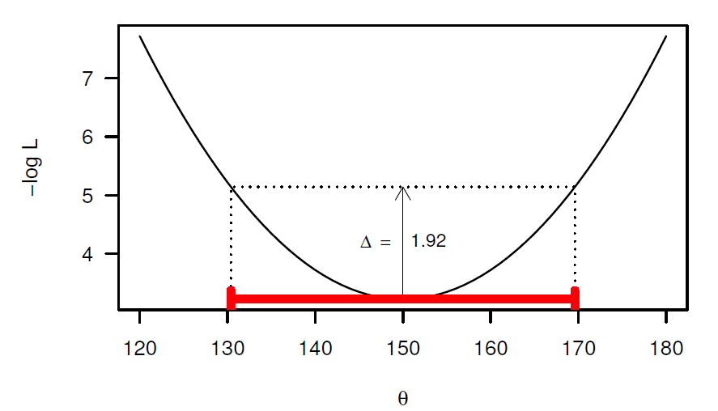
Calculating confidence intervals
0.5χ²_{df=1} = 1.92 for 95% confidence interval

Slide 10
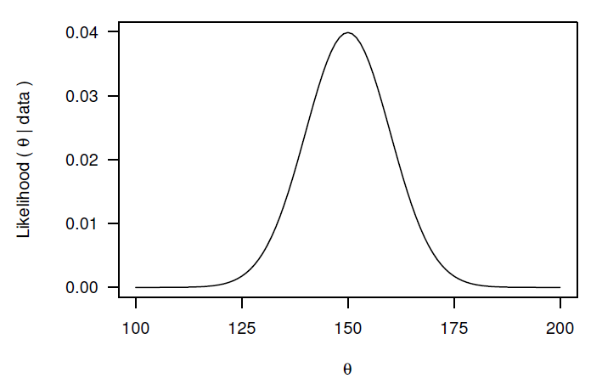
Profile likelihood
Fix parameter of interest at a value
Minimize –log(L) by estimating all other parameters
Save this value of –log(L)
Repeat over range of values for the parameter

Slide 11
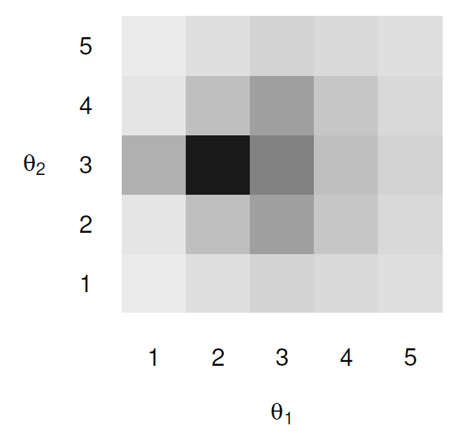
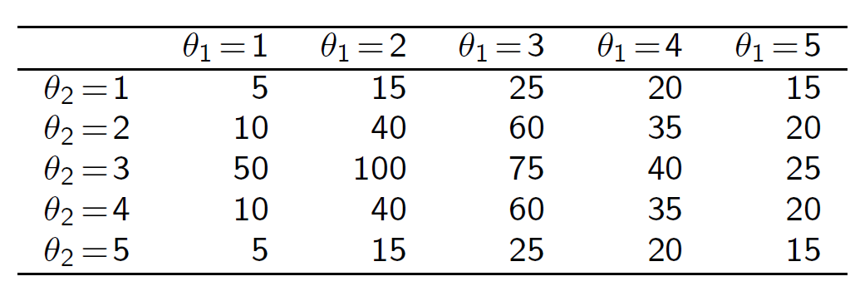
Interpreting a profile likelihood
Consider a 2-dimensional likelihood surface, describing the likelihood at different values of two parameters:

Slide 12
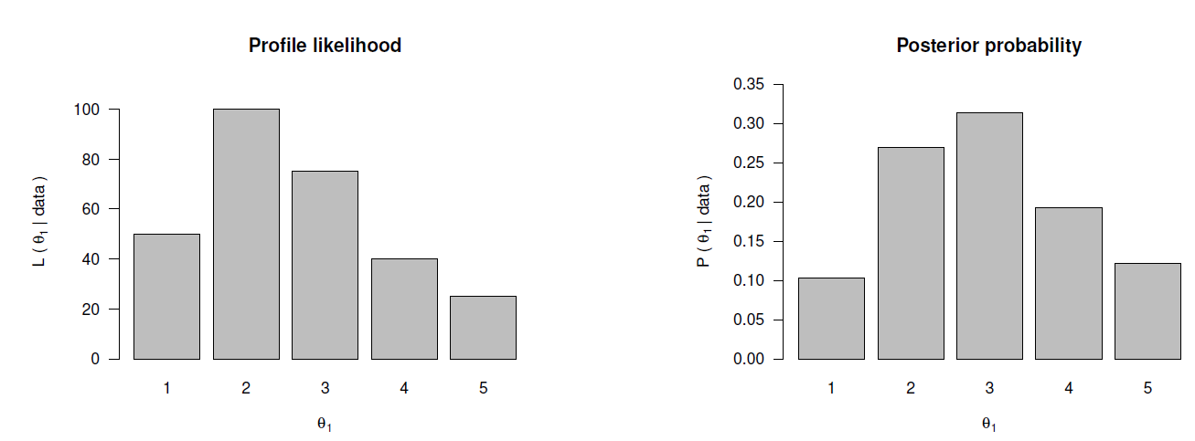
Marginal distribution
In likelihood inference, we find the maximum likelihood for each value of θ₁ across values of θ₂
In Bayesian inference, we integrate the likelihood over θ₂

Slide 13
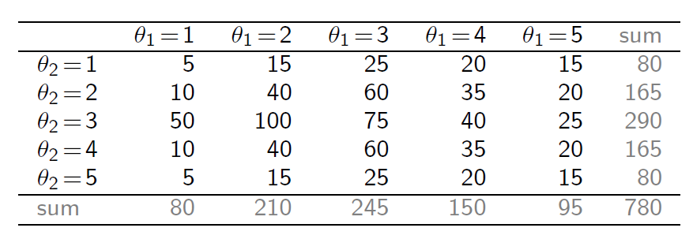
Interpreting likelihood
Would you think θ₁ = 2 or θ₁ = 3?

Slide 14
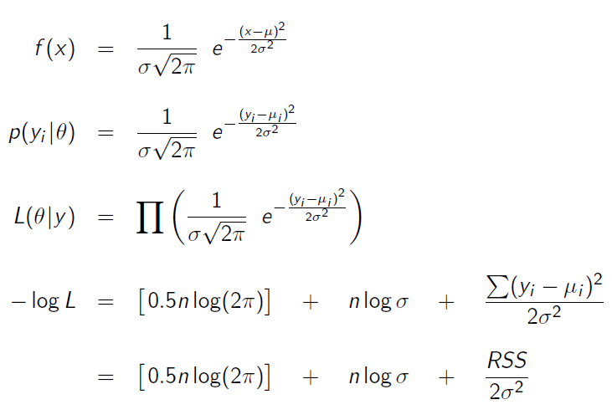
Normal distribution

Slide 15
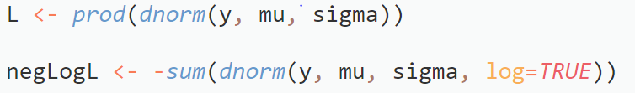



dnorm in R

Slide 16
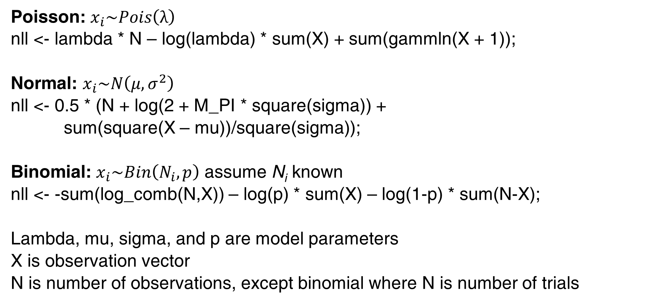
Likelihood functions for a few known models
Poisson: $x_{i}\sim Pois\left(λ\right)$
nll <- lambda * N – log(lambda) * sum(X) + sum(gammln(X + 1));
Normal: $x_{i}\sim N\left(μ,σ^{2}\right)$
nll <- 0.5 * (N + log(2 + M_PI * square(sigma)) +
sum(square(X – mu))/square(sigma));
Binomial: $x_{i}\sim Bin\left(N_{i},p\right)$ assume N_{i} known
nll <- -sum(log_comb(N,X)) – log(p) * sum(X) – log(1-p) * sum(N-X);
Lambda, mu, sigma, and p are model parameters
X is observation vector
N is number of observations, except binomial where N is number of trials

Slide 17
Exercise: generate data from distributions
Walk through normal.tpl to generate normal distribution of deviates with mean 2.0 and standard deviation 5.0
Estimate mean and standard deviation
Redo for poisson and binomial likelihoods

Slide 18
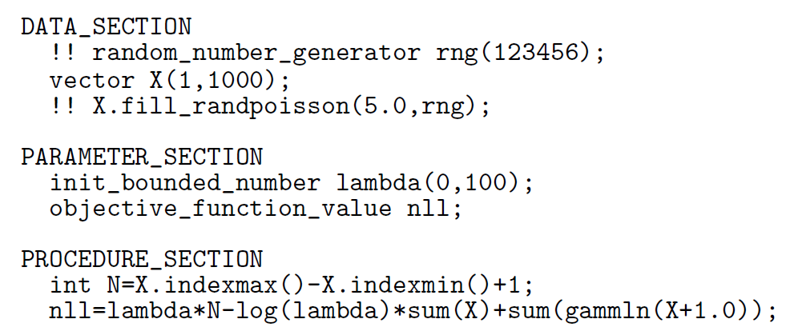
Poisson

Slide 19
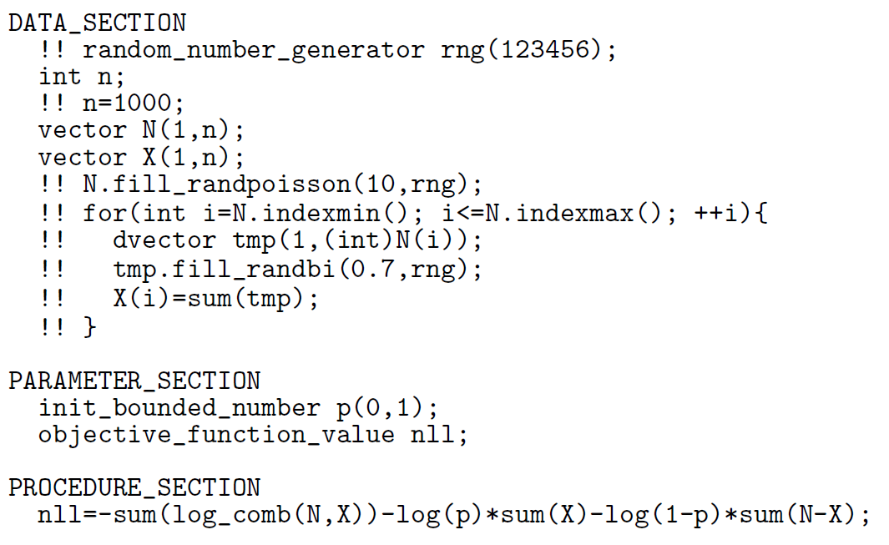
Binomial

