Slide 1
Estimating uncertainty

Slide 2
Ways of estimating uncertainty
Hessian-based
Likelihood profiles
MCMC

Slide 3

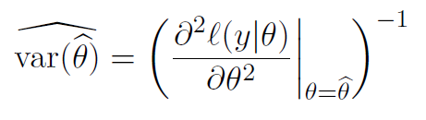

Maximum likelihood estimates and Hessian
Maximum likelihood estimate: values that maximize the likelihood for the actual observations
Curvature of the negative log likelihood function gives an estimate of the variance of the maximum likelihood estimator
Hessian matrix of second derivatives:

Slide 4
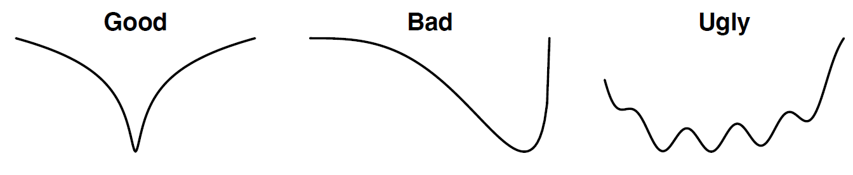
Negative log likelihood curvature
Estimator and hessian matrix are often found by numerical methods
Delta method: general method for deriving the variance of asymptotically normal random variables

Slide 5
Default estimation of uncertainty: delta method
ADMB uses the delta method to calculate the covariance matrix
Covariance matrix calculated from:
Hessian – matrix of second order partial derivatives
Hessian calculated from:
Jacobian – matrix of first order partial derivatives
Inverse of hessian is a reasonable approximation of the covariance matrix provided the assumption that the optimum solution is approximately linear

Slide 6
Important notes on the delta method
Delta method is based on a normal approximation, so it is not always appropriate
It may be useful to compute the confidence intervals in log-scale and transfer quantiles to the original scale to ensure a parameter is positive
Variables other than the actual model parameters can be added to the output reports by declaring in PARAMETER_SECTION sdreport_
Typical output files are .PAR, .STD, and .COR

Slide 7
Likelihood profiles
Negative log-likelihood, fixing the
parameter to each value in turn
(minimize on the rest of the parameters)
Select a wide range of possible values for p
Fit the model to find the MLE and negative log likelihood
Plot the negative log likelihood against p
ADMB includes option to create likelihood profile
-log
likelihood
MLE
•
•
•
•
•
•
•
Parameter of Interest
Alternative
values for the
parameter

Slide 8
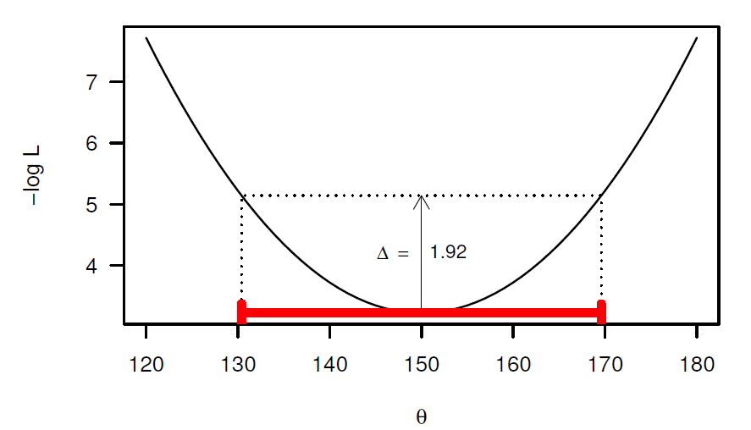
Calculating confidence intervals
0.5χ²_{df=1} = 1.92 for 95% confidence interval

Slide 9
Likelihood profiles in ADMB
Include in PARAMETER_SECTION likeprof_number
Then use –lprof argument when running the model
Will produce files .PLT for each parameter profiled
Can adjust number of points profiled for finer resolution
PARAMETER_SECTION
likeprof_number Linf_prof;
Run with arguments:
vonbert –lprof

Slide 10
Exercise: Likelihood profiles
Von Bertalanffy
Profile over Linf and vbk
Run with R or command line
Plot in R
Age-structured
Profile over q
Run with R or command line
Plot in R
Example
PARAMETER_SECTION
likeprof_number Linf_prof;
Run with arguments:
vonbert –likeprof

Slide 11
Markov Chain Monte Carlo (MCMC)
Bayes theorem:
Need to specify prior distribution
Objective: represent posterior by means of a large number of vectors of parameters
Constructs a joint Bayesian posterior for the model parameters
ADMB uses Random walk Metropolis-Hastings algorithm to sample from the posterior distribution

Slide 12
Markov Chain Monte Carlo (MCMC)
Set up a long chain which starts at a pre-specified parameter vector
Traverses the posterior distribution
Goal: get a sequence of parameter vectors which converges to the posterior distribution
The sample from the posterior distribution is every nth element in the chain

Slide 13
Markov Chain Monte Carlo (MCMC)
Starting vector
First “few” points

Slide 14
Markov Chain Monte Carlo (MCMC)
Impact of increasing
the number of cycles

Slide 15
Overview of MCMC algorithm
Select an initial parameter vector (often mode of the posterior) and compute its posterior density (likelihood * prior)
Generate a new parameter vector based on the current one (using a jump function) and compute its posterior density
Replace the current parameter vector by the new one with probability equal to ratio of the new to the current density
Output the current parameter vector
Repeat steps 2-4 many times

Slide 16
Jump function
Jump function should be chosen to optimize performance (but usually selected for computational convenience)
It should be possible to reach all possible parameter vectors eventually by applying the jump function long enough
ADMB jump function – multivariate normal distribution centered at the current parameter vector
Jump function can be adjusted dynamically during the initial phase of MCMC
Too many “new” parameter vectors being accepted – increase the width of the jump
Too few “new” parameter vectors accepted – decrease the width of the jump
Approx. 30-40% acceptance

Slide 17
Burn-in and thinning
Reduce the impact of the initial parameter vector and Markov nature of the algorithm by having a burn-in period and thinning the chain
Burn-in: 5-50% of the total chain length to allow the algorithm to set itself up
Thin the chain by taking every nth value to prevent autocorrelation

Slide 18
MCMC in ADMB
Run MCMC with argument –mcmc N, where N is the number of steps
Output in .HST file
Can save chain of parameters using –mcsave N, for example:
<model name> mcmc 100000 –mcsave 10
Which would take 100000 samples and save every 10 samples
Output in .PSV file
Can examine output chain of variable that is not a model parameter using mceval_phase
After running model: <model> -mcmc 100000 –mcsave 10
<model> -mceval
Outputs .CHA file

Slide 19
Exercise: SCA MCMC
Run SCA model (agestructured3) using MCMC
Examine results in R

