Slide 1


Introduction ADMB Workshop Alaska Department of Fish and Game March 2018
Merrill Rudd
merrillrudd@gmail.com
With special thanks to Arni Magnusson, Rob Ahrens and Andre Punt

Slide 2
Objectives
Goals during this workshop
Estimating variance on quantities of interest
Setting up a framework to conduct simulations and retrospective analysis
Generating well-organized model output useable for model diagnostics, selection, and visualizing results
Goals after this workshop
Bring ADF&G assessments to a reproducible framework
Writing ADMB code properly

Slide 3
Overview
Day 1 Statistical overview ADMB approach, syntax, files, output Developing likelihoods Debugging | Day 3 Using ADMB for simulation Retrospective analysis Estimating uncertainty
Day 2 Reading ADMB results into R Non-linear models Age-structured models Model diagnostics and selection | Day 4 Work with Herring Assessment Model or other examples

Slide 4
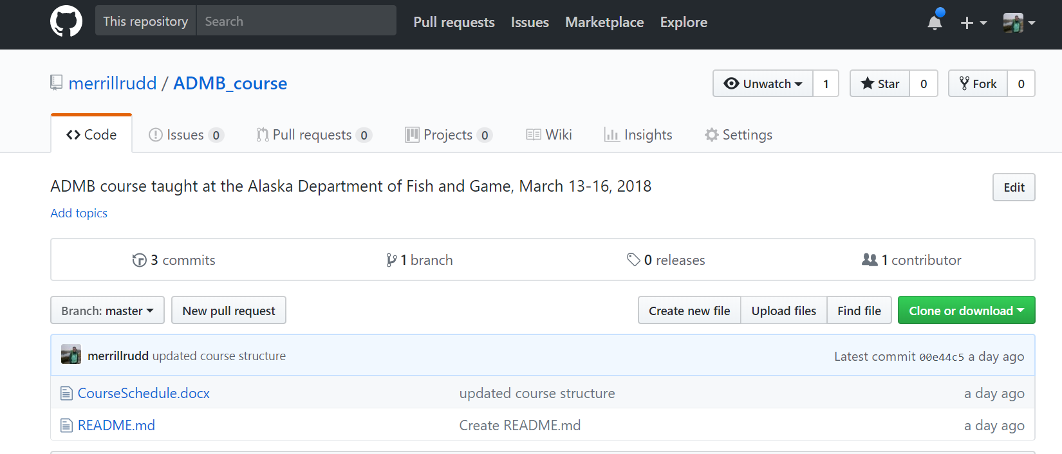
Course website
https://github.com/merrillrudd/ADMB_course
Lectures and example code are available on Github
Clone or download materials where you want to save them

Slide 5
Course website
https://github.com/merrillrudd/ADMB_course
ADMB installation instructions and some background material are available on the “Wiki” page

Slide 6
Why use ADMB?
Finds the value of parameter vector that minimizes complex non-linear functions
ADMB is faster, more accurate, and more stable than R optimizers (e.g. “optim”) with more functionality for understanding parameter uncertainty
Estimates asymptotic variance-covariance matrices
Computes likelihood profiles for parameters and model outputs
Sampling parameter vectors from Bayesian posteriors (MCMC)

Slide 7

Maximum likelihood
Expresses how well the data support a parameter value or hypothesis
Probability = knowing parameters → predicting data
Likelihood = knowing data → estimating parameters
Like residual sum of squares, but more useful: not only point estimate, but also uncertainty
$$L(p|Data)$$

Slide 8
Likelihood basics
We can fit a model to many types of data at once and combine the likelihood components with simple multiplication
The likelihood of the data D = D₁ + D₂ is the product of the likelihoods of each D₁ and D₂:
Integrated models: e.g. tag resighting, abundance index, etc.
Unified framework, for simple or complex models
Data point 1
Data point 2

Slide 9


Other likelihood considerations
To compute the likelihood we need:
A model between the input variables and data
The sampling distribution – how the data pertain to the model prediction, e.g. normal distribution:
${\hat{L}}_{a}=L_{∞}(1−\exp\left(−k\left(a−t_{0}\right)\right))$
$L= \frac{1}{\sqrt{2π}σ}e^{−{\left({\hat{L}}_{a}−L_{a}\right)}^{2}/2σ^{2}}$
Model prediction
Data

Slide 10
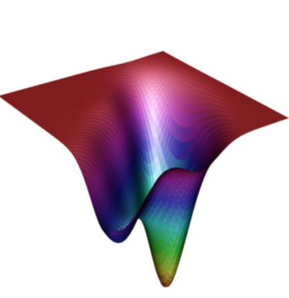
Finding the maximum likelihood
Given a likelihood function, we find the maximum likelihood values for the parameters by:
Maximizing the log-likelihood or
Minimizing the negative log-likelihood
This equation is difficult to solve!

Slide 11
Automatic differentiation
ADMB uses the AUTODIF C++ class library
Combines array language with automatic differentiation
Supplemented with precompiled code for derivatives of common array and matrix operations
User only provides description of statistical model, ADMB handles the process of fitting the model to data and reporting results
Many aspects of C++ programming are hidden from the user

Slide 12
Developing a model and likelihood
User inputs data
User defines the state dynamics model and observation model
ADMB estimates parameters and error terms as fixed or random effects to minimize the objective function
Variability (process error)
Measurement error (observation error)
Parameters
Statistical criterion
State dynamics model
Observation model
(Predicted data)
Observations (Data)

Slide 13






Von Bertalanffy growth model
$$L_{∞}, k, t_{0}$$
$${CV}_{L}$$
Variability (process error)
Measurement error (observation error)
Parameters
$$P(L|a, {CV}_{L})$$
$${\hat{L}}_{a}$$
$$L_{a}$$
Statistical criterion
Von Bertalanffy growth model
Observation model
(Predicted data)
Observations (Data)
$$L_{a}=L_{∞}(1−\exp\left(−k\left(a−t_{0}\right)\right))$$

Slide 14



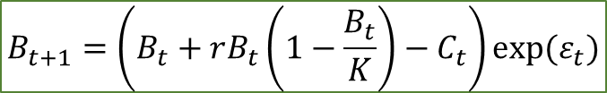




Surplus production model (e.g. Schaefer)
$$ε_{t}\sim N(0,σ_{B})$$
$$σ_{y},σ_{C}$$
$$r, K$$
Variability (process error)
Measurement error (observation error)
Parameters
$${\hat{y}}_{t}=qB_{t}$$
$$B_{t}$$
$${\hat{y}}_{t}$$
$$y_{t}$$
Statistical criterion
Surplus production model
Observation model
(Predicted data)
Observations (Data)
$$B_{t+1}=\left(B_{t}+rB_{t}\left(1−\frac{B_{t}}{K}\right)−C_{t}\right)exp⁡(ε_{t})$$

Slide 15
Default estimation of uncertainty: delta method
ADMB uses the delta method to calculate the covariance matrix
Covariance matrix calculated from:
Hessian – matrix of second order partial derivatives
Hessian calculated from:
Jacobian – matrix of first order partial derivatives
Other options:
Profile likelihood
MCMC

