Slide 1
ADMB approach and syntax

Slide 2
ADMB “Approach”
Create template (.TPL) file
Reads in the data, identifies parameters and derived variables, defines the model, and defines the objective function to be minimized
Convert .TPL to C++ (.CPP) file using tpl2cpp.exe
Compile and link resultant C++ program
Run the program

Slide 3
ADMB programs use a template (.TPL) file
TPL file specifies:
The function to be minimized
The data (constants) that are part of the function
The parameters to be varied to minimize the function
Any variables that depend on the parameters but are not parameters themselves
Variability (process error)
Measurement error (observation error)
Parameters
Statistical criterion
State dynamics model
Observation model
(Predicted data)
Observations (Data)

Slide 4
Anatomy of the TPL file
DATA_SECTION
Read in data
PARAMETER_SECTION
Declare model parameters and objective_function_value
PROCEDURE_SECTION
Relate parameters to data, specify the objective function
ADMB minimizes the objective function and writes out results
REPORT_SECTION (Optional)
Used to export values of interest into the .REP file
* There are many other sections available, we will use only these sections in the first exercises

Slide 5
Basic data types
Three basic data types
Estimated parameters are dvariables
Intermediate calculations and derived quantities are also dvariables
Each data type can form a vector, matrix, 3d array, etc.
int | Integer
double | Floating point value
dvariable | Floating point value with derivative info

Slide 6
Declaring objects
Declaration | DATA_SECTION | PARAMETER_SECTION
int | Integer | Integer
init_int | Integer from file | -
number | Double | dvariable
init_number | Double from file | dvariable to estimate
init_bounded_number | - | dvariable to estimate with bounds

Slide 7
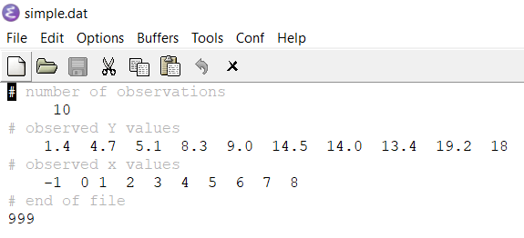
The data file (.DAT)
By default ADMB looks for a data file with the same name as the .TPL file
simple.dat associated with simple.tpl
Lines with # are ignored
The structure of the .DAT file determines how it is read in
ADMB reads the next value according to the instructions in the DATA_SECTION of the .TPL

Slide 8
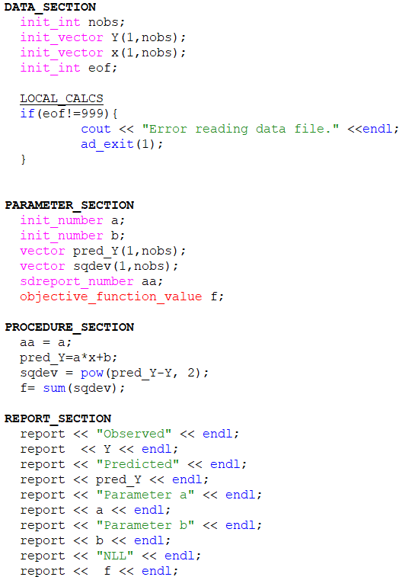
simplest.tpl

Slide 9
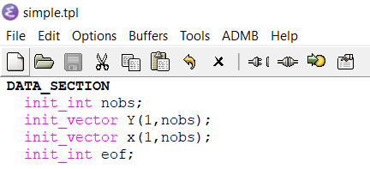
DATA_SECTION
Prefix init_ tells ADMB to pull in data from the data file depending on the size of the container you create

Slide 10
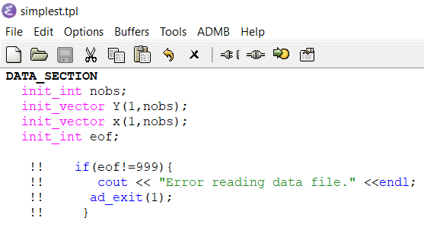
DATA_SECTION
LOCAL_CALCS section can be used for data-related calculations or transformations
!! is an alternative to LOCAL_CALCS

Slide 11
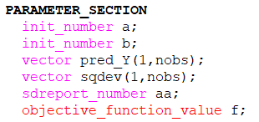
PARAMETER_SECTION
Prefix init_ is also used to declare parameters
Derived parameters and global variables that need to be differentiable can also be declared in this section
Must define objective_function_value

Slide 12
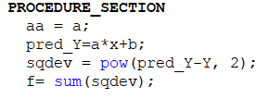
PROCEDURE_SECTION
Define model
Often broken into functions using header FUNCTION to ultimately calculate the objective function
All lines in this section must end with ;

Slide 13
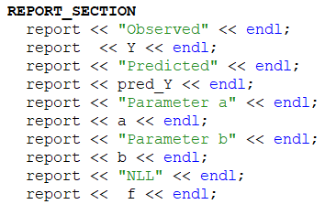
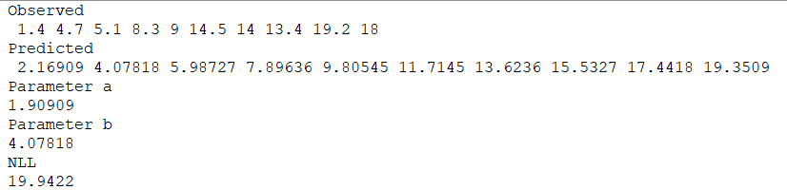
REPORT_SECTION
Export values of interest into the .REP file
Not required but useful

Slide 14

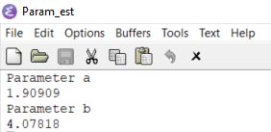
REPORT_SECTION
Can also output to an alternative file:

Slide 15
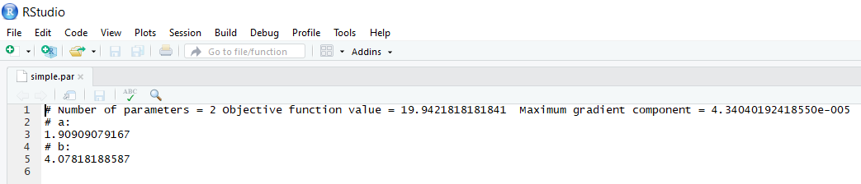
Produced files to look at
.PAR
Includes number of parameters, objective function value, maximum gradient component, and parameter estimates

Slide 16
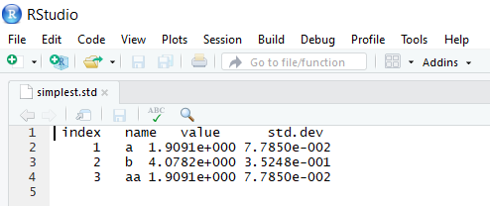
Produced files to look at
.STD
Parameter estimates, associated standard deviations
Estimate and standard deviation for any declared sdreport_values and likeprof_numbers

Slide 17
Example 1: Run simplest.tpl
Check that model runs
Review files .DAT and .TPL
Check and familiarize with output files
Read into R using simplest.R

Slide 18
Example 2: Estimate the mean
Create a new model mean.tpl that estimates the population mean
Use simplest.tpl as a template
Implement 3 approaches, where the objective function is:
Residual sum of squares: point estimate only
Full likelihood: evaluate uncertainty, estimate sigma
Concentrated likelihood: evaluate uncertainty, set sigma to MLE

Slide 19
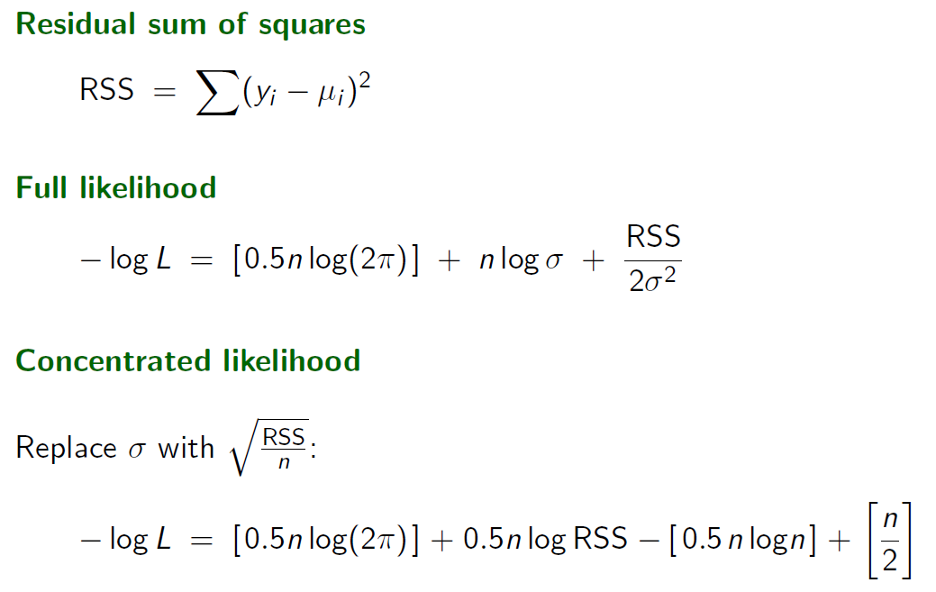
Example 2: Estimate the mean
Create a new model mean.tpl that estimates the population mean
Use simplest.tpl as a template
Implement 3 approaches to the objective function
Point estimate only
Evaluate uncertainty, estimate sigma
Evaluate uncertainty, set sigma to MLE

Slide 20
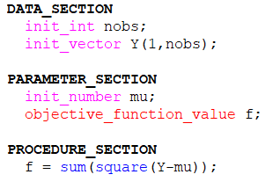
Example 2 solution
RSS

Slide 21
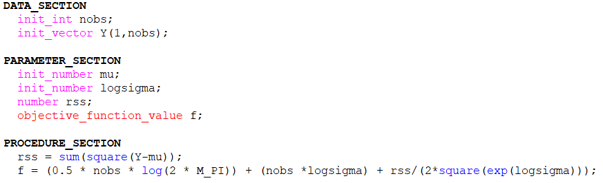
Example 2 solution
Full likelihood

Slide 22
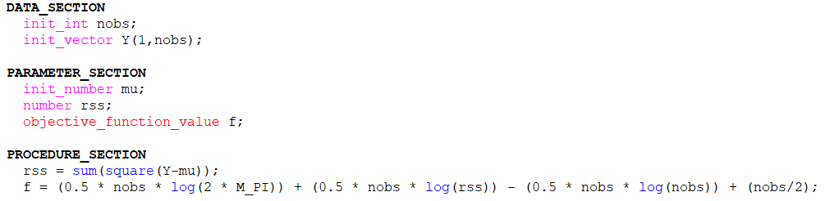
Example 2 solution
Concentrated likelihood

Slide 23
Other sections
FUNCTION
Used to break up code within the PROCEDURE_SECTION in distinct parts
Similar to functions in R
TOP_OF_MAIN_SECTION
Settings
GLOBALS_SECTION
Define libraries, globally-defined variables (e.g. time)
FINAL_SECTION
Calculate elapsed time of program to run

Slide 24
Extracting parts of vectors and matrices
v(2) vector element
M(5,2) matrix element
v.sub(2,5) vector elements
row(M,5) one row
column(M,2) one column
M.sub(2,5) several rows
trans(M).sub(2,5) several columns
Exercise: test these functions to extract parts of vectors and matrices.

